Slide 1


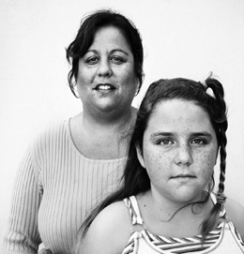
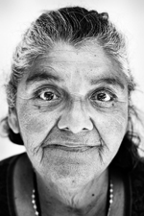

2013
WeALLCount
Contact:
Jessica Osmun
Project Coordinator
(858) 292-7627, ext. 14
jessica.osmun@rtfhsd.org
Notes:
I would like to start by thanking you all. Your support and personal involvement in the count helped to make this possible.
Thank you.

Slide 2

Today’s Discussion…
    National Perspective
    2013 WeALLCount Campaign
        The Impact of WeALLCount
        Geographical Overview
        Trends
    What’s Next?
Notes:
We will begin today by looking, in very broad strokes, at the national picture of homelessness provided by information from point-in-time counts across the country.
We will then move into a brief description of WeAllCount, San Diego County’s point-in-time homeless count before focusing on region-wide results from the count.

Slide 3

National Perspective -
January 2012 Point-in-Time Count
633,782 Any Night in the USA
239,403 People in Families (38%)
394,379 Individuals (62%)
99,894 “Chronic” (15.8%)
62,619 Veterans (9.9%)
Source: National Alliance to End Homelessness (2013), State of Homelessness in America 2013
Notes:
The U.S. Department of Housing and Urban Development mandates that communities receiving HUD funding to address homelessness must complete point-in-time counts during the last 10 days of January. Snapshot.
The point-in-time count identifies the number of homeless people (sheltered and unsheltered) and their location. It also captures detailed demographic
information on a subset of these individuals. This data is vital when identifying strategies and services that can enable people to leave the street.
Point-in-time count information on the sheltered homeless population is mandated every year, and is pulled primarily from the Homeless Management Information System (HMIS).
Point-in-time count information on the unsheltered population is mandated every other year. 2013 was a mandated year.
More than 60% of communities across the country choose to conduct an annual point-in-time count for both their sheltered and unsheltered homeless populations. We are among them.
NOTE: The national perspective that we will be reviewing this morning is from information gleaned from the 2012 point-in-time counts across the country.

Slide 4
About WeALLCount
Point-in-Time Count. One night.
Unfunded Mandate
End Of January Throughout United States
Annual Homeless Assessment Report to Congress
Entire County – All Cities And Unincorporated Areas
Step 1: Unsheltered “Street Count”
Step 2: Sheltered Count – Via HMIS Systems
Step 3: Survey – At Least 15% Of Populations
Notes:
Unsheltered “Street Count” – Volunteers deployed across the county in teams of two and three. Census tract maps were used to record the number of homeless persons seen. RTFH reviewed the maps to ensure accuracy and recorded and analyzed the data collected.
Demographic data for those who were unsheltered was derived from follow-up interviews administered by trained volunteers.
Sheltered: Demographic data regarding those who were sheltered on the night of the count is derived from the region’s Homeless Management Information System (HMIS), which is administered by The Regional Task Force on the Homeless (RTFH).
Once the analysis is completed, the results of the count are reported to the U.S. Department of Housing and Urban Development (HUD) and used, along with Point-in-Time
Count (PITC) data from communities across the country, to produce the Annual Homeless
Assessment Report (AHAR) for Congress.
Remember: Point-in-Time counts are, by their very nature, estimates.

Slide 5
Why Is Counting Important?
HUD Mandate
National Effort
Funding For Local Services
Understanding
Answers critical questions . . .
Who, Where, Why, and What it takes to end homelessness
Knowledge
Detailed Analysis
In-Depth Reports
Shared Information
Action
Targeted Services
Collaboration
Prevent / Alleviate / END
You Can’t Fix What You Can’t Measure
Notes:
The WeALLCount campaign is a unique and invaluable annual project that assesses homelessness throughout San Diego County.
The campaign enables our entire community to better understand the scope, details, trends, impact, and potential solutions to homelessness.
WeALLCount empowers our region to qualify for millions in critical federal funds. Those resources go directly to services which address homelessness on many levels.
WeALLCount is instrumental in helping our region collaborate and implement targeted services that lead to homeless persons becoming permanently housed.

Slide 6
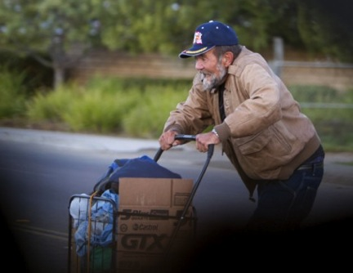
WeAllCount Community Partners
Colleges
Military
VA
Law Enforcement
Environmental Groups
Local Politicians
Individuals
Local Gov’t Agencies
Faith Community
Notes:
There is another benefit to WeAllCount that isn’t often discussed. The count provides an opportunity for all sectors of the community to come together.
On an individual level, we often hear from volunteers that their experience participating in the count has been enlightening and rewarding….That their understanding of and connection to the community has increased…. and they have gained a deep appreciation for the humanity that we all share.
The partnerships listed above took many forms: volunteer support, funding, deployment centers and interview sites.

Slide 7
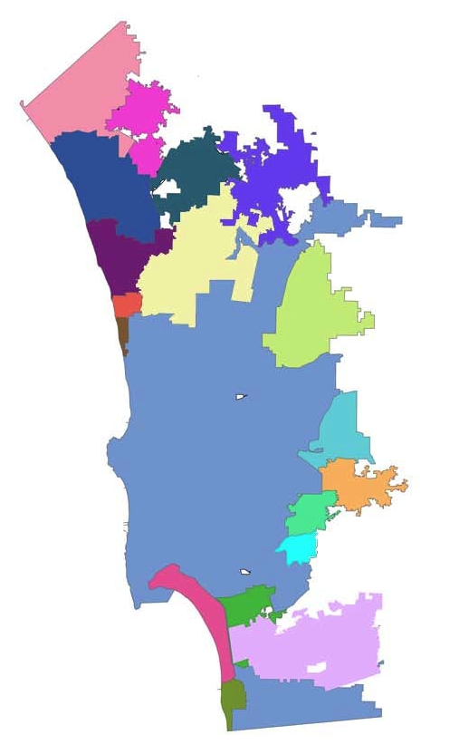
2013 WeALLCount Deployment Centers & Interview Sites
City of Poway City Hall
Community Christian Services
Community Resource Center
Crisis House
Downtown Partnership Clean & Safe
East County Transitional Living Center
First Presbyterian Church
Grace Church
Harbor Church
Holy Trinity Episcopal Church
Interfaith Community Services
La Mesa United Methodist Church
LeSar Development Consultants
Neil Good Day Center
North County Lifeline
North County Solutions for Change
Pacific Beach United Methodist Church
Point Loma United Methodist Church
St. Vincent de Paul Villages
San Diego LGBT Community Center
South Bay Community Services
Veterans Village of San Diego
Veterans Village – New Resolve
United Way
YMCA
Notes:
Many community organizations graciously lent their space to use as deployment centers and/or interview sites during the 2013 Count.

Slide 8
900 Volunteers –
Many served in multiple roles
751 – Enumerators
216 – Surveyors
40 - Deployment Center Coordinators & Assistants
23 - Volunteers assisted with Data Entry
Over 5,000 Volunteer Hours
Notes:
Volunteers are the heart and soul of this event. WeAllCount is not possible without the support of the community – and is only as strong as the support from the community.
For the 2013 count, we had unprecedented volunteer participation and media coverage.

Slide 9
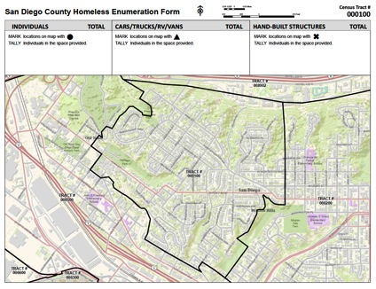

Covering San Diego County
605 Census Tracts
4,526 Square Miles
2,000 Miles Of Roads
2010 Census: 3.1 Million
  Higher Population Than 20 States
  Fifth Most-populous County In USA
Notes:
Remember: point-in-time counts, by their very nature, are estimates.
We can not canvass every canyon or riverbed. We do not know how many people were missed in abandoned buildings or in other hidden places.
Also… because this is just a snapshot.. One point in time… individuals and families who were able to find a place to stay on that particular night…even if they had been homeless and unsheltered or weeks prior and would be again on the following day.. Were not counted.

Slide 10

WeAllCount 2013
8,879 People Were Homeless
4,574 Unsheltered (51.5%)
4,305 Sheltered (48.5%)
1,866 People in Families* (21%)
7,013 Individuals* (79%)
2,472 Chronic Individuals* (27.9%)
1,486 Veterans* (16.7%)
*Includes both sheltered and unsheltered
Notes:
NOTE:
The information on this slide includes both sheltered and unsheltered.
Re Chronic -- There were also 14 families who were chronically homeless.
Re: Families/Chronic -- Overall, there were 597 families who were homeless. 2.3% of homeless families were chronically homeless

Slide 11
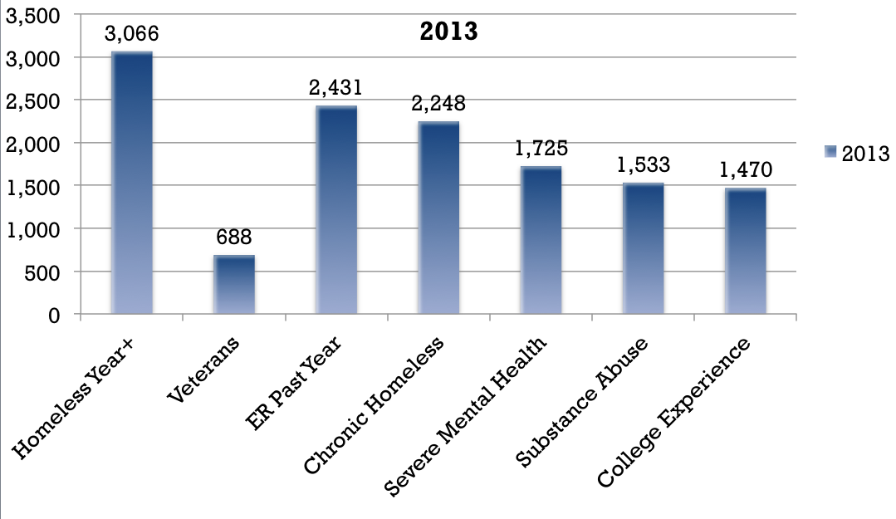
Unsheltered Homeless Profile
Estimates extrapolated from 697 surveys of adults self-reporting as Unsheltered during PITC
Notes:
These estimates were extrapolated from 697 surveys of adults who self-reported as having been Unsheltered on the night of the PITC.

Slide 12
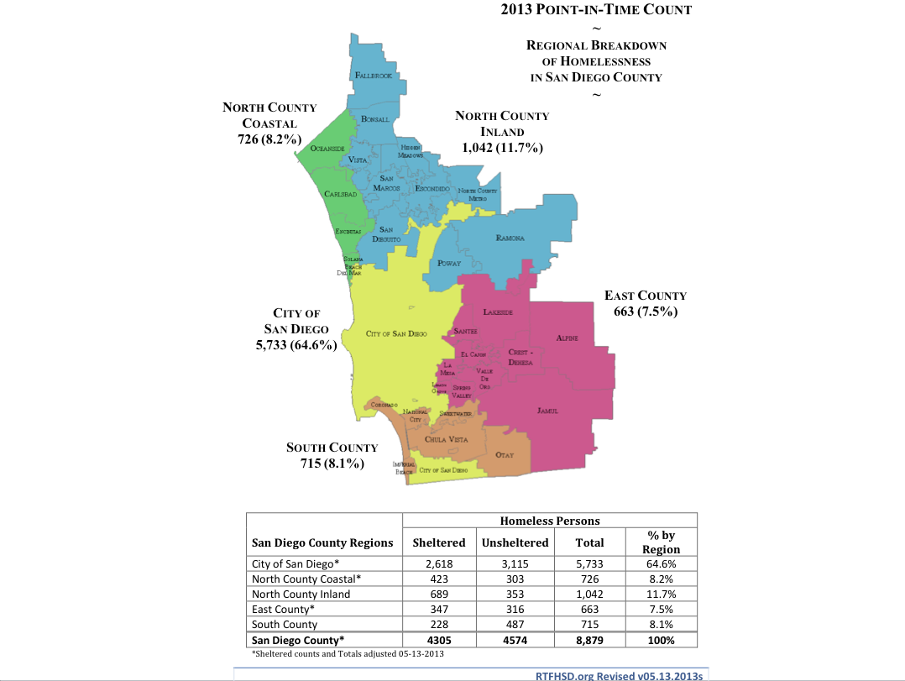

Slide 13
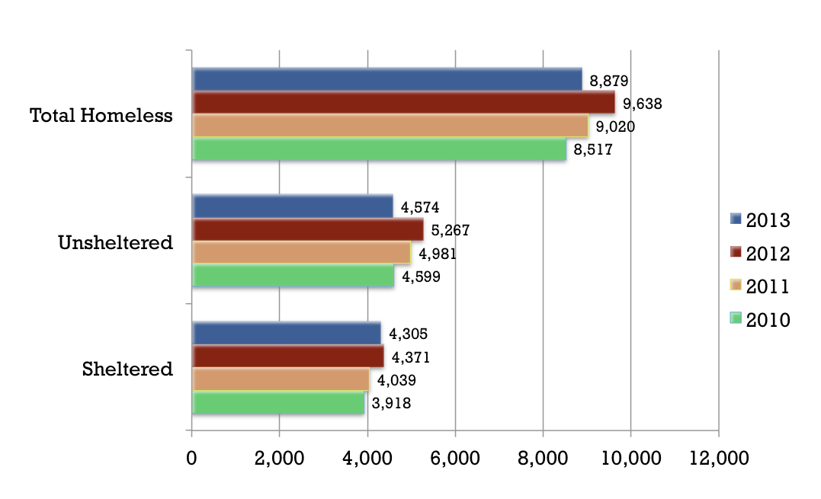
Regional 4-Year Trends – San Diego County
Notes:
In San Diego County – 2012 saw the highest numbers of sheltered, unsheltered, and overall homeless populations.
Note: remember slide #5 – nationally, the peak was in 2010

Slide 14
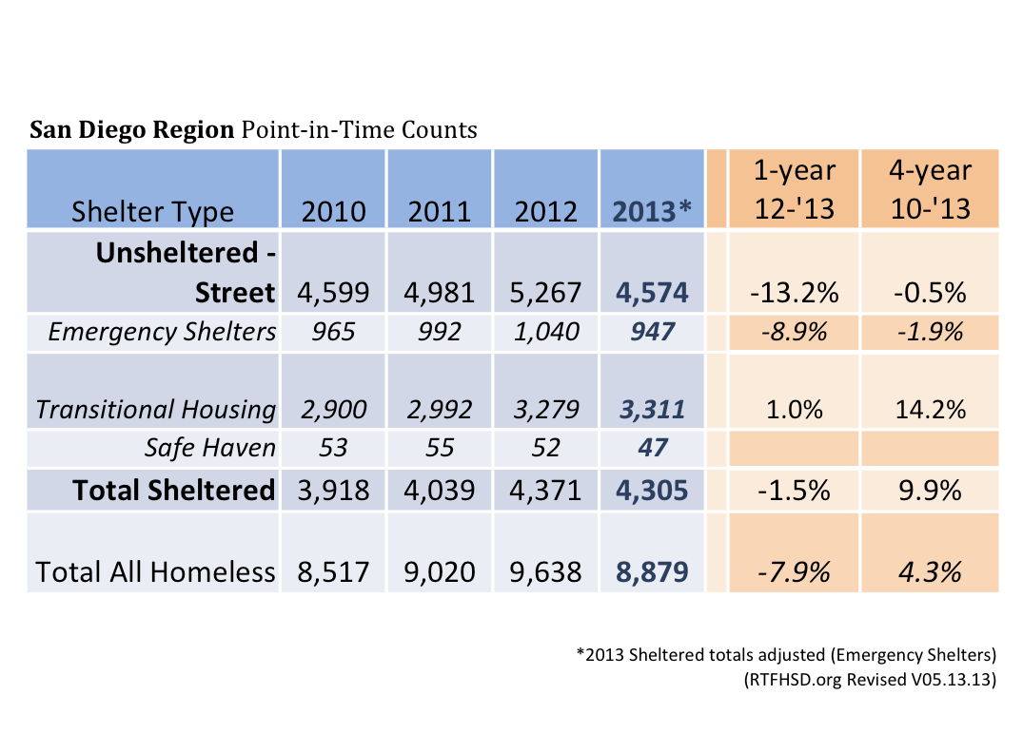

Slide 15
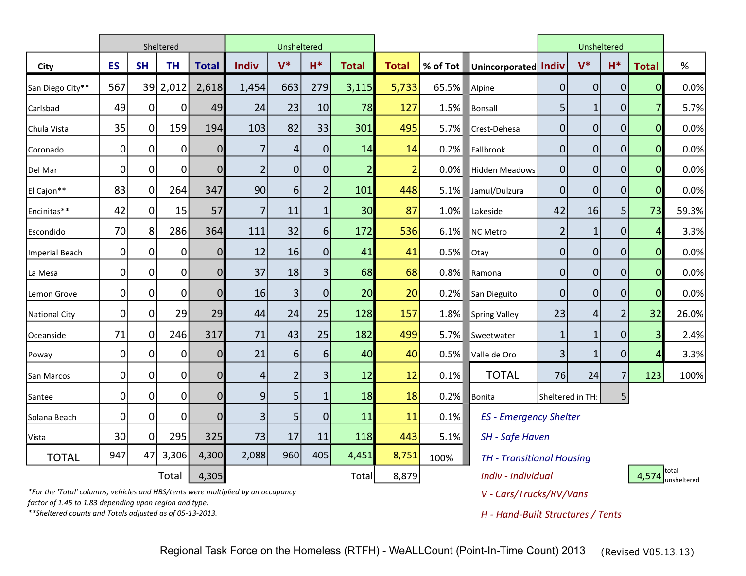

Slide 16
What’s Next?
4/30/2013 – Data submitted to HUD
Further Analysis
Publish Results/Reports
Education and Outreach
Fundraising
WeALLCount 2014
Notes:
On April 30th we submitted information from the count to HUD.
Re Further Analysis – Tell us what you want to know! Our analysis will only be meaningful if it is something that you can actually use!
Re Results/Reports –
Analysis will continue through the summer – on data from PITC and HMIS. We have multiple projects and requests … so tell us what you want/need, so that we can prioritize.
AHAR – Annual Homeless Assessment Report. Data collection period runs through October. So we can not even begin the AHAR until then.
Re Fundraising –
WeAllCount – the point-in-time count, is an unfunded mandate. We need to raise money each year in order to make it happen.

Slide 17

Be a part of 2014!
Volunteer Opportunities:
Volunteer Recruitment
Community Partnerships
Enumerator
Surveyor
Data Entry
Deployment Center Coordinator/Assistant
Save the Date!
Friday, January 24, 2014 (4:00-7:00am)

