Slide 1

STATE OF CYCLING
IN SAN DIEGO COUNTY

Slide 2

A Year of Records
❖ Record breaking participation in Bike to Work Day – over 7500
❖ Sold Out Bike the Bay – 3200+
❖ Increased attendance and funds raised (and fun had) at Tour De Fat
❖ Widespread media coverage
❖ Bikes Count!

Slide 3
A New Strategic Plan
❖ Mission
The San Diego County Bicycle Coalition advocates for, and protects the rights of, all
people who ride bicycles.
We promote bicycling as a mainstream, safe, and enjoyable form of transportation and
recreation.
❖ Vision
❖ Guiding Principles
❖ Goals
❖ Actions

Slide 4
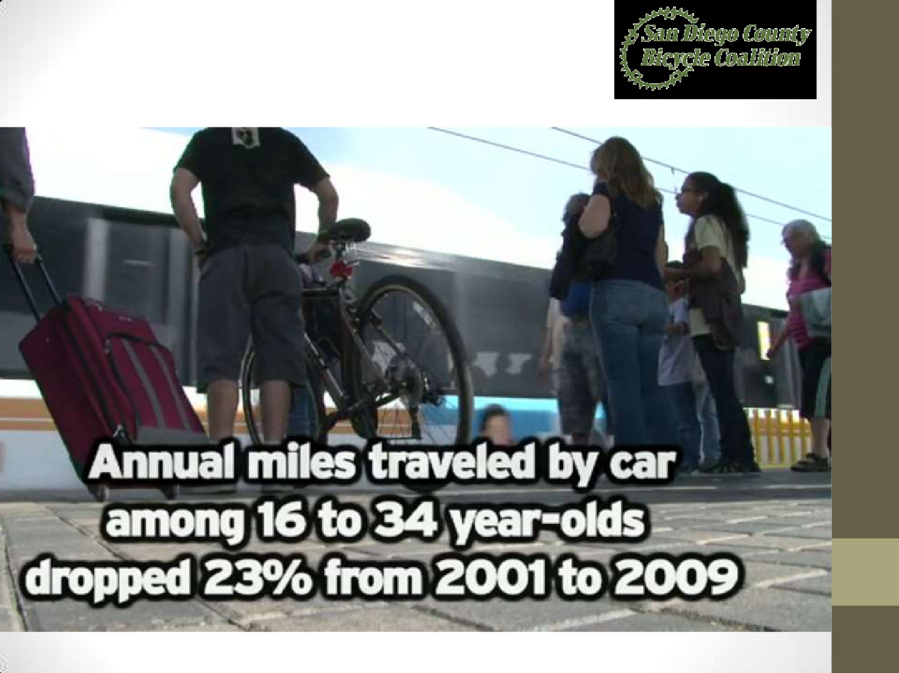
Bike More, Drive Less

Slide 5
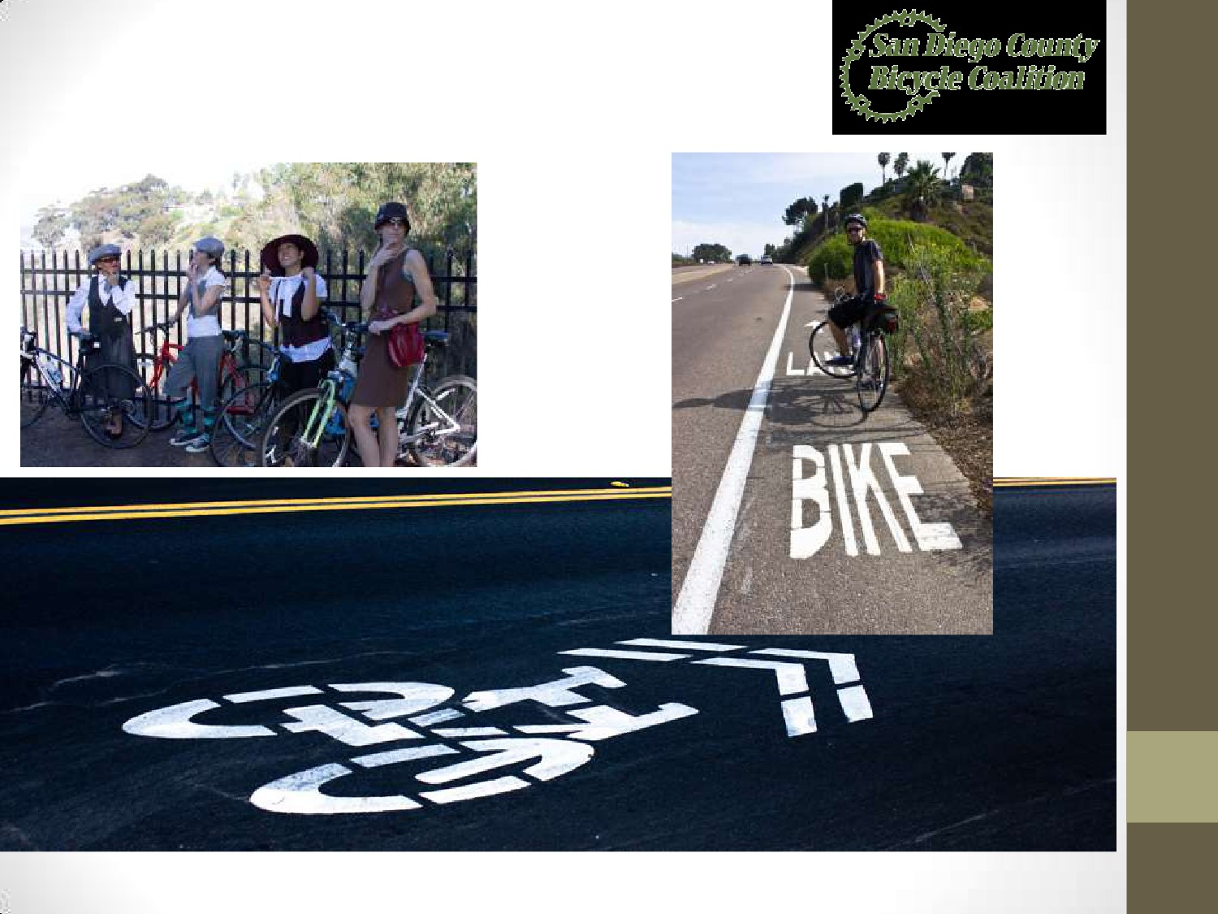
Bike More, Drive Less

Slide 6
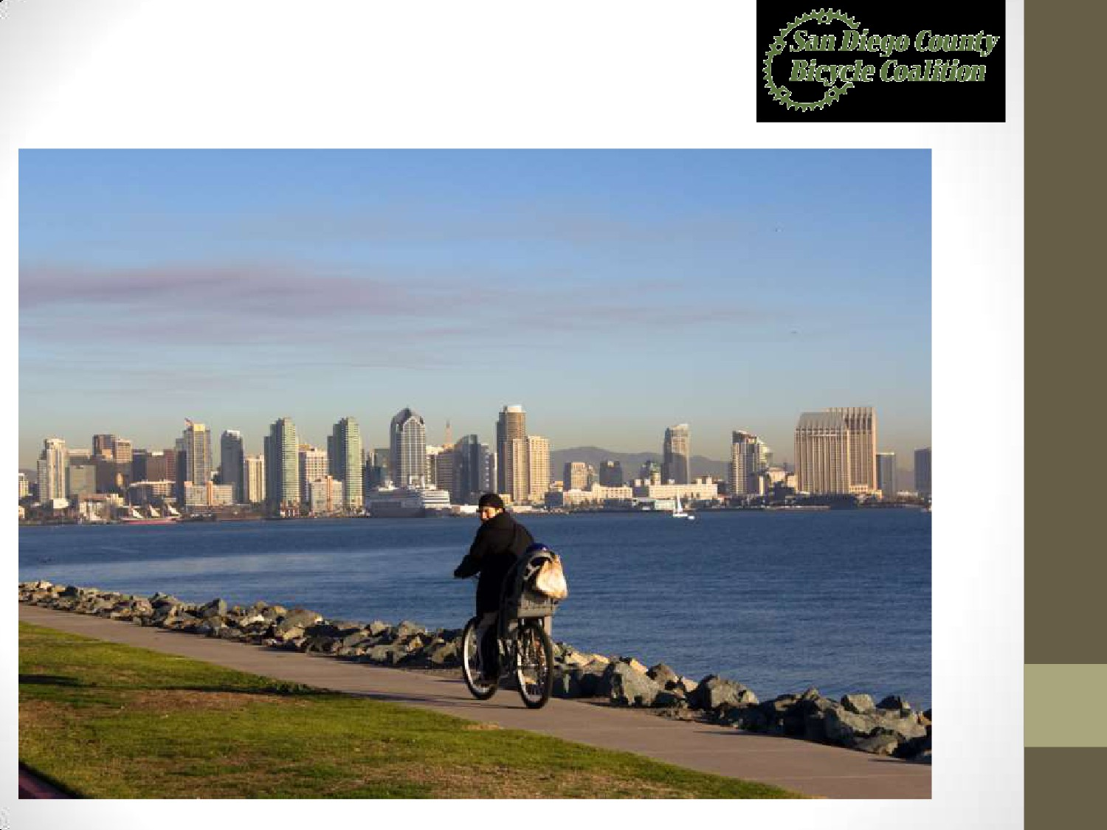
Vision: The Most Bike
Friendly region In the World

Slide 7
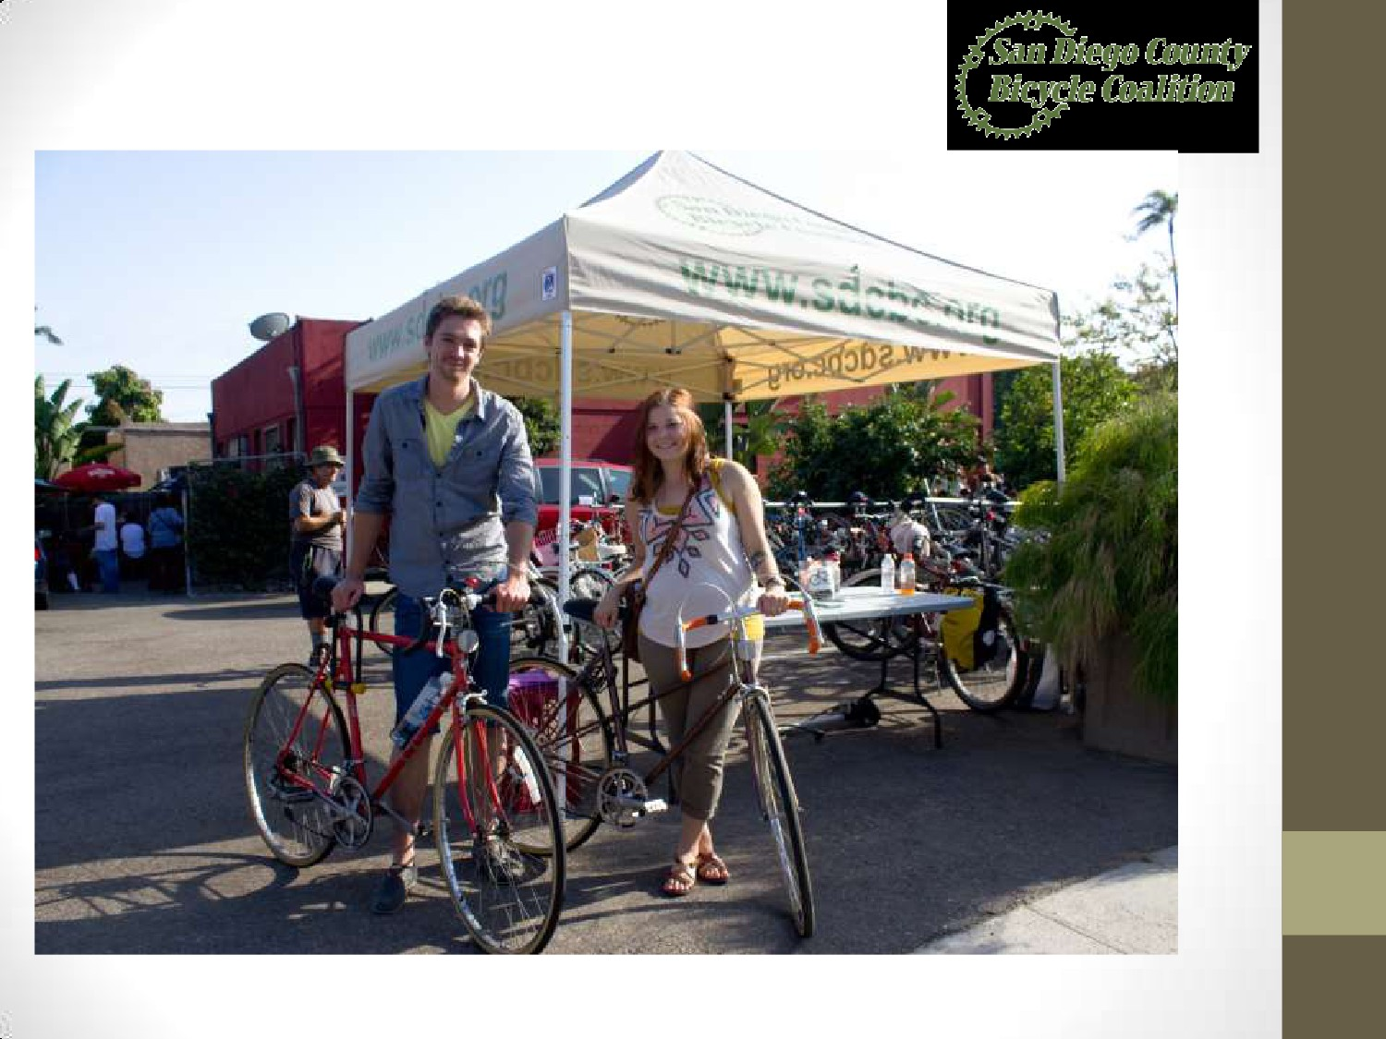
Goals: Membership

Slide 8
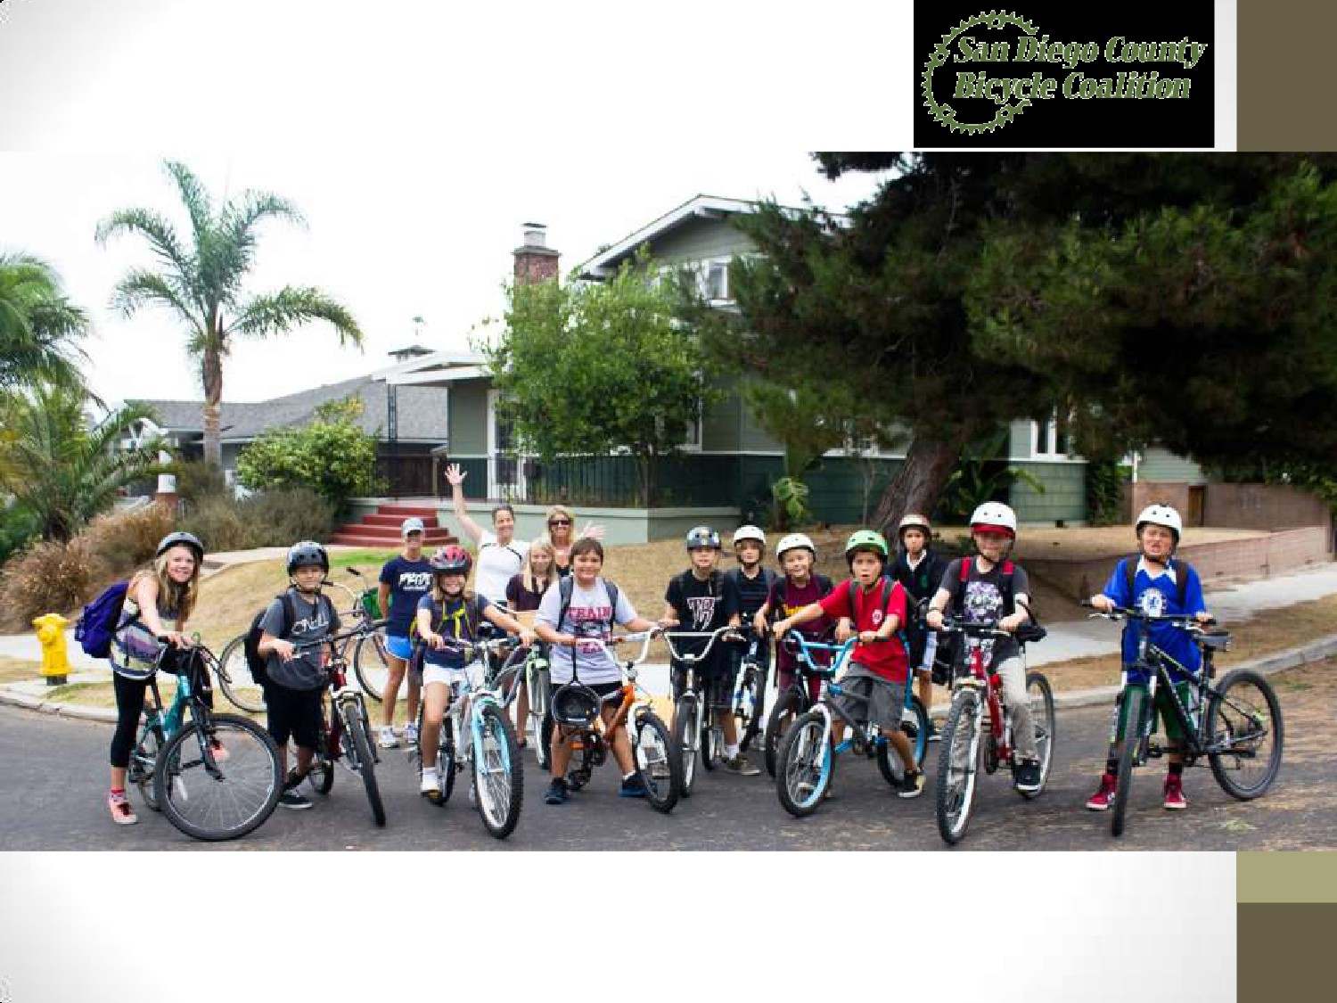
Goals: Education

Slide 9
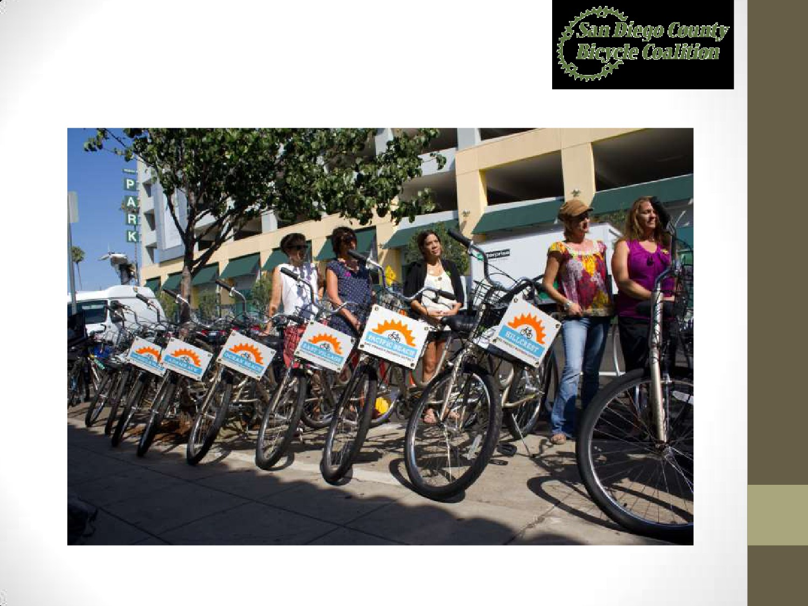
Goals: Advocacy

Slide 10
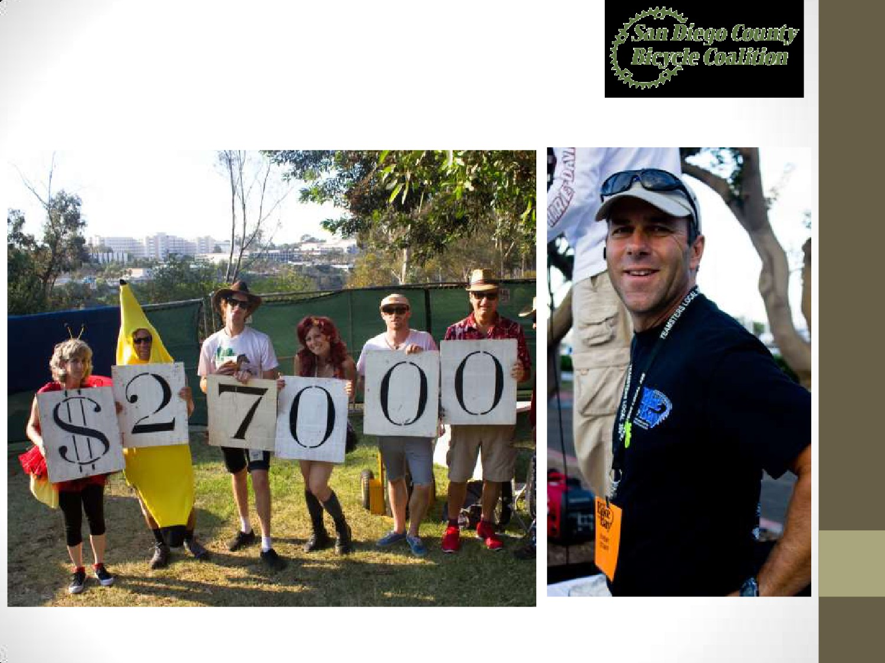
Goals: Organizational Capacity

Slide 11
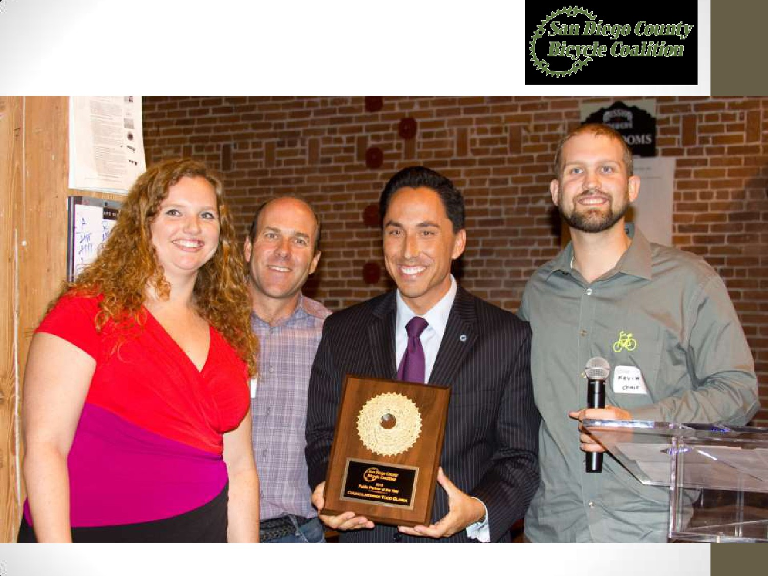
The Squeaky Wheel

Slide 12

The Squeaky Wheel

Slide 13

The Squeaky Wheel: Advocacy
❖ Attended dozens of working group meetings, hearings, city council meetings
❖ Mayoral debate
❖ San Diego elects a Bike-friendly Mayor!
❖ Participated on SANDAG urban corridor projects, Coast Hwy 101 projects, Bay
shore bike way and many other efforts around the county
❖ Worked with local law enforcement
❖ Partnerships:
❖ Working closely with city staff
❖ Collaborating with other organizations
❖ Engaged in state and national issues as well.
❖ National Bike Summit
❖ California Bicycle Coalition

Slide 14
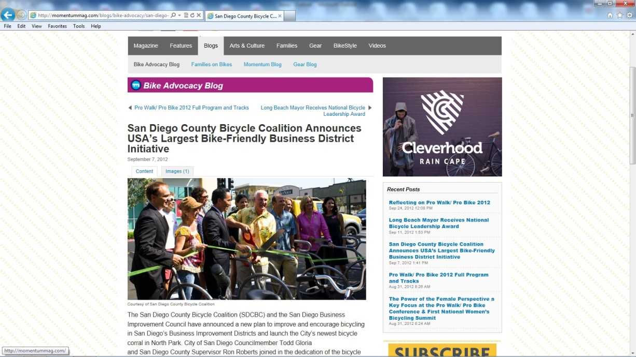
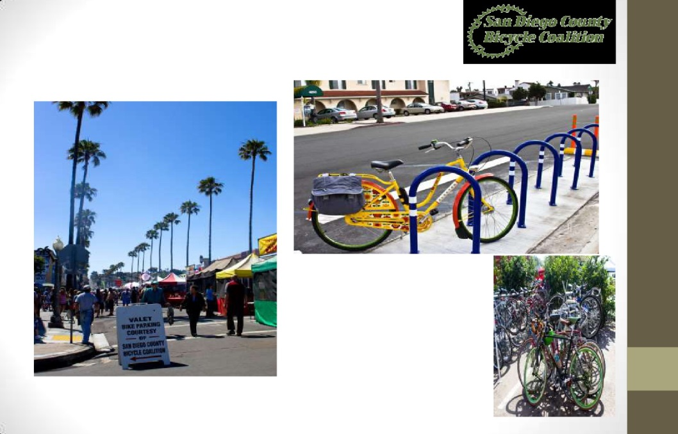
Bike Local, Shop Local

Slide 15
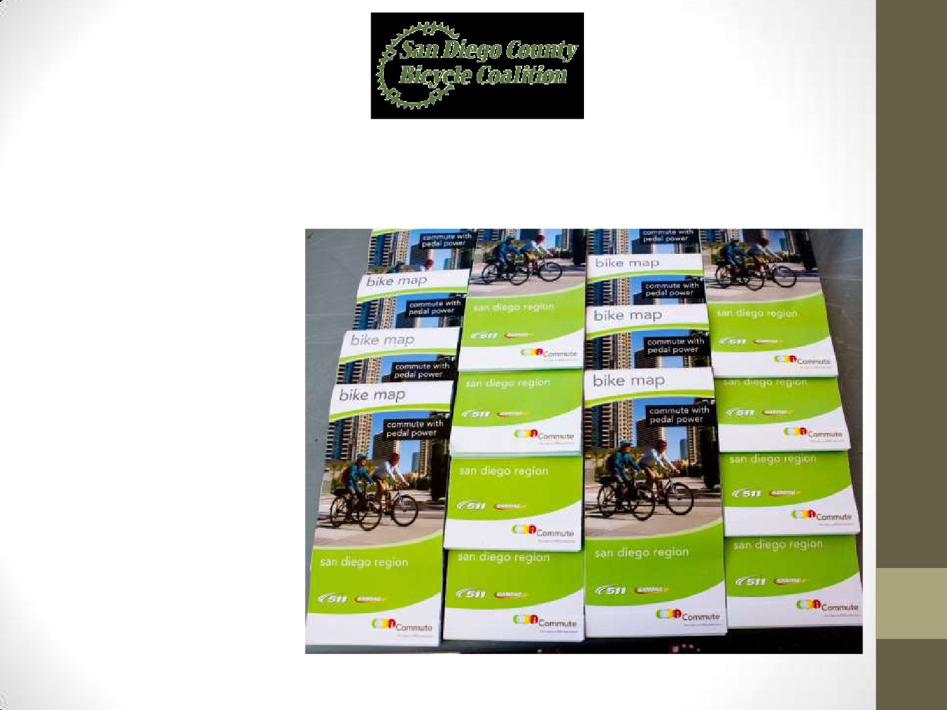
Community Bicycling Organizations
❖ Oceanside
❖ Encinitas
❖ Solana Beach
❖ Chula Vista
❖ Coronado

Slide 16
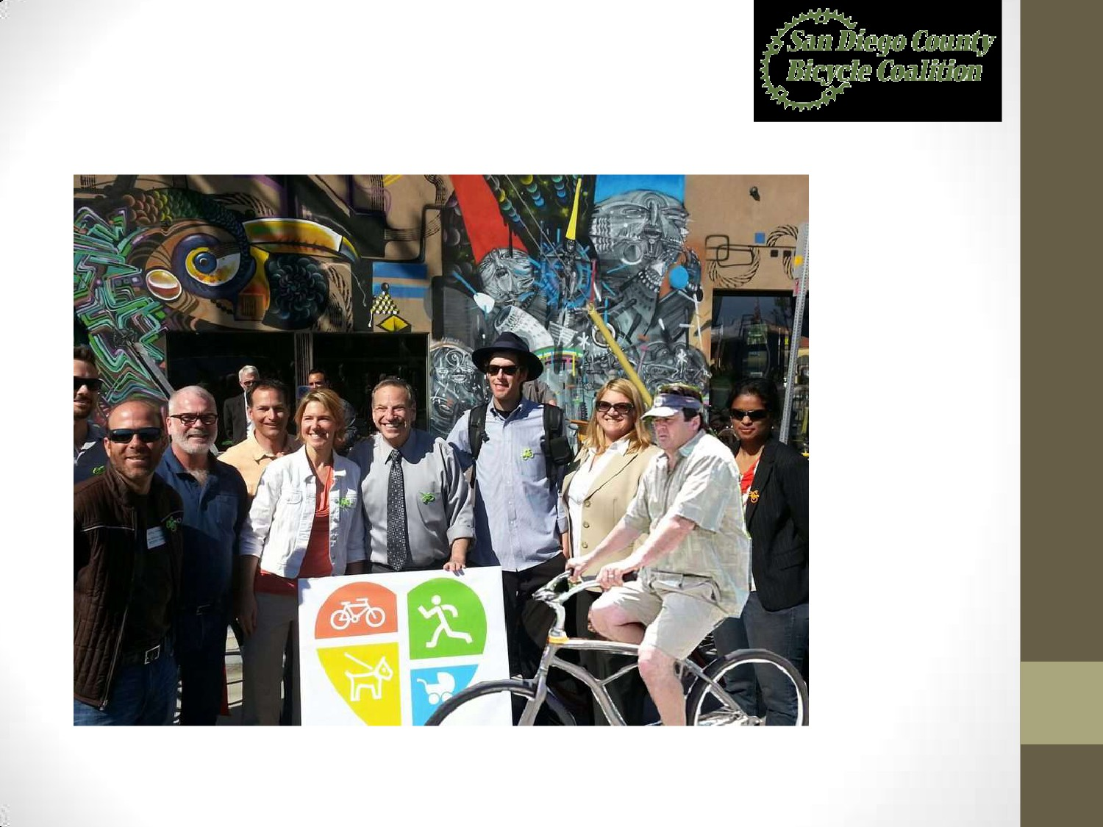
CicloSDias!

Slide 17
2013 Key Dates and Activities
❖
o  May - National Bike Month
o Bike Month Kickoff Ride & Press Event - 5/1
o Bike to Work Day - Fri. 5/17
o CicloSDias Mini - Sun. 5/19 - Balboa Park
❖ 6/16 - CicloSDias Mini -Presidio Park
❖ 7/21 - CicloSDias Mini - Golden Hill Park
❖ 8/11 - CicloSDias! - 30th Street
❖ 8/25 - 6th Annual Bike The Bay
❖ 9/28 - Tour de Fat
❖ 12/12 - Annual Meeting and Holiday Joy Ride

