Slide 1
SUSTAINABLE & RESILIENT COMMUNITIES
BUILDING RESILIENT WATER SYSTEMS
GENI – World Resources SIM Center
July 3, 2014
Cary Lowe, Ph.D., Attorney
Chair, San Diego City Council Water Policy Implementation Task Force

Slide 2
THE PROBLEM
PUTTING THE NEED FOR
WATER RESILIENCY IN
LONG-TERM CONTEXT

Slide 3

Water is our lifeblood.
7 days

Slide 4
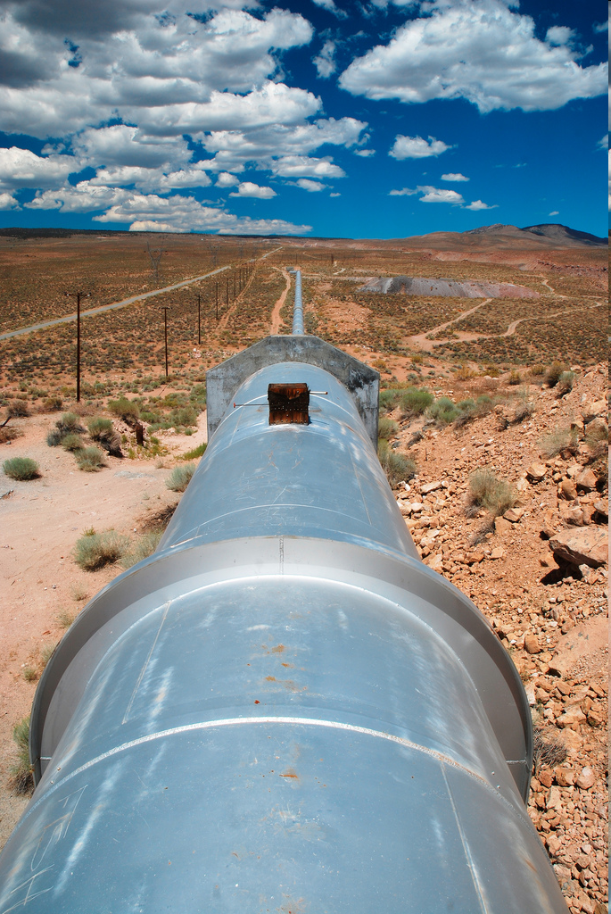
We are at the mercy of others.
Over 80% of our water is imported.

Slide 5
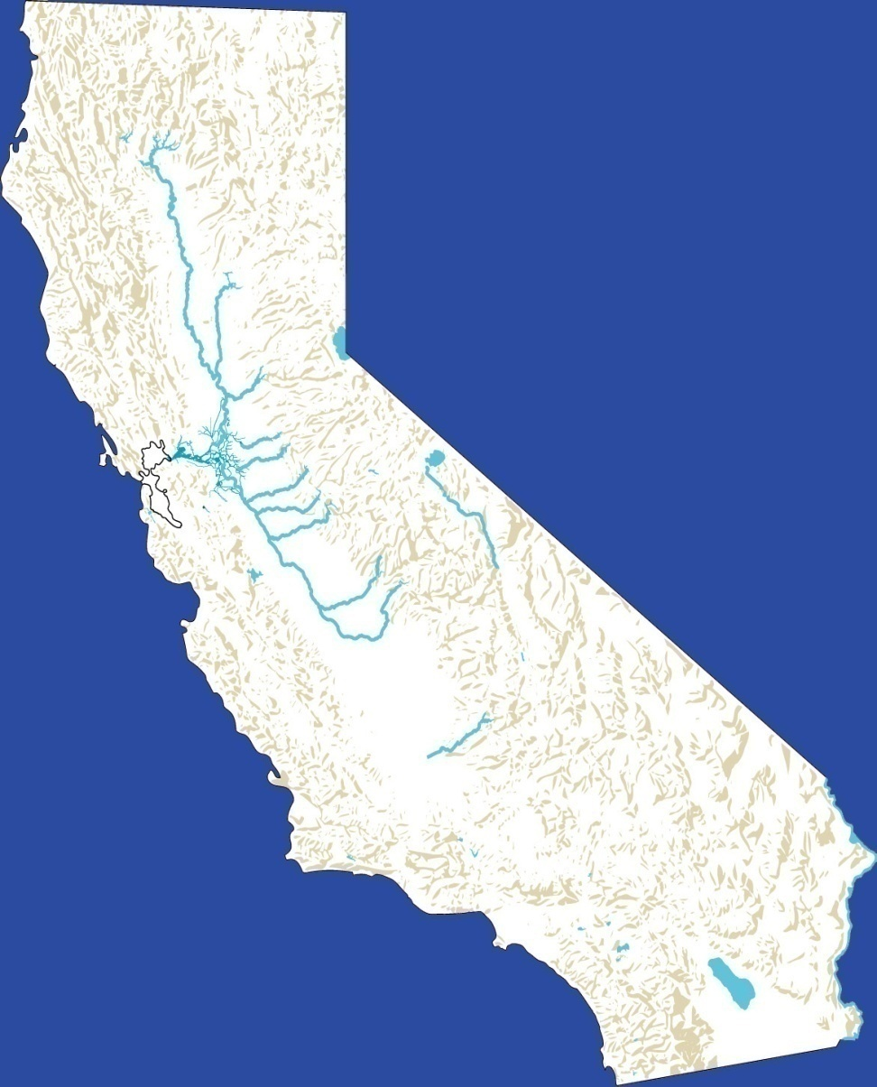

We’re at the end of the pipeline.
LAKE
SHASTA
LAKE
OROVILLE
State Water Project
(Bay-Delta)
20%
Colorado River
63%
Local Supplies
17%
Cary Lowe, Land Use Attorney & Mediator
Notes:
5

Slide 6
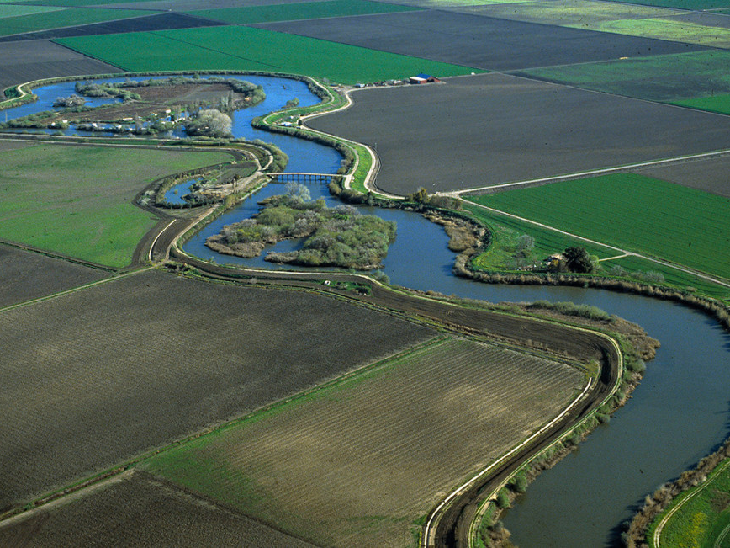
The Sacramento Delta is in a state of environmental collapse.

Slide 7
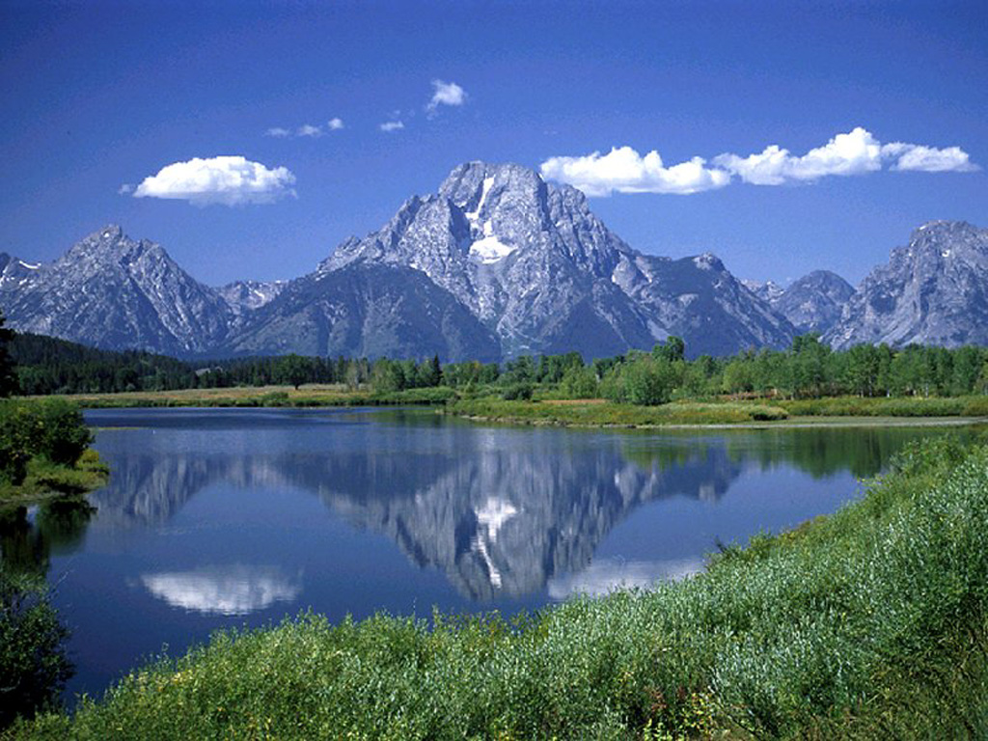
Climate change is reducing rainfall, Colorado River flow and the Sierra Nevada snowpack .

Slide 8
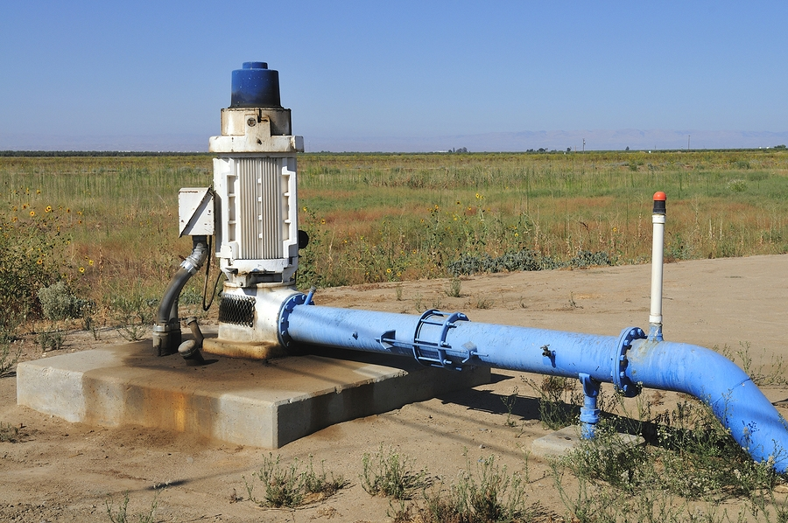
Limited groundwater resources.
Geology in SD region supports limited aquifers
Localized opportunities for groundwater recharge
Localized opportunities for groundwater desalination

Slide 9

Competition for supply.

Slide 10
Population is increasing.
                650,000
                more people
                in the region by 2030

Slide 11
Using too much water.
160
gallons/day/capita
2+
times as much as in Australia or Israel, and
far more than other industrialized nations

Slide 12
And it’s too cheap.
2/3 cent
per gallon for tap water

Slide 13
We can afford to pay more.
We pay 1000
times as much for bottled water.

Slide 14
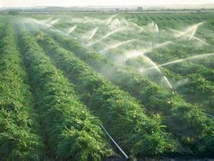
But we can’t solve the problem alone.
over 3/4
of water statewide is used by agriculture (and half of that for livestock & fodder)

Slide 15
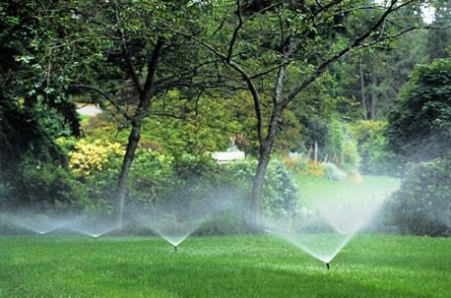
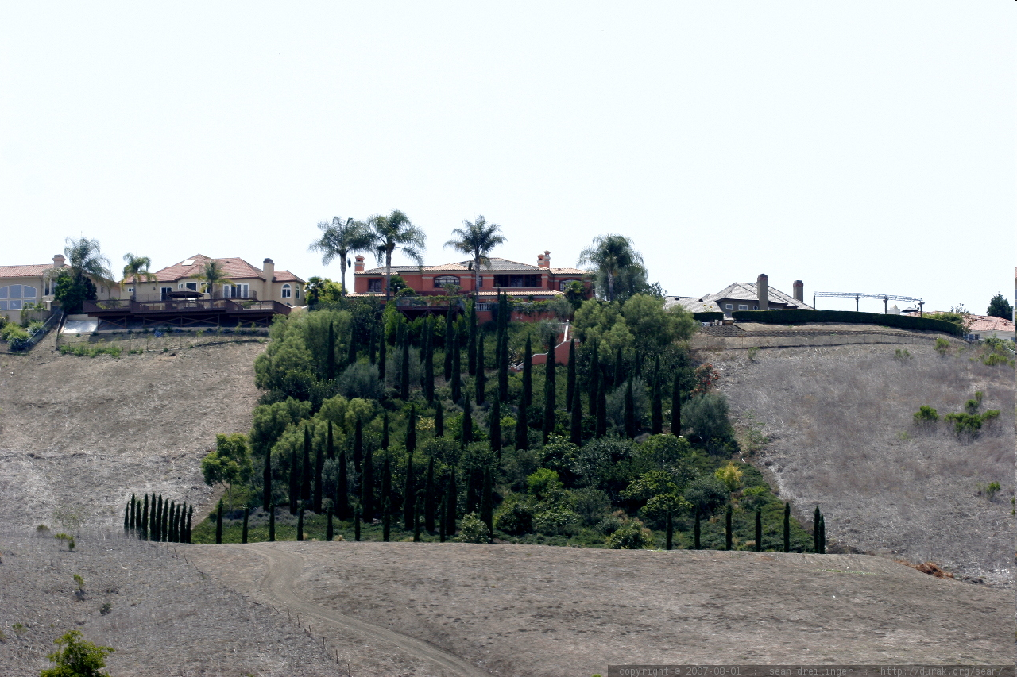
              Even in urban areas.
              Nearly 2/3 of residential use is for landscape irrigation.

Slide 16
WHERE WE STAND
Increasing uncertainty over reliability of water supply
Overdraft of groundwater basins
Expanding requirements for environmental analysis of water supply programs and contracts
Requirements to reduce water consumption

Slide 17
SOLUTIONS
Starts with conservation.
State mandates 20% reduction by 2020.
Expect stricter conservation requirements.

Slide 18
Landscape irrigation.
              40
              percent reduction possible
              with simple, inexpensive
              irrigation controls,
              more by changing to native plants

Slide 19
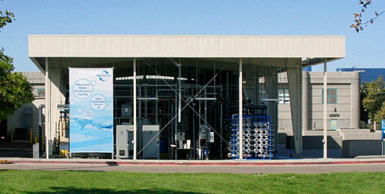
Recycling wastewater.
15 million gpd from SD AWP in 1st phase
80 million gpd at build out, comprising
40% of City’s needs

Slide 20
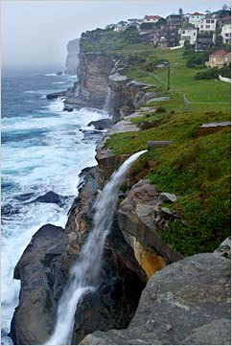
Potential for storm water use.

Slide 21
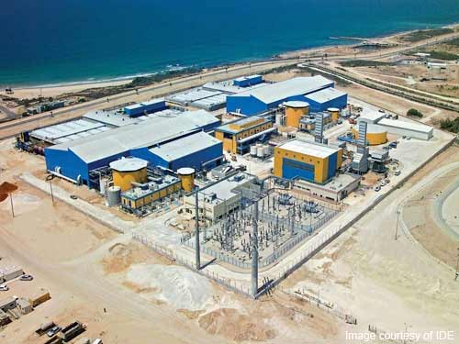
Desalination?
Seawater desal
Energy-intensive (6xAWP)
Ghg-intensive
Expensive
Small part of a diversified water portfolio, unless technology breakthrough
Groundwater desal
Localized opportunities

Slide 22
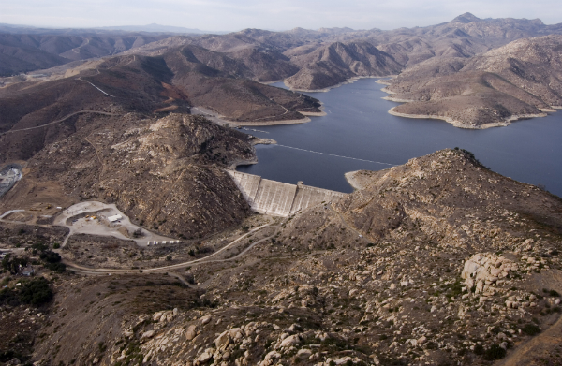
Increased storage needs.
SD County Water Authority and City of San Diego expanding local storage capacity.
Need more in region to increase self-reliance.
Mainly limited to surface storage.

Slide 23
SDCC Water Policy Implementation
Task Force
11 diverse members, appointed by City Council
Council adopted most recommendations in 12/13
Remainder of recommendations being analyzed
Possible model for other jurisdictions
Focus on water reliability/independence

Slide 24
Goals
Reducing imported water 12% by 2025 and 35% by 2035
Increasing city wastewater recycling to 10% of treated water by 2025 and 35% by 2035
Initiating recycling of stormwater by 2020
Mitigating environmental consequences of water development actions
Reducing per capita water consumption 20% by 2020 and 35% by 2035

Slide 25
Recommendations
Conservation
Water Recycling & Reuse
Rate Structure Reform
New Technologies

Slide 26
Water Conservation
Ongoing program to create a water conservation ethic among the public
Modifying the City’s drought alert standards
Promoting water-conserving landscaping (lower water use plants, lower et factor)
Strengthening requirements for retrofitting homes with water conserving fixtures at resale
Using new technology to facilitate tracking of indoor and outdoor water use
Incentives for sustainable development, including for reductions in water use

Slide 27
Water Recycling and Reuse
Replenishing groundwater with stormwater
Analyzing feasibility of stormwater recycling
Filling gaps in “purple pipe” system
Expanding potable water production through recycling
Supporting legislation to facilitate both direct and indirect potable reuse
Facilitating use of graywater for irrigation

Slide 28
Rate Structure
Modifying current rate structure to steeper tiers to incentivize conservation
Moving toward water budgeting for irrigation, with higher rates above level
Could also consider increasing rates during drought periods

Slide 29
Innovation and Technology
Reducing water loss in the city system
Clear guidelines for on-site wastewater treatment and reuse facilities
______________________
Reducing energy consumption in the water distribution system
Taking embedded energy implications into account in water supply decisions

Slide 30
Other Areas of Opportunity
Continued push toward zero net water use, especially in commercial buildings and neighborhood-scale residential projects
Especially push toward low water-consuming landscaping and high-efficiency irrigation
Requirements for mitigation of net water impacts by retrofitting off-site older structures or landscaping

Slide 31
Proactive Strategies
Look to jurisdictions taking lead for useful concepts
Update local Urban Water Management Plans
Update General Plan elements dealing with resources and public safety
Look beyond cost/benefit analysis
Need public support -- Build alliances among water agencieds, environmental interests, organized labor, civic groups, etc.

Slide 32

New Water Conservation Ethic

Slide 33
Contact:
Cary Lowe, Ph.D., AICP
Land Use Attorney & Mediator
Tel: (619) 255-3078
E-mail: carylowe@cox.net

