Slide 1

Farming in
San Diego County
Eric Larson
Executive Director
San Diego County Farm Bureau

Slide 3
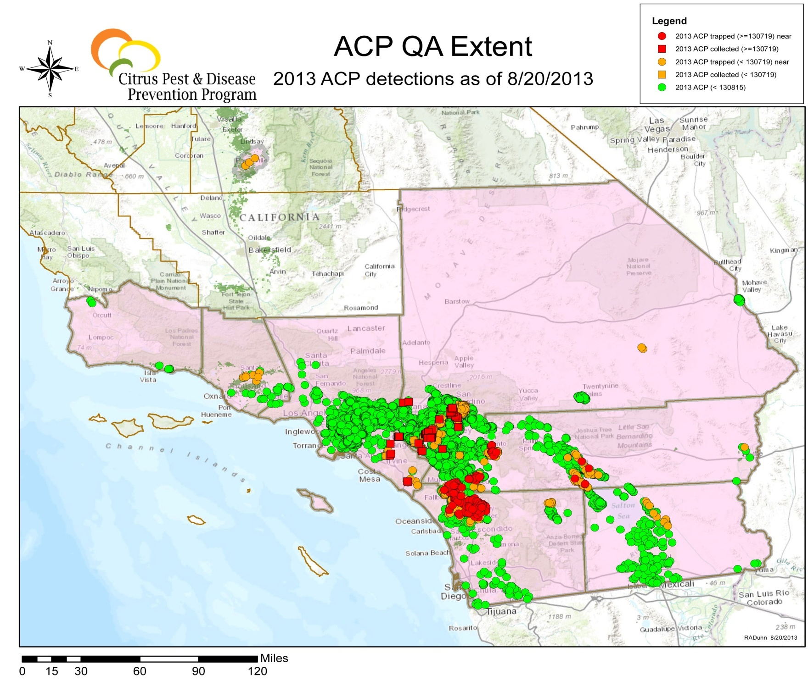

Slide 4
What Farm Bureau Does
Represent the farm community
  Local
  California Farm Bureau
  American Farm Bureau
The source of information for members
Interaction with agency officials
Work with the press
Develop member benefits

Slide 5
Organizational Structure
Formed 1914
Operate on non-profit basis
Income comes from dues-paying members
Governed by board of directors

Slide 6
Local Agriculture History
Missionary influence
Dry farming, cattle, limited irrigation
1939 Lemons 1956 Tomatoes
1945 Vegetables 1966 Eggs
1948 Milk 1976 Tree Fruit
1950 Beef 1978 Nursery

Slide 7
National Rankings
#19 farm economy among all counties
# 1 in nursery production
# 1 in avocado production
# 1 in number of small farms
#1 in number of organic farms
# 1 in farmers with off-farm income

Slide 8
Annual Farmgate Value in millions

Slide 9
The Crop Profile
Fruit
21%
Vegetables
9%
Livestock & Poultry
4%
Nursery &
Floral
65%
Other
<1%

Slide 10
Crop Profile by Acreage
Livestock
75%
Other
5%
Fruit
13%
Nursery & Floral
3%
Vegetables
2%

Slide 11
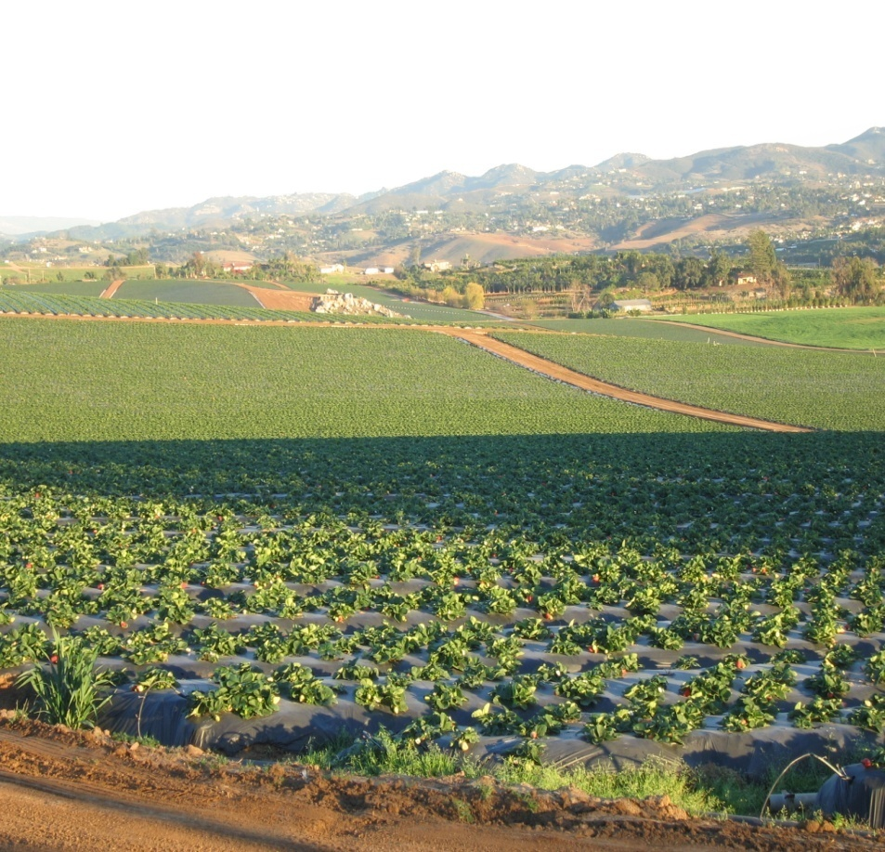
What Farming Means to the Community
Economic
  $5+ billion annual impact
Environmental
  Air quality
  Fire suppression
  Open space
  Wildlife corridors
  Hedge against urbanization
Community Character
  History
  Local products
  Ambiance

Slide 12
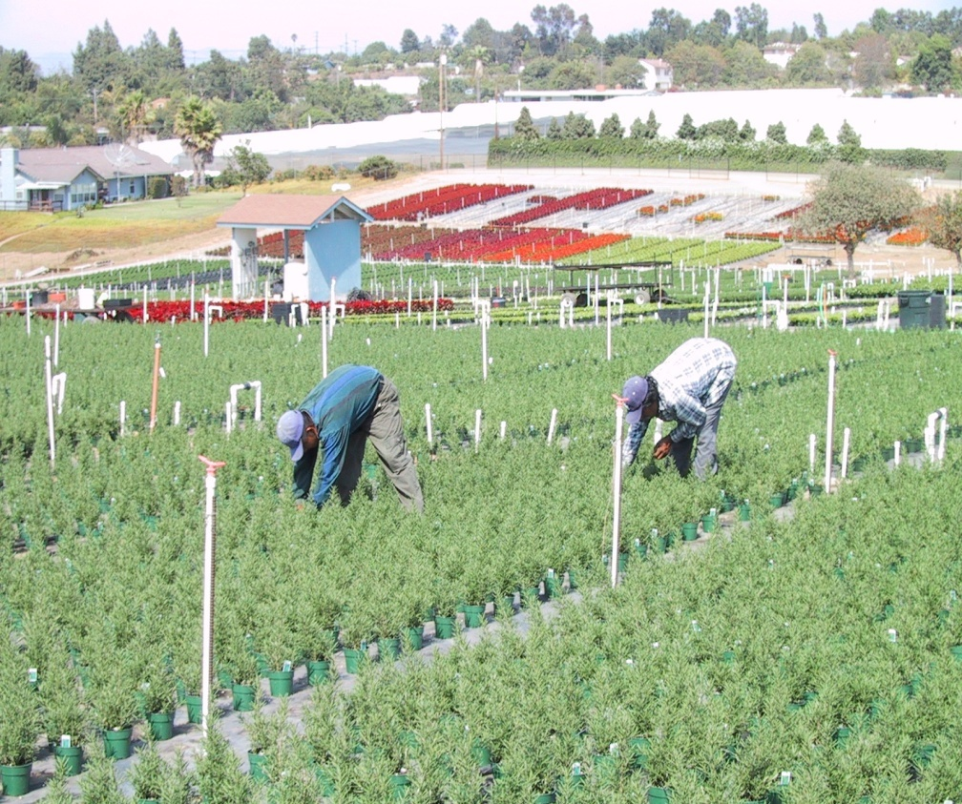
Farming Has Done Well Here
Climate
Imported water
Transportation
Labor supply
Local markets

Slide 13
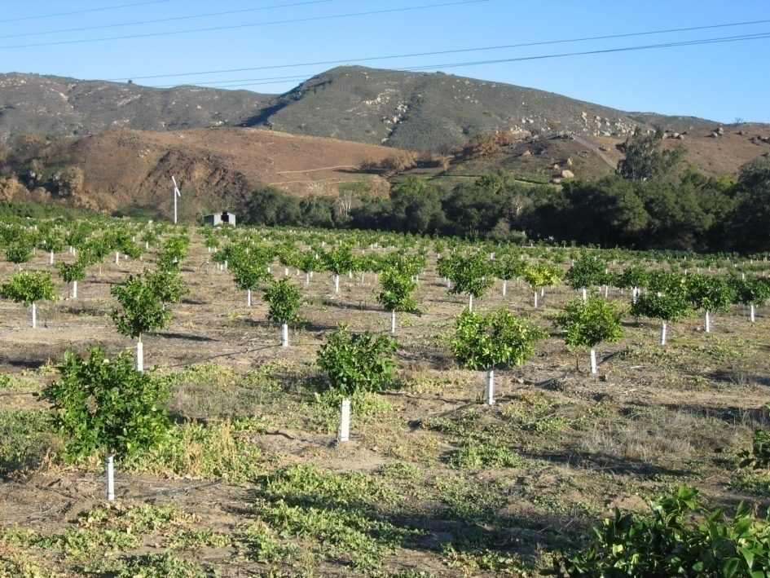
Today’s Challenges
Water
Immigration reform
Pest exclusion
Economy

Slide 14
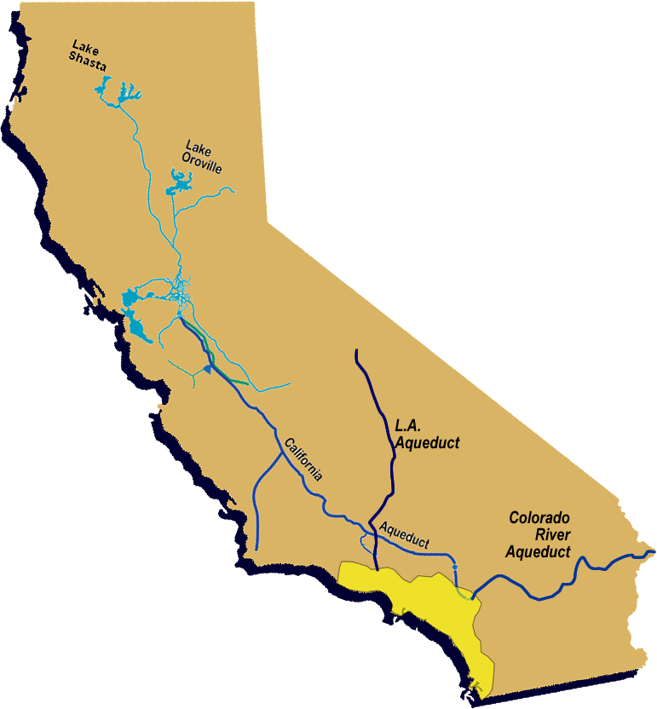
Where So. California Gets its Water
Water Banking / Exchanges
Transfers & Storage
Local Supplies
LA Aqueduct
SWP
Supplies
Colorado River Aqueduct Supplies
Local Supplies
Groundwater & Recycling
Conservation,
Surface & GW
Storage
Notes:
Southern California gets its water from many sources
Originally groundwater and surface water
LA aqueduct first imported supply, expanded to CRA, SWP.
Today, portfolio of resources with conservation, recycling, conjunctive use storage, and transfers and exchanges

Slide 15
Water Supply
Years of drought on the Colorado River
Less precipitation in snow, melting earlier
Court ruling on the Delta smelt
Insufficient storage
There were 20 million fewer Californians when system was completed
QSA ruling and appeal

Slide 16
Water Pricing
Colorado River Water was affordable
Core supply switched to Delta
New sources are expensive
Less water delivered by system means each gallon sold carries more costs
Delta and storage fix will be expensive
$2000 per acre-foot water by 2020

Slide 18
Immigration Reform
Farm crops are planted and harvested by foreign-born workers (90%+)
Majority work with forged documents
Farmers need a reliable, legal workforce
Post-election interest in reform

Slide 19
Pests and Pest Exclusion
Traveling public introducing exotic pests
Volume of travelers and packages
Border priorities have shifted
Agency budgets becoming an issue

Slide 20
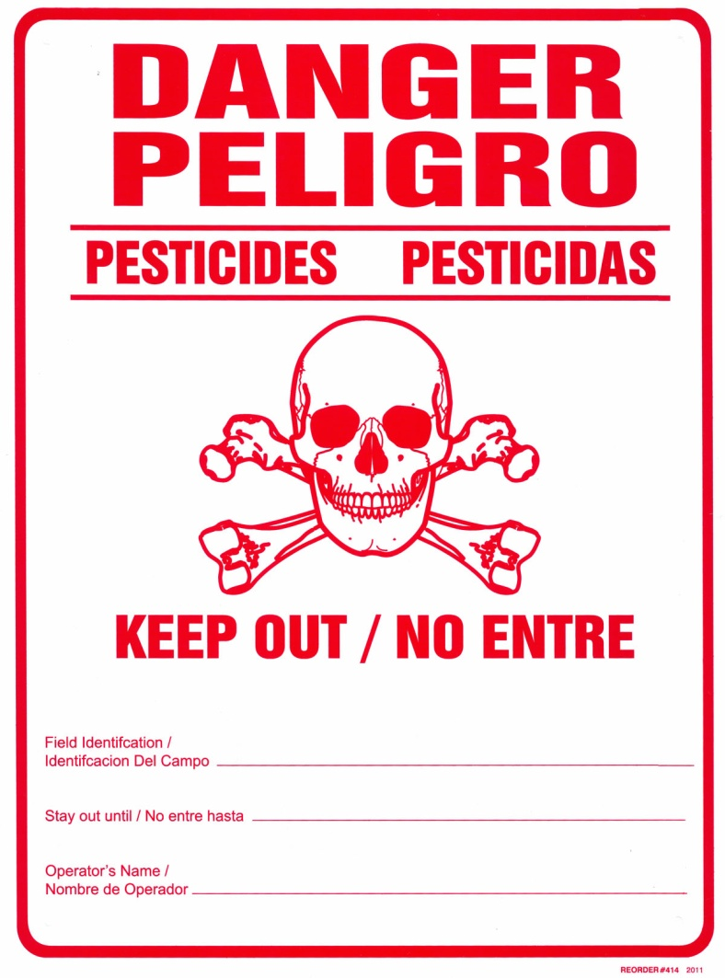
Impact from New Pests
Shipping restrictions for growers
Additional use of pesticides
Threat to organic growers

Slide 21
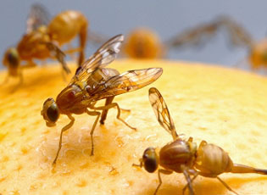
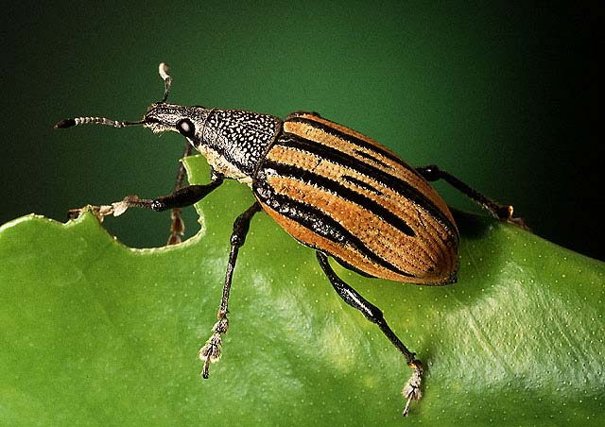
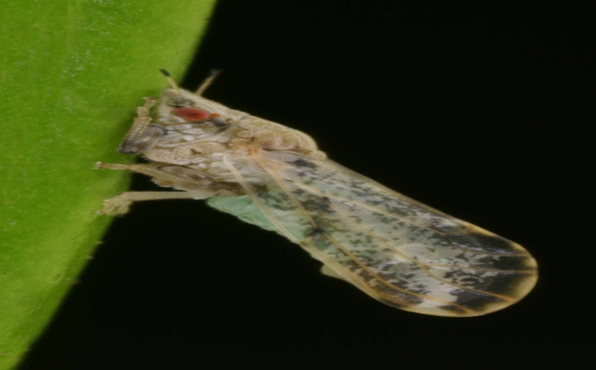
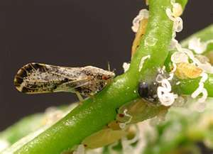

Asian citrus psyllid Light brown apple moth
Fruit flies Diaprepes root weevil

Slide 22
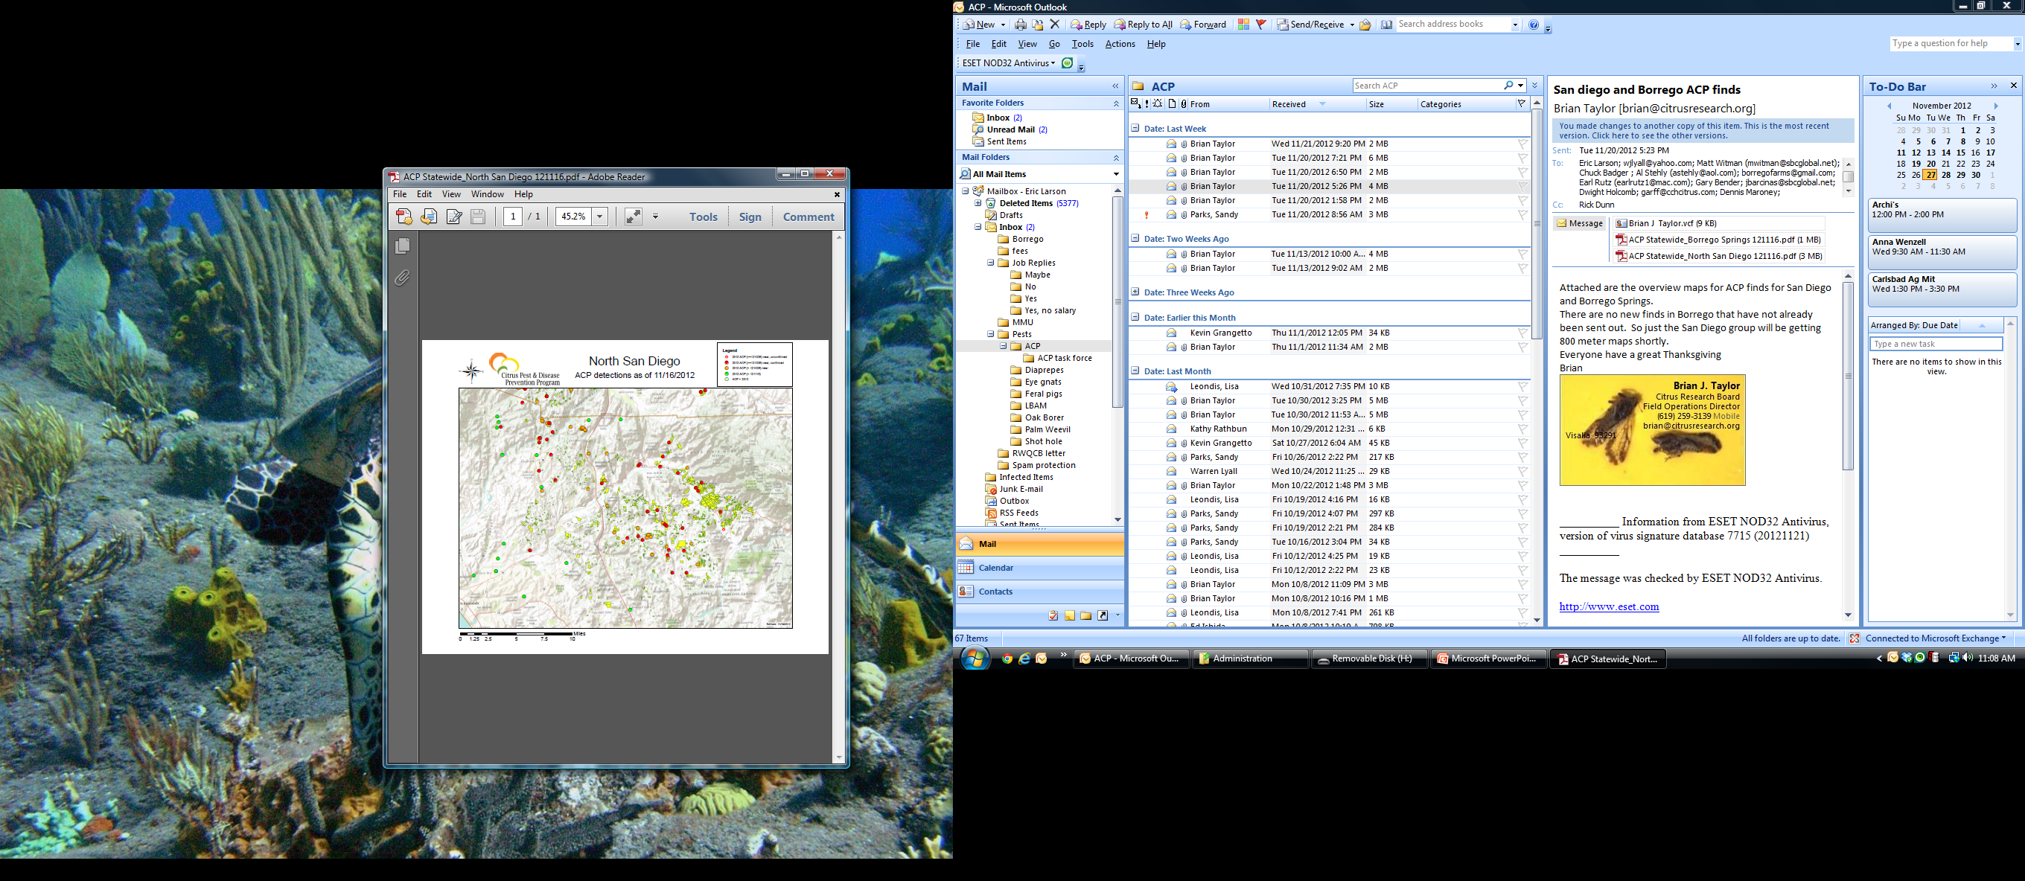

Slide 23
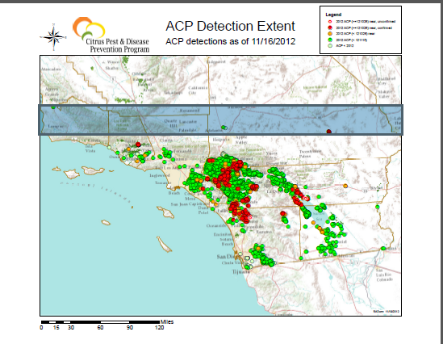

Slide 24


Slide 25
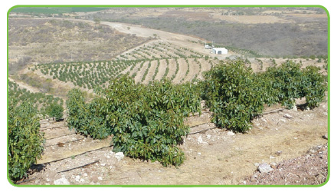

Slide 26
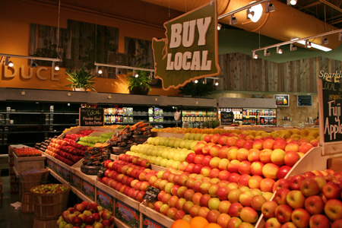

Slide 27


Slide 28
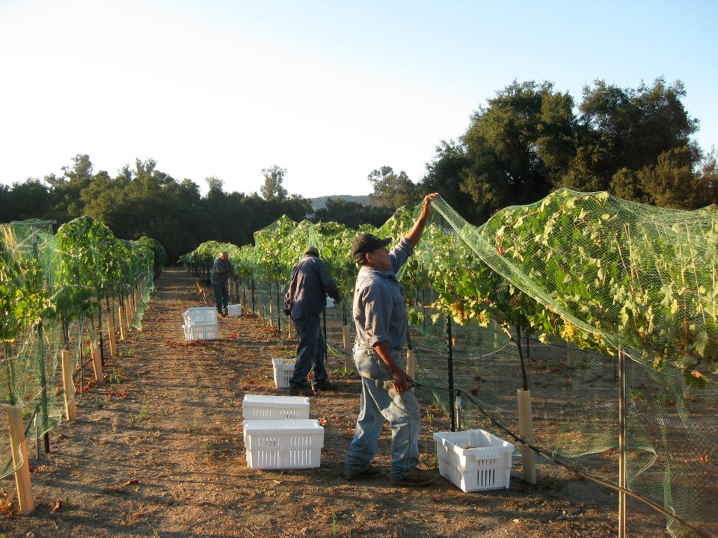

Slide 29
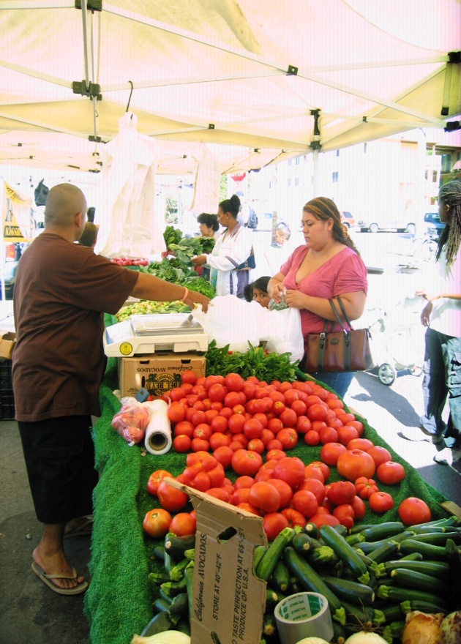
Economy
Ornamentals are discretionary
Building slowdown
Food imports often less expensive
Rising costs
Farmers are “price takers, not price makers”

Slide 30
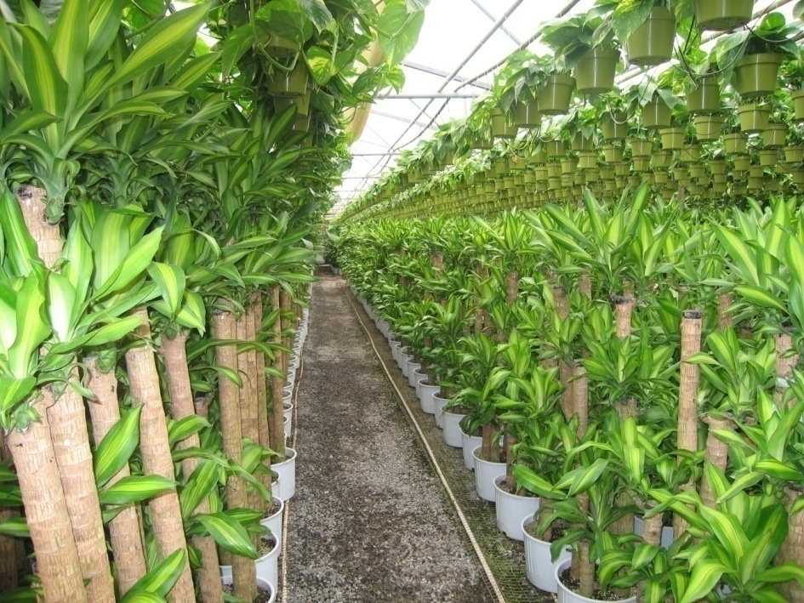
Farmers Looking Forward
Innovation
Technology
Water use management
Return per acre
Cost control
Niche markets
Crop selection

Slide 31
The Bottom Line
Farming is a business and
profitability will dictate above all else

