Slide 1
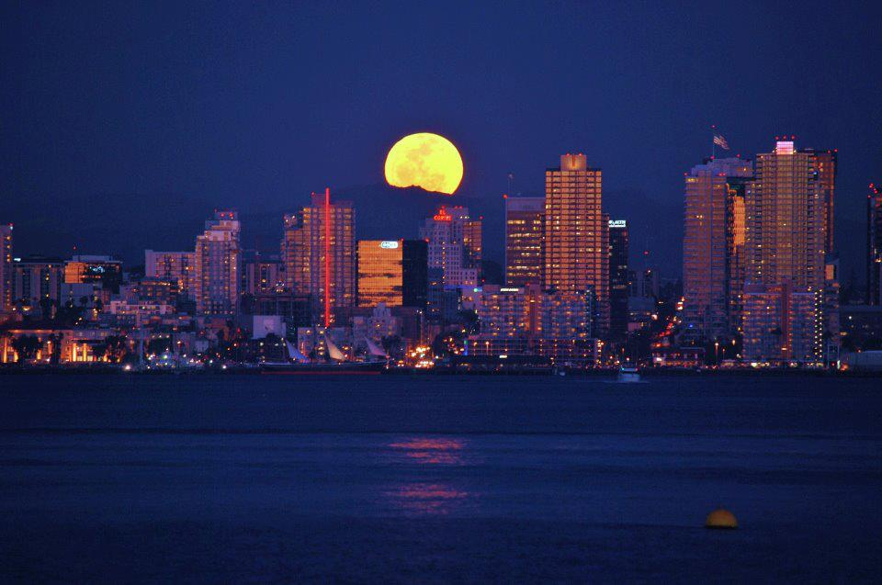
Kelly Cunningham Economist, Senior Fellow www.nusinstitute.org
Sequestration Impacts on San Diego
March 2013
Notes:
1

Slide 2

U.S. Federal budget compared
to a Household/Family Budget
Annual family income: $27,000
Money the family spent: $35,500
New credit card debt: $8,500
Outstanding balance
on credit: $129,000
Proposed spending cut: $420

Slide 3
Federal Budget Projections, FY 2013
(trillions) %GDP
Revenues $ 2,708 16.9%
Total Outlays $ 3,553 22.2
Mandatory 2,116 13.2
Discretionary 1,213 7.6
Net interest 224 1.4
Deficit $ -845 -5.3
Sequester -42 -.27
Debt held by Public $12,937 76.3
GDP $16,034
Source: Congressional Budget Office

Slide 4
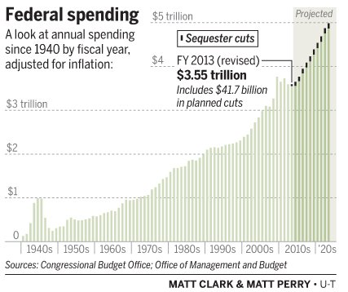

Slide 5

Imagine a government agency with only two tasks: (1) building statues of Benedict Arnold and (2) providing life-saving medications to children. If this agency’s budget were cut, what would it do?
The answer, of course, is that it would cut back on the medications for children. Why? Because that would be what was most likely to get the budget cuts restored. If they cut back on building statues of Benedict Arnold, people might ask why they were building statues of Benedict Arnold in the first place.
Dr. Thomas Sowell
Senior fellow at the Hoover Institution
Author of "Applied Economics“.

Slide 6
Sequester Impacts 2.4% of Federal Budget
Sequester Savings Breakdown (2013-2012, in Billions of $s)
Defense Discretionary $461
Non-Defense Discretionary 294
Interest Payments 169
Medicare 92
Other Mandatory 48
Sequester Total $1,064

Slide 7
Excluded from the Sequester
Defense
All military personnel accounts (upon the president’s request)
Overseas Combat Operations –only 2013
Foreign Military Sales Trust Fund
Military Retirement Fund
Domestic
Social Security
Medicare (limited to 2% cut in provider payments)
All low-income program, including:
Medicaid
Refundable income tax credits
Food stamps

Slide 8
Summary of Annual Federal
Spending in San Diego, FY 2010

Slide 9
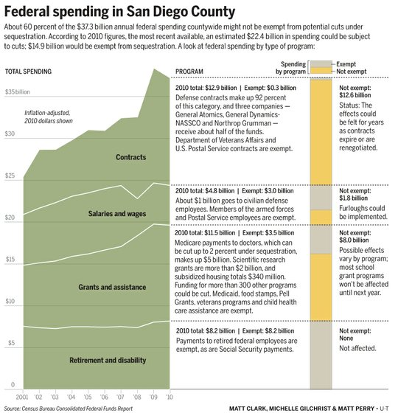

Slide 10
Business
San Diego Defense Spending by Sector
Notes:
10

Slide 11
Annual Sequestration Impacts
in San Diego
Reduced Domestic Spending: $481-$761 million
Reduced Defense Spending: $1.1-$1.7 billion
Total Annual Sequestration Impacts $1.6-$2.46 billion
With multiplier (indirect/induced)
the total impact approaches $5 billion
Forecast of 2013 San Diego GDP $187.6 billion
Potential loss from sequestration in 2013 -2.7%
http://www.nusinstitute.org/assets/resources/pageResources/FiscalCliffBrief.pdf

Slide 12
Sequestration Impacts in San Diego
during FY2013 (over next six months)
Reduction of non-defense $300-400 million
Non-exempt programs -8.4%
Health centers and Indian health -2.0%
Reduction of defense programs $700-800 million
(other than military personnel funding) -7.5%
Total Sequestration $1.0-1.2 billion

Slide 13

Business
Sequestration Impacts on San Diego
San Diego is a federal hotspot
The region experienced spike in size of U.S. budget, now will see cuts
By Matt Clark and Jeff MacDonald, Thursday February 28, 2013
“We’ve benefitted more from the run-up in federal spending, so we will be more affected by the cuts,” said Kelly Cunningham of the Institute for Policy research at National University.
The county has about 1 percent of the nation’s population and receives three times that portion of federal spending, Cunningham said. Federal spending has grown from about 17 percent of the county’s economy at the start of the last decade to 22 percent at the end.
Budget Cuts to Defense Will Sting, But S.D. Has Seen Worse
Experts: Great Recession, aerospace slowdown in ’90s hit harder than sequestration
By Jonathan Horn, Sunday March 3, 2013
‘Disproportionate impact’
“For San Diego, it’s a disproportionate impact because we have so much federal spending here,” said Kelly Cunningham, economist at the National University System Institute for Policy Research. “The easiest way to think about it is our population is 1 percent of the nation, so if everything was equitably done we’d lose 1 percent of whatever this cutback is, but because our defense industry is so massive, we are seeing 3 percent of federal government spending cut.”
Notes:
13

Slide 14
San Diego Metropolitan Area Gross Domestic Product
“San Diego Economic Momentum Slowing in 2013”, San Diego Economic Ledger, January 2013, http://www.nusinstitute.org/assets/resources/pageResources/EconomicLedger-SanDiegoForecast2013.pdf
Notes:
14

