Slide 1


Topic of Discussion
“Population Pressure: Land and Water”
Presented by the Plan B Project Team
Plan B 4.0: Mobilizing to Save Civilization
by Lester R. Brown

Slide 2
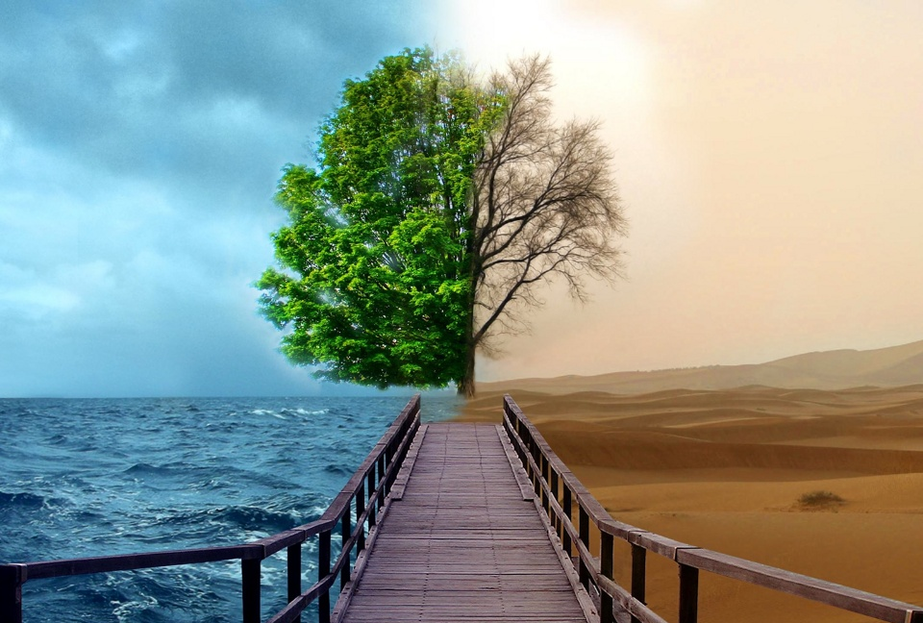
&
WATER
LAND
Source: www.talkandroid.com

Slide 3
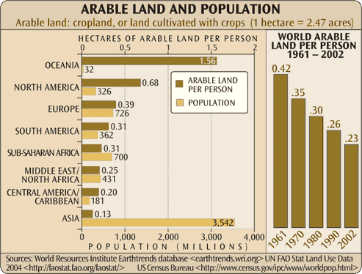
Arable Land Around the World

Slide 4
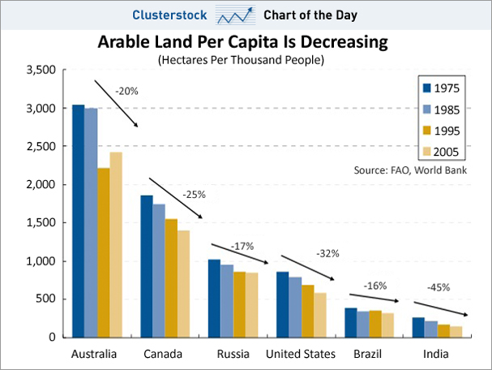
Loss of Arable Land

Slide 5
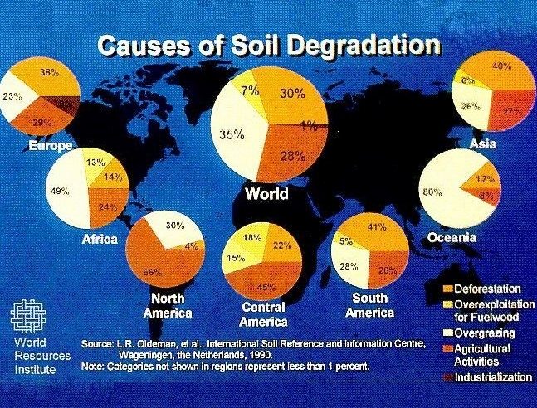

Slide 6
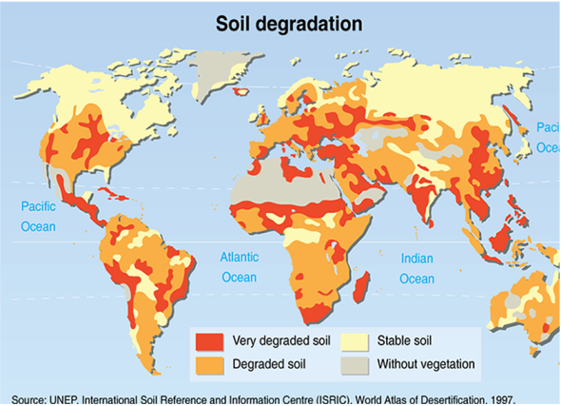
Soil Degradation

Slide 7
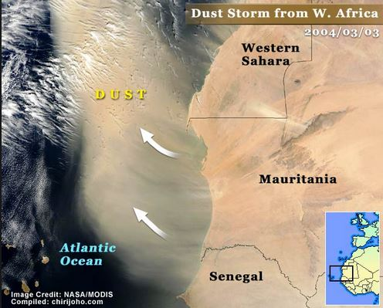
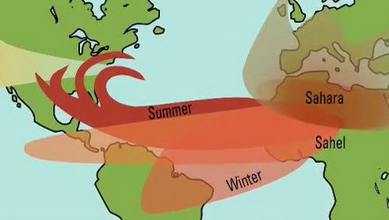
Dust storms in Africa
Source : NASA / aerosols.hamptonu.edu

Slide 8
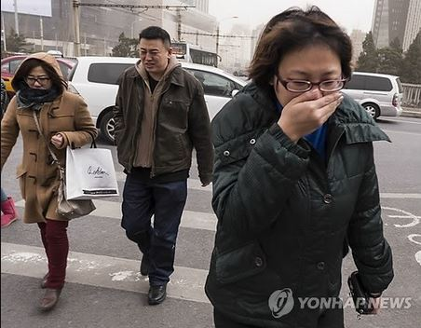
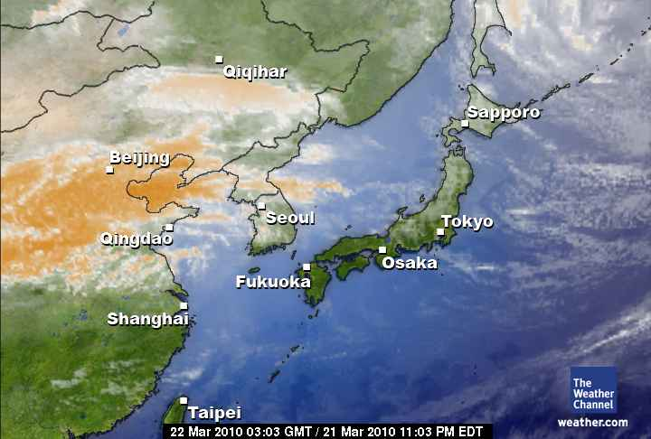
Dust storms in Asia
Source: weather.com

Slide 9
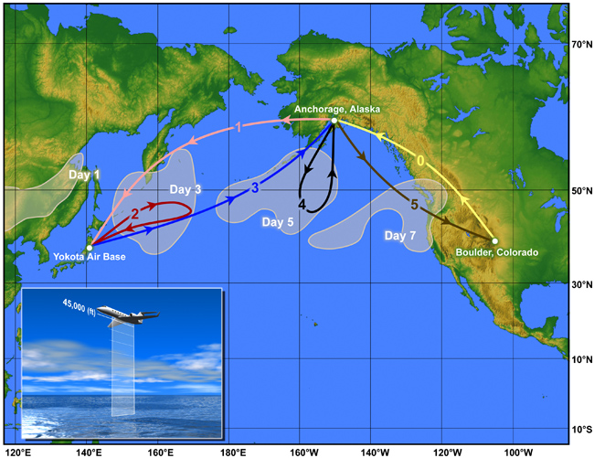
Movement of Asian Dust Storms
Source: ucar.edu

Slide 10
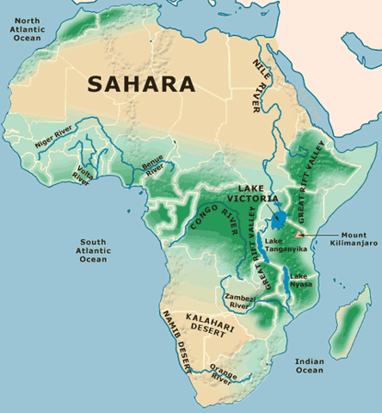
Displacing People
Source: www.wpmap.org

Slide 11
Every day we are drinking 4 Liters of Water and “eating” 2000 Liters of Water
Source: Plan B – Mobilizing to Save Civilization, Lester Brown

Slide 12
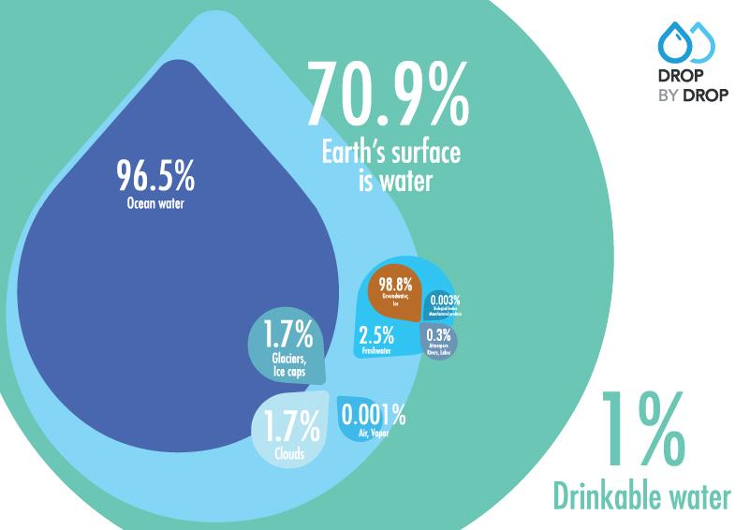
There’s this water issue….
Source: www.dropbydrop.eu

Slide 13
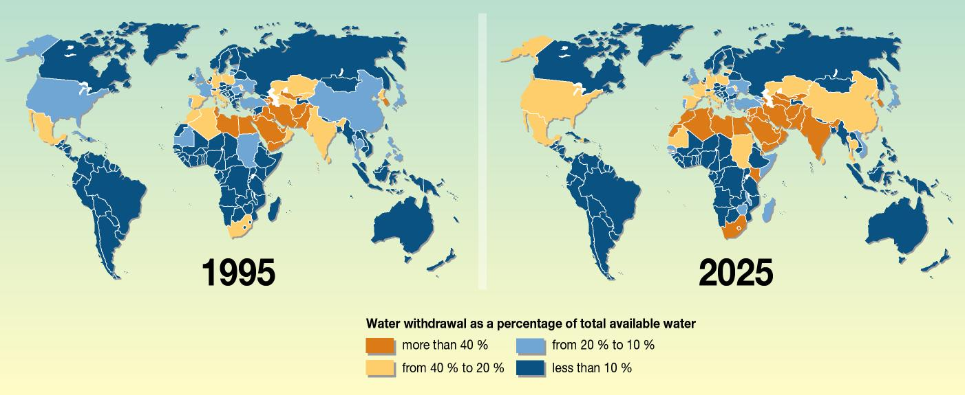
Source: Philippe Rekacewicz, UNEP GRID-Arendal

Slide 14
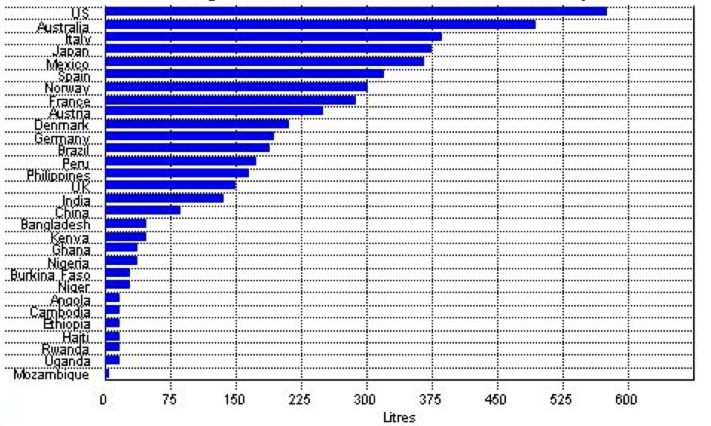
Average Water Use per Person per Day
Source: United Nations Development

Slide 15
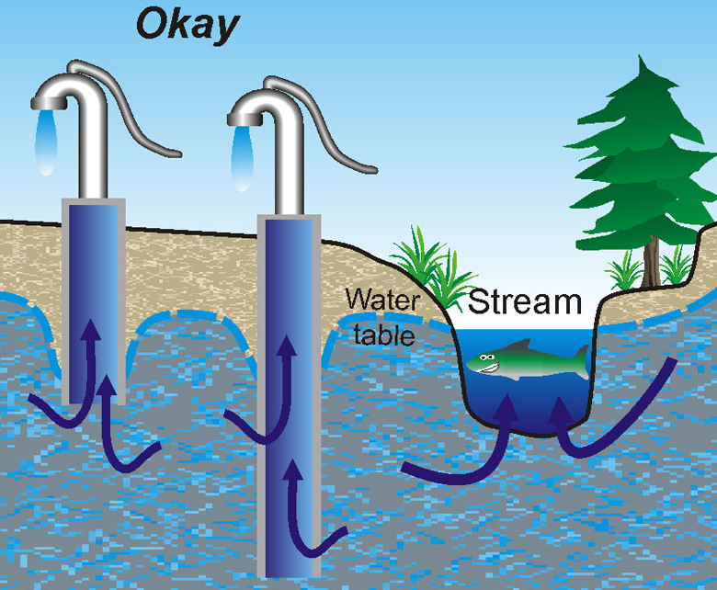
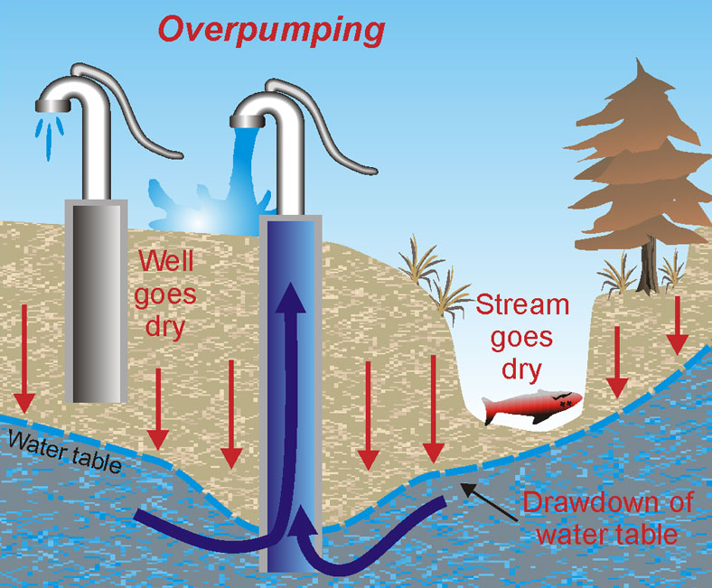
Sustainable usage
Overpumping
Source: National Resources Canada

Slide 16
Water Usage
Source: http://www.waterfootprint.org/

Slide 17
Water Usage
Source: gracelinks.org

Slide 18
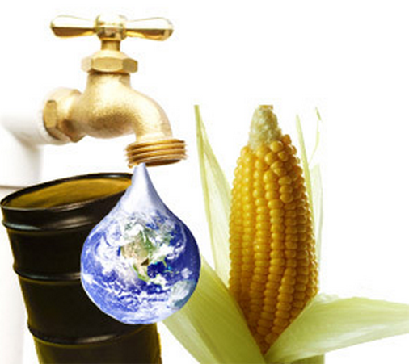
1 Gallon of Ethanol = 3 Gallons of Water
Source: US Grain Council

Slide 19
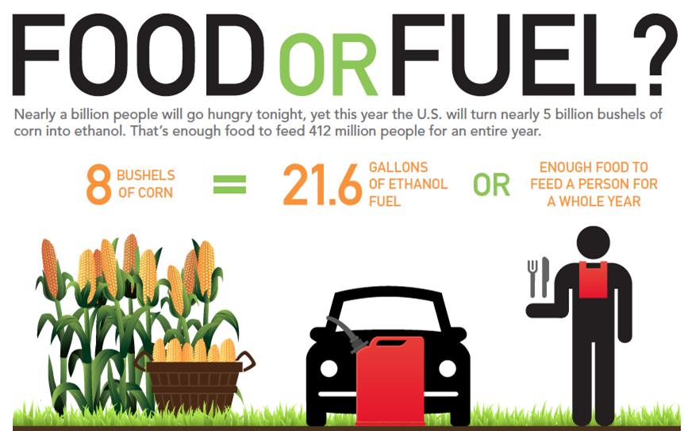
Cars and People Competing for Grain
Source: Foodorfuel.com, USDA

Slide 20
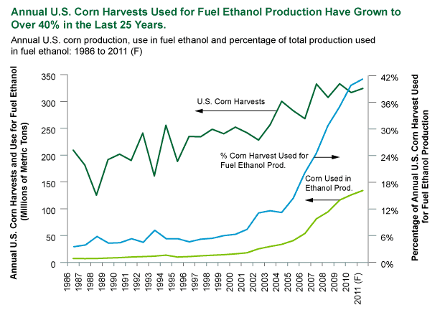
Source: USDA

Slide 21
Water Depletion
Borrego Valley declined 2 ft (0.6m)/year over 20 years.
Over 35 years, the water table dropped 150 ft (45m) in Baja California and groundwater wells have dried up.
Source: http://groundwater.sdsu.edu/

Slide 22
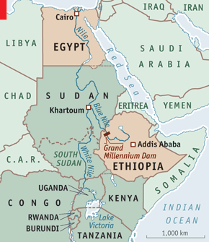
Land and water conflicts
Source: www.egyptindependent.com

Slide 23
India
Start Video
Source: Rain Water Harvesting at Silvassa
Notes:
Movie: 2:33 http://www.youtube.com/watch?v=L1S4uRxYsZ4

Slide 24
Every Year….
~692 Billion Gallons of Water
~550 million Big Macs
=
enough to sustain
1,000,000 People a year!
Source: http://www.foxnews.com/story/0,2933,294370,00.html
Source: www.waterfootprint.org
Notes:
2,400 Liters of water to make one burger

Slide 25
“Water and its availability and quality will be the main pressures on, and issues for societies and the environment under climate change.”
Source: Intergovernmental Panel on Climate Change, 2007

