Slide 1


Topic of Discussion
“Selling Our Future”
Presented by
________________________________
Plan B 4.0: Mobilizing to Save Civilization
by Lester R. Brown

Slide 2
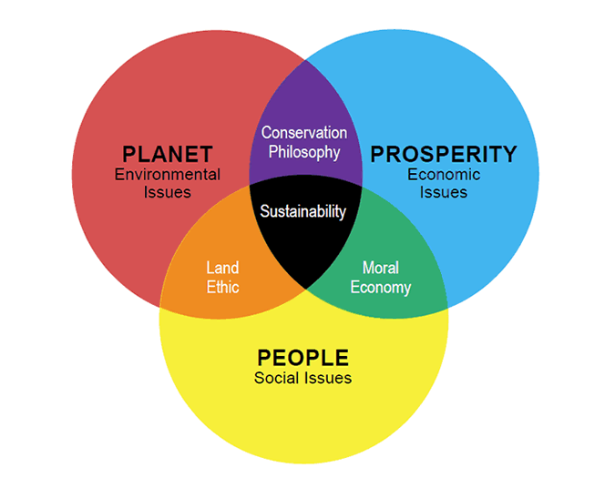
Source: The Hedgehog Review, INSTITUTE for ADVANCED STUDIES in CULTURE, UVA

Slide 3
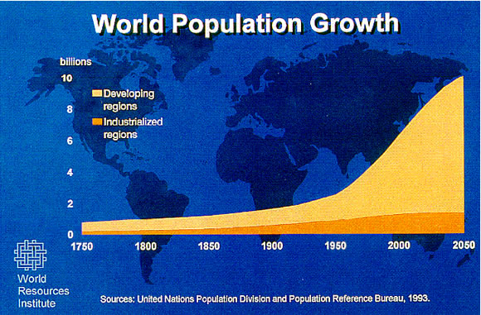

Slide 4
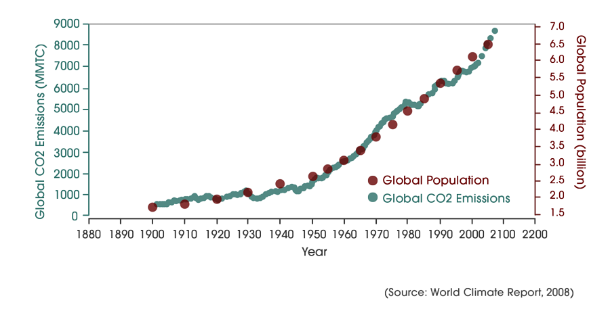
Population & CO2 Emissions

Slide 5
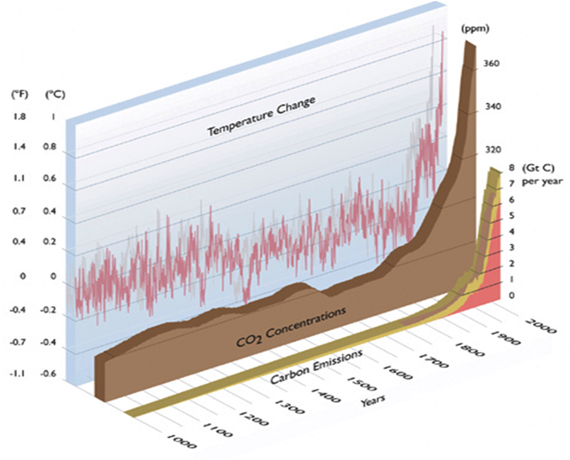
CO2 & Temperature Correlation
CO₂ Concentration
Fossil Fuels
Land-use Change
Source
Source: Arctic Climate Impact Assessment, 2004

Slide 6
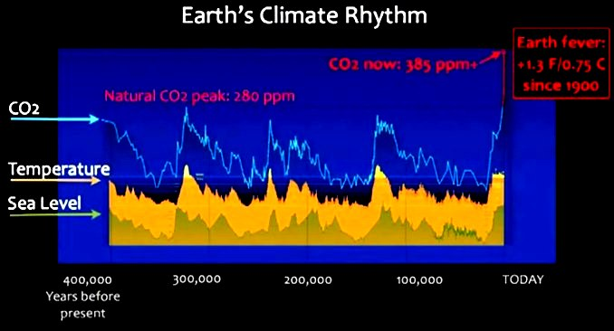
Source: James Balog, TED Global, 2009

Slide 7
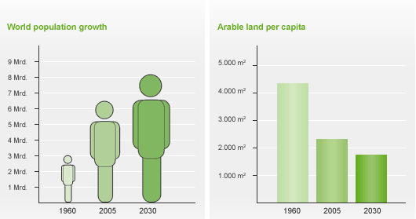
More People → Less Arable Land
Source: Food and Agriculture Organization of the United Nations

Slide 8
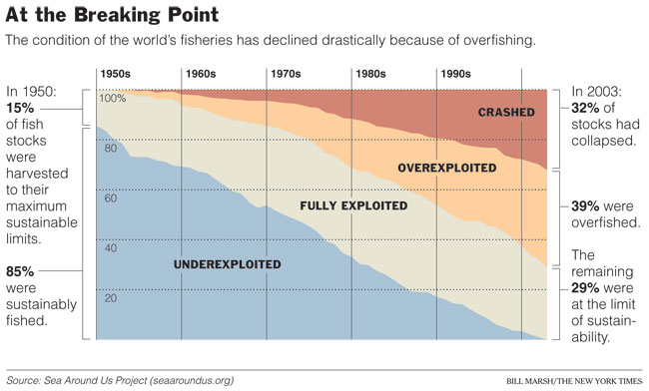
Fisheries
NOW
Source: Sea Around Us Project

Slide 9
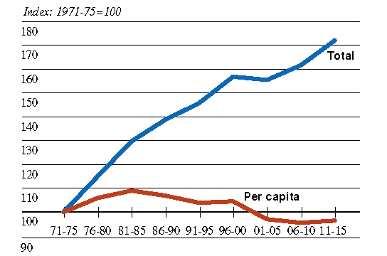
Global Grain Production: 1971 - 2015
Source: International Food Policy Research Institute, 1999

Slide 10
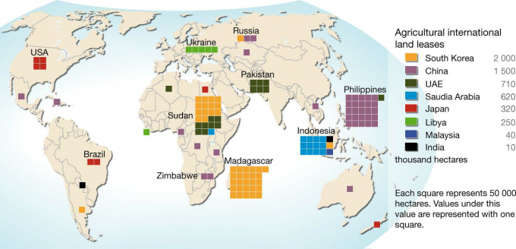
Political Dependency for Land
Leased Lands of South Korea:
Twice the Size of San Diego County
20% of the Size of South Korea’s Land Mass
Source: Hugo Ahlenius, UNEP/GRID-Arendal

Slide 11
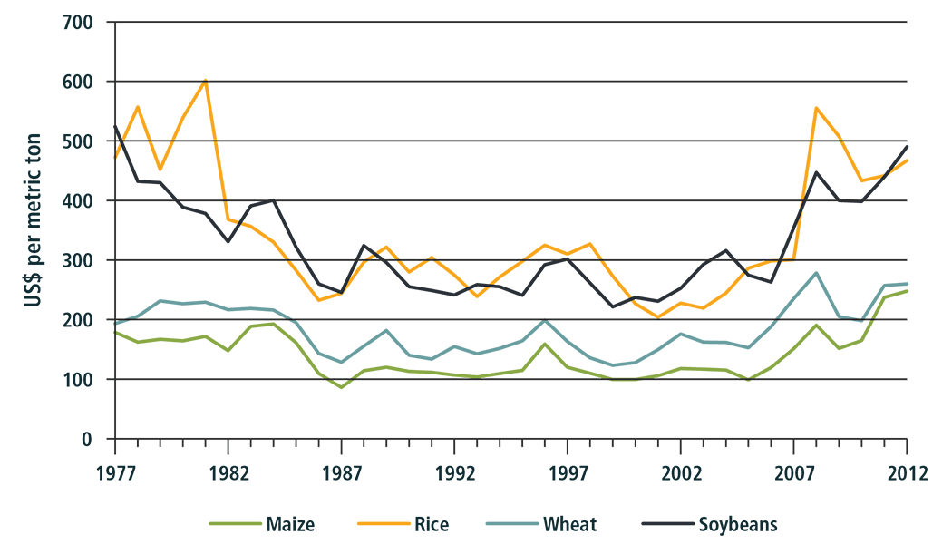

Price Increase from 2005 to 2011
Source: World Bank, GEM Commodities, 2013

Slide 12
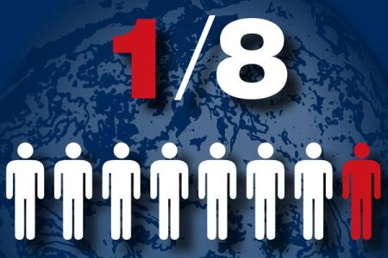
Roughly 1 Billion People Go to Sleep Hungry
EVERY DAY!
Source: Food and Agriculture Organization of the United Nations

Slide 13
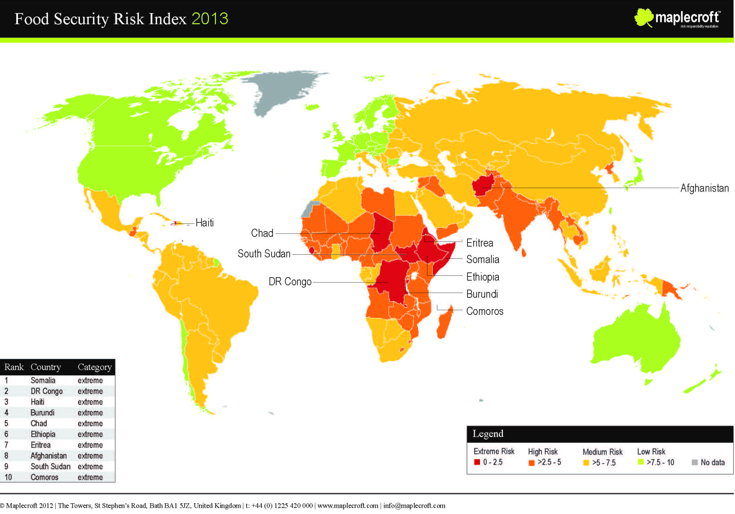
Source: © Maplecroft 2012

Slide 14
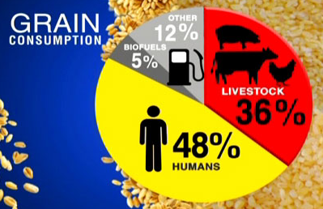
8lbs Grain = 1lb Beef
Source: Food and Agriculture Organization of the United Nations

Slide 15
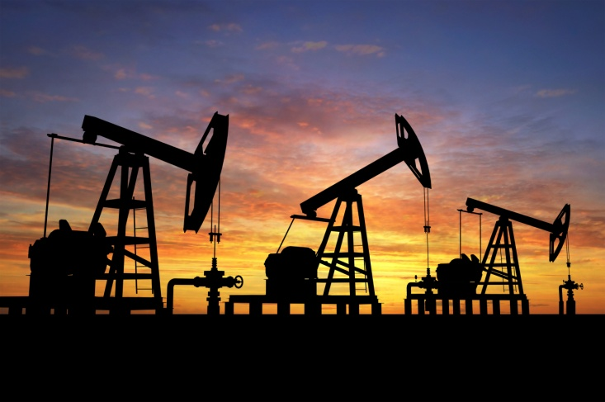
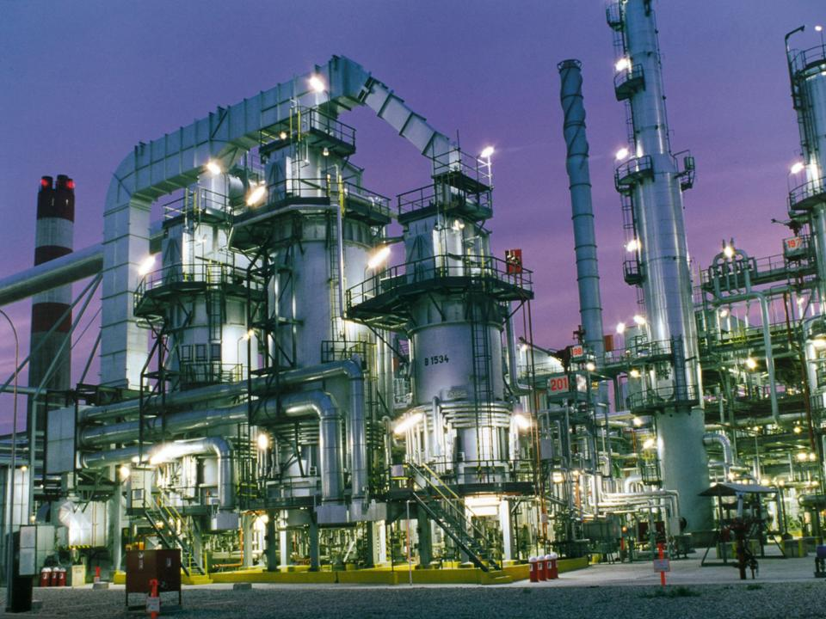
Problem: Dependence on the World Market
Market: Does not pay for indirect costs
Example: Oil drilling
  Direct cost:
    Finding oil
    Pump oil
    Refining oil
    Shipping oil

Slide 16
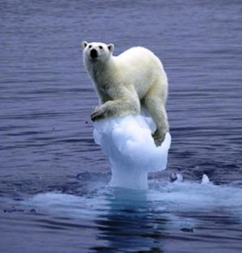
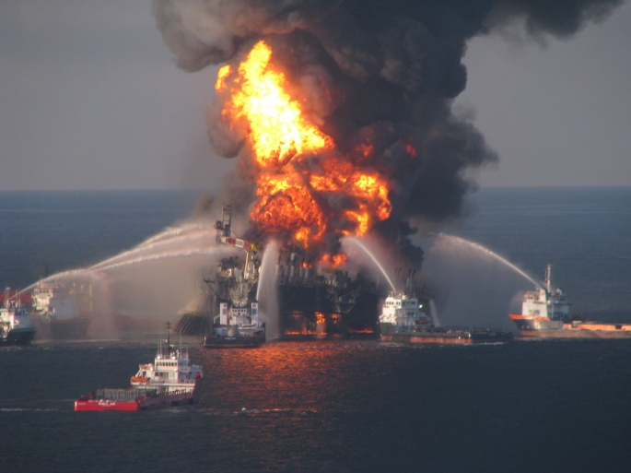
Problem: Dependence on the World Market
Market: Does not pay for indirect costs
Example: Oil Drilling
  Indirect cost:
    Climate Change from Burning Oil
    Burst pipeline

Slide 17
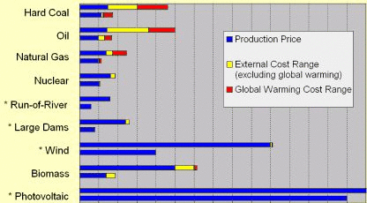
External Costs and Its Balance
Source: World Nuclear Association

Slide 18
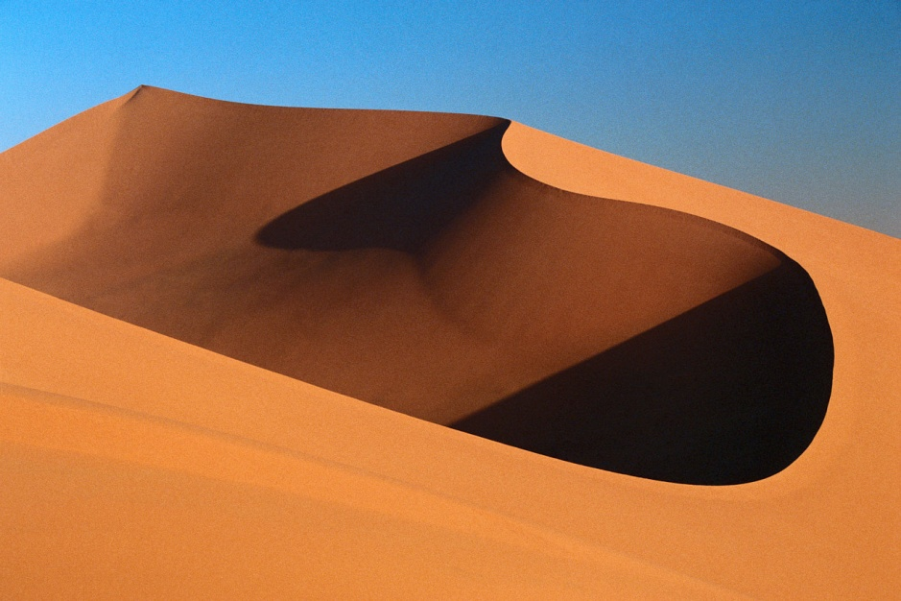
Our Solution: Plan B
PLAN B
Source: based on Plan B 4.0, by Lester R. Brown, 2009

Slide 19
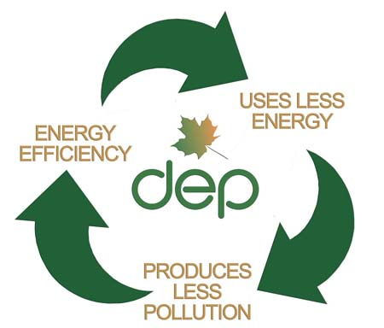
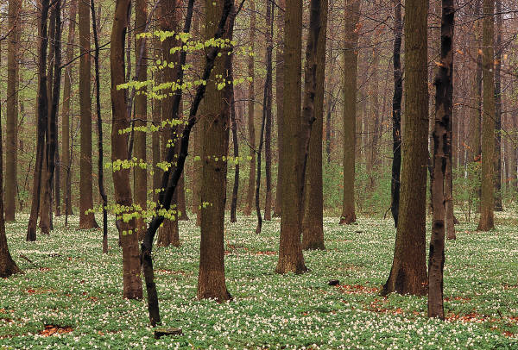
(1) Cutting Carbon Emissions
How?
  Increasing Energy Efficiencies
  Invest in Renewable Energies
  Replenish the forests
Notes:
DEP = Department of Environmental Protection

Slide 20
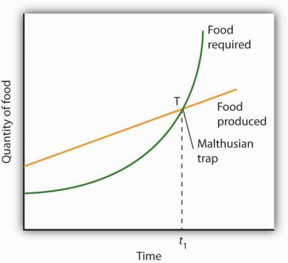
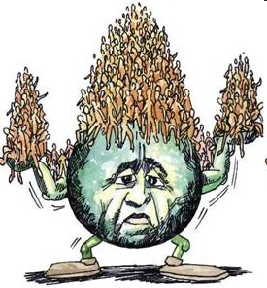
(2) Stabilizing Global Population at 8 Billion
Why?
20??
Source: Based on An Essay on the Principle of Population, Malthusian Theory
Notes:
http://www.web-books.com/eLibrary/ON/B0/B62/095MB62.html
http://www.google.com/imgres?imgurl=&imgrefurl=http://www.rozsavage.com/2013/01/16/book-excerpts-part-1-the-environmental-imperative/&h=0&w=0&sz=1&tbnid=CdXzw4MsEGdoXM&tbnh=233&tbnw=216&zoom=1&docid=TtygUxVbT9a1AM&hl=en

Slide 21
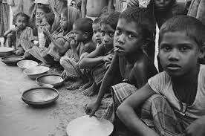
(3) Approximately 3 billion people suffering from poverty and 22,000 children are daily dying from poverty

Slide 22
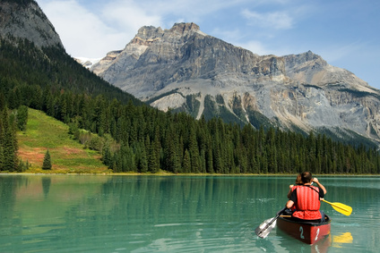
(4) Restoration of Our Natural Systems
Why?
  To reverse the damage we have already done
  To provide a future for later generations

Slide 23
“Earth provides enough to satisfy every man's needs, but not every man's greed.”
― Mahatma Gandhi

