Slide 1
City of san Diego Community Planners Committee and 42 Community Planning Groups
#CPGsWork
Building Civic Engagement,
working together WE can make a difference.
Joe LaCava, Chair, Community Planners Committee
Community Voices: Community Planning Groups
September 2013

Slide 2
The Conundrum…
CPGs – “We have no authority, no one is listening to us.”
Private Developers – “Planning groups have too much power, they need to be controlled.”
Participants/Activists – “I am here on one issue. Why doesn’t the planning group reflect my values?”

Slide 3
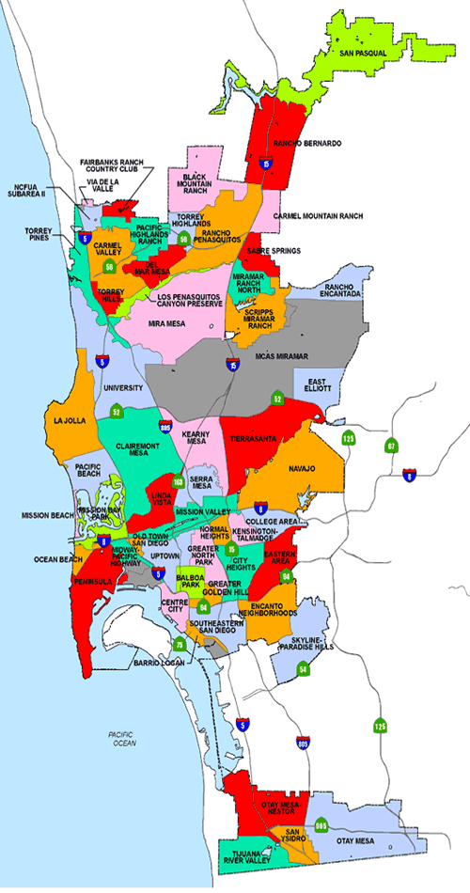
42 Community Planning Groups
Carmel Mountain Rch
Carmel Valley
City Heights
Clairemont Mesa
College Area
Del Mar Mesa
Downtown/Centre City
Eastern Areas
Encanto
Greater Golden Hill
Kearny Mesa
Kensington-Talmadge
La Jolla
Linda Vista
Midway Pacific Hwy
Miramar Ranch North
Mira Mesa
Mission Beach
Mission Valley
Navajo
Normal Heights
North Park
Ocean Beach
Old Town San Diego
Otay Mesa
Otay Mesa-Nestor
Pacific Beach
Peninsula
Rancho Bernardo
Rancho Peñasquitos
Sabre Springs
San Pasqual Valley
San Ysidro
Scripps Miramar Ranch
Serra Mesa
Skyline Paradise Hills
Southeastern
Tierrasanta
Torrey Hills
Torrey Pines
University
Uptown
Barrio Logan

Slide 4
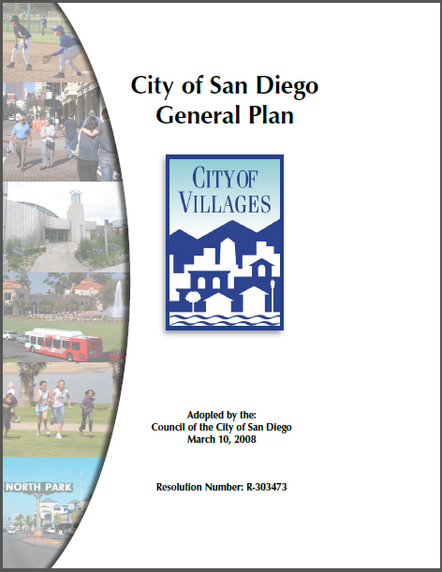
General Plan
Expresses city’s vision and values
Foundation for all land use decisions.
Foundation for all policy decisions.
Used by City Hall, policy makers, other regional governments, consultants.

Slide 5
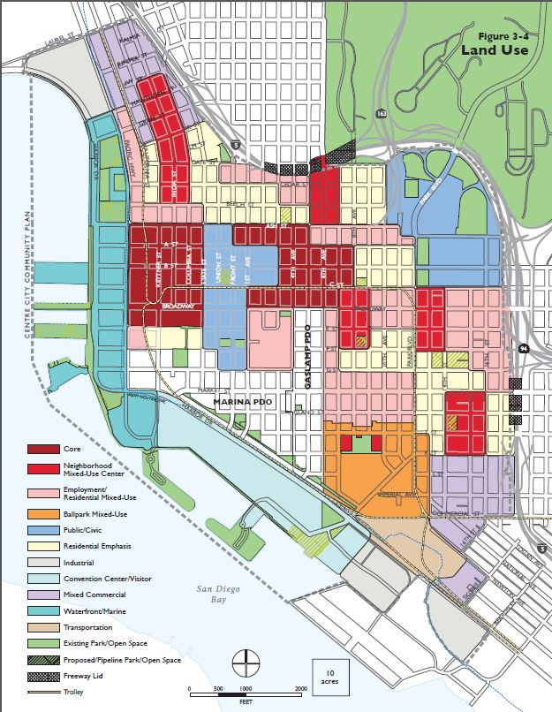
Community Plans
Specific land uses and public improvements
Tailored policies and long-range physical guide
Used by City Hall, residents, merchants, property owners, developers, etc.
Typical topics:
Land Use
Mobility
Urban Design
Public Facilities and Services
Natural and Cultural Resources
Economic Development

Slide 6
The Challenge
Despite best efforts, Mayor’s Office, City Staff, City Council, can’t fully appreciate how city actions translate to your community, your neighborhood, the street you live on.
City actions happen every day – private development proposals, city infrastructure improvements, new policies, new zoning. On the ground input is needed.

Slide 7
Community Planning Groups
First recognized by City in 1966.
Formal mechanism for community input on land use decision-making.
Advisory, recommendations.
2006, City Attorney: Comply with California's Open Meeting Law, Ralph M. Brown Act.
Actions and deliberations to occur openly with public access & input.

Slide 8
Let’s not forget… Community Planning Groups are People
Community
Group
Planning
People

Slide 9
Key Difference: CPGs v. other community organizations
CPGs: Discuss → deliberate → VOTE
Other Orgs: Discuss → decide → ACT

Slide 10
CPGs: Basic Scope
Review/make recommendations on:
Private development proposals
City initiatives (policy, zoning regulations, master plans)
Infrastructure (streets, traffic calming, bike lanes, etc.)
Discuss community issues → Can be pro-active
Liaison with City Hall
Community Plan Update (every 20+ years or so)

Slide 11
CPGs: Meetings & Composition
Meetings
Monthly, typically in evening
Agendas posted at least 72 hours in advance
Most have subcommittees
Composition
12 to 20 elected members
Membership drawn from homeowners, renters, merchants, property owners – Folks with direct connection to community
1/3rd to 1/4th of seats open every year
Best Mix: 1/3rd detailed knowledge, 1/3rd institutional knowledge, 1/3rd fresh voices/energy.

Slide 12
CPGs: Why Attend Meetings?
Find out what’s happening in your neighborhood
Voice your opinion and influence decisions
Discuss changes in your neighborhood
Work with community-minded individuals
…attendance part of eligibility to run for a seat

Slide 13
CPGs – Some Pluses…
Brings together community-minded individuals
Democratic elections
Open to everyone
Agenda posted in advance
Well structured
Recommendations direct to City Hall
City Council, City Staff, private developers all seek out CPG recommendations

Slide 14
…and Minuses for first timers
Can be too structured
Special language, acronyms, knowledge
Strong personalities, discontents
Disinterest from community may lead to callousness when new voices show up.
No financial support from city
Minimal technical support from city
No second language services

Slide 15
Community Planning Committee
Umbrella organization over the CPGs
1 appointee (usually chair) from every CPG
Meeting monthly, 24 to 30 attend
Scope
City-wide policy
City-wide ordinances
City-wide initiatives (master plans)
Liaison with City Hall
We do not:
Review private development projects
Community specific issues
Private initiatives

Slide 16
CPC and CPG roles expanding…
Infrastructure Priorities
2012: City invited CPC/CPGs to provide Neighborhood Input on Infrastructure Priorities.
2013: Process formalized in City Council Policy
… important steps towards authentic Public Participation in city budgeting.

Slide 17
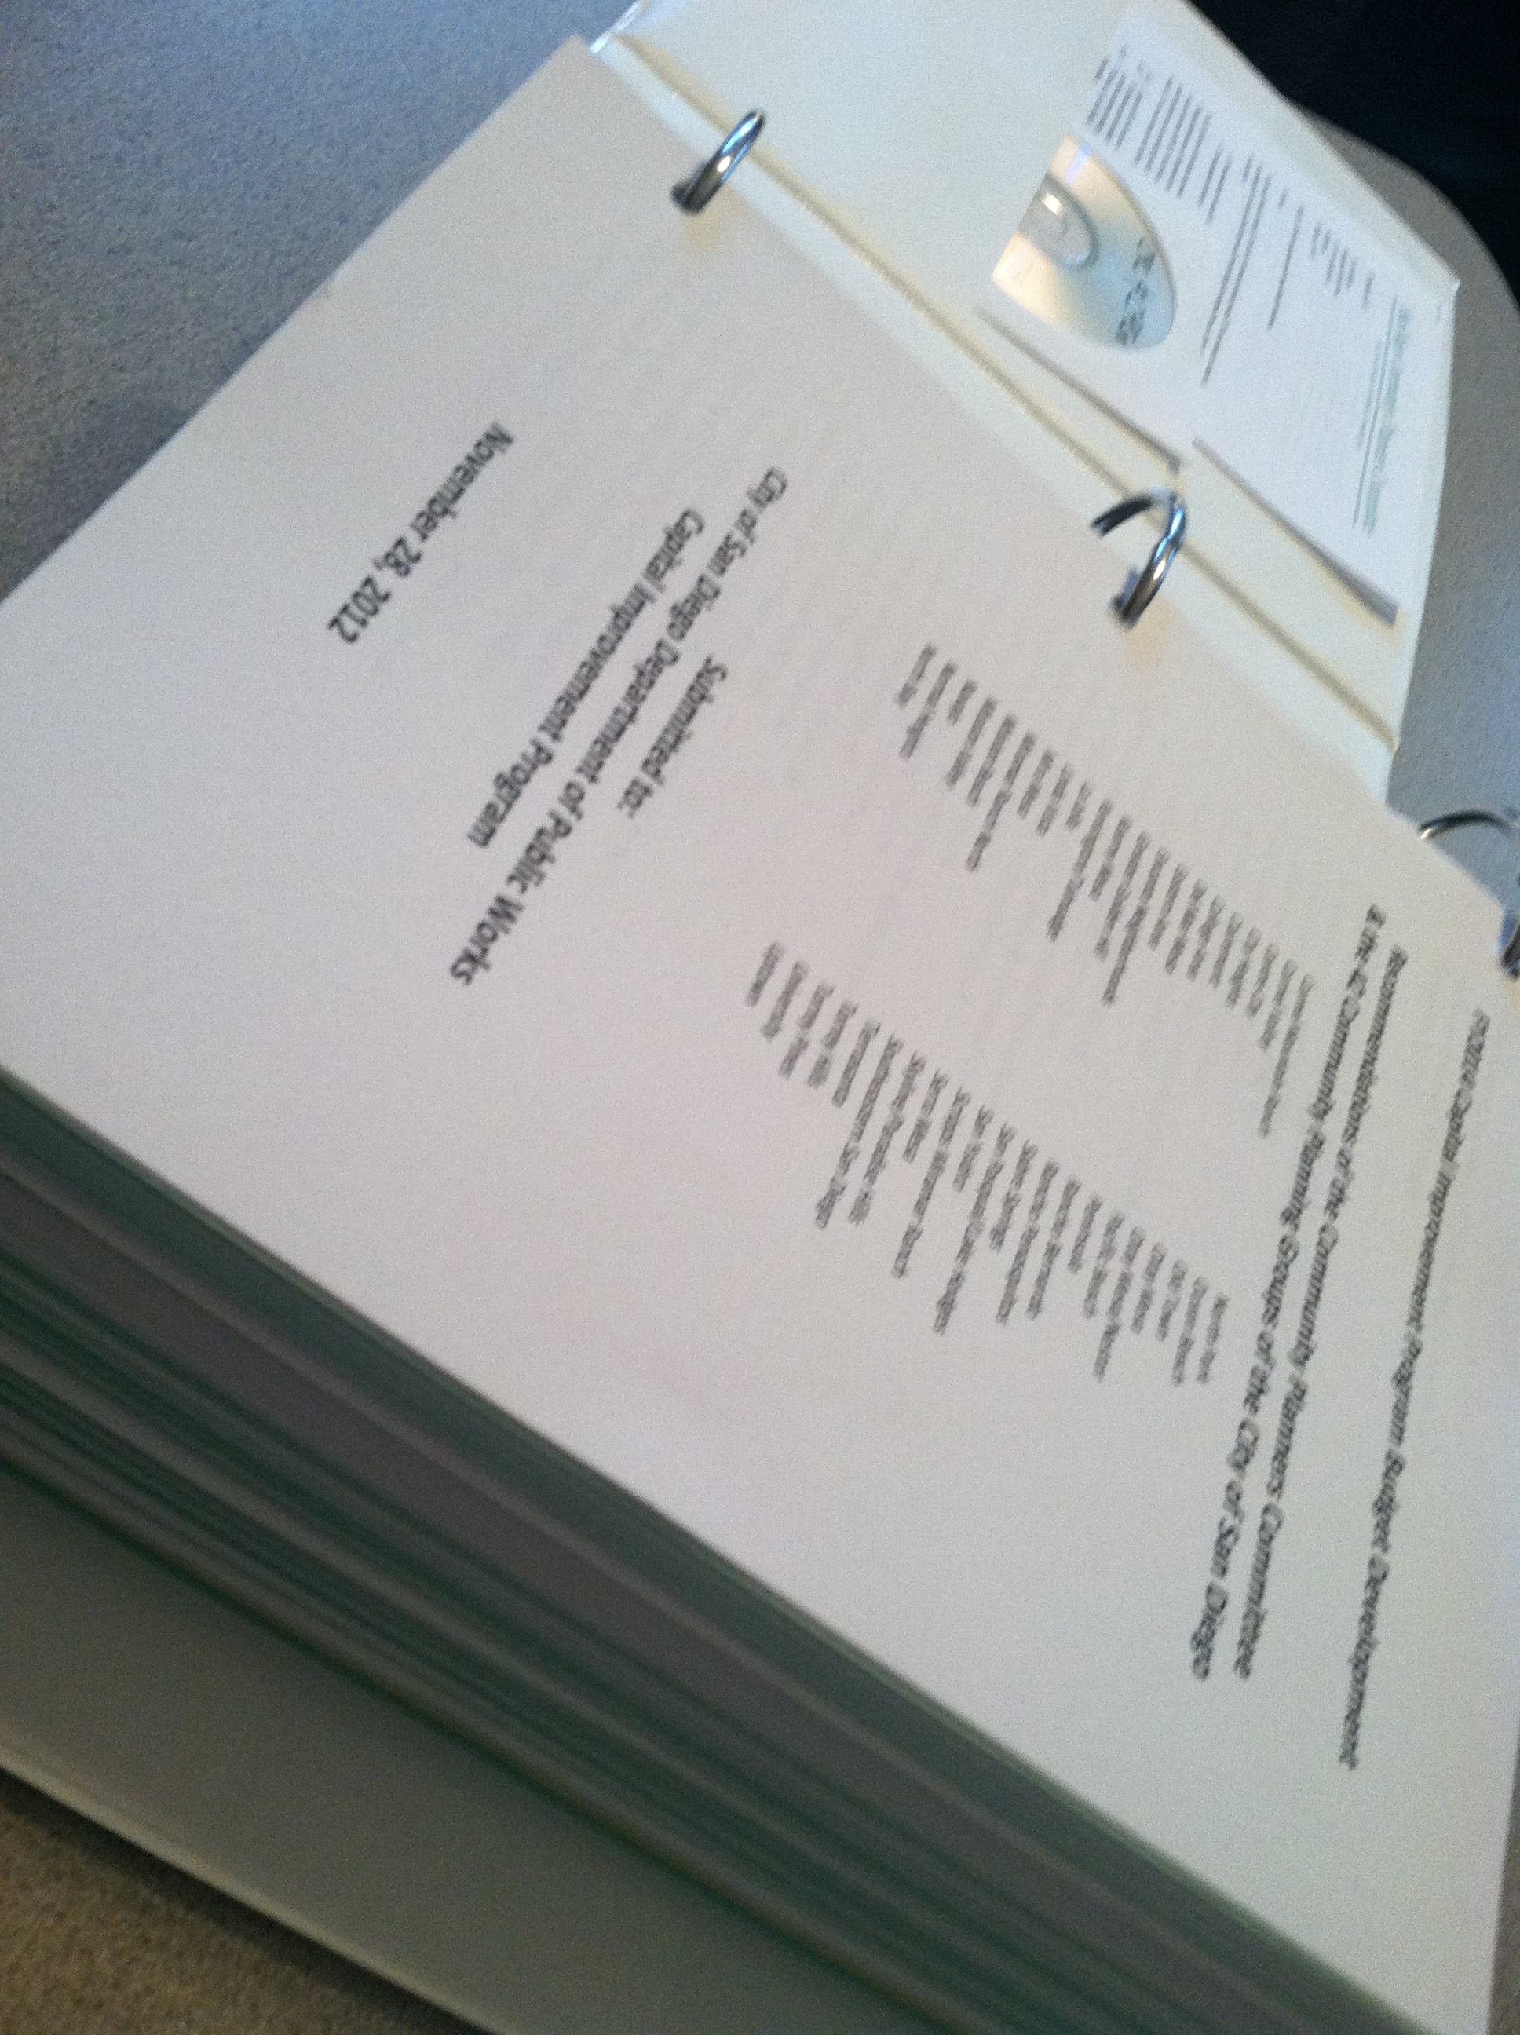
2012 Results
29 communities recommended a total of 225 new projects in addition to prioritizing current CIP projects.
16 communities south of Interstate 8 identified 176 new projects
13 communities north of Interstate 8 identified 49 new projects
11 communities made no recommendations for FY2014 but look forward to FY2015
3 communities south of Interstate 8
8 communities north of Interstate 8
2 groups did not respond
10 projects funded in FY2014 Budget

Slide 18
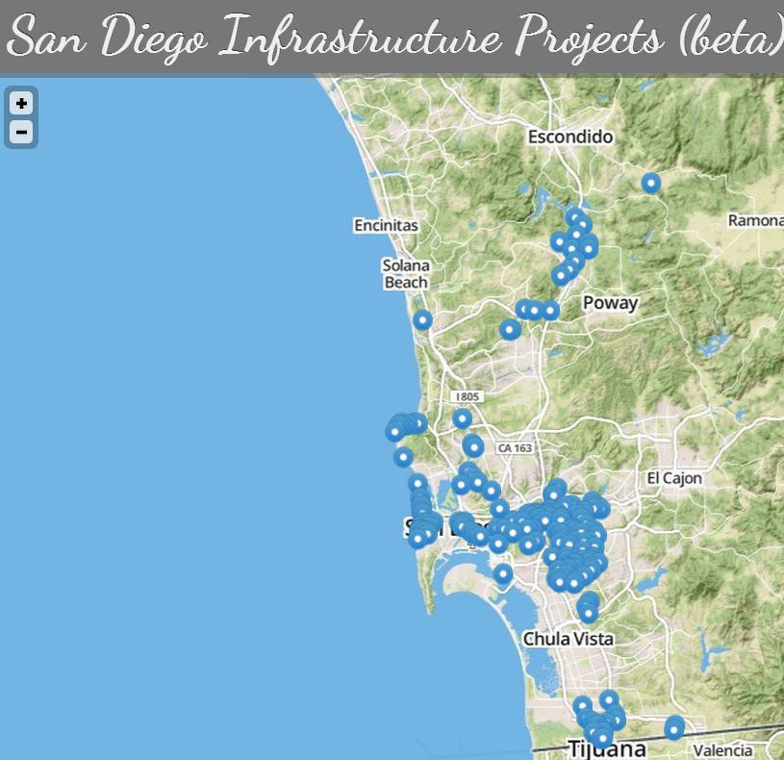
Support Your Local Infrastructure
http://infrastructure.opensandiego.org/
To prioritize infrastructure projects.
Or text your infrastructure needs:
760.239.7578

Slide 19
Other community organizations…
Rec Councils (city recognized; parks, recreation centers)
Merchant Associations (aka Main Street, BID)
Parking Districts
Town Council
Neighborhood Councils
Advocacy Groups (WalkSD, BikeSD, MoveSD, etc)
CPGs are not the gatekeepers but the recognized link between communities and City Hall.

Slide 20
The Conundrum…Revisited
CPGs: “We have no authority, no one is listening.” Need feedback from City Hall and self-reflection.
Developers: “Planning groups have too much power, they need to be controlled.” Power derives from credibility and degree City Council respects CPG recommendations. Ease of filing appeals does give an edge.
Participants/Activists: “I am here on one issue. Why doesn’t the planning group reflect my values?” Group reflects voters who showed up at election time. Only through investment of time by all stakeholders will a planning group reflect diversity of its community. Patience and persistence will help drive acceptance of your values.

Slide 21
Conclusion
Community Planning Groups
provide for civic engagement.
best venue for direct input to City Hall decisions.
stronger when everyone participates.
#CPGsWork
Questions?
Joe LaCava, Chair, Community Planners Committee
858.488.0160 | joe@avetterra.com | @joe_lacava

