Slide 1
Kelly Cunningham Economist, Senior Fellow www.nusinstitute.org
2013 Economic Outlook
“San Diego’s post-recession economic recovery”
June 2013
Notes:
1

Slide 2


Business
“Prediction is very difficult, especially
about the future.” – Niels Bohr
“Forecasting is like trying to drive a car while only being able to see out the rear view mirror.” - Anonymous
Notes:
2

Slide 3

Business
EconoMeter January 4, 2013
Q: Will the U.S. be better off on Jan. 1, 2014, than it is today?
Panel's answer: Yes 7, No 1
Kelly Cunningham, National University System
A: NO
The economy may slightly grow and employment increase, but the nation will not be better off by the end of the year. With payroll and upper-income tax increases, and new taxes under Obamacare taking effect, every household and taxpayer will see net take-home pay declining in 2013. The unsustainable path of “entitlement” spending on pensions and health care continues, while America’s enormous structural budget deficit compounds. “Real” inflation will escalate although underreported by official CPI figures. America’s perpetual fiscal irresponsibility will continue to increase until the real full financial cliff is ultimately reached when lenders stop lending to the U.S.
Notes:
3

Slide 4
U.S. Federal budget
equivalent to:
Household budget:
Annual family income:
$21,700
Money the family spent:
$38,200
New debt on the credit card: $16,500
Outstanding balance on credit card: $142,610
Total budget cuts so far: $33.50
U.S. Tax revenue:
  $2.17 trillion
Fed budget:
$3.82 trillion
New debt:
  $1.65 trillion
National debt: $14.27 trillion
Recent budget cuts:
$38.50 billion

Slide 5
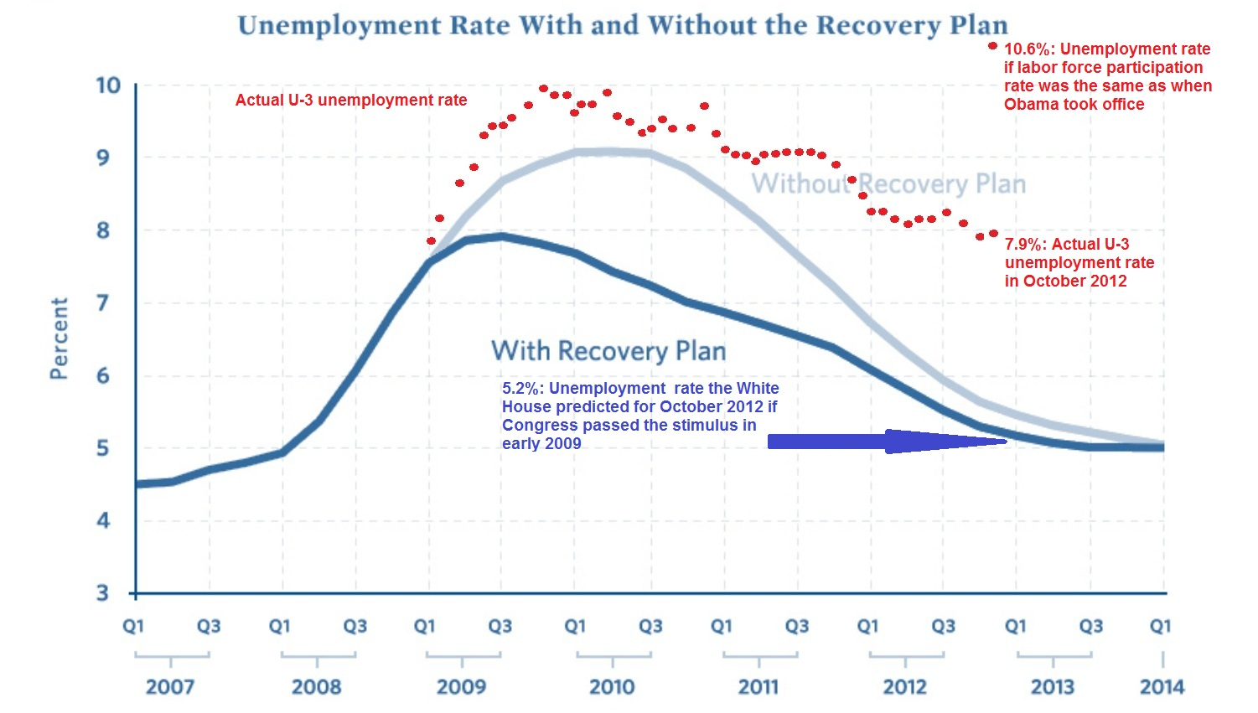
Estimate and reality of
post-crisis U.S. unemployment

Slide 6
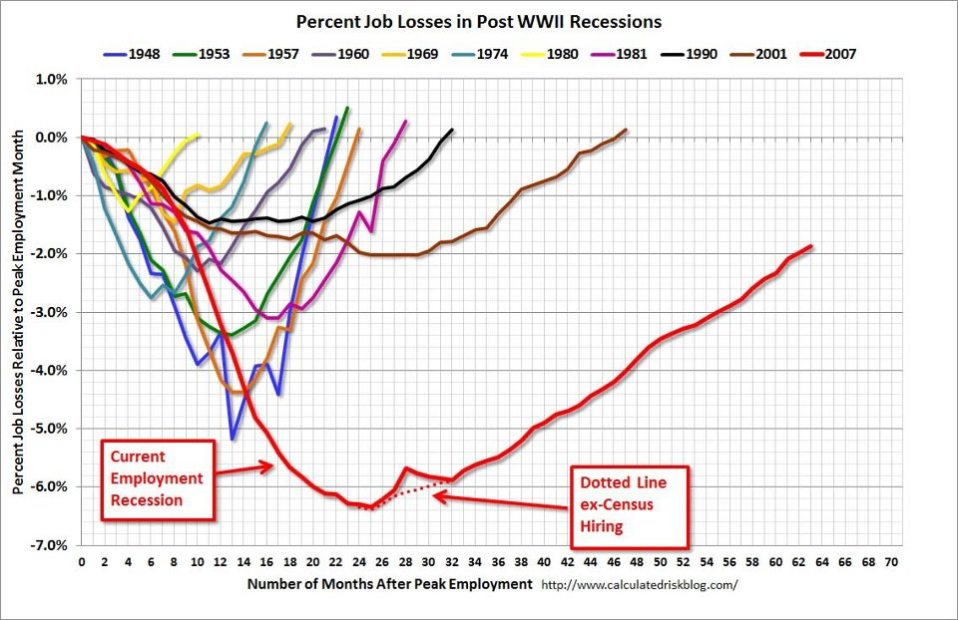
U.S. Job Loss and Recovery
Notes:
6

Slide 7
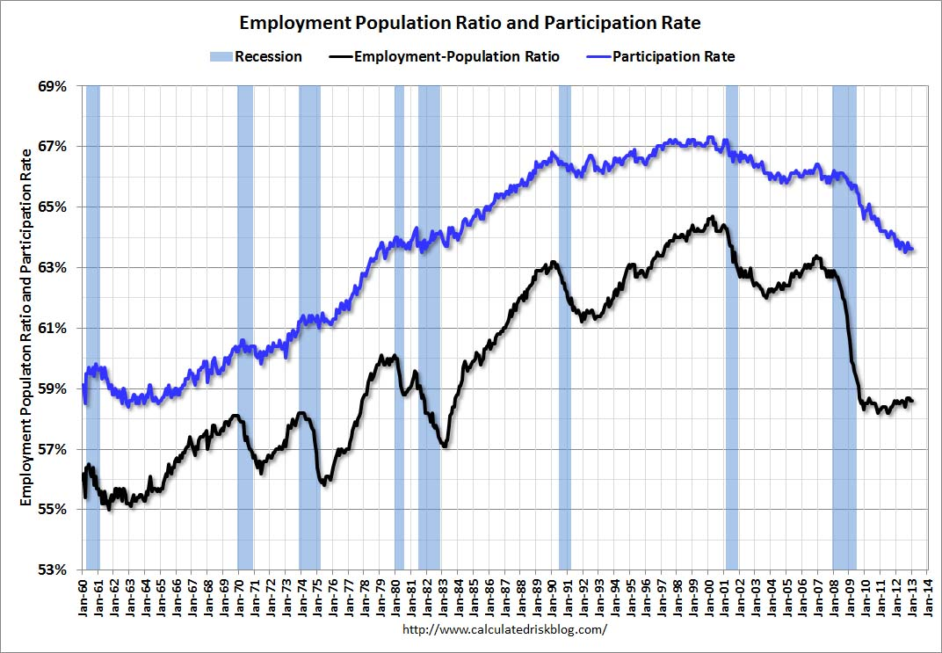
Employment Population Ratio, Participation Rate

Slide 8
San Diego, California, U.S. Jobs
Nonfarm payroll employment seasonally adjusted
Notes:
8

Slide 9
Unemployment Rate Comparison
Notes:
9

Slide 10
Alternative measures of labor underutilization
Second Quarter of 2012 through First Quarter of 2013 Average
U-1: Persons unemployed 15 weeks or longer, as a percent of the civilian labor force.
U-2: Job losers and persons who completed temporary jobs, as a percent of the civilian labor force.
U-3: Total unemployed, as a percent of the civilian labor force (this is the definition used for the official unemployment rate).
U-4: Total unemployed plus discouraged workers.
U-5: Includes U-4 plus all other marginally attached workers.
U-6: Includes U-5 plus total employed part time for economic reasons.
Notes:
10

Slide 11
Definition of Gross Domestic Product
Product approach:
Market value of all final goods and services calculated during year
Net Value Added = Gross Value of output – Value of Intermediate Consumption
Income approach:
Sum total of incomes of individuals living in a country during year
GDP = compensation of employees + gross operating surplus + gross mixed income + taxes less subsidies on production and imports
GDP = COE + GOS + GMI + TP & M – SP & M
Expenditure method:
All expenditure incurred by individuals during year
GDP = private consumption + gross investment + government spending + (exports − imports)
GDP = C + I + G + (X-M)
Notes:
11

Slide 12
San Diego Metropolitan Area
Gross Domestic Product
Notes:
12

Slide 13
Comparison of Annual Change in GDP
SAN DIEGO, California, U.S.
Notes:
13

Slide 14
Ranking of Gross Domestic Products - 2012
Notes:
14

Slide 15
Change in San Diego Jobs by Industry Sectors Annual Average 2011-2012 Net Change: 18,900
Notes:
15

Slide 16
San Diego Industry Employment Change
San Diego technology companies account for: Average Wage, 2nd Qtr 2012
Establishments: 6% Employment: 11% San Diego (overall) $53,500
Payrolls: 21% Average Wage: 190% Tech Average $101,500

Slide 17
San Diego Technology Employment by Sector

Slide 19
San Diego County Population
Notes:
19

Slide 20
Annual San Diego County Population Change
Notes:
20

Slide 21
San Diego Population by Ethnicity/Race
Notes:
21

Slide 22
San Diego Population by Ethnicity/Race and Age
Notes:
22

Slide 23
S&P/Case-Shiller Home Price Indices
Seasonally Adjusted
Notes:
23

Slide 24
Housing Affordability Ranking
Notes:
24

Slide 25
Ratio of Median Housing Price to Median Household Income
Notes:
25

Slide 26
San Diego Housing Construction
Notes:
26

Slide 27
Vacant San Diego Housing Units
Notes:
27

Slide 28
Home Ownership Rates
Notes:
28

Slide 29

www.nusinstitute.org
Our Mission
The Institute is a non-partisan organization that formulates and promotes high quality economic, policy, and public-opinion research.
Notes:
29

