Slide 1
Energy supply in San Diego County How Sustainable are we?
Tom Brill, Director of Strategic Planning SDG&E
© 2011San Diego Gas & Electric Company. All copyright and trademark rights reserved.

Slide 2
Agenda
Company Background
Challenges in providing reliable energy
How we meet these challenges
What we are doing to address these challenges going forward

Slide 3
Sempra Energy Overview
CA Regulated Utilities
Infrastructure
Largest U.S. customer base with over 7.8 MM meters serving 30 MM Californians
6.5 MM gas meters and 1.3 MM electric meters
San Diego-based energy holding company with 2011 revenues of just over $10 billion and 17,500 employees worldwide working in four major business units, supplying energy to more than 31 million consumers.
Latin American utilities
Import/Export, storage and transportation of natural gas
Clean generation
Sempra International
Southern California Gas Company
Sempra U.S. Gas & Power
San Diego Gas & Electric

Slide 4
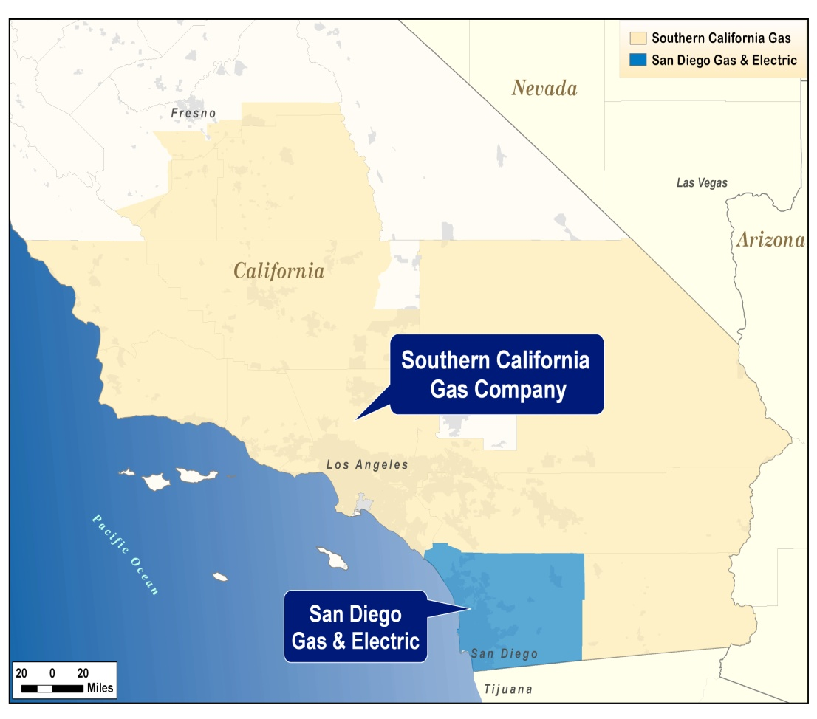
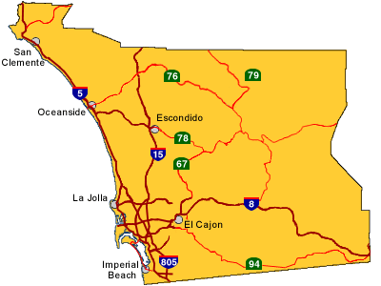
SDG&E Service Area
Provider of electric & natural gas services to 3.5 million consumers
4,100 square miles of service territory spanning two counties and 25 communities
1.4 MM electric meters and 880,000 natural gas meters

Slide 5
What has changed at SDG&E?
Customer Programs and Initiatives
Helping customers save energy
Energy goals and alerts
Pricing options
Rewards programs
In-person home audits
My Energy, SDG&E mobile app and Green Button deployment
Making it easy to do business
My Account usability
Multiple channels for rate selection
Web transactions optimization
Smart Meter deployment
1.3 million electric and 880,000 gas Smart Meters installed
Will enable customers to manage and customize their energy service through HAN technology and other behind the meter applications
Smart Grid deployment
First utility in the nation in submit a smart grid implementation plan
“Smartest Utility” in the nation for two years in a row

Slide 6
What has changed at SDG&E?
Environmental Stewardship
Alternative fuel fleet
86% of SDG&E’s passenger vehicles are alternative fuel, electric, hybrid or CNG
37% of bills are sent electronically: Best in the U.S.
Received 2012 Climate Leadership Award from the Environmental Protection Agency for Organizational Leadership
Renewable Portfolio Standard (RPS) implementation
From 3% to 21% in 5 years
Roof-top solar PV adoption
35% compound growth rate in the number of NEM customers in the last 5 years
Customer options for Electric Vehicles
7th year of SDG&E’s clean transportation program
San Diego region leads rollout of plug-in electric vehicles (PEVs); more than 1900 already circulating (1/10 of PEVs in the nation)
Special rates for PEVs in place emphasizing off-peak charging
Daimier launched Car2Go in San Diego, U.S.’s first electric car sharing service, starting with 300 PEVs
All while maintaining a record of operational excellence
No.1 in Western U.S. in Reliability 6 straight years & No.1 in the Nation in 2010

Slide 7
Our role: deliver reliable and safe service that meets the demands and needs of our customers
Generation
Transmission
Distribution
Retail Customers
CPUC (California) regulated
SDG&E owns Palomar (565MW), El Dorado (480MW), peaking plants and 20% ownership of San Onofre Nuclear Generating Station (443MW)
Purchases power from many sources
FERC (Federal) regulated
SDG&E owns and maintains
Under operational control of California Independent System Operator (ISO)
Looped system
CPUC (California) regulated
SDG&E owns and operates
16,800 miles (60% underground)
Radial System
CPUC (California) regulated
3.4 million consumers
1.3 million electric and 880,000 gas Smart Meters installed
New uses of the grid: roof-top solar, EVs, fuel cells, etc
Notes:
Reliable transmission and distribution of energy
Responsible for maintaining the electric grid

Slide 8

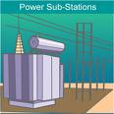
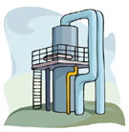

The Utility World Today
Energy Flow
Electricity
Natural gas
Gas Storage

Slide 9
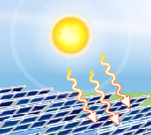
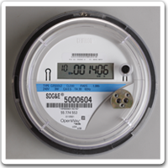
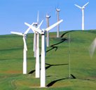
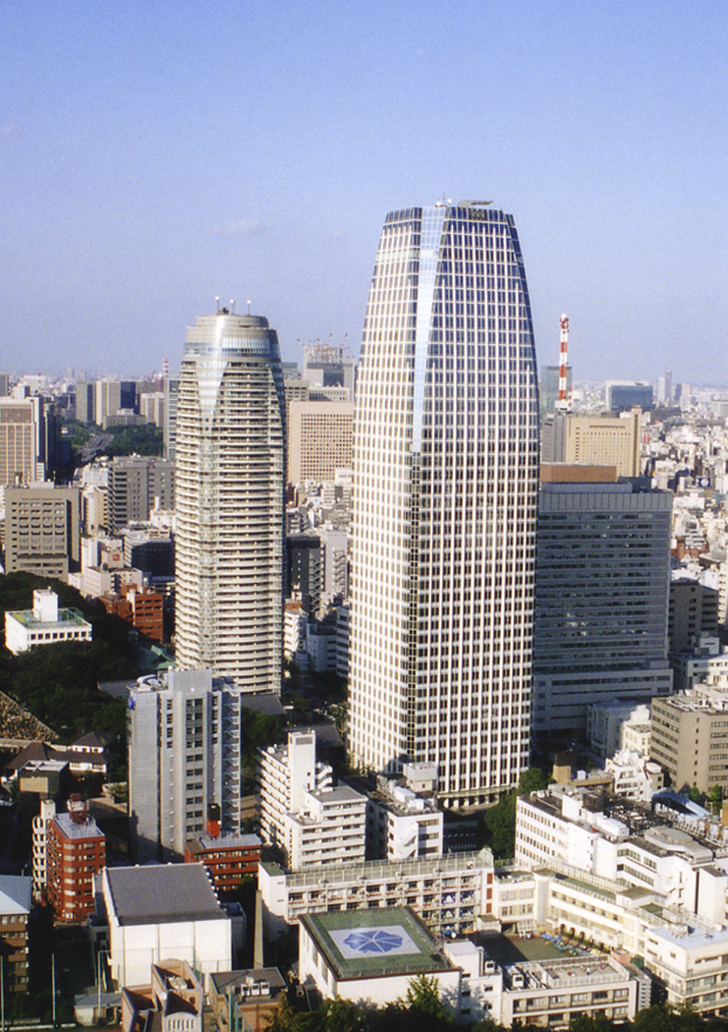
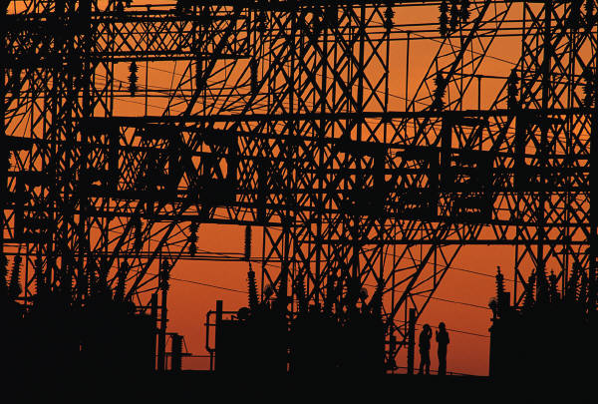
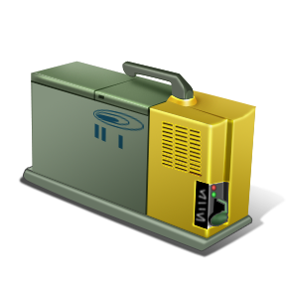
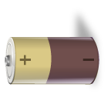
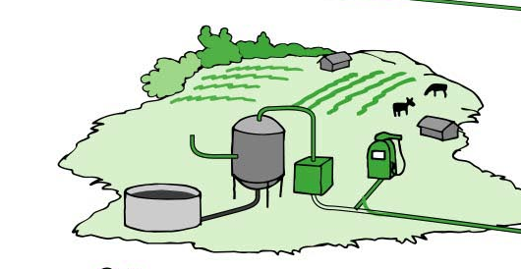

The Utility World Tomorrow
Energy Flow
Solar Power
Smart Meter
Smart Home
Smart Grid and OpEx
Smart Office
Fuel Cell
Energy Storage
Biofuels
Clean Transportation
CO2
Gas Storage
Enhanced Oil Recovery

Slide 10
Where does our electricity come from?
Utility-Provided |  | Ten Years Ago | Today | Tomorrow
PPAs (central station) |  | X | X | X
Feed-in-tariffs and Renewable Auction Mechanism (distributed generation) |  |  | X | X
Utility-Owned
Central Station:
Conventional |  | X | X | X
Renewable |  | X | X | X
Community/Distributed Generation
Solar Energy Project and Sustainable Communities |  |  | X | X
Share the Sun and Sun Rate |  |  |  | X
Customer-Provided |  | Ten Years Ago | Today | Tomorrow
Self-Generation:
Rooftop Solar PV |  | X | X | X
Wind |  |  | X | X
Fuel Cells |  |  | X
Combined Heat and Power |  |  | X | X
Community Choice |  |  | X | X
Direct Access |  |  | X | X

Slide 12
Future Resource Planning and Procurement
We work to minimize the total cost of the resource Portfolio
First look for cost-effective energy efficiency and demand response programs
Using least cost best fit competitive processes to add generation sources
Actively managing the contract portfolio and look to hedge fuel price risk
Seeking opportunities where SDG&E involvement can reduce ratepayer costs
Resource planning is becoming increasingly complex
Intermittency of renewable resources
Lack of visibility of customer-site generation
Balance local and central resources to ensure resource flexibility, adequacy and cost-competitiveness

Slide 13
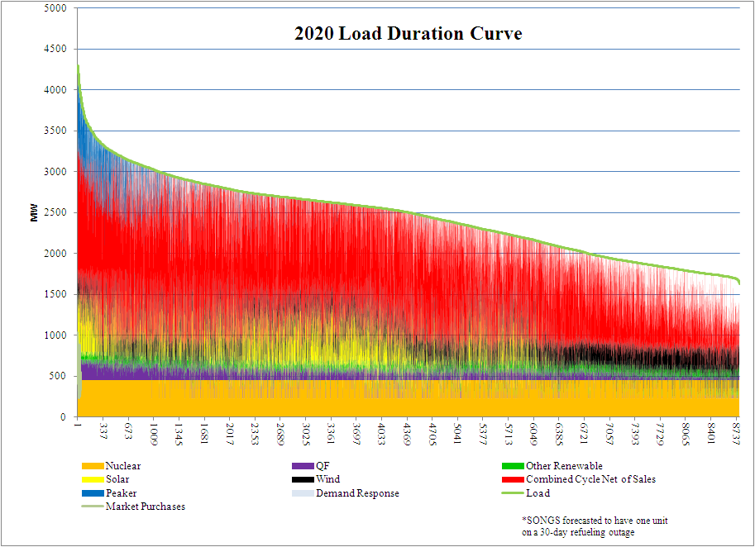
2020 Load Duration Curve (Illustrative Dispatch)
Supply must always meet demand (challenge)
Base load, intermediate, and peak demand
Different sources of energy meet different demands And needs of the portfolio

Slide 14
Challenges in Meeting RPS Goals
Project or contract failure is caused by any of a number of independent factors (e.g., site control, permitting, financing) and will likely continue at some level
The length of time required for permitting and other basic development steps adds to the risk that an individual project may fail
The CAISO and stakeholders are actively engaged in the design of market initiatives that support grid reliability as we achieve 33% renewables
The outcome of these initiatives will establish the amount of incremental flexible capacity resources needed and how they will be used
It is critical that these resources are built in time, both to integrate renewable resources and to replace retiring once-through-cooling generation

Slide 15
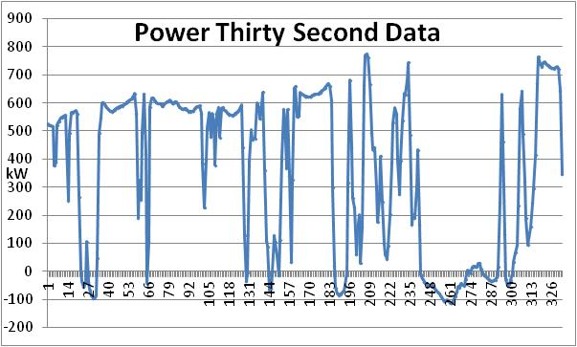
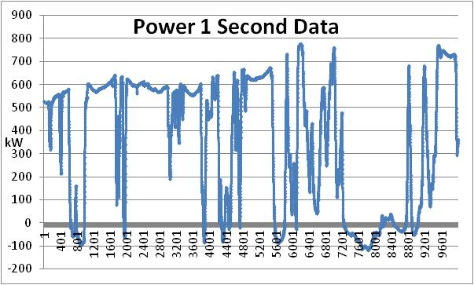
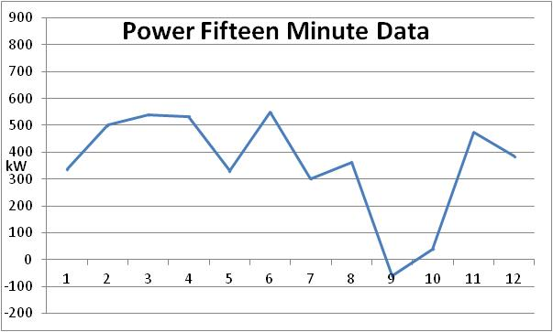
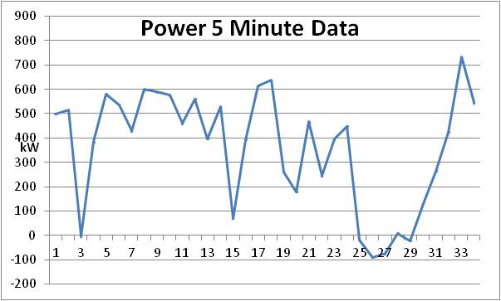
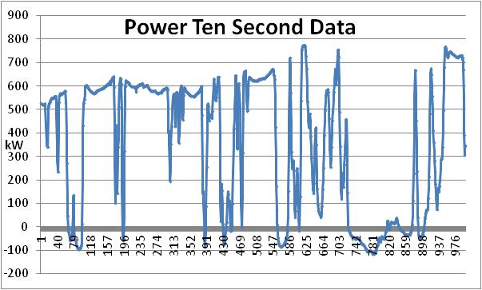
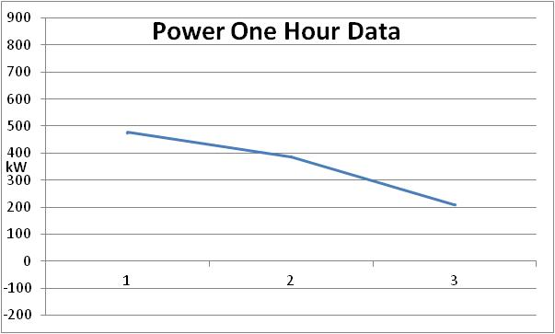
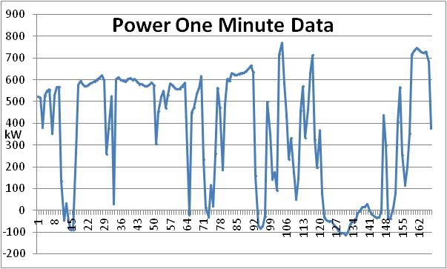
Solar PV Intermittency

Slide 16
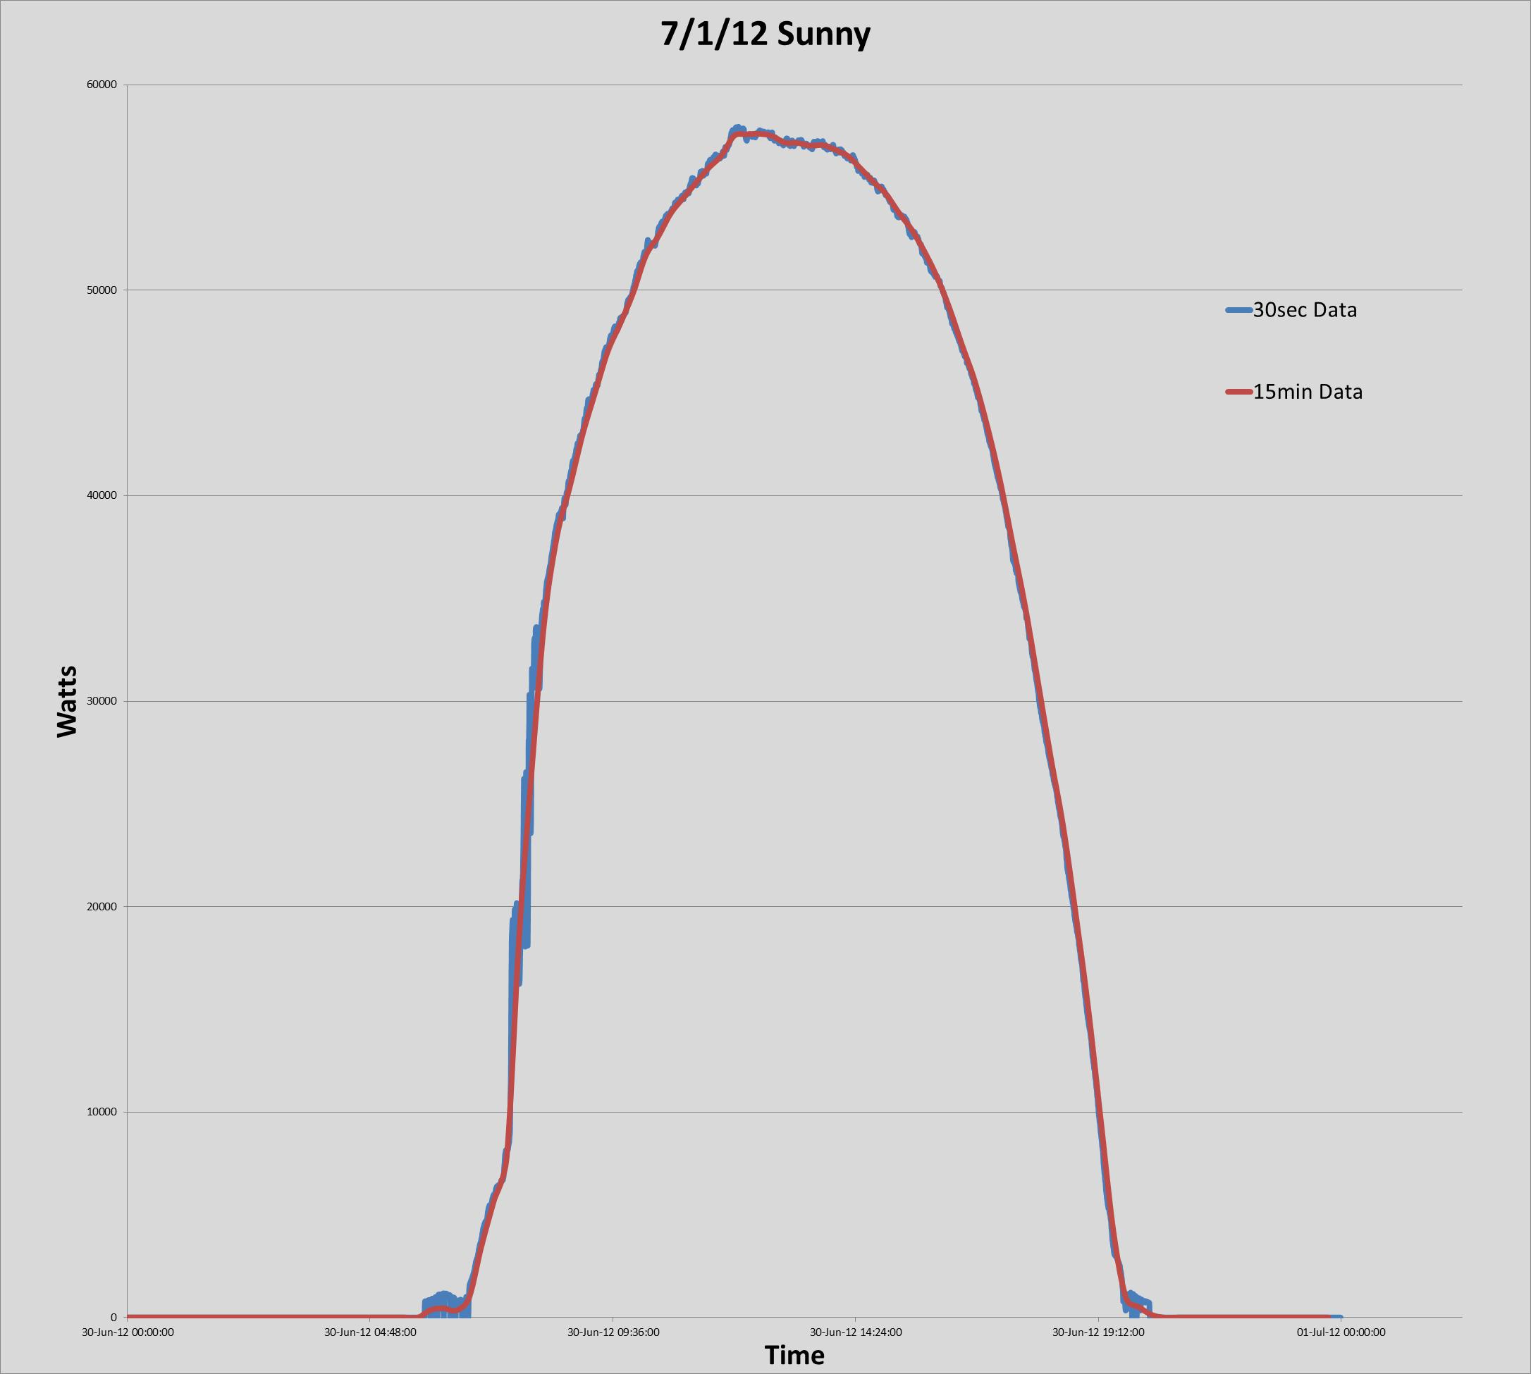
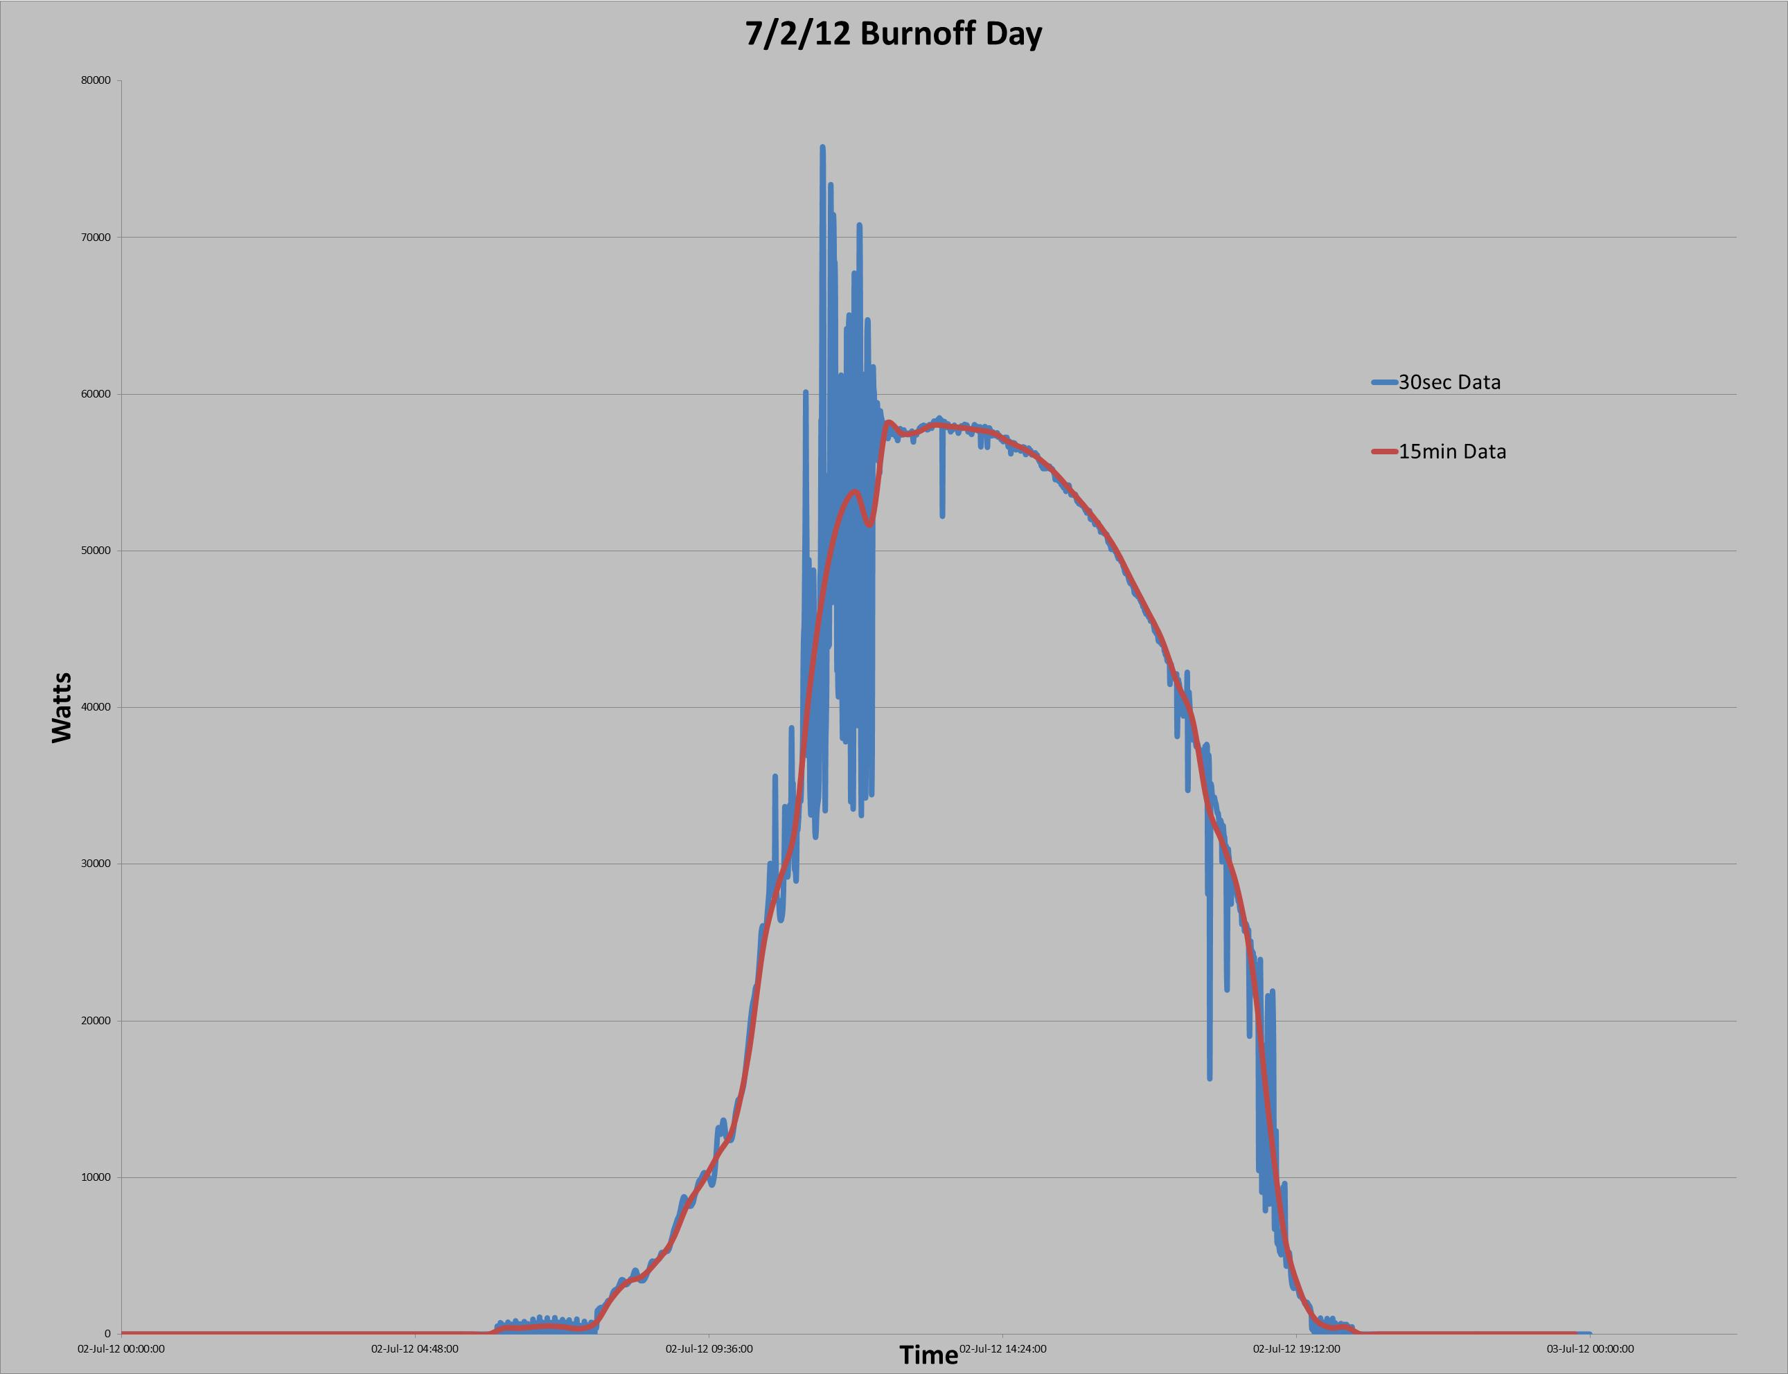
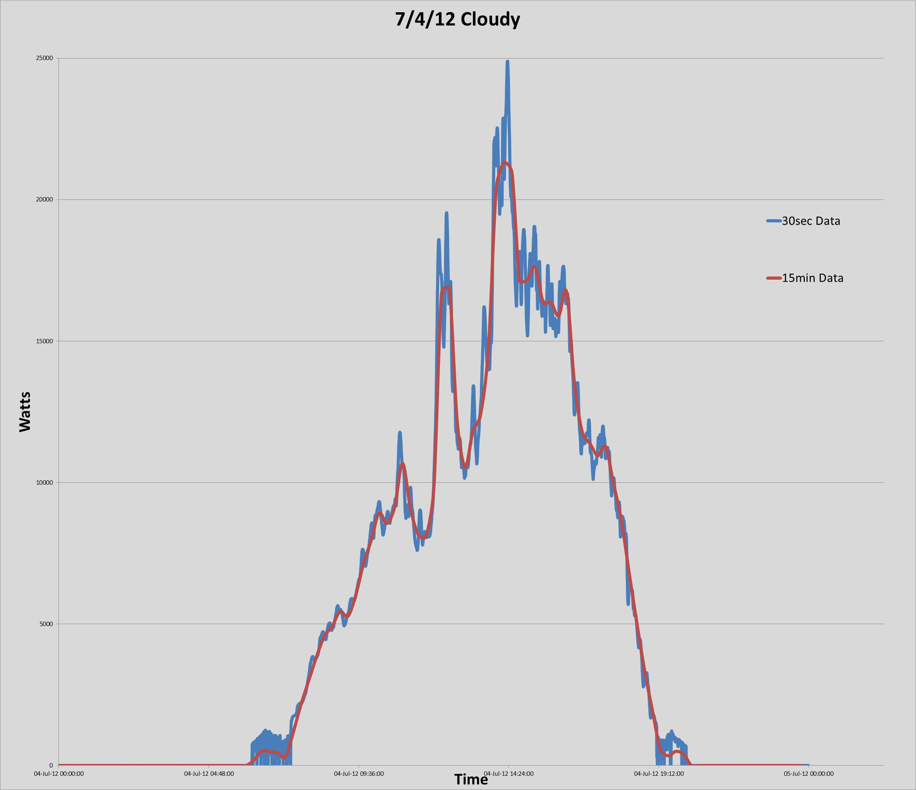
Inverter Operation Today
Notes:
Impact of a 250 kW PV system on the secondary voltage
As output increases voltage rises

Slide 17
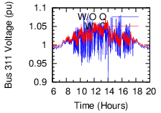

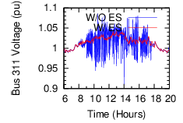

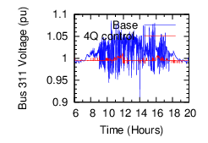

PV Intermittency Mitigation Based
Upon Modeling with Smart Inverters
With and without dynamic VAr device
Q
-P
P
With and without energy storage
-Q
With and without storage and 4 quadrant control
Red = With Blue = Without
Notes:
Operating at different power factor affects voltage magnitude
For an illustrative example operating at a 0.7 power factor can have 2 times the generator rating as one generator operating at unity power factor while maintaining the same voltage
$1M for 2 MVA dynamic VAr device
$3M for 500 kW, 1500 kW battery

Slide 18
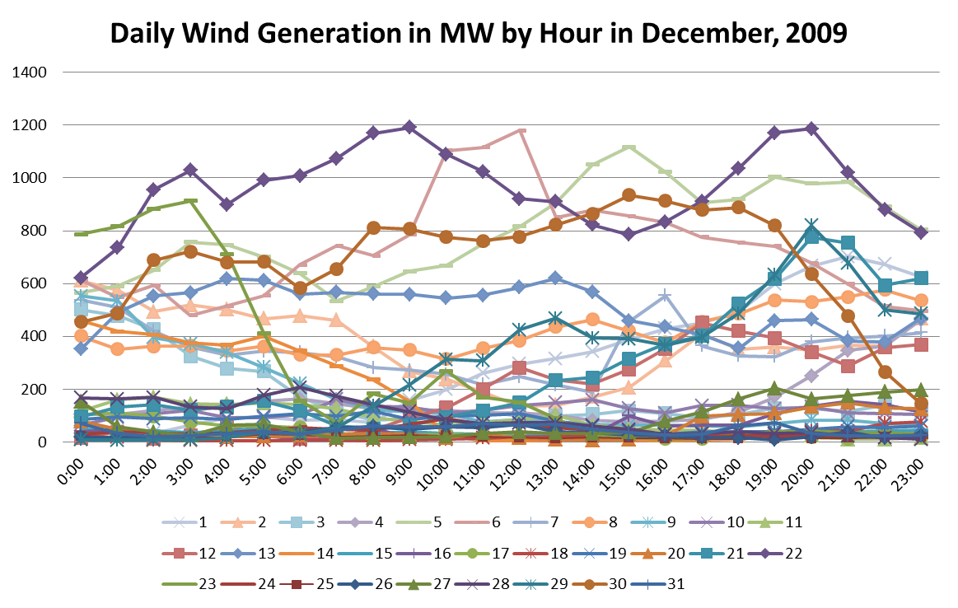
Variability in Wind Generation
Data source: “ISO Balancing Authority Area Hourly Wind Generation Data for 2009”, CAISO

Slide 19
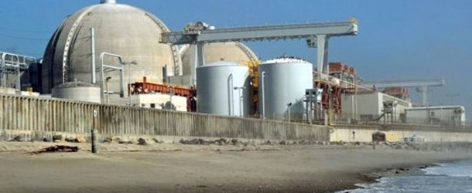
San Onofre Nuclear Generation Station (SONGS)
SDG&E is a 20% owner, SCE is the operator of the plant and the majority owner
SONGS's two reactors (Units 2 and 3) have been offline since January 2012
Nuclear generation serves a cost-effective method to meet base-load demand
With the possibility that San Onofre may remain offline this summer, Southern California could be challenged for electric resources this summer.

Slide 20
Pio Pico and Quail Brush Gas-Fired Peaker Plants
Because solar and wind power are intermittent and not always available, there is a need to backup these energy gaps with reliable, quick starting power sources
The uncertainty surrounding the operation of the San Onofre Nuclear Generating facility suggests that an earlier start date of these facilities would provide added power supply insurance for the region
The peaker plants were viewed by the CPUC as insurance against future demand issues and there was a timing mismatch, contracts would go into effect 2014 but perceived capacity need would not materialize until 2018
While these two contracts were denied, the Commission approved the third peaking facility contract with Escondido Energy Center and also authorized SDG&E to meet a local capacity requirement need of up to 298 MW of new local capacity beginning in 2018
Notes:
Pio Pico 305 MW
Quail Brush 100 MW

Slide 21
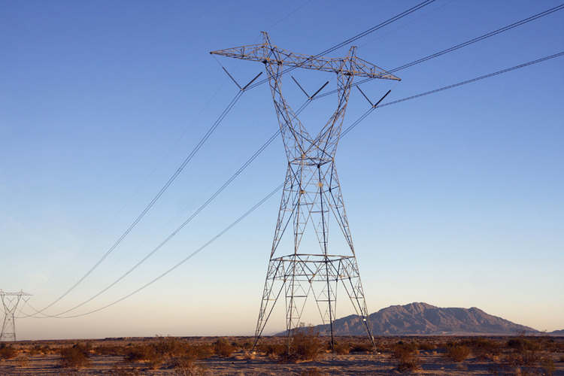
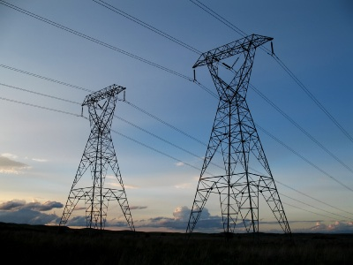
Sunrise Powerlink
117 mile long transmission line was put into service this past June
Used to supply renewable energy form the Imperial Valley
Addresses Renewables Portfolio Requirements
Improves the power supply situation in San Diego by increasing the amount of imports into the region
Received numerous awards
National Environmental Excellence Award from the National Association of Environmental Professionals
Outstanding Engineering Project Award for 2013 from the San Diego Engineering Community

Slide 22
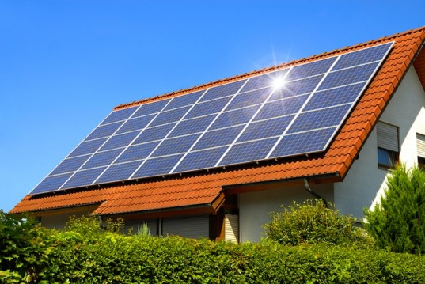
Rooftop Solar PV
Residential home installations increased by 34% from 2011 to 2012
Installations heavily driven by incentives and tax benefits

Slide 23
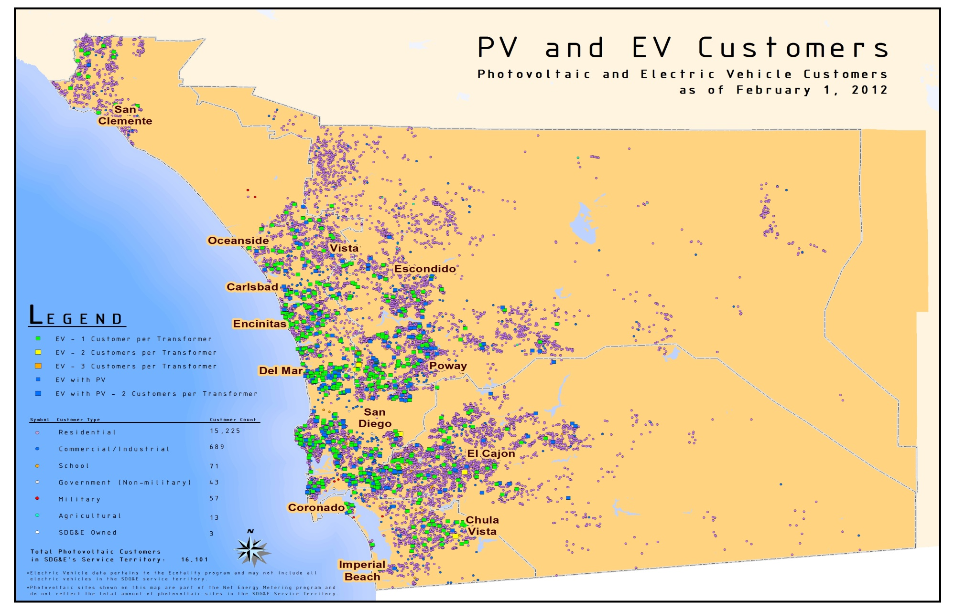
Integration of DER Solar & Electric Vehicle Customers

Slide 24
Net Energy Metering (NEM) Installations Monthly Growth 2010-2013

Slide 26
Peak Demand Compared to Solar Production

Slide 27
System Planning
Notes:
Impact of PV and wind on a reduced system load month
Little reduction of the peak load
Significant reduction between 9 am and 4 pm
Ramping generation requirements increase significantly
Loss of system inertia by 2020 impacts transient performance capabilities of the grid

Slide 28
System Planning
Notes:
Impact of PV and wind on a typical peak system load month
Peak load shifted to 7 pm when there is little sun and wind resources
Significant reduction between 9 am and 5 pm
Little overall reduction in system peak
Loss of system inertia by 2020 impacts transient performance capabilities of the grid

Slide 29
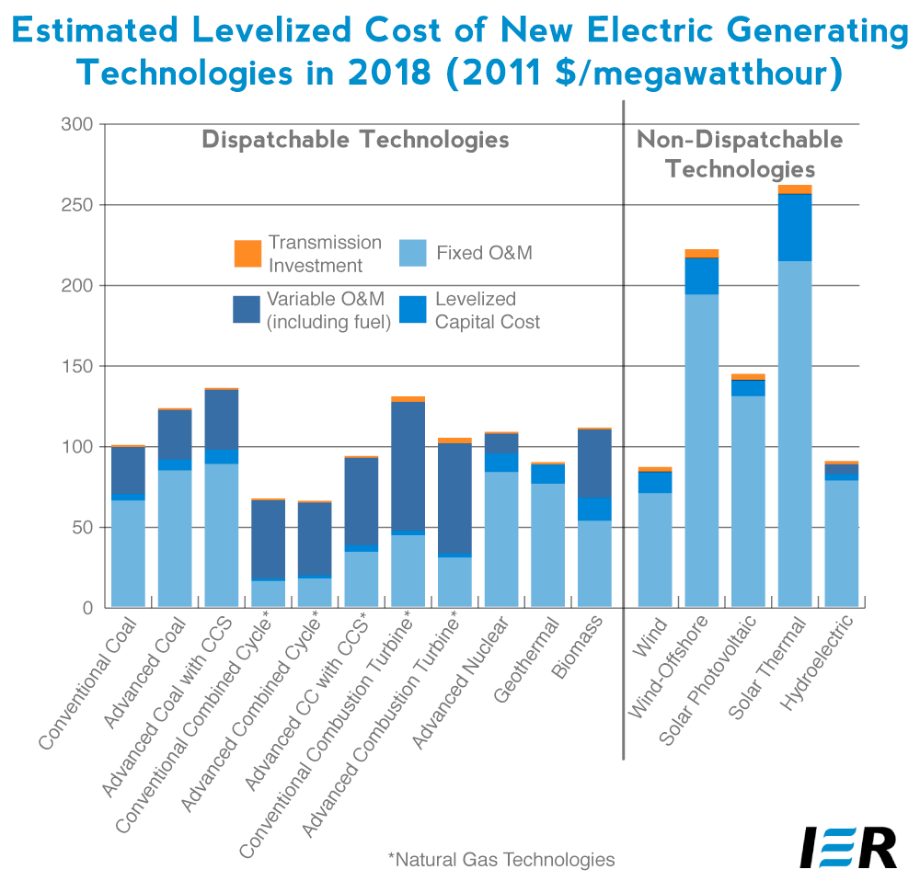
Central station generation vs. distributed generation costs
National Renewable Energy Laboratory (NREL) levelized cost of energy (LCOE) calculator
Assuming
a 20 year period
7% discount rate
6550 $/kW (2012 average cost according to CSI)
20% capacity factor
LCOE of Rooftop Solar PV
Unsubsidized | 36.9 cents/kWh
Subsidized | 26.3 cents/kWh
EIA Annual Outlook 2013

Slide 30
Summary
Commodity
Uncertainty of demand and production
Integration of renewables
Price: least-cost, best-fit
Reliability
Integrating distributed generation at distribution level
Power Quality
Lack of visibility of customer site generation
Accurate and transparent price signals
Customer energy demand
Customer privacy
Customer Segmentation
Electric vehicles
Demand Response and energy management
Notes:
The importance of planning for demand needs going forward
Flexibility to adjust for changing needs due to changing energy climate (Renewables and Rooftop PV)

