Slide 1
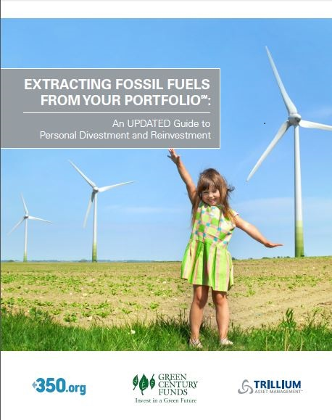

Why You Should Consider Extracting Fossil Fuels from Your Portfolio

Slide 2
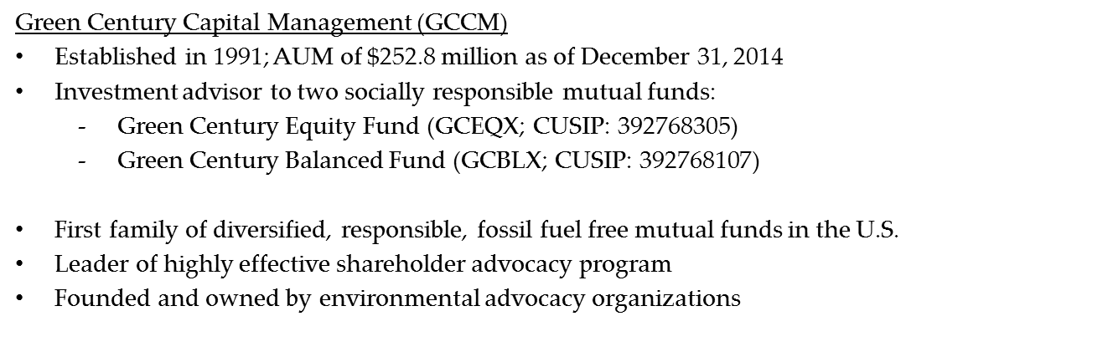

Green Century Overview

Slide 3
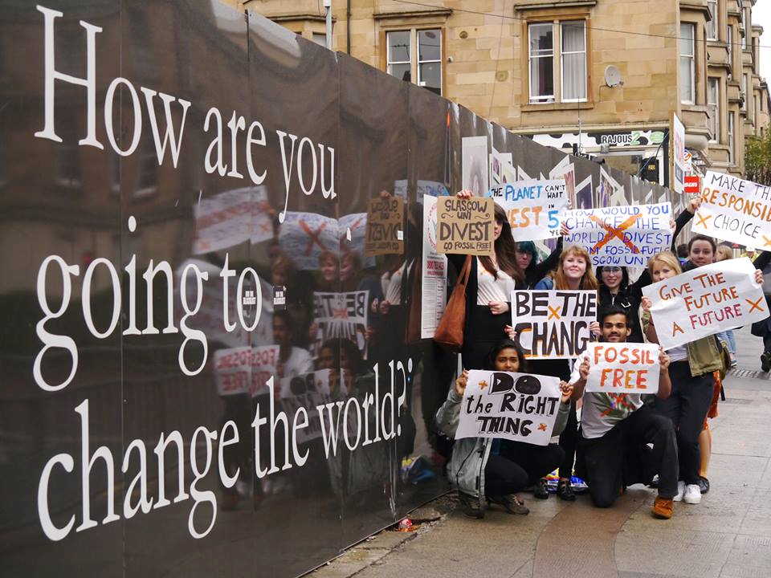
Moral and Political Reasons to Divest from Fossil Fuel Companies
Stop aligning yourself and your institutions with the industry that has driven climate change
Start aligning yourself with the companies that share your values and promote energy efficiency and sustainable agriculture
Build a climate change movement that supports sensible policies to curb climate change
Divestment has become a key avenue for young and old people across the country to try to curb climate change
Photo: 350.org

Slide 4
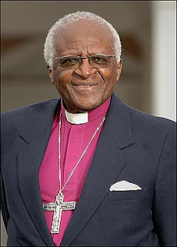
Moral and Political Reasons to Divest
What Divestment Does not Need to Do to be Effective:
Reduce total investments in the fossil fuel corporations
Bankrupt a company
Succeed alone as a strategy or tactic
What Divestment Does:
Reduces power of industry trade associations, front groups, lobbyists and paid experts to influence legislation, regulation and public discourse
How?
By taking away social license of fossil fuel companies
By growing a powerful climate change movement
“We must stop climate change.
And we can, if we use the tactics that worked in South Africa against the worst carbon emitters.”
- Archbishop Desmond Tutu

Slide 5
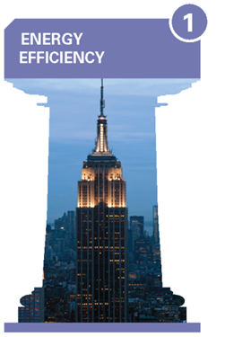


Financial Reasons to Consider Divestment
May reduce risk of holding devalued and stranded assets
May help you avoid companies with high capital expenditures and lower dividend payments
May help you benefit from companies taking advantage of demand for greener industries and a low-carbon future

Slide 6
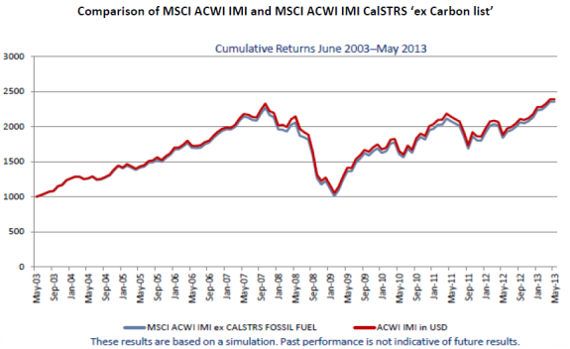
Fossil Fuel Free Investments
*
* See important disclosure information regarding MSCI ACWI IMI and MSCI ACWI IMI CalsTRS ‘ex Carbon list’ indexes. Source: MSCI ESG Research Issue Brief FAQ: Responding to the Call for Fossil-fuel Free Portfolios ,December 2013

Slide 7
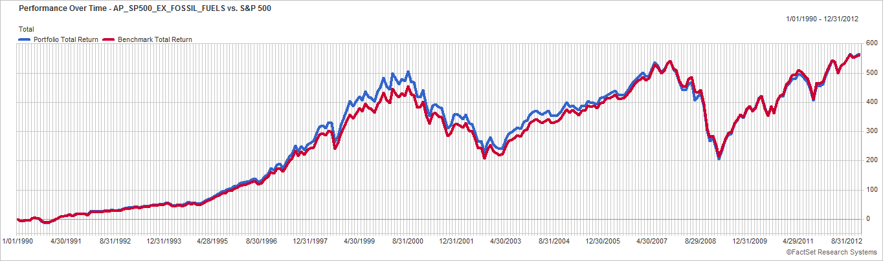
Chart 1: Simulated Historical Cumulative Performance: Divestment Has Little Impact Overall
*
* See important disclosure information regarding AP_SP500_EX_FOSSIL_FUELS and the S&P 500 ® indexes
As of December 31, 2012. Source: Advisor Partners research, FactSet data
Past performance is no guarantee of future results and current performance may be higher or lower than the performance shown.
Notes:
7

Slide 8
Green Century Equity Fund Performance
Average Annual Total Returns as of 12/31/14:
*
Total expense ratio: 1.25%. See the Disclosure section for more information on the S&P 500® Index Benchmark.
The performance data quoted represents past performance, and past performance is not a guarantee of future results. Investment return and principal value of an investment will fluctuate so that an investor's shares, when redeemed, may be worth more or less than their original cost. Current performance may be lower or higher than the performance information quoted. To obtain performance information current to the most recent month end, please call 1-800-93-GREEN. Performance is calculated after fees and includes the reinvestment of income dividends and capital gain distributions, if any. The performance shown does not reflect the deduction of taxes that a shareholder might pay on any Fund distributions or the redemption of Fund shares. A redemption fee of 2.00% may be imposed on redemptions or exchanges of shares you have owned for 60 days or less.
* See important disclosure information regarding the S&P500 ® Index

Slide 9
Green Century Balanced Fund: Performance
Average Annual Total Returns as of 12/31/14:
*
Total expense ratio: 1.48%. Please see Disclosure section for important Index information.
The performance data quoted represents past performance, and past performance is not a guarantee of future results. Investment return and principal value of an investment will fluctuate so that an investor's shares, when redeemed, may be worth more or less than their original cost. Current performance may be lower or higher than the performance information quoted. To obtain performance information current to the most recent month end, please call 1-800-93-GREEN. Performance is calculated after fees and includes the reinvestment of income dividends and capital gain distributions, if any. The performance shown does not reflect the deduction of taxes that a shareholder might pay on any Fund distributions or the redemption of Fund shares. A redemption fee of 2.00% may be imposed on redemptions or exchanges of shares you have owned for 60 days or less.
*See important disclosure information regarding the Custom Balanced Index

Slide 10

Fossil Fuel Free Investing – Opportunities for Individual Investors
Green Century Funds: First family of diversified and responsible fossil fuel free mutual funds
Green Century Equity Fund (GCEQX)
A diversified portfolio of stocks based on longest running sustainable investment index.
Green Century Balanced Fund (GCBLX)
A diversified portfolio of stocks and bonds
Neither Fund invests in:
- Coal, oil, and gas companies engaged in exploration, extraction, refining or processing
- Agricultural companies that use GMOs (genetically modified organisms), large-scale pesticide applications or factory farm practices
- Military weapons/civilian firearms companies
- Nuclear power companies or companies that derive significant revenues from tobacco
Both Funds seek companies with strong environmental policies and sustainability practices and which are effectively managing environmental risks and opportunities

Slide 11

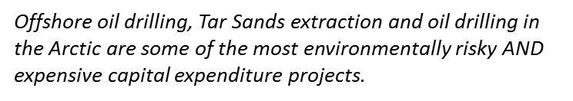
The Shortcomings of Shareholder Engagement with Fossil Fuel Companies
Shareholder advocacy cannot change a company’s core business
Not within scope of the strategy
Shareholder advocacy has no track record of success on this issue
No significant direct reductions in the production of fossil fuels achieved
Access does not equal influence or translate to progress
Disclosure is not reduction

Slide 12
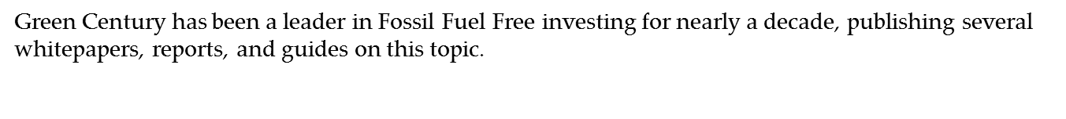
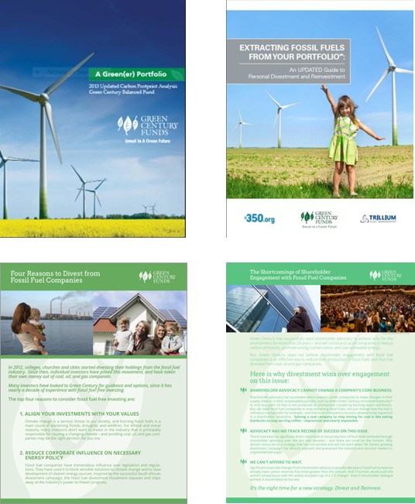
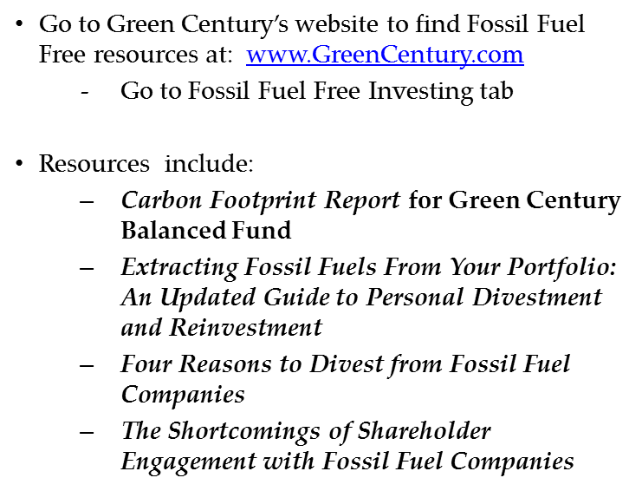
The Shortcomings of Shareholder Engagement with Fossil Fuel Companies

Slide 13
Disclosure: Important Information
Stocks will fluctuate in response to factors that may affect a single company, industry, sector, or the market as a whole and may perform worse than the market. Bonds are subject to risks including interest rate, credit, and inflation. The Funds’ environmental criteria limit the investments available to the Funds compared to mutual funds that do not use environmental criteria.
The Custom Balanced Index is comprised of a 60% weighting in the S&P Supercomposite 1500 Index and a 40% weighting in the BofA Merrill Lynch 1-10 Year US Corporate & Government Index (the BofA Merrill Lynch Index). The S&P Supercomposite 1500 Index is an unmanaged index of 1500 selected stocks. The BofA Merrill Lynch Index tracks the performance of U.S. dollar-denominated investment grade government and corporate public debt issued in the U.S. domestic bond market with at least 1 year and less than 10 years remaining maturity, including U.S. treasury, U.S. agency, foreign government, supranational and corporate securities. It is not possible to invest directly in the Custom Balanced Index, the S&P Supercomposite 1500 Index, or the BofA Merrill Lynch Index.
The S&P 500® Index is an unmanaged index of 500 selected common stocks, most of which are listed on the New York Stock Exchange. The S&P 500® Index is heavily weighted toward stocks with large market capitalization and represents approximately two-thirds of the total market value of all domestic stocks. It is not possible to invest directly in the S&P 500® Index.

Slide 14
Disclosure: Important Information
The MSCI ACWI IMI Index is a free float-adjusted market capitalization weighted index that is designed to measure the equity market performance of developed and emerging markets. The MSCI ACWI IMI universe covers 24 developed markets and 20 emerging markets, including 8,514 listed companies as of Nov. 29, 2013. It is not possible to invest directly in the MSCI ACWI Index.
The MSCI ACWI IMI Index CALSTRS ex Carbon List is comprised of the MSCI ACWI IMI Index minus certain companies. The California State Teachers Retirement System (CALSTRS) provided a list of carbon-reserve owning companies that mirrored the Carbon Tracker list of the top 100 coal companies and the top 100 oil and gas companies, assessed on the potential carbon emissions from their reserves. www.carbontracker.org/report/carbon-bubble/ pages 13-14. It is not possible to invest directly in the MSCI ACWI IMI Index CALSTRS ex Carbon List.
The AP_SP500_EX_FOSSIL_FUELS Index is a portfolio designed by Advisor Partners that is comprised of the S&P 500 ® and then excludes the U.S. oil, gas and coal companies that own carbon in the ground, as well as many chemical companies, utilities and miners. In the most recent month of the chart, December 2012, the rules excluded a total of 72 stocks. It is not possible to invest directly in the AP_SP500_EX_FOSSIL_FUELS Index.

Slide 15

Disclosure: Important Information
The holdings of the Green Century Funds may change due to ongoing management of the Funds. References to specific investments should not be construed as a recommendation of a security by the Funds, their advisor, administrator, or distributor.
This information has been prepared from sources believed to be reliable. The views expressed are as of the date of this writing and are those of the Advisor to the Funds.
You should carefully consider the Funds' investment objectives, risks, charges and expenses before investing. To obtain a Prospectus that contains this and other information about the Funds, please visit www.greencentury.com, email info@greencentury.com, or call 1-800-93-GREEN. Please read the Prospectus carefully before investing.
The Green Century Funds are distributed by UMB Distribution Services, 2/15

