Slide 1
Energy: Challenges with Becoming More Sustainable
Robb Anderson
Director – Resource Planning
San Diego Gas and Electric Co.
© 2011San Diego Gas & Electric Company. All copyright and trademark rights reserved.

Slide 2
New Energy Sources Jan. ‘12 – April ’15”
Energy Efficiency: 129 MW
Roof Top Solar: 247 MW
  Residential: 201 MW
  Non-Residential: 46 MW
Renewable Power: 1,803 MW
  Solar 1,091 MW
  Wind 709 MW
  Bio Gas 3 MW
Fossil: 810 MW
  Wellhead Escondido Repower (10 MW Increase)
  Pio Pico Energy Center (300 MW approved)
  Carlsbad Energy Center (500 MW approved)
These resource will facilitate shutdown of over 1,100 MW of 1960’s era fossil plants and cover for the loss of San Onofre Nuclear Generation Station
* Capacity values are nameplate

Slide 3
Daily Average Wind Power Generation – September 2013

Slide 4
Daily Wind Power Generation
September 2013

Slide 5
Significant amount of incremental RPS energy above 33% RPS levels are curtailed in 40% scenarios.
Scenarios (33%) | RPS Energy Curtailed (Gwh) | RPS Actual Achieved
Trajectory | 153 | 32.9%
Trajectory without Diablo Canyon | 26 | 33%
High load | 136 | 32.9%
Scenarios (40%)
40% RPS in 2024 | 2,825 (15% of incremental RPS above 33%) | 38.7%
Expanded preferred resources | 4,637 (89% of incremental RPS above 33%) | 37.5%
Source: http://www.caiso.com/Documents/Aug13_2014_InitialTestimony_ShuchengLiu_Phase1A_LTPP_R13-12-010.pdf

Slide 6
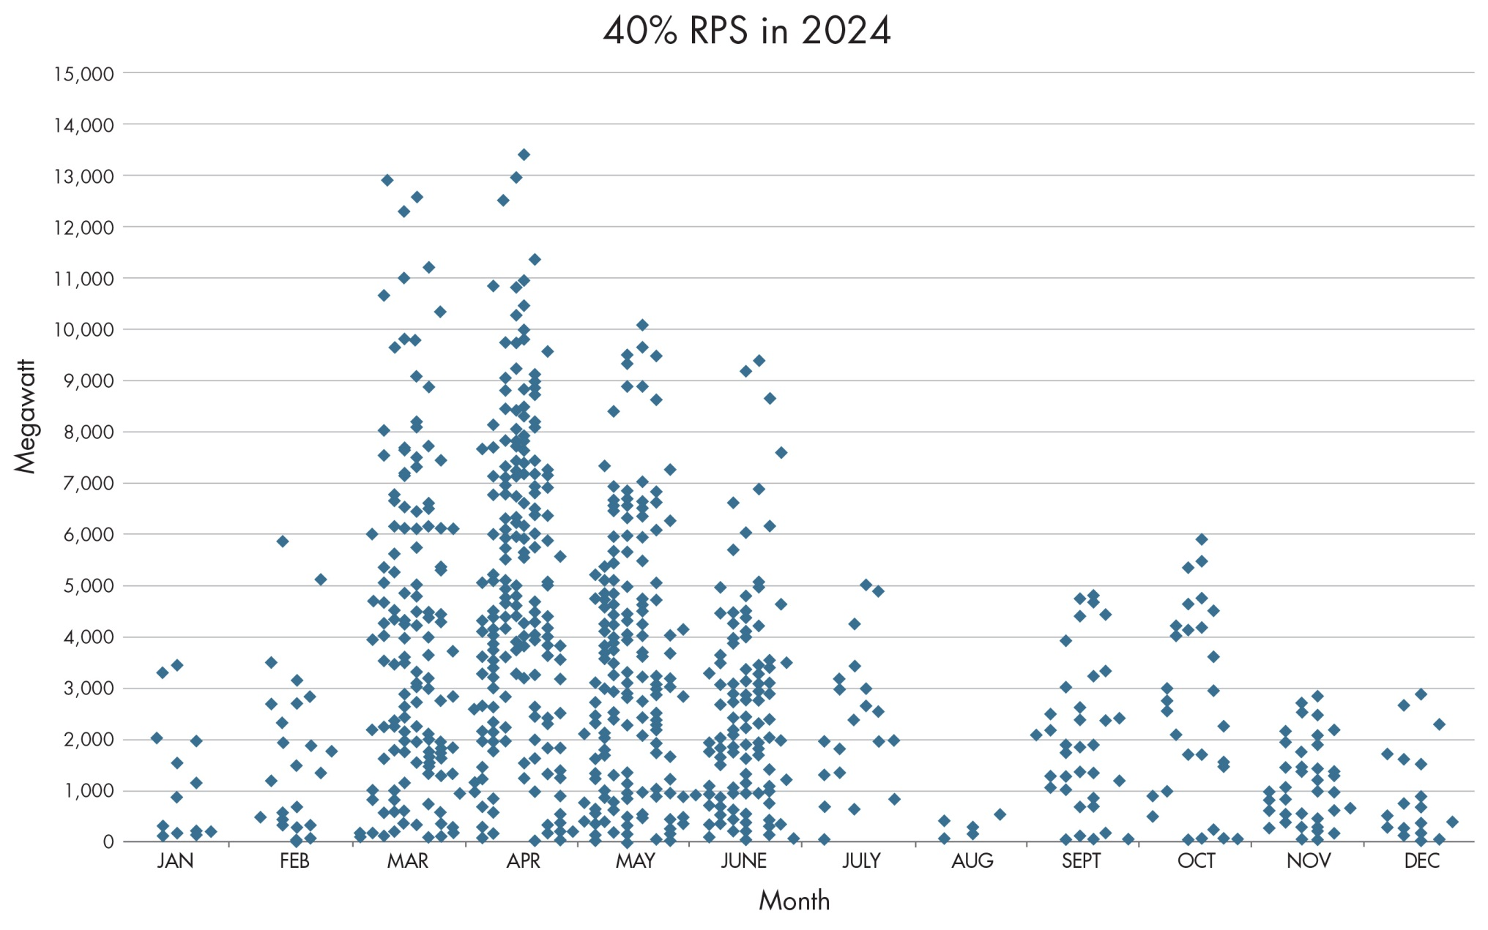
RPS Curtailment in 2024 – 40% RPS Scenario
Source: http://www.caiso.com/Documents/Aug13_2014_InitialTestimony_ShuchengLiu_Phase1A_LTPP_R13-12-010.pdf

Slide 7
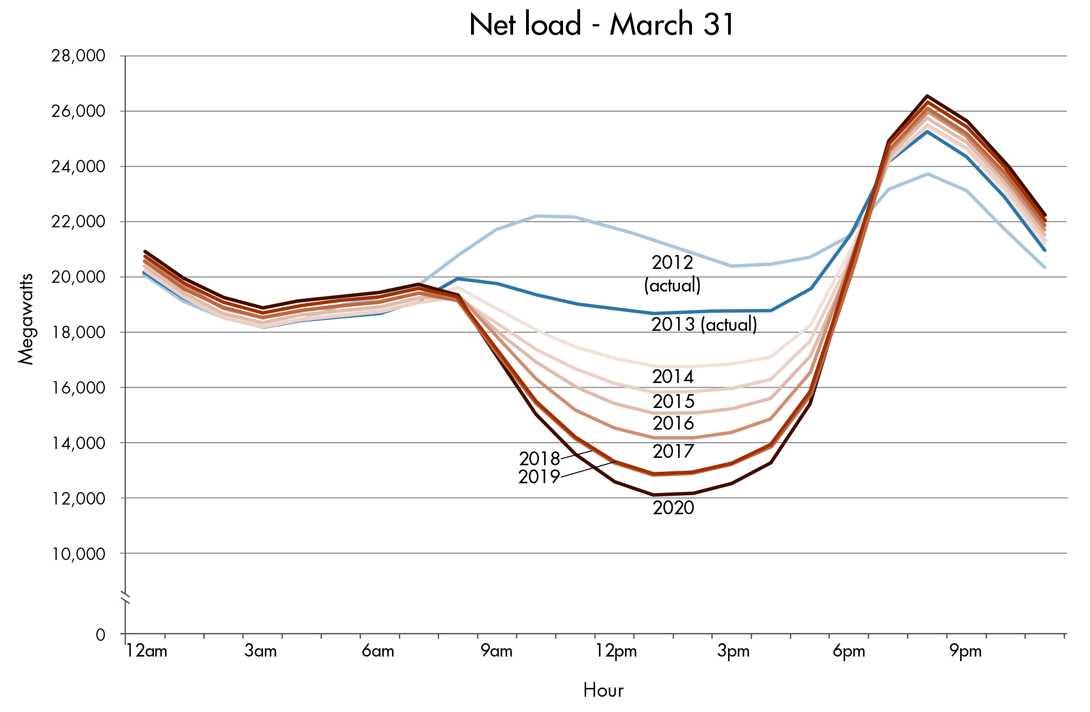
Need to maintain reliability in all hours of the day
ISO has already seen the need
to curtail generation in 2014.
Operational requirements include:
Minimum flexible resources necessary to provide ramping
Necessary ancillary services
Load following
Ramp need
~13,000 MW
in three hours
Potential over generation

Slide 8
SDG&E system latest record peak:
Sept. 16-17, 2014

Slide 9
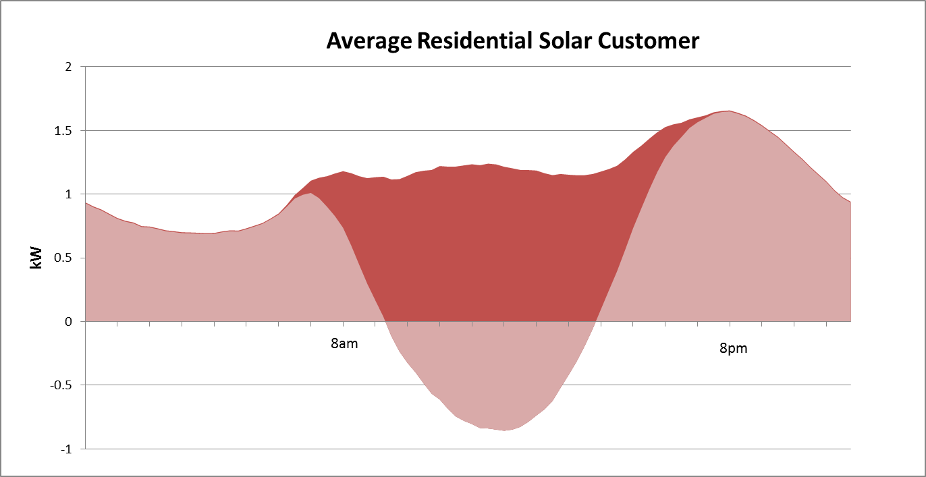
Solar Doesn’t Address Residential Distribution Peaks

Slide 10
Energy storage procurement targets
The California Public Utilities Commission approved a decision which establishes a target of 1,325 MW of energy storage capacity for procurement by the Investor Owned Utilities by 2020, with installations under the program required no later than 2024.
SDG&E’s Procurement Target Details:
 | 2014 | 2016 | 2018 | 2020 | Total
Transmission | 10 | 15 | 22 | 33 | 80
Distribution | 7 | 10 | 15 | 23 | 55
Customer | 3 | 5 | 8 | 14 | 30
Total | 20 | 30 | 45 | 70 | 165

Slide 11
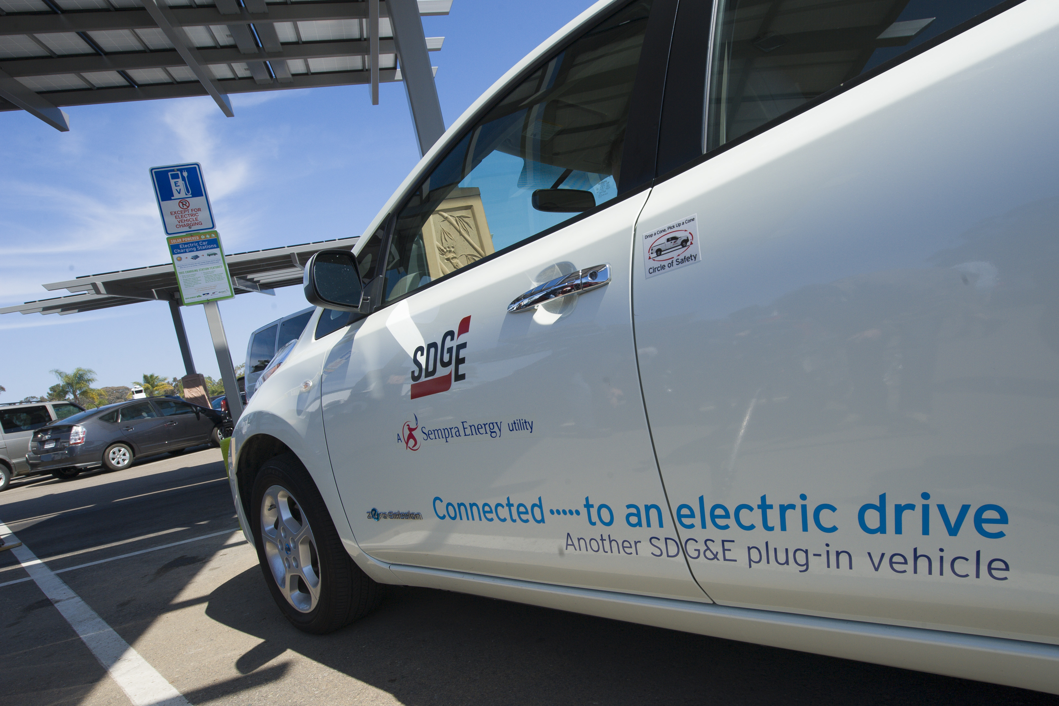
SDG&E grid-integrated charging
More than 16,100 electric vehicle (EV) in our service area
There are 890 commercial level 2 charging stations at 324 locations in SDG&E service area and 44 publically available DC fast charge stations at 31 locations
Today, there are more than 20 models on the market – and plenty of federal, state and dealership incentives available for would –be buyers
We encourage customers to charge their EVs at night – when electricity is plentiful and costs the least

Slide 12
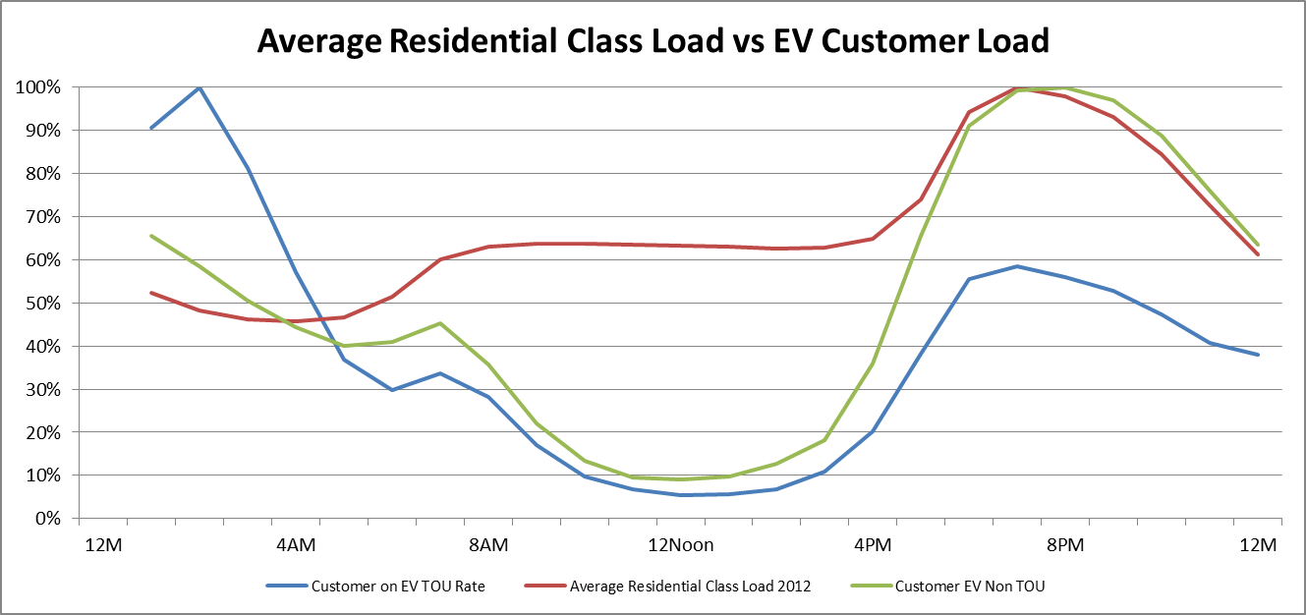
Average Residential Load and Solar Electric Vehicle Customer Loads
Customers will respond to rates

Slide 13
Key future opportunities for utilities and customers
Use technology and improved business processes to reduce energy costs
Advocate for a more streamlined regulatory process to provide greater flexibility and transparency
Use programs and technology to optimize use of the grid
Increase customer engagement through innovative programs and services, including an online energy marketplace

