Slide 1

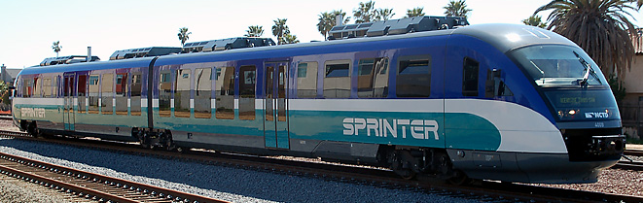
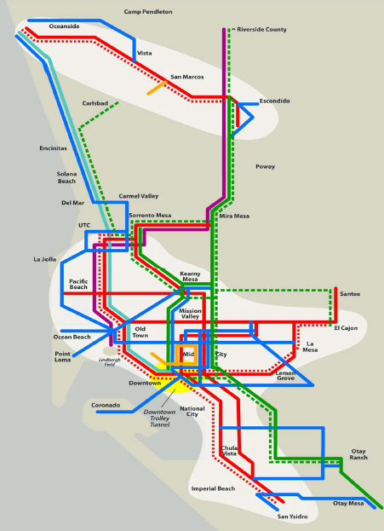
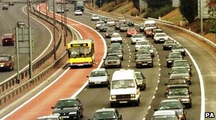
San Diego County: Towards a Reliable and Sustainable Public Transportation System
Franco Boscolo
Research Associate, Global Energy Network Institute (GENI)
Under the supervision of
Peter Meisen
President, Global Energy Network Institute (GENI)

Slide 2
Summary
Fleet information
Population trends
Suggestion for a more reliable system
Suggestion for a more sustainable system

Slide 3
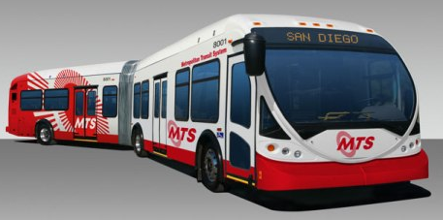
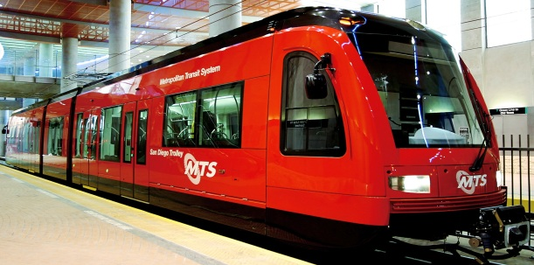
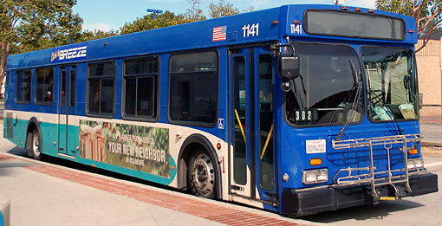
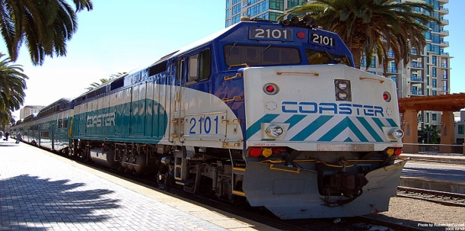
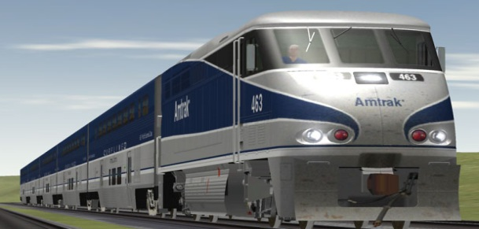
Fleet information
MTS
    Bus
    Trolley
NCTD
    BREEZE
    COASTER
    SPRINTER
Amtrak
    Pacific Surfliner
Notes:
MTS: Metropolitan Transit System
NCTD: North County Transport District

Slide 4
Population trends
Modes of commuting to work (2010)

Slide 5
Population trends
Daily Vehicle Miles Travelled (VMT) per capita
Notes:
San Diego:
13.5 miles in 2009
14.5 miles in 2010
California:
12.7 miles in 2009
13 miles in 2010

Slide 6
Population trends
Daily Vehicle Miles Travelled (VMT)
Notes:
2005: 62 millions
2007: 61 millions
Actual: more than 60 millions

Slide 7
Population trends
Transit ridership by city
Notes:
NYC: 508
SD: 75

Slide 8
Population trends
Population, jobs and housing growth
Notes:
2008: Population 3,131,552: Jobs 1,501,080; Housing 1,140,654
Current (2011): Population 3,140,069
2050: Population 4,384,867; Jobs 2,003,038; Housing 1,529,090

Slide 9
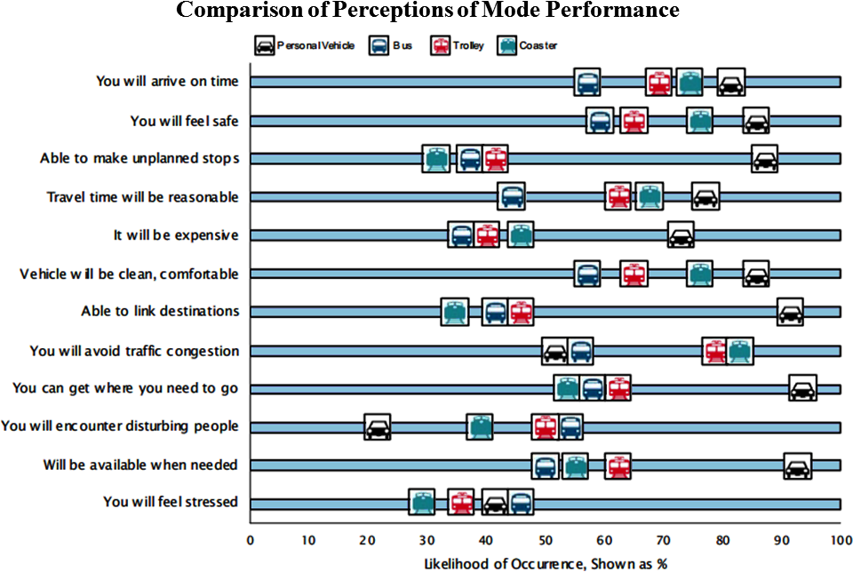
Proposal: reliable system
Comparison of perception of mode performance

Slide 10
Proposal: reliable system
Motivations for not using transits

Slide 11
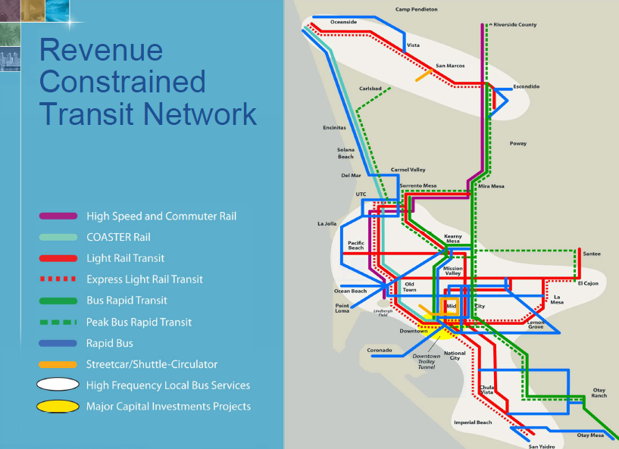
Proposal: reliable system
2050 regional development plan
Area improvement
Transit development
Fast connections

Slide 12
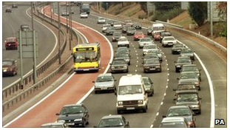
Proposal: reliable system
Bus lanes and automatic light systems
Toll lanes on highways
Bus lanes on
city centres
Active signal priority system

Slide 13
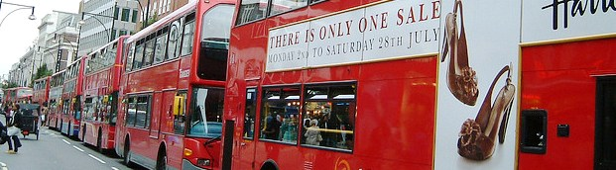
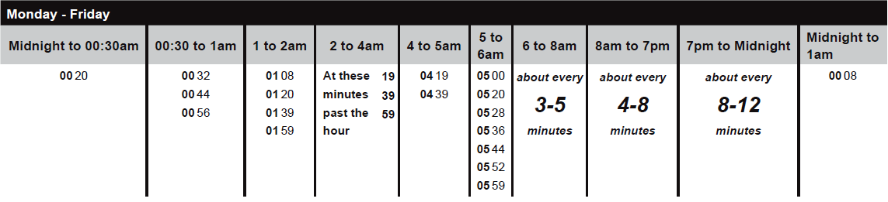
Proposal: reliable system
More transit options
Higher transit frequency

Slide 14
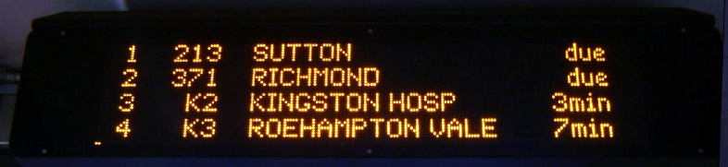
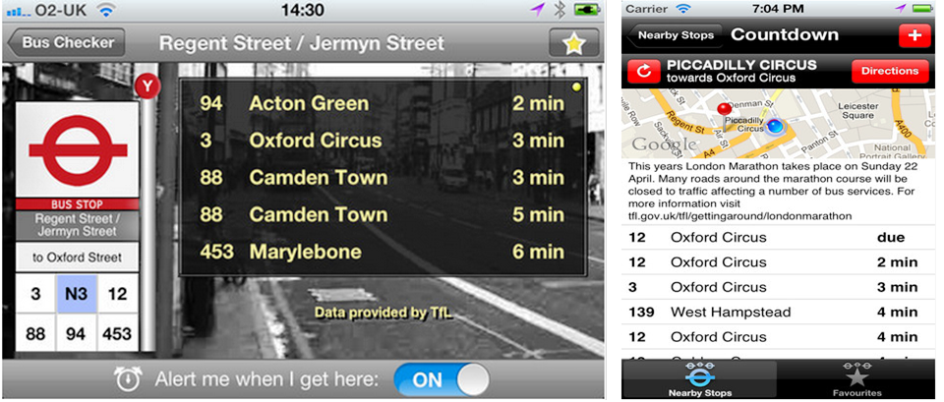
Proposal: reliable system
GPS-tracked transits:
Online and mobile Apps:

Slide 15
Proposal: sustainable system
Diesel vs. Compressed Natural Gas (CNG)
Reduction: 25.45% 28.45% 98.12%

Slide 16
Proposal: sustainable system
Diesel vs. Compressed Natural Gas (CNG)
When both engine types are retrofitted with cleaning technologies, reductions decrease
Source | Emissions (gCO₂eq/km)
 | Diesel | CNG | Reduction
Beer et al. 2001 | 1,759 | 1,604 | 8.81%
Sliva et al. 2006 | 2,277 | 2,070 | 9.09%
Costs do not justify CNG choice:
Cost Details | CNG ($) |  | Clean Diesel ($)
 | Per Bus | Per Fleet | Per Bus | Per Fleet
Incremental CNG Fuel | 2,860 | 0.6 x 10⁶ | - | -
CNG Fuel Station Maintenance | - | 0.9 x 10⁶ | - | -
Incremental Bus Maintenance | 5,200 | 1.0 x 10⁶ | - | -
Incremental Cleaning Technology | - | - | 1,040 | 208,000
Diesel Fuel Station Maintenance | - | - | - | 92,000
Clean Technology Replacement | - | - | 137 | 27,400
Annual Technology Cleaning | - | - | 670 | 134,000
TOTAL |  | 2,500,000 |  | 461,400
Notes:
Examples:
Catalitic reduction
Particulate filters

Slide 17
Proposal: sustainable system
Electrification of the railway system
Rail and light-rail services powered by Diesel engines:
Service | Company | Travel (mi) | Weekly Trips | Yearly Travel (mi)
Coaster | NCTD | 41 | 46 | 98,072
Sprinter | NCTD | 22 | 132 | 151,008
Pacific Surfliner | Amtrak | 63 | 154 | 504,504
Total |  |  |  | 753,584
Electrification has the benefits of:
  - Reducing environmental impacts
  - Improving the reliability of the service
  - Increasing the capacity of trains
  - Reducing maintenance, fuel and wear and tear costs

Slide 18
Proposal: sustainable system
CO₂ reduction by electrification: 20% - 35% (no local)
Reliability improvement by electrification: 29% - 57%
Reduced operating costs (35%) and leasing costs (20%)

Slide 19
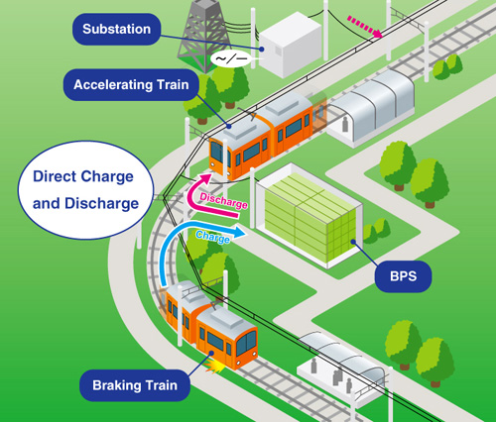
Proposal: sustainable system
Regenerative braking system

Slide 20
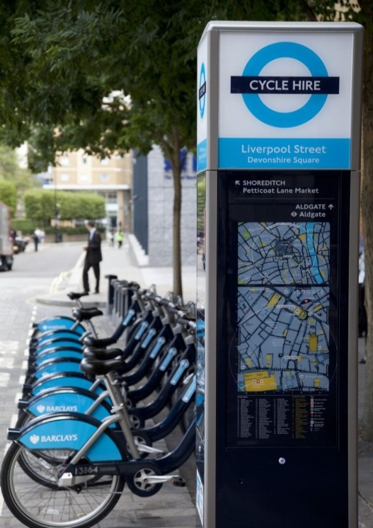
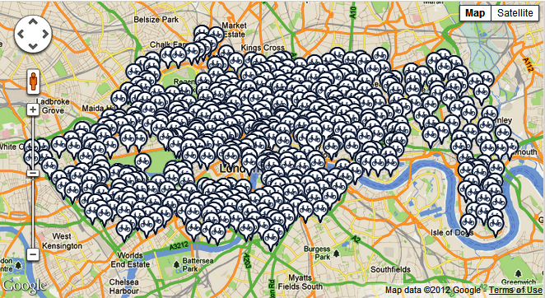
Proposal: sustainable system
Cycling and walking
Type | Miles | %
Bike Path | 159.3 | 11.9
Bike Lane | 890.2 | 66.4
Bike Route | 243.9 | 18.2
Freeway Shoulders | 47.4 | 3.5
Total | 1340.8 | 100
Current San Diego availability
Development of more bike and pedestrian paths
Development of a bike docking station system
Notes:
400 hiring docking points
6,000 bicycles
2000-2010 number of cyclists doubled
Development plan: 400% increase by 2026

