Slide 1

Sustainable San Diego Making Smart Growth Smarter

Slide 2
Who We Are
A Collaboration of organizations and individuals that believe
SB375 provides an opportunity for all of us to work together to plan thriving communities, a healthy environment and a robust economy.
Notes:
We are a collaboration of organizations and individuals that are individually working on the various components of what has come to be known as sustainable communities.

Slide 3
Members
Andy Hamilton, San Diego County APCD
Barry Schultz Esq., Stutz Artiano Shinoff and Holtz,
Betsy Morris, EM Advisors, Retired CEO, SDHC
Cheryl Moder, San Diego County Childhood Obesity Initiative
Corrine Wilson, Center on Policy Initiatives
Dave Gatzke, Community HousingWorks
Doris Payne-Camp, San Diego Housing Federation
Carleen Stoskopf, San Diego State University School of Public Health
Elyse Lowe, MOVE San Diego
Emily Young, San Diego Foundation
Erin Steva, CALPIRG
Frank X. Riley, Regional Director HUD
Greg Konar, Konar Design
Georgette Gomez, Environmental Health Coalition
Hannah Cohen, Project Manager
Harry Watkins, Pt. Loma Nazarene University
Jennifer Vanica, Jacobs Family Foundation
John Nash, San Diego Housing Commission
Kathleen Ferrier, Health Equity by Design
Kathy Keenan, San Diego Bicycle Coalition
Kerry Sheldon, Local Initiatives Support Corporation
Ken Grimes, WALK San Diego
Lindsey Lupo, Point Loma Nazarene University
Mariano Diaz, LISC
Mary Lydon, Executive Director, Urban Land Institute SD
Melissa Stephens, American Lung Association California
Michael Fitts, Endangered Habitats League
Michael Nagy, San Diego Regional Chamber of Commerce
Mike Stepner, New School of Architecture
Mirle Bussell, UCSD Urban Studies
Myles Pomeroy retired City of San Diego planner
Nancy Lytle, SEDC
Nico Calavita, Professor Emeritus, San Diego State University, Urban Planning
Nina Smart, Jacobs Center for Neighborhood Innovation
Norma Chavez-Peterson, Justice Overcoming Boundaries
Ryan Wiggins, Transportation for America
Sara Steinhoffer, Hospital Association of SD & Imperial Co
Shelia Sarkar, SDSU
Susan Riggs Tinsky, Citizens Coordinate Century III
Tom Scott, San Diego Housing Federation
Tracy Delaney, County of San Diego Public Health
Notes:
The list was in your packet. You can see that we have experts and advocates in the areas of multi-modal transportation , creating homes that are affordable for all income levels, land use planning, public health, philanthropy, social equity and business. We have been staffed with a small sub-grant from the Ford Foundation to the San Diego Housing Federation have Hannah Cohen organize the group. We have received additional support from the San Diego Foundation and the Jacobs Family Foundation.

Slide 4
Vision
Sustainable San Diego envisions a San Diego region characterized by thriving communities, a healthy environment, and a robust economy. Only when every San Diegan has equal opportunities, regardless of where they live or their income, race, or social status, will we be able to achieve an economically and environmentally balanced region.
Notes:
We believe the San Diego Region can be collection of vibrant neighborhoods that promote healthy lifestyles and are enjoyed by all regardless of income

Slide 5
Values
Sustainable San Diego is comprised of organizations invested in a range of issues: land use and housing, transportation, social equity, health, environmental justice and communications. Sustainable San Diego believes that each participating entity has significant contributions to make to regional planning. We will work interdependently to articulate strategies, create tools, and coordinate our efforts. We are eager to work with the numerous regional and statewide efforts underway in a collaborative and complementary fashion in order to create sustainable San Diego communities.
Notes:
Good land use and transportation planning in the context of assuring that the benefits accrue to all San Diegans will provide the greatest return on investment in terms of not only reducing green house gases, but creating a more vibrant region.

Slide 6
Mission
Sustainable San Diego is a collaboration of local, regional, and statewide groups dedicated to creating a vibrant and more equitable future for the San Diego region. We are committed to building a powerful movement that works toward sustainability in a diversity of areas including but not limited to health, social equity, community development, and environmental conservation work.
Notes:
To work with SANDAG and the general public to develop a ground-breaking RTP and Sustainable Communities Strategy that will serve as a model for the California and the Nation. We want to bring the expertise of our individual organizations in the areas of healthy communities; clean transportation alternatives; and community development to complement SANDAG’s strengths.

Slide 7
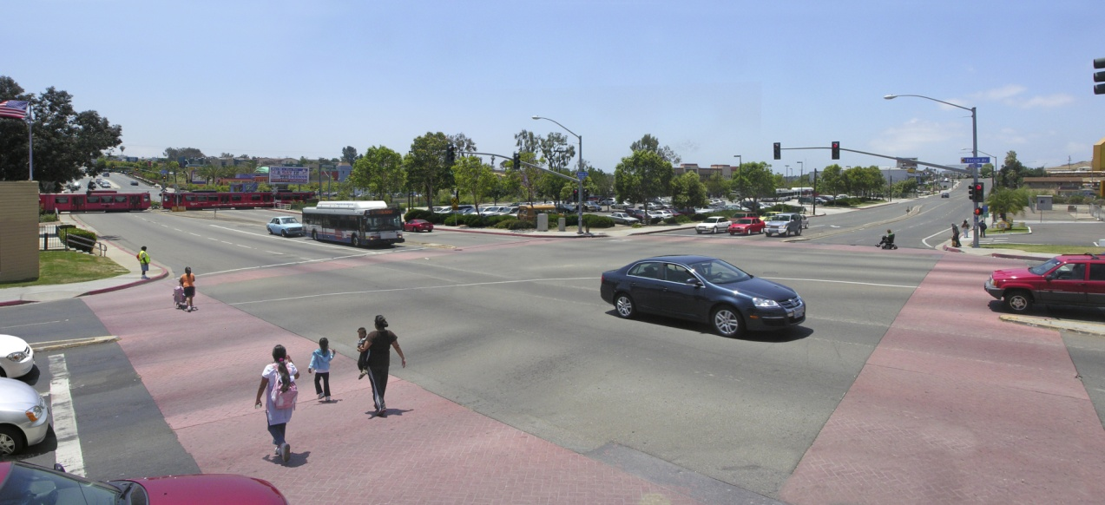
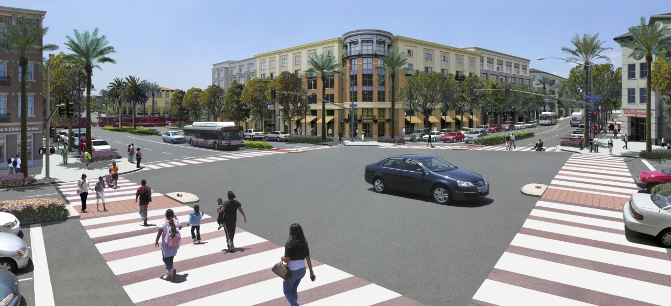
Euclid Ave Trolley Station at Market Street San Diego, CA
Existing
Conceptual
Notes:
SANDAG is well down the road. This slide from your Smart Growth Toolbox demonstrates the basis of our shared vision

Slide 8
Expanding the Vision
Plan for Neighborhoods that include:
Neighborhood Serving Retail that makes walking and biking for shopping feasible
Access to healthcare
Homes that are affordable for the jobs in the immediate area
Access to open space for recreation
Access to good schools
Notes:
We want to add some fine graining to that vision that we believe when modeled will greatly expand the GHG reduction possibilities for the 2035 target dates

Slide 9
Prioritizing Investments
Focus Investments on Improving Transit Connecting Neighborhoods to Jobs
Focus Investments on the older lower income communities
Focus investments on leveraging existing infrastructure by fixing and upgrading
Notes:
We think that re-prioritizing transportation and other investments will take you farther down the road. For example,

Slide 10
Results
Reduced use of the automobile
Reduced water consumption
Reduced energy use per household
Healthier lifestyles for the residents
Reduced housing costs
All resulting in more discretionary spending and a strong economy that benefits all
Notes:
Vision California estimate household savings of $6400 per year, just on automobile costs

Slide 11
Contact
On the Web: http://sustainablesandiego.org
Twitter: http://twitter.com/SustainSanDiego
Hannah Cohen
619-203-7324
hannah@housingsandiego.org

