Slide 1
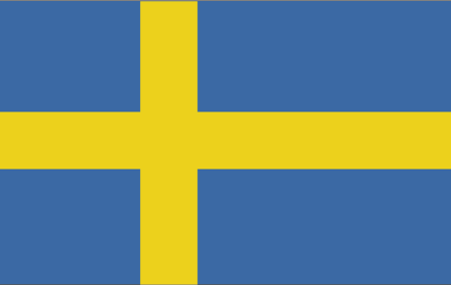
Sebastian Hanna
Internship: Global Network Energy Institute http://www.geni.org/
Can Sweden be powered by 100% Renewable Energy by 2020?

Slide 2
Summary:
Background
Motivation
History of energy mix and the current mix
What do I propose for a transition to 100% renewable energy
The Swedish Electricity Certificate System, pro’s and con’s
Solutions
2020 estimates and projections
What needs to be done to achieve the 100% scenario
Acknowledgements

Slide 3
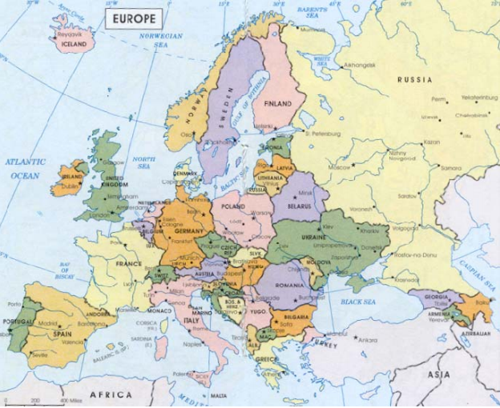
Background: Sweden
Area: Twice the size of Great Britain, about the same size as California.
Population: About 9 million.
Long coastline, rivers and lakes in the north. 20% of the population lives in the northern half of Sweden.

Slide 4
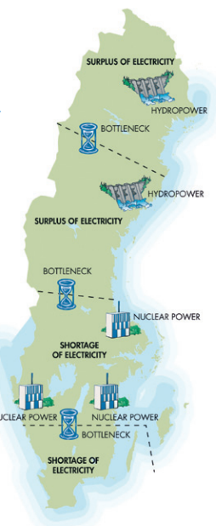
Motivation:
What if Sweden decided to commit to transitioning to 100% renewable energy for its electricity sector by 2020, would that be feasible?
The current energy mix: nuclear power and hydropower supply together the majority of Sweden’s electricity. The hydropower facilities are in the North and the nuclear power plants are in the South.

Slide 5
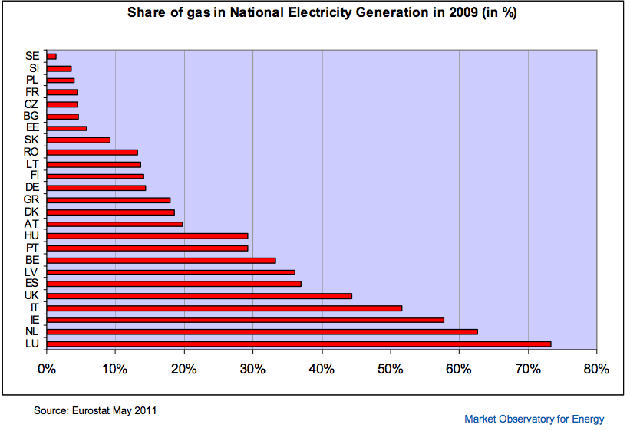
How did Sweden’s energy mix evolve to the current state? Share of Gas (1%)

Slide 6
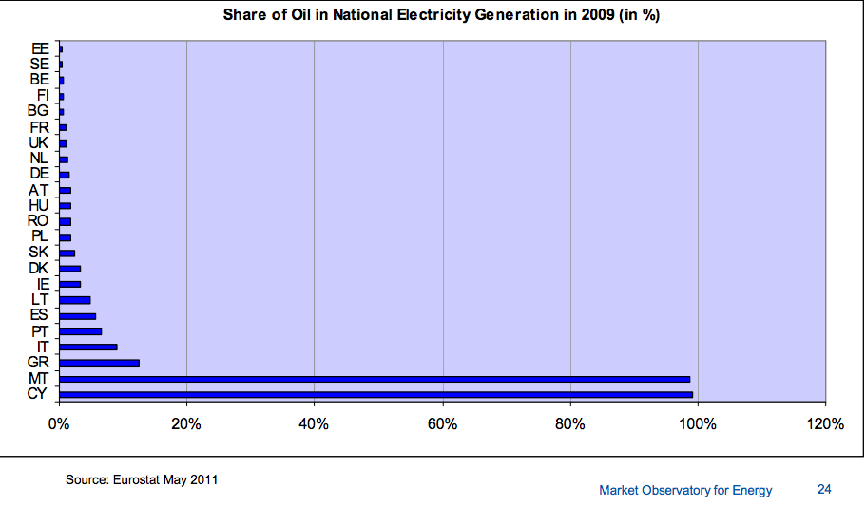
Share of Oil (1%)

Slide 7
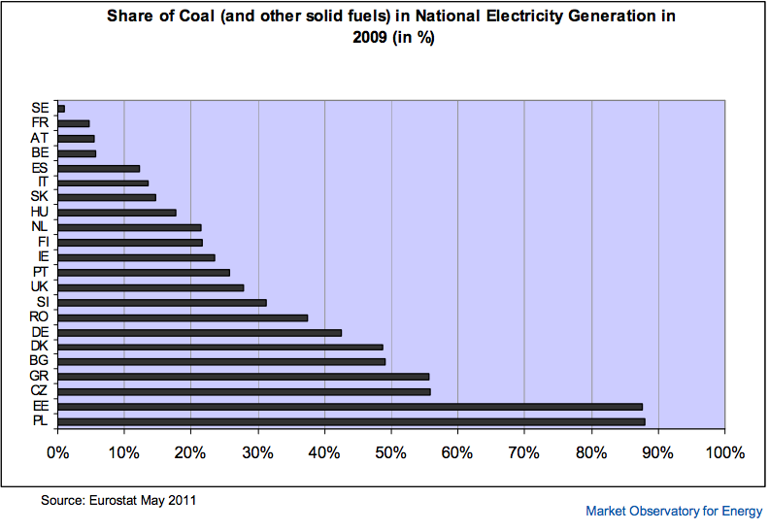
Share of coal (1%)
Sweden has a low-carbon economy

Slide 8
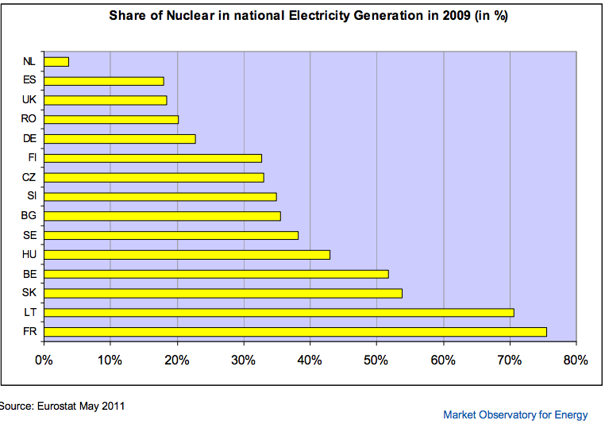
Share of Nuclear Power (38%). Nuclear power is considered cleaner than fossil fuels but it is not renewable!

Slide 9
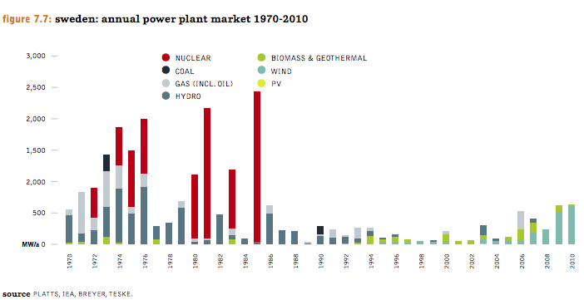
Annual power plant market

Slide 10
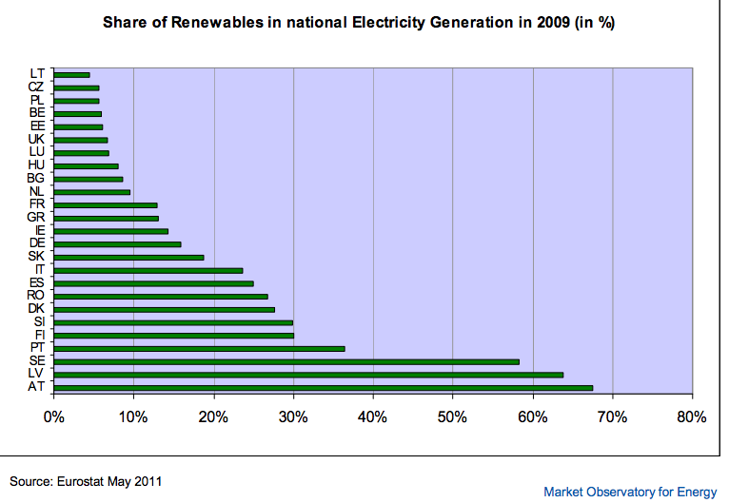
Renewable Energy (57%). For Sweden, this is mainly hydropower and biomass.

Slide 11
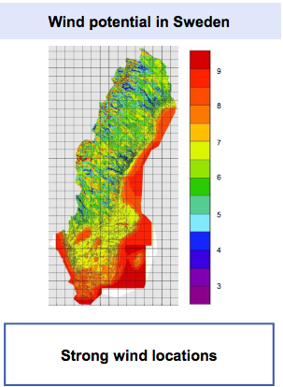
Proposed Path:
Wind power and Biomass
For a transition to 100% renewable energy, fossil fuels are not he main obstacle.
Biomass has been increasing quickly as a percentage of the national electricity generation.
Sweden has great wind power potential.
Wind power accounts for only a few percentage points of the national power mix, but the wind power industry has a promising future.

Slide 12
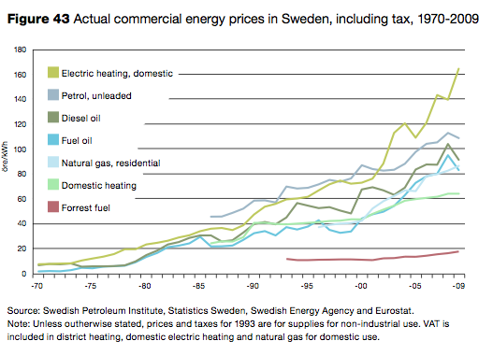
Timber! Forest fuel prices are stable. This is why bio-fuels have taken over the fuel market

Slide 13
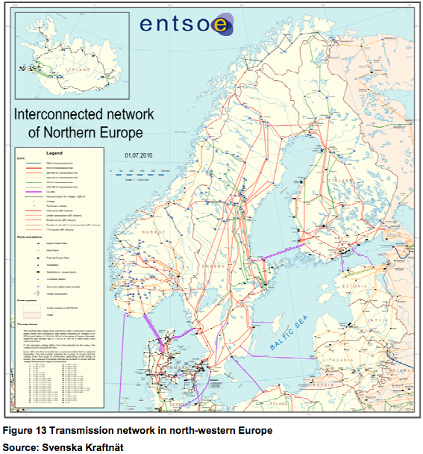
Interconnected grid between Nordic countries and Northwestern Europe

Slide 14
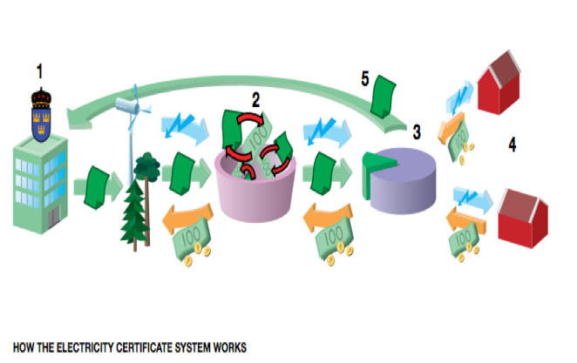
Electricity Certificates, “similar” to feed-in tariffs, but not quite!

Slide 15
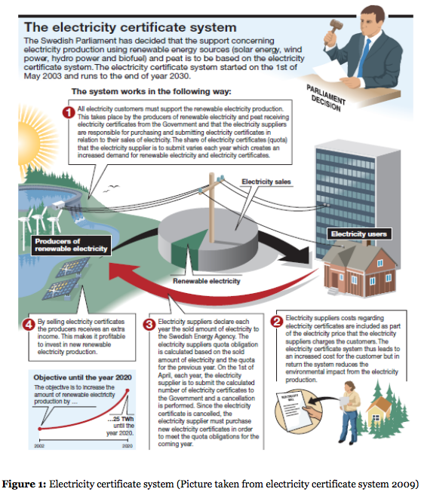

Slide 16
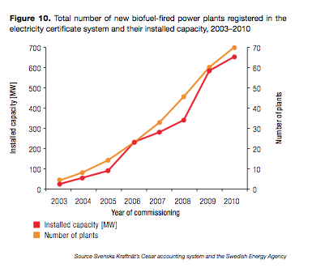
Biomass: 2003- 2010

Slide 17
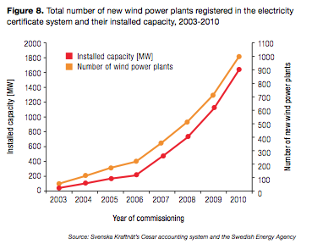
Wind Power: 2003- 2010

Slide 18
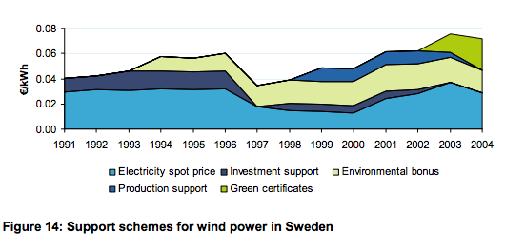

Slide 19
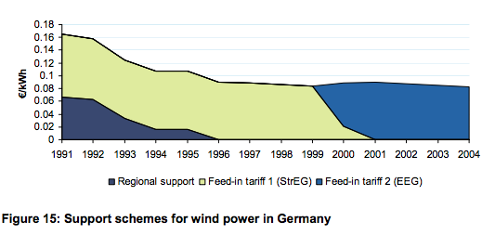

Slide 20
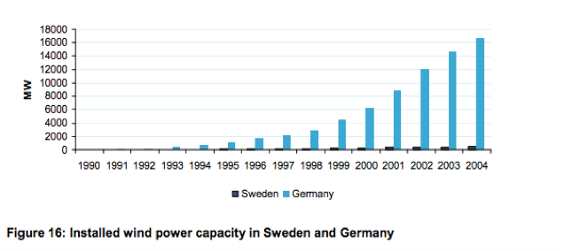
Wind power: Germany’s Feed-in-Tariff vs.
Sweden’s Green Certificate System

Slide 21
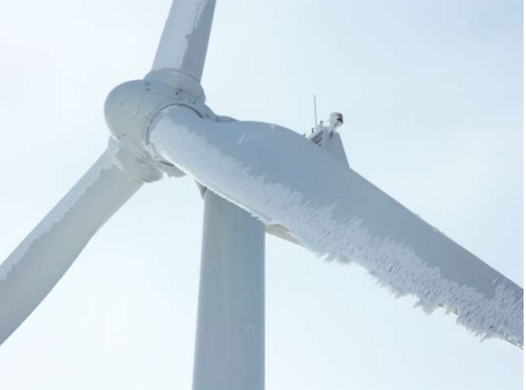
“The main challenge for wind turbines in
Sweden is icing, not low temperatures.”

Slide 22
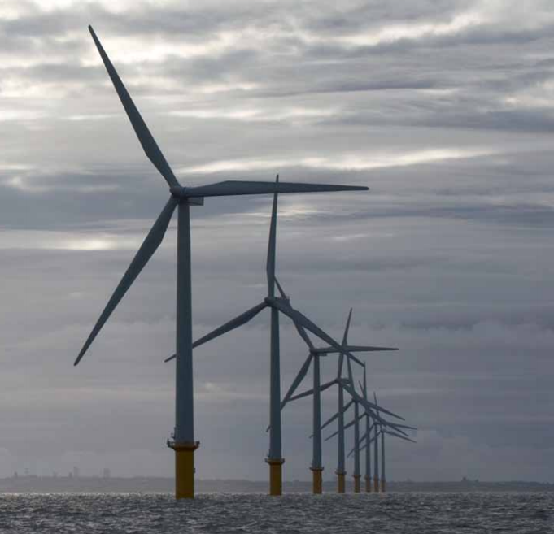
There is no current support mechanism for offshore wind power in Sweden

Slide 23
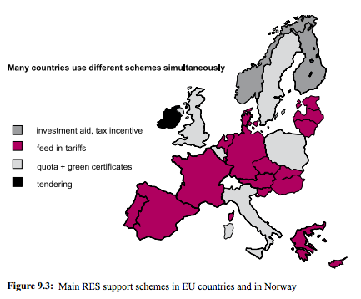
Solutions
The Swedish government should gradually turn its certificate system into a FIT system.
The government should increase the quota for wind power

Slide 24
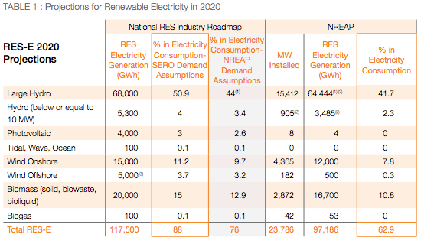
The renewable energy industry estimates are much more ambitious and this projection can be achieved

Slide 25
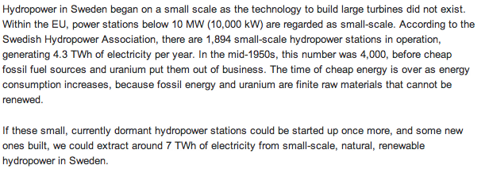
Source: http://www.triventus.com/hydropower/en/projekt/
Another sign of hope: Small-scale hydropower

Slide 26
Acknowledgements
I would like to thank GENI for giving me the opportunity to intern there. I had a great experience and gained valuable knowledge on renewable energy thanks to this opportunity.
I want to thank Peter Meisen for his guidance on my project and the GENI staff.
I would also like to thank my faculty mentor, Dr. Jungie Zhang from the IRPS Graduate School at UCSD, who offered me great advice.

