Slide 1
Background

Slide 2
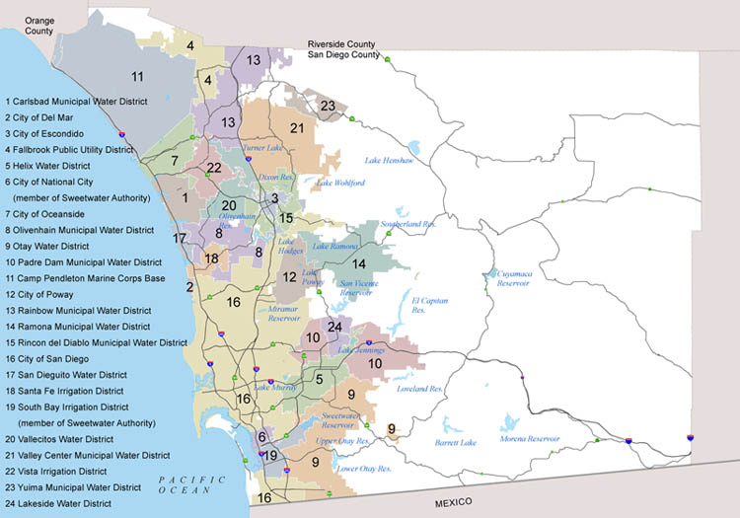
San Diego County Water Authority Service Area

Slide 3
Estimated Fiscal Year 2010 Water Supply Portfolio
Recycled Water 4%
Conservation 10%
Local Surface Water
3%
Groundwater 2%
Dry-Year Transfer 2%
MWD 53%
Canal Lining
16%
IID Transfer 10%
*Fiscal year 2010: July 1, 2009 – June 30, 2010

Slide 4
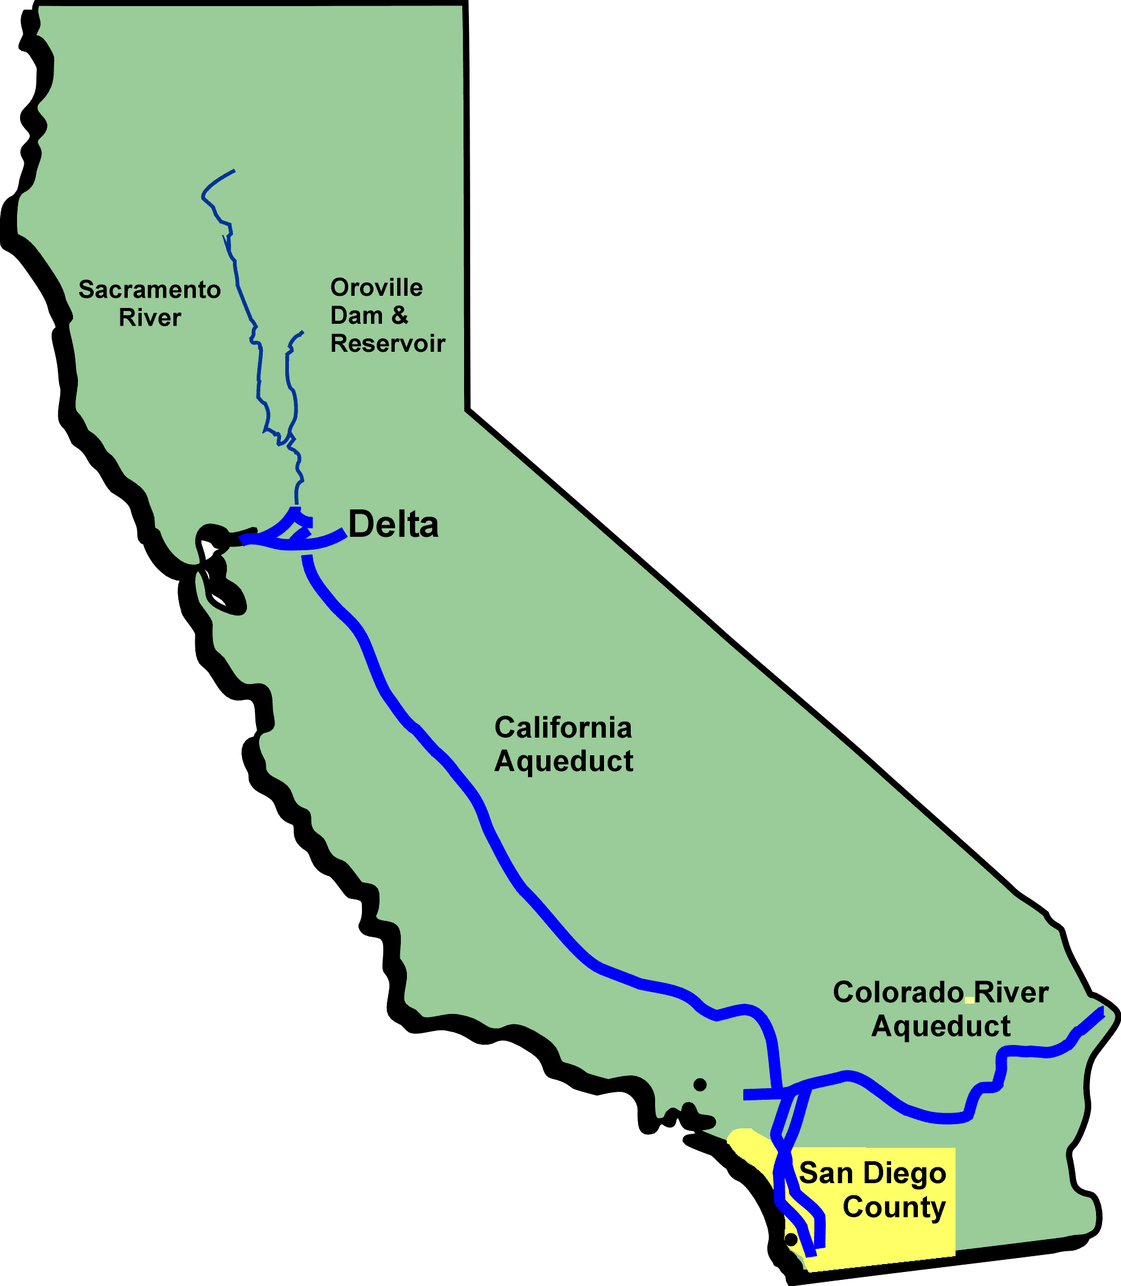
Sources of Imported Water from Metropolitan Water District (State Water Project and Colorado River)

Slide 5
Where is Residential Water Used?
AWWA Research Foundation 1999 Residential End Uses of Water Study

Slide 6
How Do We Use Water in the San Diego Region?
Acre-feet
60%
14%
16%
10%
*Based on the Water Authority’s 2009 Annual Report

Slide 7
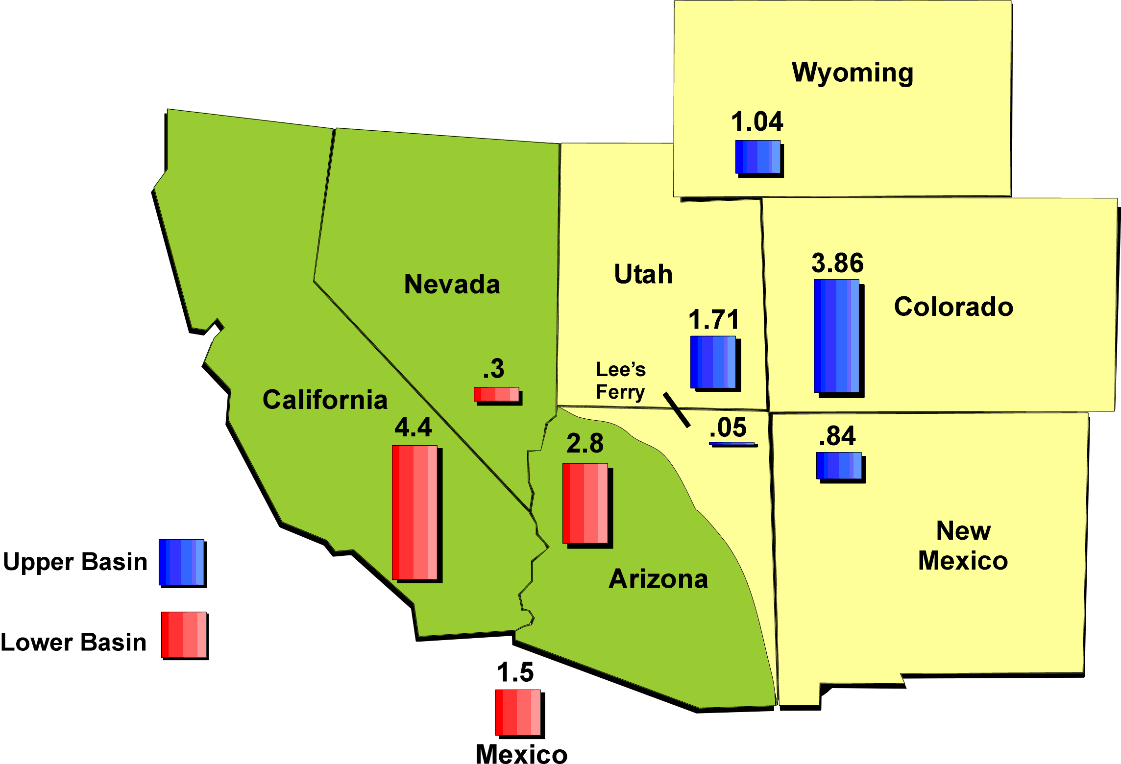
Colorado River Entitlements (Million acre-feet)
Notes:
The Colorado River is managed and operated under numerous compacts, federal laws, court decisions and decrees, contracts, and regulatory guidelines collectively known as the "Law of the River." Law of the River apportions the water and regulates the use and management of the Colorado River among the seven basin states and Mexico. California’s entitilement is 4.4 MAF.

Slide 8
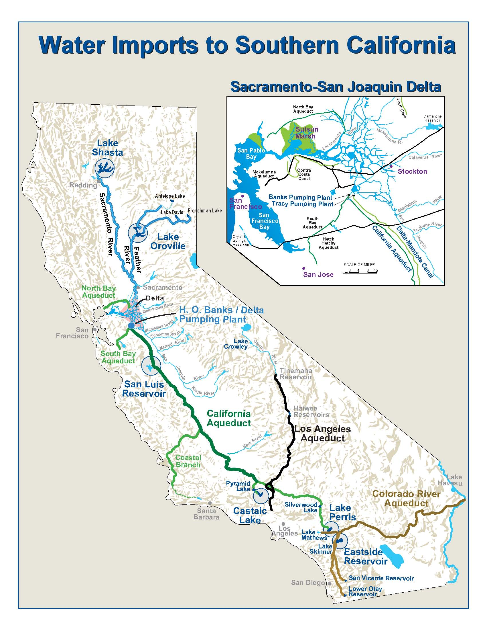
Notes:
The California State Water Project is a water storage and delivery system of reservoirs, aqueducts, powerplants and pumping plants. Its main purpose is to store water and distribute it to 29 urban and agricultural water suppliers in California.
The Project is maintained and operated by the California Department of Water Resources. Of the contracted water supply, 70 percent goes to urban users and 30 percent goes to agricultural users.
The Project makes deliveries to two-thirds of California's population, providing water supplies for 25 million Californians and 750,000 acres of irrigated farmland.
The Project is also operated to improve water quality in the Delta, control Feather River flood waters, provide recreation, and enhance fish and wildlife.
Can create a conflict when there are competing uses.

Slide 9
San Diego Area Recycled Water Treatment Plants
Notes:
Here is a map which shows the location of the region’s recycled water purveyors: (Point out nearest one to your audience first!)
The City of Carlsbad also receives recycled water supplies from the Vallecitos Water District’s Meadowlark Water Reclamation Facility.
The City of Del Mar, San Dieguito WD, and the Santa Fe ID receive recycled water for their customers from San Elijo Water Reclamation Facility.
Rincon del Diablo MWD provides recycled water to its customers supplied through the City of Escondido’s Hale Avenue Resource Recovery Facility.
The City of Poway gets it’s recycled water deliveries from the City of San Diego.
The Otay Water District supplements it’s recycled water supply from the City of San Diego’s South Bay Water Reclamation Plant.

Slide 10
Challenges

Slide 11
Population Growth Within San Diego County (Millions)
Historic
Projected
Source: SANDAG 2050 Regional Growth Forecast

Slide 12
Low Average Annual Rainfall (Inches)
San Diego rainfall at Lindbergh Field

Slide 13
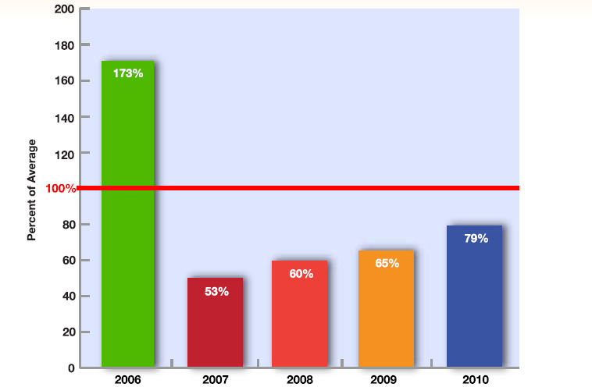
Statewide Droughts
Runoff below average since 2007
Source: DWR California Drought Update May 2010

Slide 14
Ongoing Dry-Year Conditions on the Colorado River
Unregulated Inflow to Lake Powell
(% of average – water year)
Notes:
On the Colorado, conditions for this year will end below average. Projected runoff into Lake Powell is now at 70% of normal.
2011 will be the 9th dry year out of 11 consecutive years.
The US Bureau of Reclamation forecasted that there could be shrotages on the river in 2012 under certain hydrologic conditions, with Arizaon and Nevada experiencing these shortages first. We will continue to follow this and report back.

Slide 15
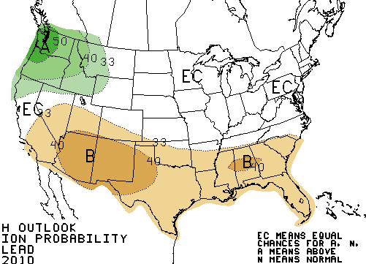
La Niña Conditions Present
3-Month Precipitation Outlook October – December 2010
A= Above Average
B= Below Average
EC= Equal Chance
Source: National Weather Service Climate Prediction Center September 16, 2010

Slide 16
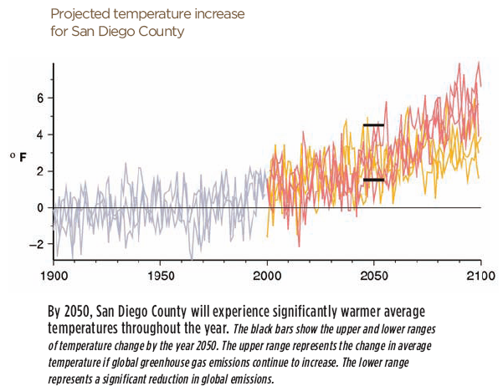
Climate Change Potential Water Management Impacts
Source: San Diego Foundation, San Diego’s Changing Climate: A Regional Wake-Up Call (2008)
Notes:
Most likely the water industry will see the earliest impacts of climate change.
Scientists believe we are already experiencing the effects of climate change.
This slide shows some of the changes we can expect.
– more frequent and persistent

Slide 17
Pumping Restrictions to Protect Fish Species Limit State Water Project Deliveries
Regulatory Pumping Restrictions
JAN FEB MAR APR MAY JUN JUL AUG SEP OCT NOV DEC
Salmon
No
Restrictions
Delta Smelt
Longfin Smelt
Notes:
This chart illustrates the problem created by the pumping restrictions put in place to protect some of the protected fish species we just saw.
The ability to pump water from the Delta is limited in nine months out of every year.
The only time there are no restrictions on the pumps is July through September.
These restrictions create a bottleneck that severely limits the amount of water that can be pumped from the Delta to the 25 million people in Central and Southern California who depend on it for all or part of their water.
These restrictions limit supplies under all conditions by 23-to-30 percent. In fact, we lose more water in wet years, limiting our ability to refill reservoirs to help us manage water during dry years.
17

Slide 18

Impacts of Regulatory Restrictions on Southern California’s Supplies
Reduced deliveries from State Water Project due to pumping restrictions
30% lost
(-565,800 AF)
30% lost
(-459,954 AF)
1,320,200 AF
1,058,046 AF
23% lost
(-137,540 AF)
460,460 AF
Critical Dry
Average
Wet
AF = Acre-feet
One acre-foot = 325,900 gallons
*Source: Metropolitan Water District; updated 7/28/2009
Notes:
A significant amount of these supplies – shown in red -- will be lost because of these pumping restrictions.
About one-fourth to one-third of supplies are now lost because of the regulatory restrictions now in place.
These lost supplies make it much harder for water agencies to replenish reservoirs in wet years to help manage water supplies during dry years.

Slide 19
Challenges to Conservation
Numerous Factors Influence Water Demands
Nonresidential Characteristics
Rate Structure
Weather and Climate
Price of Water
Water-use restrictions
Housing and Household Characteristics
Technology Improvements
Public Education
Economy

Slide 20
What’s at stake

Slide 21
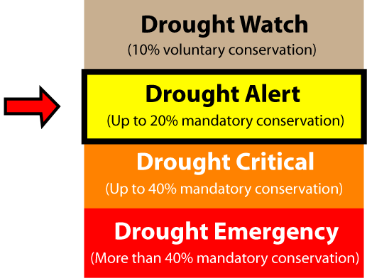
Potentially More Frequent and Severe Shortages Could Negatively Impact Economy
Current Level
Notes:
21
Let me give you a quick update on our current shortage condition and potential for change this year.
We have a Drought Alert condition in effect, which our Board approved in April 2009. This enabled our 24 member retail water agencies to activate mandatory water use restrictions or other measures to help us achieve our regional savings goal for the fiscal year ending this June.
The mandatory savings target for our region is 8 percent. The Water Authority Board set this target after the Metropolitan Water District, our largest supplier, ordered a 13 percent reduction in deliveries to the Water Authority in response to growing supply challenges.
Shortage conditions will continue into the next fiscal year

Slide 22
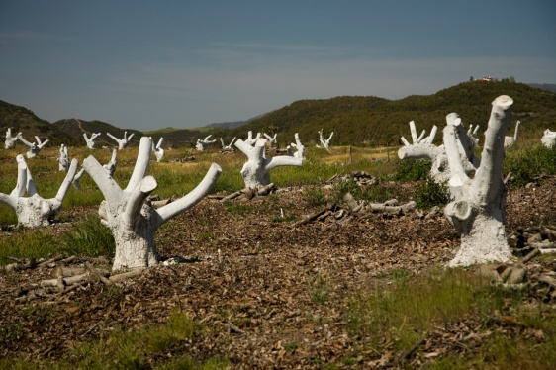

Slide 23
Reliable Future

Slide 24
Regional Water Supply Diversification
1991
2010
2020
5%
2%
6%
16%
2%
3%
4%
10%
7%
11%
95%
10%
10%
6%
9%
29%
53%
22%
Metropolitan Water District
Seawater Desalination
Imperial Irrigation District Transfer
Local Surface Water
All American & Coachella Canal Lining
Recycled Water
Conservation
Groundwater
Dry-Year Water Transfers
Notes:
In addition to improving efficiency, we must continue to diversify our region’s water supplies.
These charts show our progress in diversifying supplies since 1991, and our goals for 2020.
By 2020 our goal is to reduce our reliance on MWD to about 30 percent.
We’re also working with member agencies to build up local supplies – groundwater, recycled, desalination and conservation – so they can meet the remaining 40 percent of regional demands by 2020.

Slide 25
Increase Future Groundwater Yield (Acre-feet)
Based on Water Authority’s 2005 Updated Urban Water Management Plan

Slide 26
Increase Future Recycled Water Yield (Acre-feet)
Based on Water Authority’s 2005 Updated Urban Water Management Plan

Slide 27

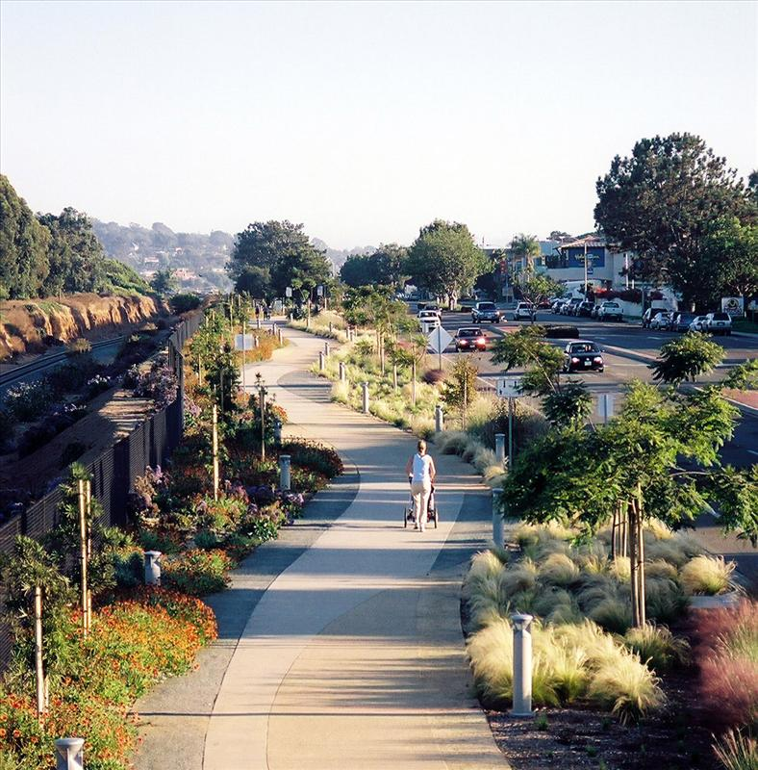
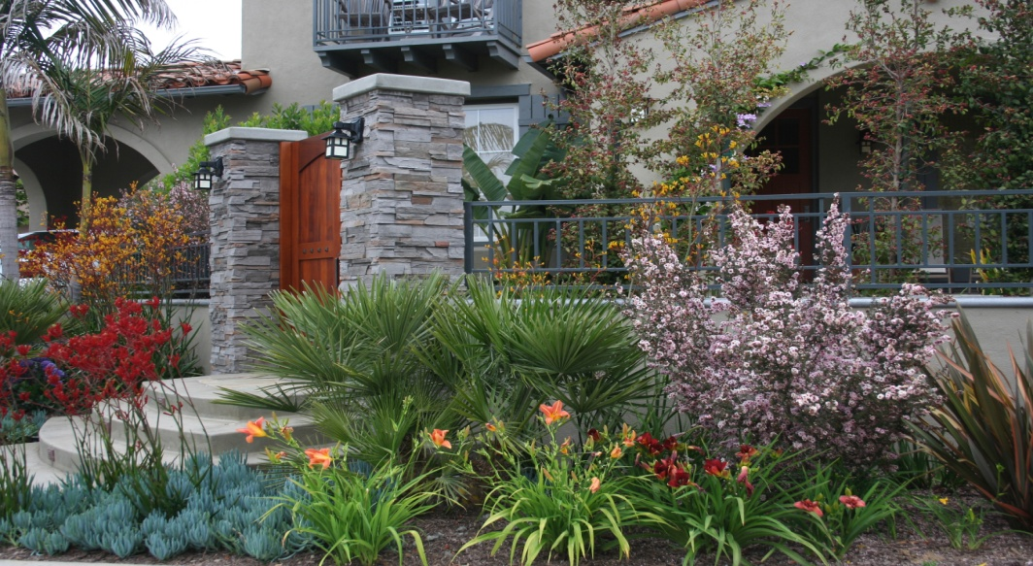
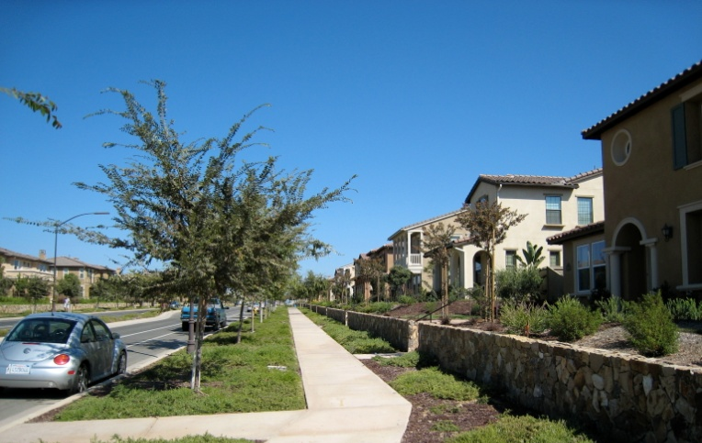
New Water Ethic

