Slide 1
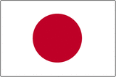
How is 100% Renewable Energy in Japan Possible by 2020?
Takatoshi Kojima
July,2012
Notes:
Good afternoon, everyone. For those of you who don’t know me, my name is Taka, from Japan. I’m here today to present this project “How is 100% renewable energy possible in Japan by 2020?”

Slide 2
Agenda
Basic Information about Japan
Country Info.
Energy Info.
Possibility
Public Mind/Opinion, High Technology, Energy Policy
Renewable Energy
Wind, Solar, Geothermal, Hydropower, Biomass
Numerical Assumption
Installed Capacity, Generated Energy
Conclusion
Notes:
Here this slide is agenda. This is a brief outline of my presentation. I would like to talk about basically five things. First, basic information and general outline of Japan. Next is the reason why 100% is possible. After this, explanation about each renewable energy which can be applied in Japan. Then, Numerical assumption and conclusion.

Slide 3
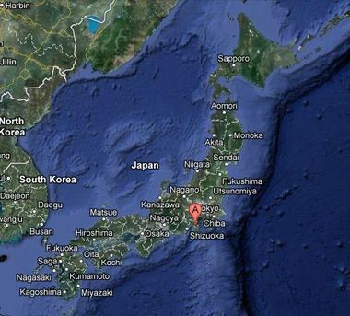
Japan
Location:
Island in East Asia
Area Size
377,864 km²
Population
126.9 million
Coastline
29,751 km(18,486 miles)
Climate
Mild, Four seasons
Notes:
First of all, let me talk about this country, Japan. Japan is island country located in east asia. The size is almost same, or slightly smaller than California, but the population of Japan is around 40% of that of United States. Therefore, as you may realize, the main problems of this country are too much people and too little land.

Slide 4
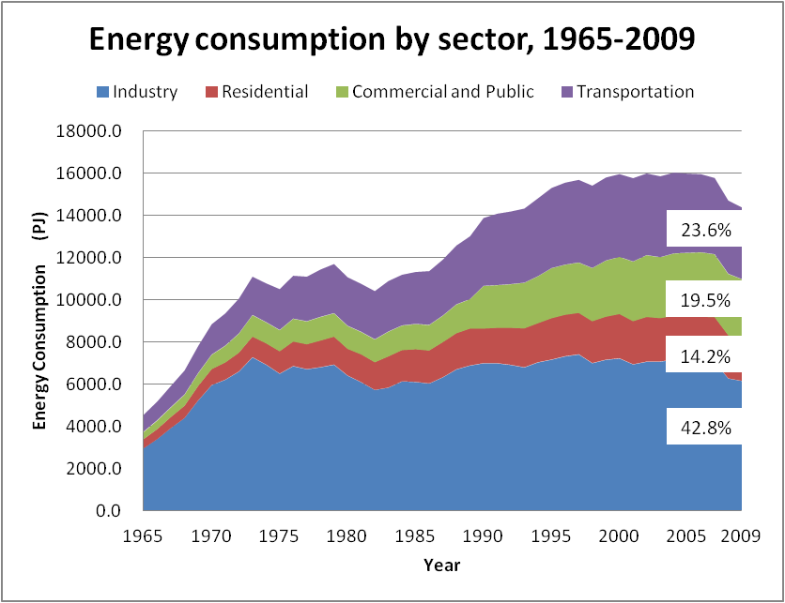

Energy Consumption
Notes:
Now, I’d like to move on to the next slide. This slide shows how Japan uses their energy. Japan uses their energy mostly industry. I assume that Japan use much energy to make lots of electronics, automobiles, and so on.

Slide 5
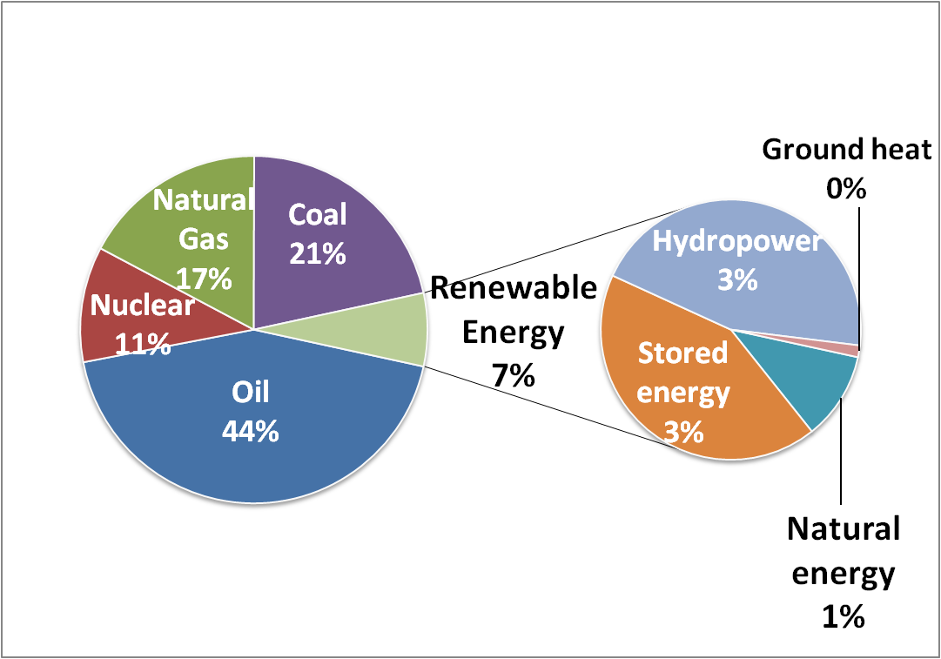
Electricity Mix in Japan
Notes:
Please take a look at this chart. This shows current electricity mix in Japan. Japan relies a variety of resources. Most of them are fossil fuels, such as Oil, Coal, and Natural gas. Plus, Nuclear power also accounts for more than 10% of its energy mix. As for renewable energy, it accounts for only 7% of entire energy mix so far. So, it might seem very difficult to achieve 100% renewable energy future in this country. However, I believe 100% renewable energy is possible in Japan.

Slide 6
Possibility
100% Renewable Energy Country
High Tech
Energy Policy System
Public Mind Opinion
Notes:
Up to here, I have spoken about the general outline of this country and energy situation in Japan. Now let me move on to the next slide. This picture shows the reason why Japan can be 100% renewable country. Three main reasons are public mind, high tech, and energy system. The three following slides are explanation of each reasons.

Slide 7
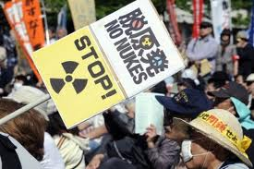
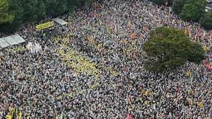
Public Mind/Opinion
Last year’s huge earthquake, tsunami, and nuclear disaster changed people’s mind
Opposition to re-start nuclear power plants
A lot of anti-nuclear demo in many places
Notes:
First of all, there are now strong public opinion and public mind in Japan. Last year’s huge earthquake followed by tsunami and nuclear disaster changed the Japanese people’s mind very much. Before that event, honestly, people (including me) did not care much about their energy. In other words, they are not concerned about our energy. However, after we Japanese experienced that event, our view has totally changed. Many people take part in anti-nuclear demo like this picture and we Japanese came to have our own opinion on our energy issues.

Slide 8
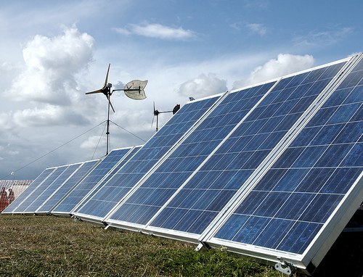
High Technology
Japan has highest number of patents in renewable energy field
Both academic/public research and private sector
Accounts for 55% of world’s patents application
Notes:
Now, let me move on to next slide. Second reason is high technology. Japan does not have natural resources, so, education system and labor force have been Japan’s big resources for a long time. As a result, Japan now has a lot of high technology in a variety of fields. Renewable energy industry is no exception. According to WIPO, Japan currently accounts for 55% of world’s patents application. It means Japan has high possibility of leading world’s renewable industry.

Slide 9
Energy Policy/System
Feed in tariff in Japan is among the highest in the world
Feed in tariff price comparison between Japan and Germany
(US cent$) | Suggested Prices in Japan | Procurement Prices in Germany | Japan/Germany Ratio
Solar | 52.5 | 23.3~31.7 | ×1.66~2.25
Wind | 28.8 | 4.55~19.5 | ×1.48~6.33
Geothermal | 34.1 | 32.5 | ×1.05
Hydro | 31.5~44.6 | 8.2~16.5 | ×1.91~7.19
Biomass | 17.0~50.8 | 7.8~18.6 | ×0.91~6.51
Notes:
I’d like to move on the next reason. Final reason is Japan’s energy policy and system. This year, Japanese government approved feed in tariff and put them into practice. The feature of this system is price. Please look at this table shown in this slide. This table shows a comparison between Japan and Germany, which is thought to be the world’s renewable energy leader. As this table shows, the price which Japan buy their energies is much higher than that of Germany. It means Japan government is really trying hard to develop renewable energy and a lot of companies from all over the world might enter the Japanese market.

Slide 10
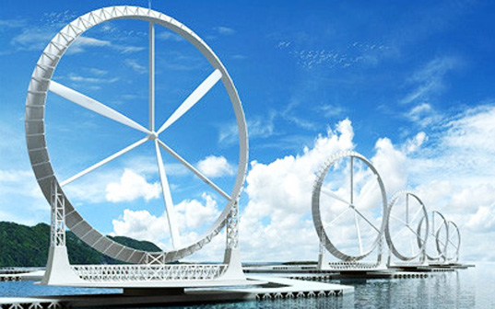
Wind
One of the biggest trend in renewable energy industry, high possibility onshore and offshore in Japan
Estimated Total Installed Capacity
130-590GW under subsidy& Feed in tariff scenario
Estimated Generated Power Capacity
230-1030TWh/year under subsidy& Feed in tariff scenario
Notes:
The following four slide are explanation about each renewable energy. Now I will talk about wind energy. Wind energy is considerd one of the biggest trend in renewable energy industry, and it is thought to have high possibility of onshore and offshore plants in Japan. According to estimation, total installed capacity will be 130-590GW under subsidy and FIT scenario, and generated power capacity will be 230-1030TWh/year under subsidy and FIT scenario.

Slide 11
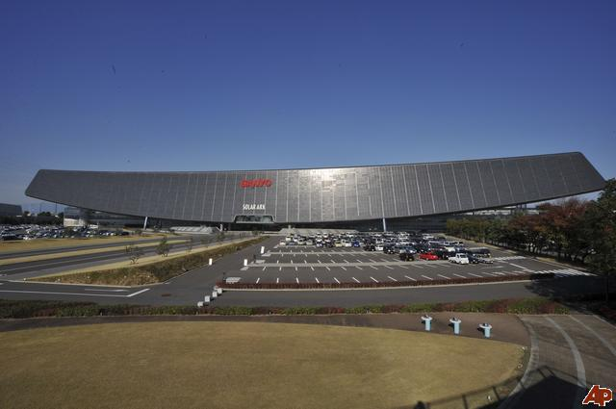
Solar
Japan gets ready to boost its solar energy production with strong Feed in tariff system
Estimated Total Installed Capacity
Up to 26GW under subsidy& Feed in tariff scenario
Estimated Generated Power Capacity
Up to 27.3TWh/year under subsidy& Feed in tariff scenario
Notes:
Another renewable energy is solar energy. Because of strong tariff and high technology about solar panel, Japan gets ready to boost its solar energy production with strong Feed in tariff system. According to estimation, total installed capacity will be 26GW under subsidy and FIT scenario, and generated power capacity will be 27.3TWh/year under subsidy and FIT scenario.

Slide 12
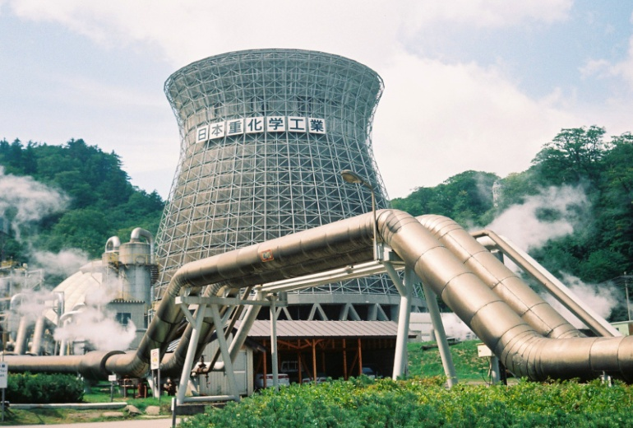
Geothermal
Japan is one of the biggest volcano country with several world’s major tectonic plates
Estimated Total Installed Capacity
1.5-4.3GW under subsidy& Feed in tariff scenario
Estimated Generated Power Capacity
9.2-26.3TWh/year under subsidy& Feed in tariff scenario
Notes:
Another renewable energy is geothermal energy. Japan's volcanoes are part of five volcanic arcs. The arcs meet at a triple junction on the island of Honshu, main island of Japan. So there are a lot of heat underground of Japan and Japan has high potential of geothermal energy. According to estimation, total installed capacity will be 1.5-4.3GW under subsidy and FIT scenario, and generated power capacity will be 9.2-26.3TWh/year under subsidy and FIT scenario.

Slide 13
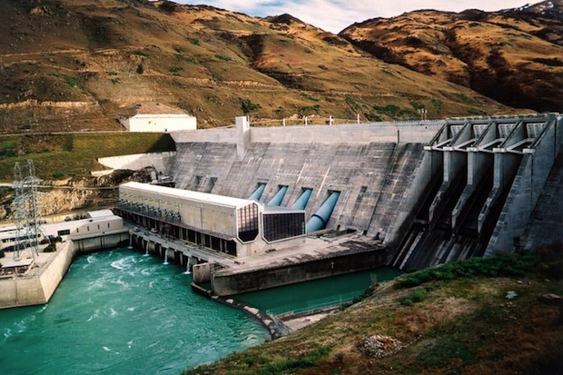
Hydropower
Hydropower is more reliable and stable than intermittent sources like wind and solar
Estimated Total Installed Capacity
2.7-5.4GW under subsidy& Feed in tariff scenario
Estimated Generated Power Capacity
15.4-30.7TWh/year under subsidy& Feed in tariff scenario
Notes:
Hydropower, I mean, small scale and middle scale hydropower is considered renewable energy. Japan has used this energy for a long time, but has not used so much as other resources like fossil fuels. Among renewable energy, Hydropower is more reliable and stable than intermittent sources like wind and solar. According to estimation, total installed capacity will be 2.7-5.4GW under subsidy and FIT scenario, and generated power capacity will be 15.4-30.7TWh/year under subsidy and FIT scenario.

Slide 14
Assumption ①
Notes:
Up to now with the previous four slides, I have spoken each renewable energy and estimated energy. Then, I would like to talk about numerical assumption of installed capacity. Please look at this chart. The vertical line shows the scinarios and the horizontal one shows installed capacity. As you can see, today’s Japan’s nationwide installed capacity is 200Million kW. And to sum up the previous four slides, Japan is estimated to be produce around 400Million kW under FIT+subsidy scenario.

Slide 15
Assumption ②
Notes:
Another numerical assumption is generated power comparison. This chart shows generated power comparison. As you can see, today’s Japan’s nationwide installed capacity is 800TWh/year. And to sum up the previous four slides, Japan is estimated to be generate around 400Million kW under FIT+subsidy scenario. From these chart, I would say Japan can manage their energy only by renewable energy.

Slide 16
Conclusion
“Is 100% Renewable Energy in Japan possible?”
“Yes, Japan can be 100% Renewable Energy Country.”
“How is 100% Renewable Energy in Japan possible?”
“The Key is Subsidy& Feed in tariff system, with variety of renewable energy resources.”
“Is it easy to achieve the goal?”
“No, finance and time are very severe concerns, but Japan can make it with lots of efforts.”
Notes:
So, what conclusions can we draw from all those slides mentioned so far? To sum up my conclusion, it is like this.

Slide 17
References
http://www.enecho.meti.go.jp/info/statistics/jukyu/resource/pdf/120413_gaisoku.pdf
http://www.eco-online.org/2011/08/15/%E6%97%A5%E6%9C%AC%E3%81%AF%E5%86%8D%E7%94%9F%E5%8F%AF%E8%83%BD%E3%82%A8%E3%83%8D%E3%83%AB%E3%82%AE%E3%83%BC%E6%8A%80%E8%A1%93%E3%81%AE%E3%83%88%E3%83%83%E3%83%97%E3%83%A9%E3%83%B3%E3%83%8A%E3%83%BC/
http://www.env.go.jp/earth/report/h23-03/full.pdf
Thanks for your attention☺
Notes:
I’ve come to the end of the presentation, so thanks very much for being here today!

