Slide 1
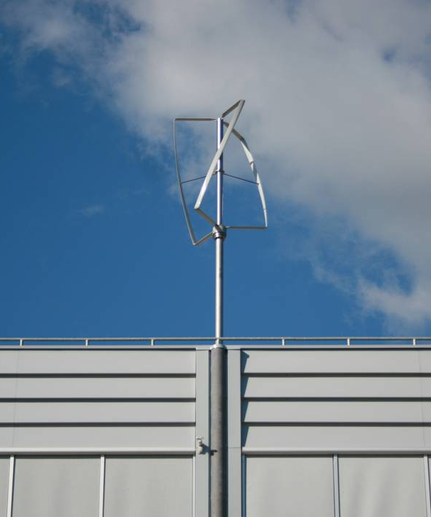
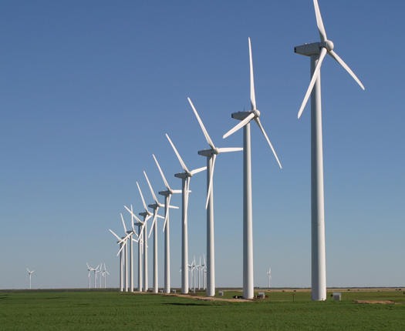

Various Wind Technologies
Notes:
Aerodynamics

Slide 2
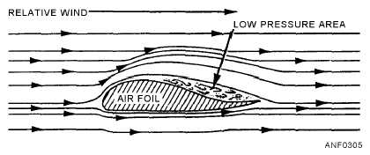
Aerodynamics

Slide 3
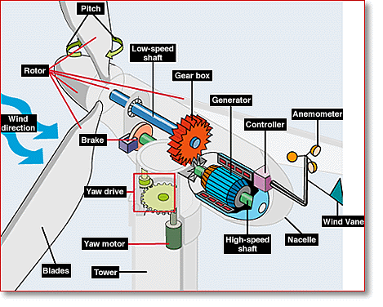
Components of a Wind Turbine
Notes:
Components of a wind turbine

Slide 4
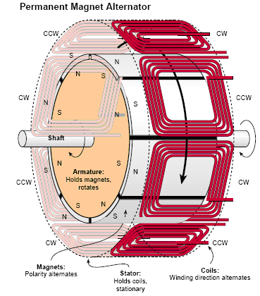
Permanent Magnet Generator

Slide 5
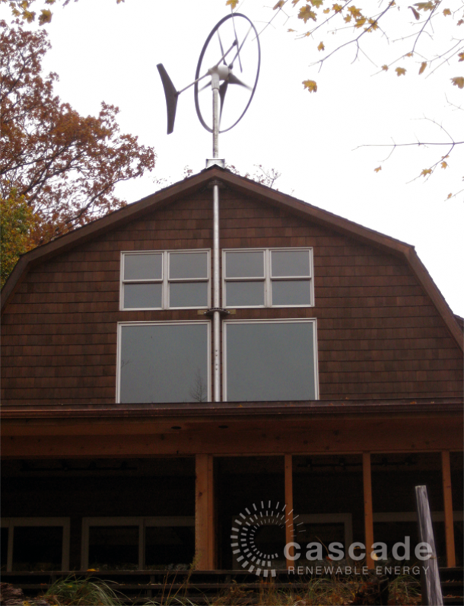
Swift Wind Turbine
Rated Power: 1.5 kW
Annual Energy Production: 1.2-1.9 MWh/year
Notes:
However, smaller horizontal axis wind turbines have been developed such as this one by Swift, which can be placed on rooftops.
Rated power = 1.5 kW

Slide 6
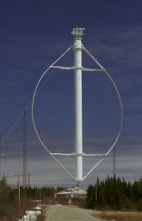
First Vertical Axis Wind Turbine
Notes:
One of the first Darrieus Vertical Axis Wind Turbines. Its blades use the same aerodynamic concept as horizontal axis wind turbines. The difference is that these do not have to face the wind and can catch wind in any direction.

Slide 7
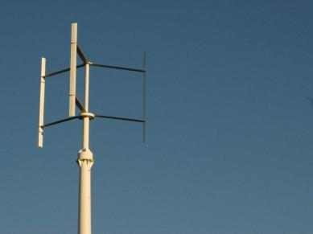
H-Rotor – UrWind O2
Rated Power: 1.7 kW
Annual Energy Production: 2-4 MWh/year
Notes:
Second design. Still relatively unstable. UrWind O2
Rated power of 1.7 kW

Slide 8
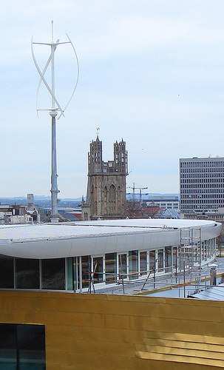
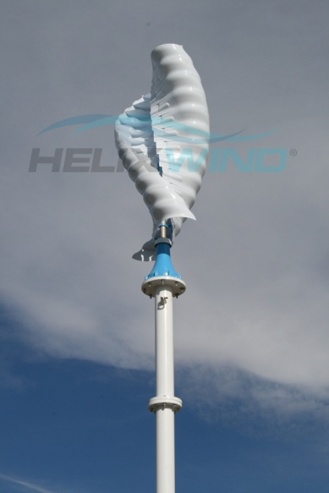
Darrieus and Savonius
Rated Power: 6.5 kW
Annual Energy Production: 4.2-7 MWh/year
Rated Power: 2.0 kW
Annual Energy Production: 2.0 MWh/year
Notes:
Nowadays, the designs have evolved to be more efficient. The one on the left is a Darrieus wind turbine while the one on the right is a Savonius wind turbine. Both are vertical axis wind turbines, but they both work differently. The blades on the Savonius turbines move by scooping the wind using *point* this part. They are relatively simple designs.
QuietRevolution (on left) – Rated power = 6.5 kW
HelixWind S322 – Rated power = 2.0 kW

Slide 9
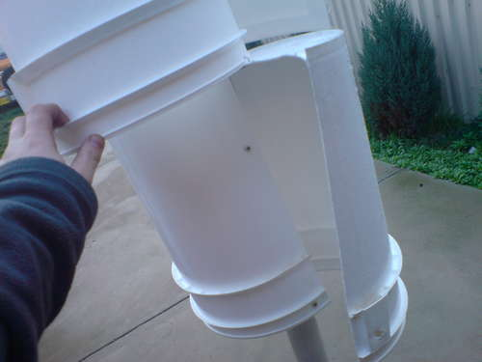
Home-Made Savonius Wind Turbine
Notes:
Savonius wind turbines are so simple that people are able to make their own from common items found in hardware stores.

Slide 10
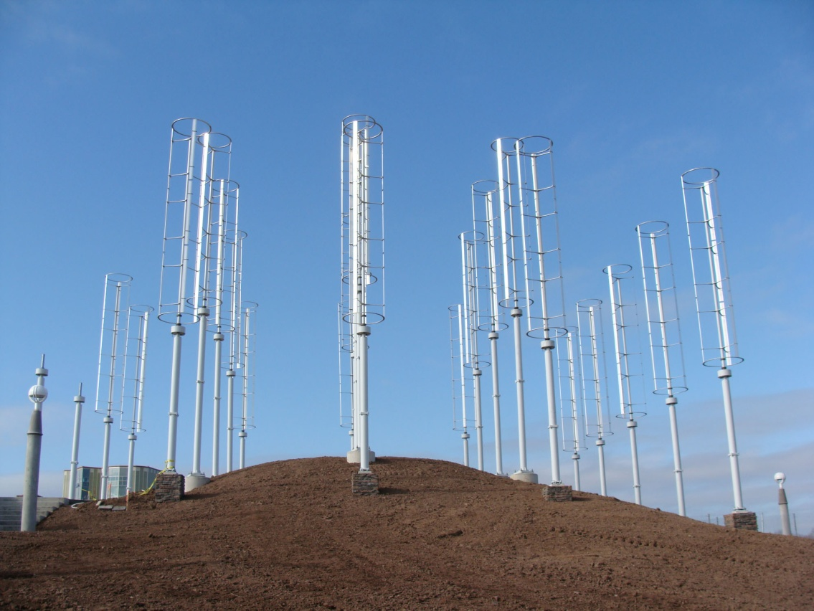
Windspire Wind Farm
Notes:
Dabiri at CalTech – Windspire wind farm has a power density of 6 to 30 W/m^2 with a foot print of 48.6 m^2 compared to the power density of a horizontal-axis wind turbine of 2 to 3 W/m^2.
Normal horizontal axis wind turbines have to be spaced 7 rotor-diameters apart. Windspire needs only 4 rotor-diameters (they have much smaller rotor diameters too)

Slide 11
Offshore Wind

Slide 12
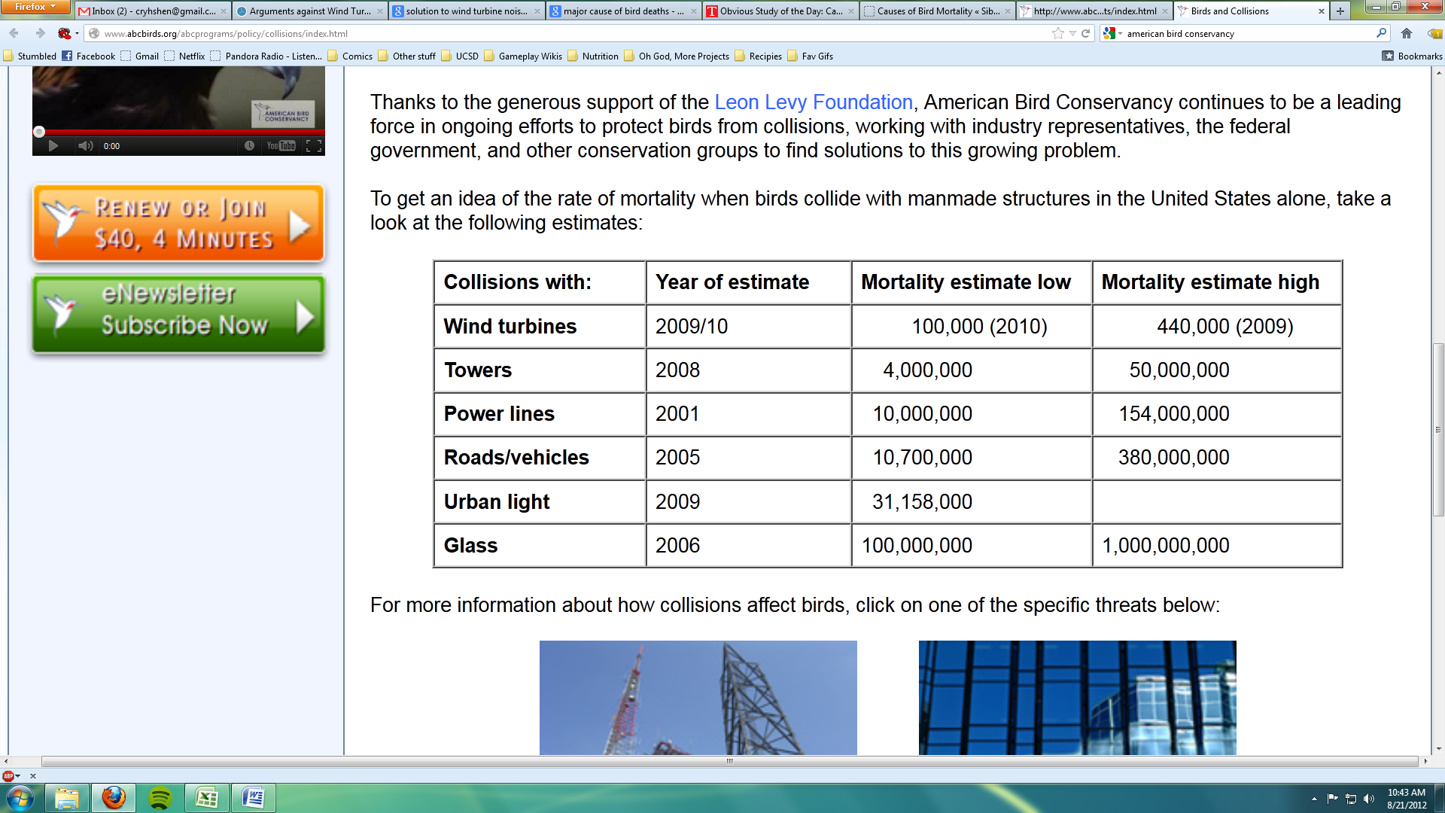
Bird Deaths

