Slide 1
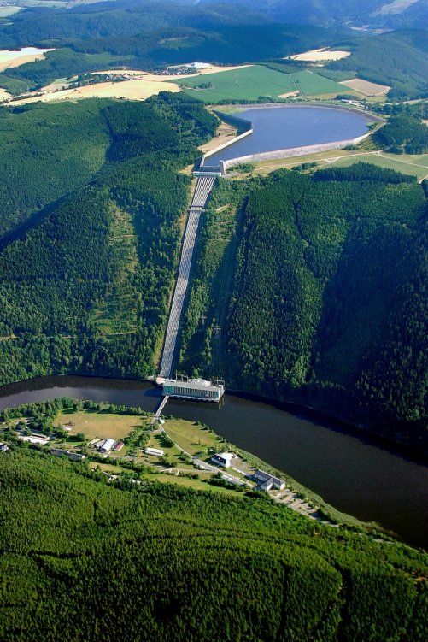

Energy Storage Technologies & Their Role in Renewable Integration
Andreas Oberhofer
Research Associate, Global Energy Network Institute (GENI)
andreasoberhofer@gmx.de

Slide 2
Table of Content
1 Short Introduction to the Electric Grid
2 Energy Storage Technologies
  2.1 Flywheels
  2.3 Superconducting Magnetic Energy Storage (SMES)
  2.3 Batteries
  2.4 Pumped Storage Hydroelectricity (PSH)
  2.5 Compressed Air Energy Storage (CAES)
  2.6 Electrolysis of water and Methanation
3 Summary / Conclusion

Slide 3
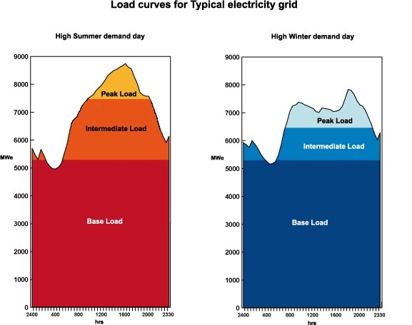
1 Short Introduction to the Electric Grid
The amount of electricity produced must always be on the same level as demanded!
Base Load
Intermediate Load
Peak Load
Source: http://www.world-nuclear.org/info/inf10.html

Slide 4
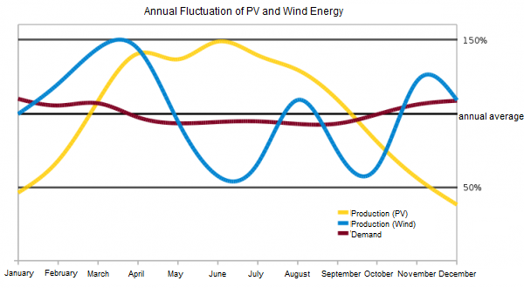
1 Short Introduction to the Electric Grid
Most renewable energy sources have a fluctuating output.
Source: http://michaelwenzl.de/wiki/ee:virtuelles-kraftwerk-lechfeld:vortrag_gruene
Need for storage solutions!

Slide 5
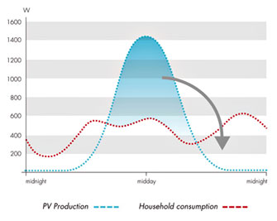
2 Energy Storage Technologies
Storage systems balance out the fluctuation of renewable energies.
Source: http://www.saftbatteries.com/MarketSegments/Energystorageandrenewables/OnGridEnergyStorage/Electricity Consumption/tabid/467/Language/en-US/Default.aspx

Slide 6
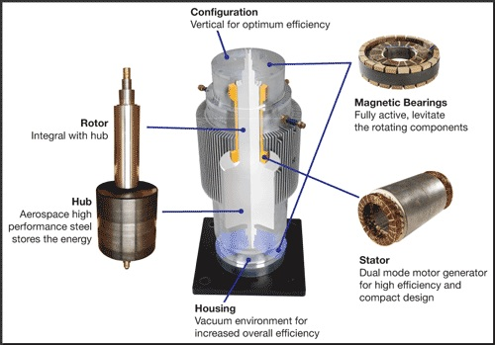
2.1 Flywheels
Flywheels store energy in form of kinetic energy in a rotating hub.
Source: http://www.acsystems.com/vycon/

Slide 7
2.1 Flywheels

Slide 8
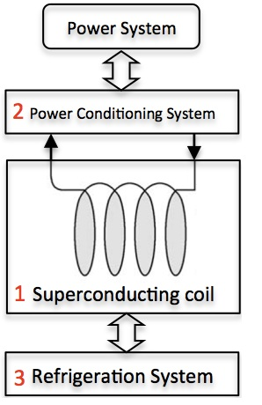
2.2 Superconducting Magnetic Energy Storage
A SMES system stores energy in form of an electromagnetic field surrounding the coil.
Source: http://www.lowcarbonfutures.org/assets/ media/SMES_final.pdf

Slide 9
2.2 Superconducting Magnetic Energy Storage

Slide 10
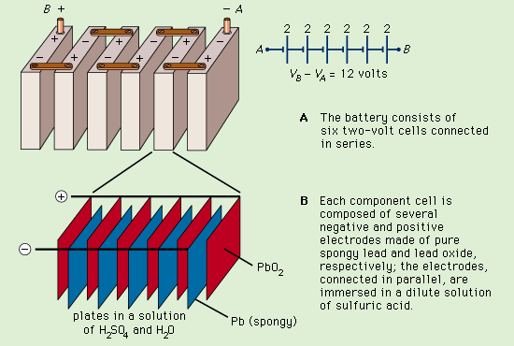
2.3 Batteries
Batteries store energy in chemical form.
Most battery technologies use two different compounds which release energy in form of an electrical current when reacting with each other.
Source: http://www.wholesale-electrical-electronics.com/p-solar-battery-np12-200ah-12v-200ah-855419.html

Slide 11
2.3 Batteries

Slide 12
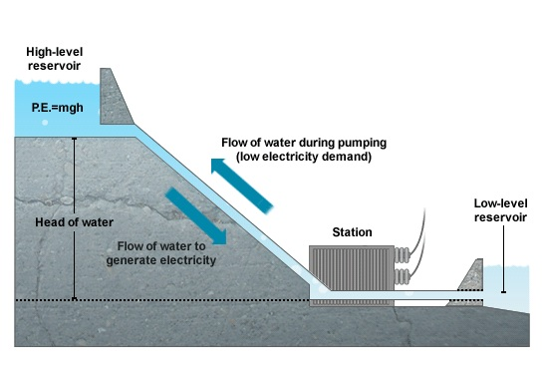
2.4 Pumped Storage Hydroelectricity (PSH)
In an PSH electrical powered turbines pump water into higher reservoirs.
When needed, the water flows back down and power the reversed turbines.
Source: http://www.bbc.co.uk/scotland/learning/bitesize/ standard/physics/energy_matters/generation_of_electricity_rev3.shtml

Slide 13
2.4 Pumped Storage Hydroelectricity (PSH)

Slide 14
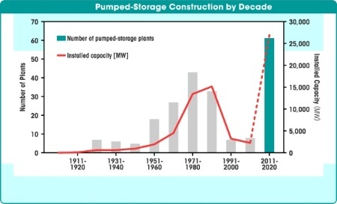
2.4 Pumped Storage Hydroelectricity (PSH)
With the new role of PSH, the numbers of new constructions have improved drastically and will furthermore.
Source: http://www.renewableenergyworld.com/rea/news/article/2011/08/renaissance-for-pumped-storage-in-europe

Slide 15
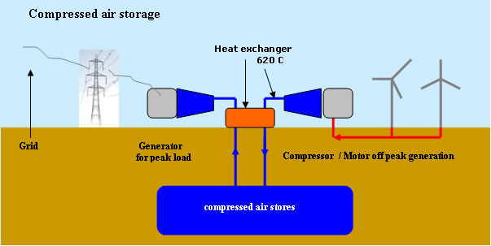
2.5 Compressed Air Energy Storage (CAES)
  CAES plants store energy in form of compressed air in underground caverns.
  The Advanced Adiabatic (AA) CAES stores the heat produced during the compression and compensates the freezing during the expansion.
Source: http://www.climateandfuel.com/pages/storage.htm

Slide 16
2.5 Compressed Air Energy Storage (CAES)

Slide 17
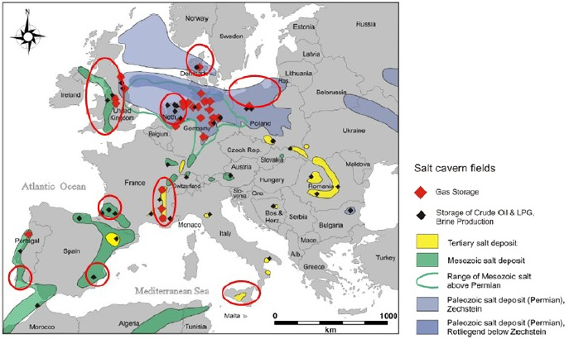
2.5 Compressed Air Energy Storage (CAES)
  Considerably large storage opportunities exist worldwide.
Source: http://web.fhnw.ch/plattformen/ee/CAS%20EE%2009%20ZA%20Druckluftspeicher.pdf

Slide 18
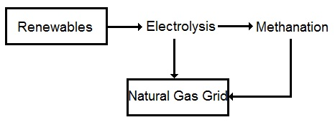
2.5 Electrolysis of Water and Methanation
  Excess Electricity could be used to produce hydrogen and methane out of water and inject it into the natural gas grid.

Slide 19
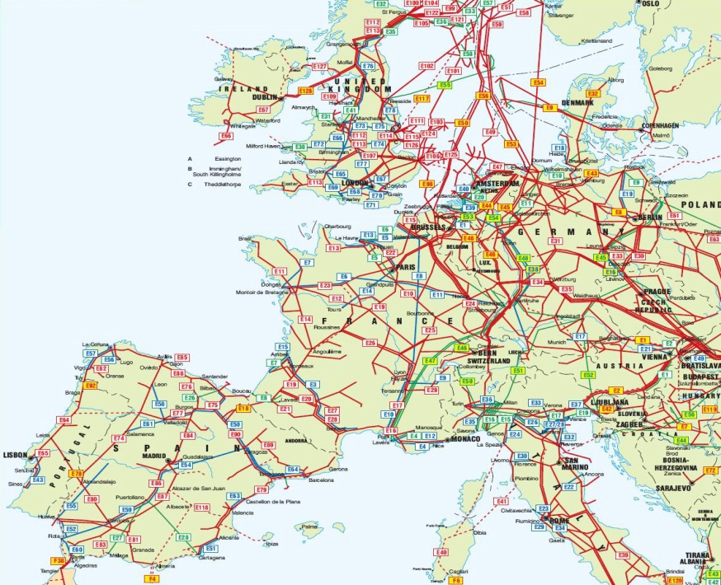
2.5 Electrolysis of Water and Methanation
  The natural gas grid in Germany alone holds the potential of storing approximately 220 TWh. ( cf. current PSH share: 0,07 TWh )

Slide 20
2.5 Electrolysis of Water and Methanation

Slide 21
3 Summary / Conclusion
  Current renewable technologies require storage possibilities
    Leading to a huge storage problem world wide
  PSH currently the only viable solution
  Flywheels, SMES and batteries possess small potential
  CAES shows the greatest potential
  Electrolysis/Methanation as a contingency plan

