Slide 1

DIVESTMENT: The reduction of some kind of asset for financial, ethical, or political objectives.
Masada Disenhouse
Co-Founder, Steering Committee Member

Slide 2
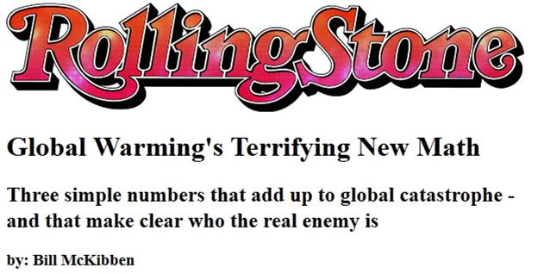
Why is it a crisis?
Notes:
In a recent Rolling Stone article 350.org founder Bill McKibben explained why climate change is a crisis that must be addressed NOW.
He talked about “three simple numbers that add up to global catastrophe” and which he calls “Global Warming’s Terrifying new Math”.
We already covered the first number—2 degrees C—the safe upper limit for global temperatures.
_____________________________________________________________________________________________________________________
In a powerful Rolling Stone magazine article from summer 2012, 350.org founder Bill McKibben explained the urgency of acting NOW to deal with climate change. He said there are “3 simple numbers that add up to global catastrophe.” We’ve already covered the first one: 2 degrees celsius of increased global temperature as the safe limit.
__________________________________________________________________________________________________________________________________________________________________
July 19, 2012 Rolling Stone magazine…rollingstone.com

Slide 3
2,795 GT CO₂
565 GT CO₂
Notes:
The second number is 565 gigatons. This is the amount of CO2 that scientists estimate we can pour into the atmosphere by midcentury and still have a good chance of staying below the 2 degree limit. But if we keep doing what we’re doing now, we’ll blow past this limit by around 2030.
The third number Bill talked about is the amount of carbon in proven reserves of coal, gas, and oil. Does anyone know what that number is? Do you think it is more than 565 gigatons? Less?
It’s 2,795 Gigatons. Again, that’s the amount of carbon contained in the proven coal, gas, and oil reserves of the planet. In short, the fossil fuels we're currently planning to extract and burn are 5 times the amount of carbon we can burn safely by midcentury.
That means we need to find a way to keep 80% of that fuel in the ground.
______________________________________________________________________________________________________________________
The second number is 565 gigatons. That is the amount of CO2 scientists estimate we can burn by 2050 and still have a good chance of staying below the 2 degree limit. But if we keep doing what we’re doing now, we’ll blow past this limit by around 2030.
The third number that is part of Bill’s simple math has to do with how much coal, oil and gas have already been found. Would anyone like to guess how much it is? Do you think it is more than 565 gigatons? Less? It’s 2,795 gigatons. That’s right: oil, gas and coal companies throughout the world have already found 5 times the amount of fuel that we can burn without destroying our planet.
That means we need to find a way to keep 80% of that fuel in the ground.
_________________________________________________________________________________________________________________________________________________________________

Slide 4
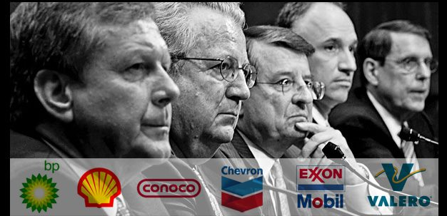

Slide 5
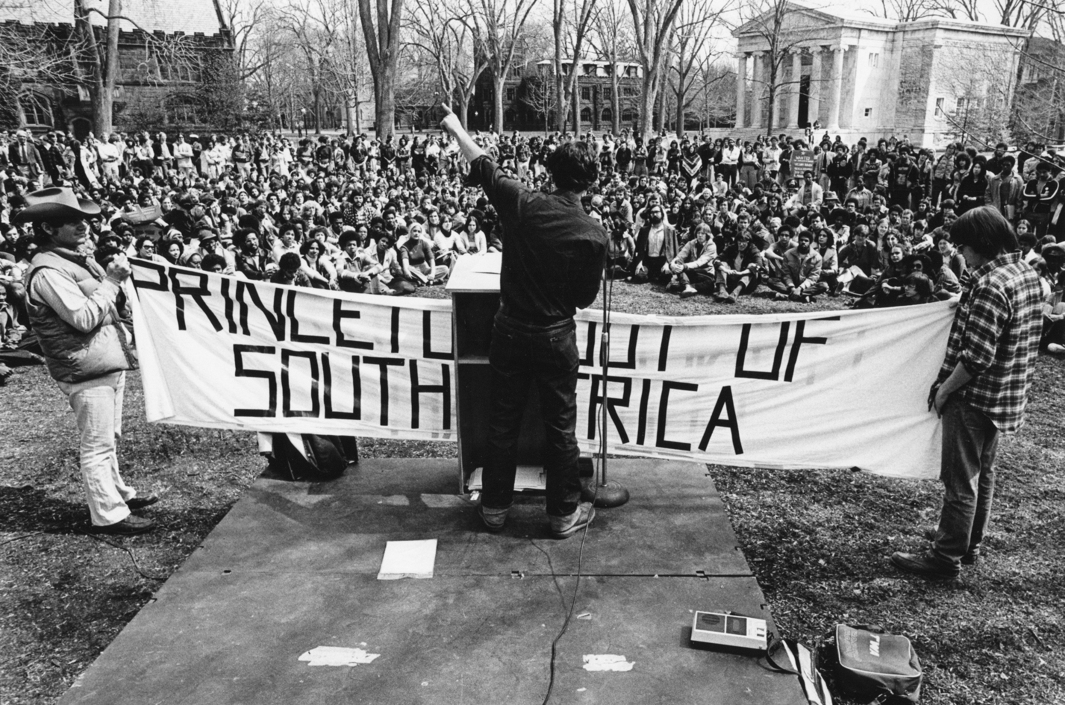

Slide 6
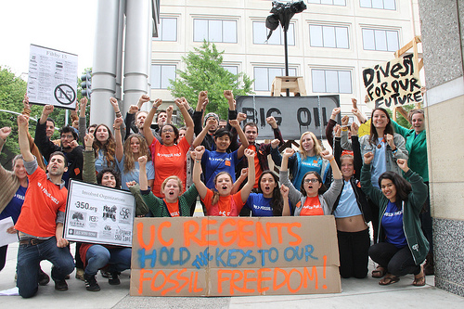

Slide 7
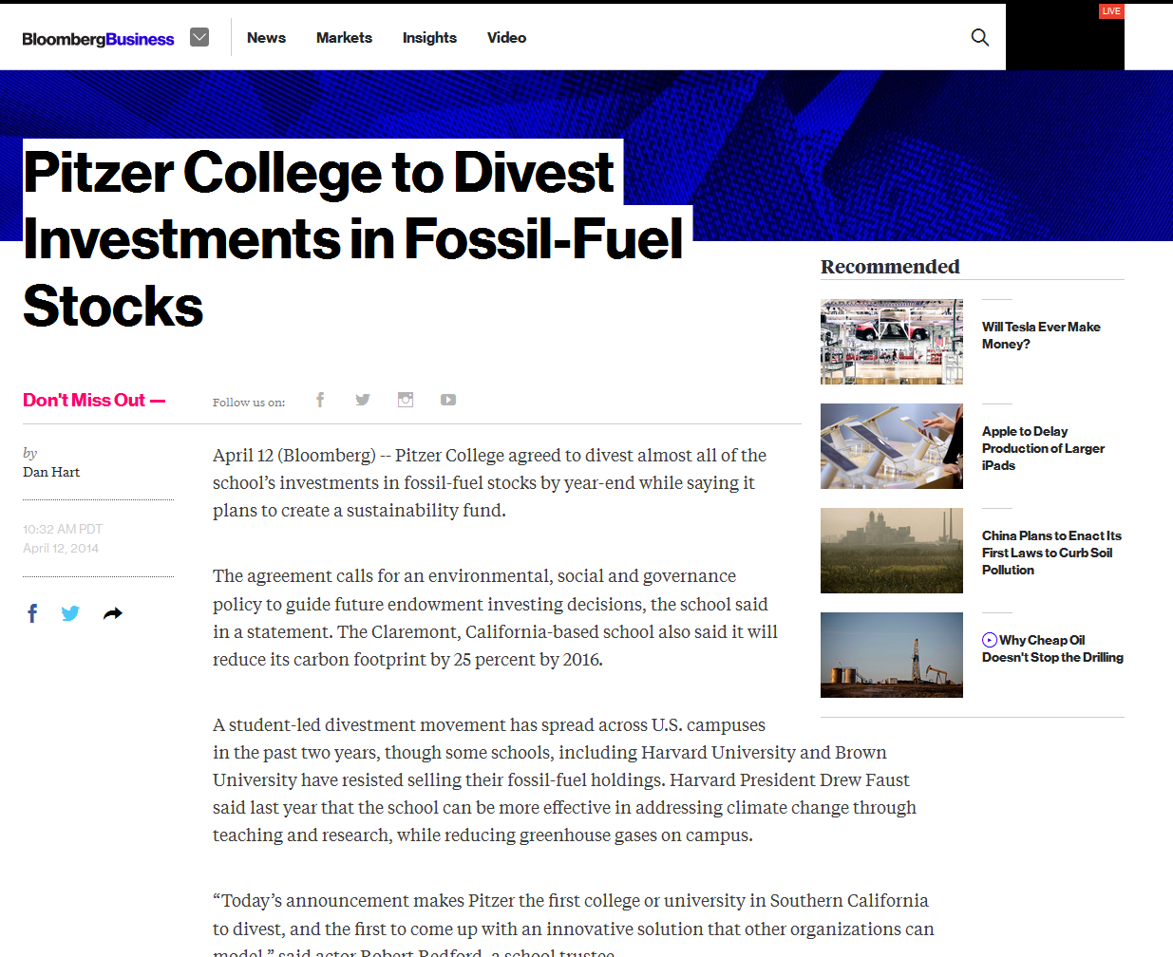

Slide 8
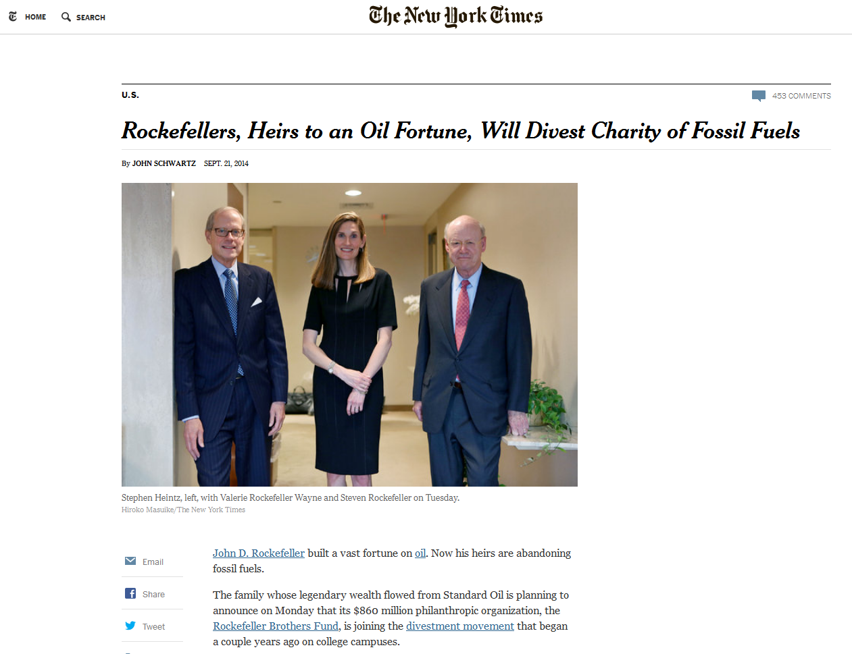

Slide 9
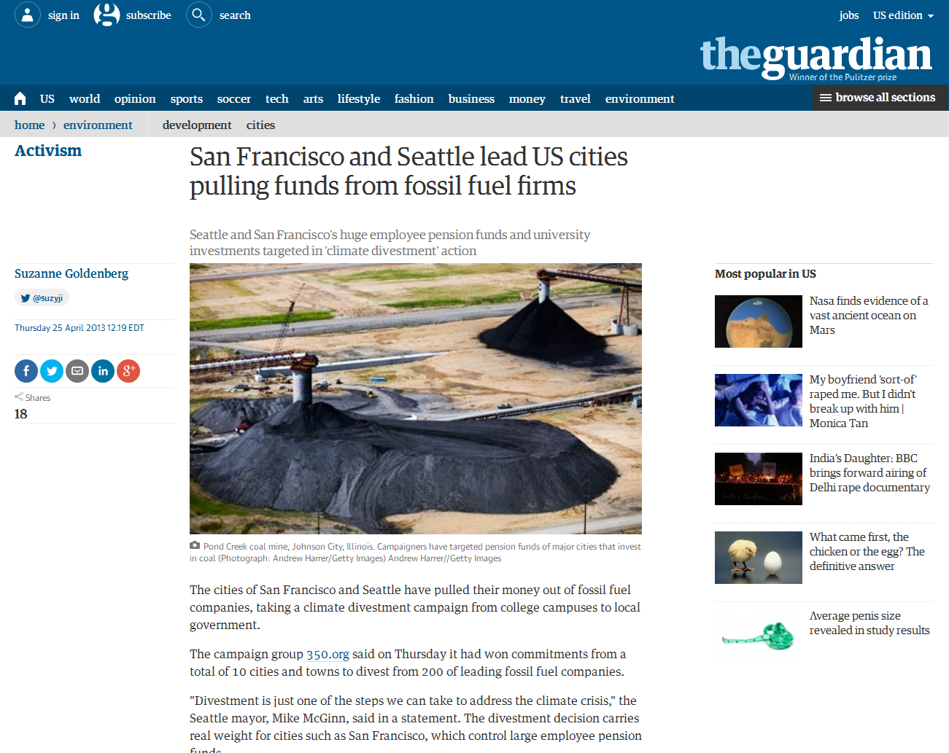

Slide 10
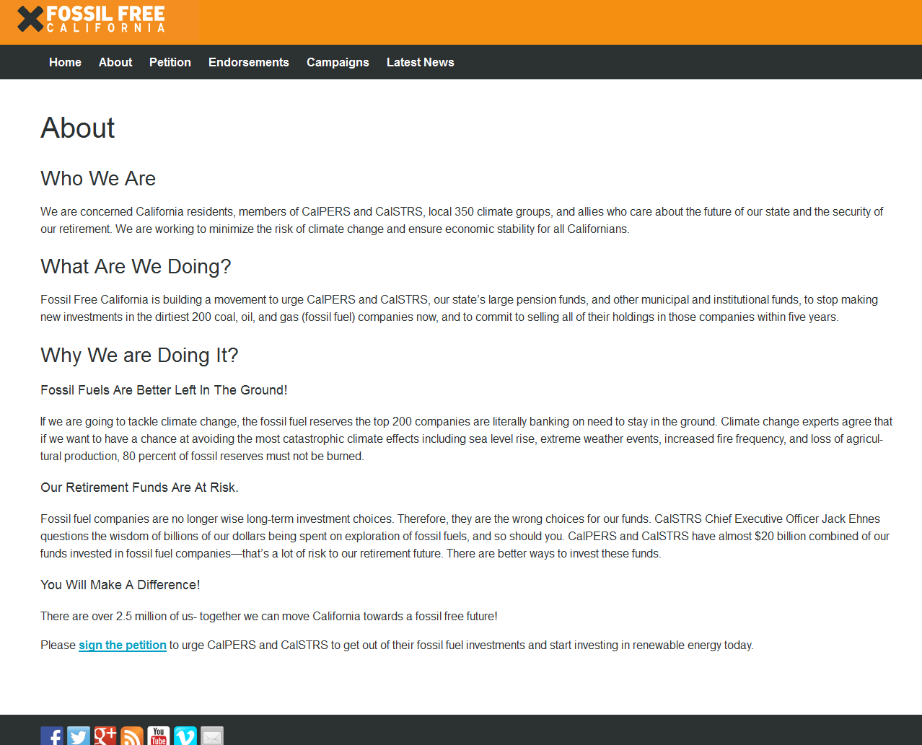

Slide 11
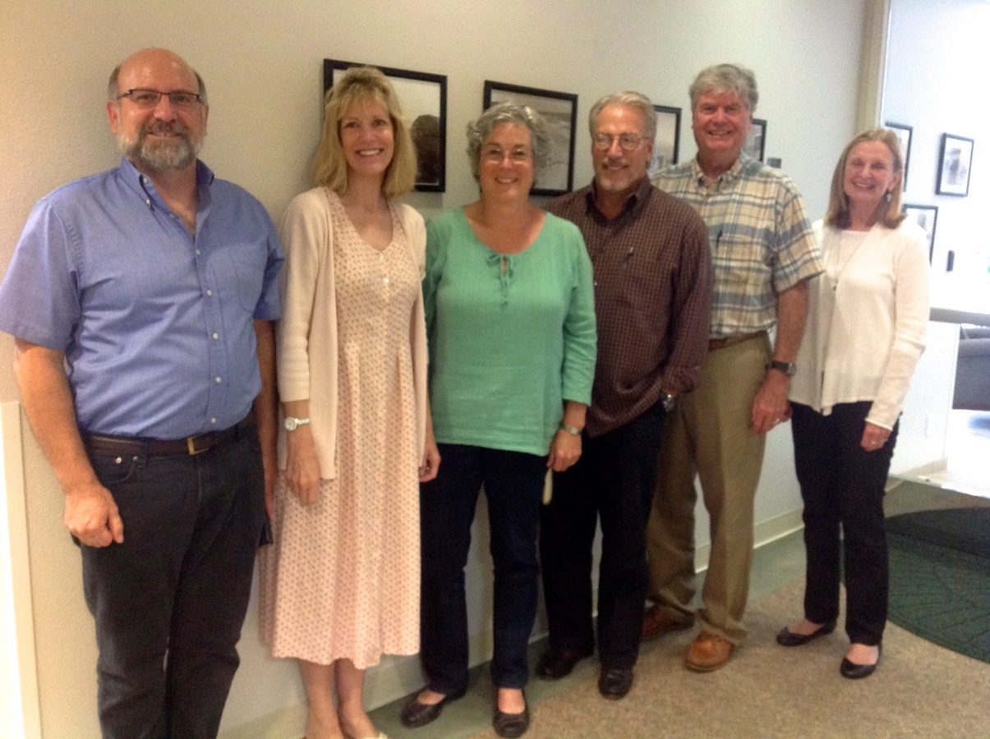
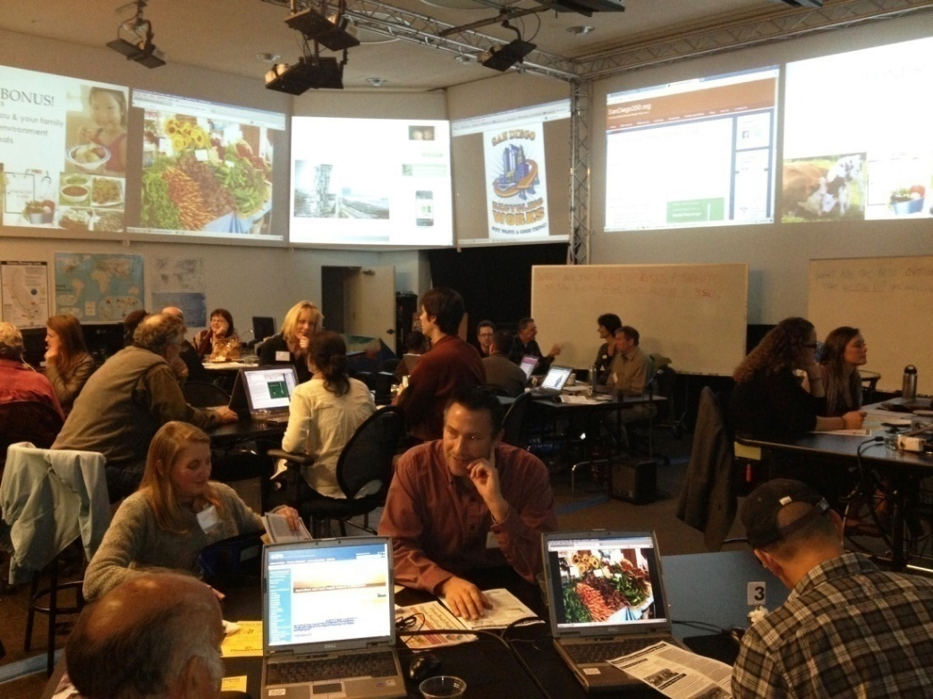
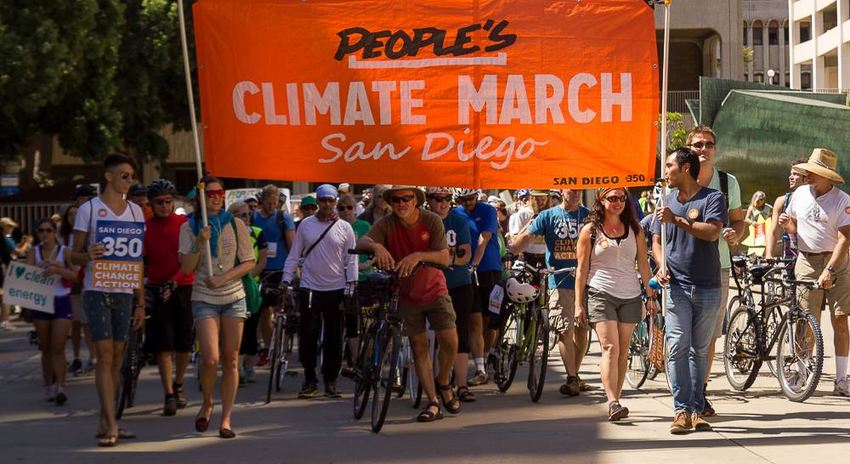
Notes:
So actually I’m going to skip the what is climate change and go right to why it’s a crisis. I was told (Jeff!) that you all know your stuff.
In this graph the red line shows how much carbon dioxide is in our atmosphere (in ppm or parts per million) over a period of several 100,00 years.
The blue line shows global temperature. (You can see that they are very closely related) [NEXT]
For many hundreds of thousands of years (including all of modern human history) the concentration of CO2 in the atmosphere has been stable at about 275ppm. [NEXT]
But by burning fossil fuels, it has now reached about 400 ppm. [NEXT]
If we continue business as usual we are on track for 550 ppm by the end of the century, an extremely dangerous level that would cause catastrophic climate problems.
Our group, SanDiego350.org, gets its name from 350 ppm. This is the concentration of carbon dioxide that scientists consider safe.
______________________________________________________________________________________________________________________________________
On this graph the red line shows how much carbon dioxide is in our atmosphere. The blue line shows global temperatures. You can see they are very closely related. For hundreds of thousands of years, the concentration of CO2 in the atmosphere was stable at around 280 parts per million. But by burning fossil fuels, it has now reached about 400ppm. If we keep doing what we’re doing now, the level of CO2 will reach 550ppm by the end of the century, an extremely dangerous level that would cause catastrophic climate problems. Our group, SanDiego350.org, gets its name from 350ppm, a level scientists say would make the planet safe.
___________________________________________________________________________________________________________________________________________________________________
Notes: Target Atmospheric CO2: Where Should Humanity Aim? By James Hansen et. al. is the paper where the 350ppm target comes from. It argues that we should aim to reduce carbon dioxide concentrations to 350ppm to avoid a largely ice-free Earth. (50 million years ago, carbon dioxide dropped in concentration to 425+/-75ppm and glaciers formed.)

Slide 12
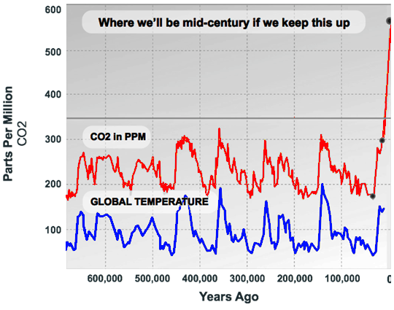

550ppm??!
Now: 400ppm
275ppm
Notes:
So actually I’m going to skip the what is climate change and go right to why it’s a crisis. I was told (Jeff!) that you all know your stuff.
In this graph the red line shows how much carbon dioxide is in our atmosphere (in ppm or parts per million) over a period of several 100,00 years.
The blue line shows global temperature. (You can see that they are very closely related) [NEXT]
For many hundreds of thousands of years (including all of modern human history) the concentration of CO2 in the atmosphere has been stable at about 275ppm. [NEXT]
But by burning fossil fuels, it has now reached about 400 ppm. [NEXT]
If we continue business as usual we are on track for 550 ppm by the end of the century, an extremely dangerous level that would cause catastrophic climate problems.
Our group, SanDiego350.org, gets its name from 350 ppm. This is the concentration of carbon dioxide that scientists consider safe.
______________________________________________________________________________________________________________________________________
On this graph the red line shows how much carbon dioxide is in our atmosphere. The blue line shows global temperatures. You can see they are very closely related. For hundreds of thousands of years, the concentration of CO2 in the atmosphere was stable at around 280 parts per million. But by burning fossil fuels, it has now reached about 400ppm. If we keep doing what we’re doing now, the level of CO2 will reach 550ppm by the end of the century, an extremely dangerous level that would cause catastrophic climate problems. Our group, SanDiego350.org, gets its name from 350ppm, a level scientists say would make the planet safe.
___________________________________________________________________________________________________________________________________________________________________
Notes: Target Atmospheric CO2: Where Should Humanity Aim? By James Hansen et. al. is the paper where the 350ppm target comes from. It argues that we should aim to reduce carbon dioxide concentrations to 350ppm to avoid a largely ice-free Earth. (50 million years ago, carbon dioxide dropped in concentration to 425+/-75ppm and glaciers formed.)

Slide 13

LINKS
SanDiego350 http://sandiego350.org
Go Fossil Free http://gofossilfree.org
Fossil Free California www.fossilfreeca.org
Global Warming’s Terrifying New Math www.rollingstone.com/politics/news/global-warmings-terrifying-new-math-20120719

