Slide 1


Topic of Discussion
“Climate Change and Energy Transition”
Presented by the Plan B Project Team
Plan B 4.0: Mobilizing to Save Civilization
by Lester R. Brown

Slide 2
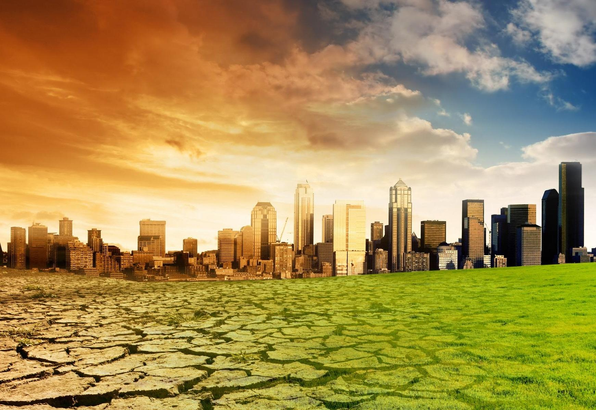
Climate Change:
Climate change refers to any significant change in the measures of climate lasting for an extended period of time.
Source: United States Environmental Protection Agency

Slide 3
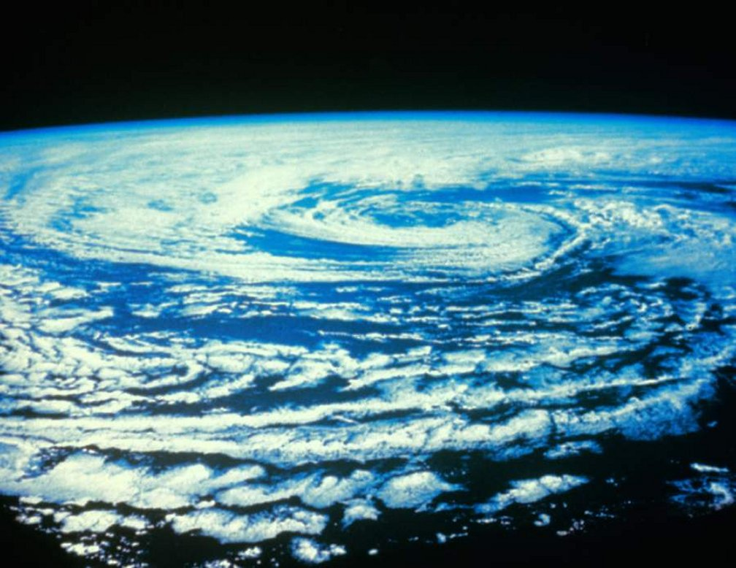
Some Definitions…
Climate: is a typical or average long term weather
Weather: short term changes such as temperature, clouds, etc.
Global Warming: average long term rising temperature
-> roughly 1°F in the last 100 years

Slide 4
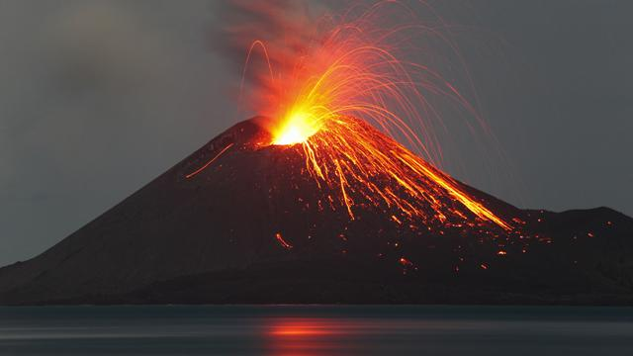
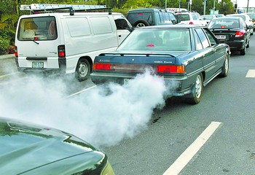
What are the reasons for Climate Change?
Natural reasons: such as oceanic processes, variation of solar radiation, plate tectonics, volcanic eruptions, etc.
NOT INFLUENCEABLE
Anthropogenic reasons (Human influence): global warming, lack of awareness, etc.
INFLUENCEABLE!!

Slide 5
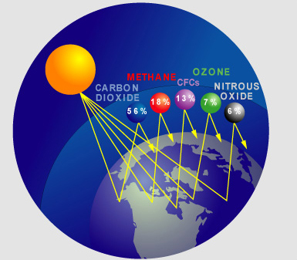
Greenhouses Gases
The gases that contribute to warming the earth due to their higher concentrations in our atmosphere.
Carbon Dioxide
Methane
Nitrous Oxide
Ozone
CFCs
Source: National Climatic Data Center

Slide 6
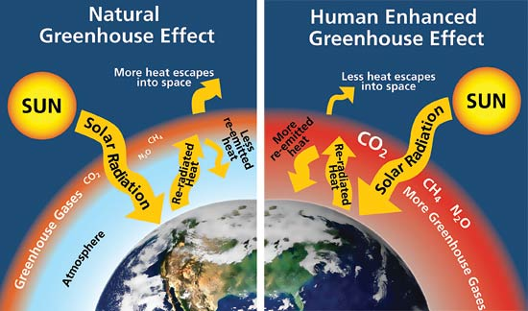
The Green House Effect
Source: National Park Service

Slide 7
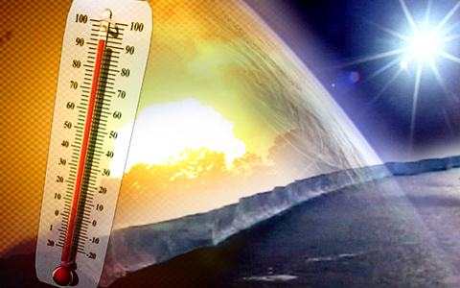
Global Warming Potential
GWP –
A measure of the total energy that a gas absorbs over a particular period of time (usually 100 years), compared to carbon dioxide.
Carbon Dioxide (CO₂) – 1
Methane (CH₄) – 21
Nitrous Oxide (NO₂) – 310
CFCs – 6,500 -15,000
Source: EPA

Slide 8
to make relations and comparisons much easier…
CO₂ equivalent
-> CO₂e = CO₂ + CH₄ + N₂O + … <-
Videos
The Carbon Cycle – by NASA
The Green House Effect – by NASA
Discovery Channel - Global Warming (recommended)

Slide 9
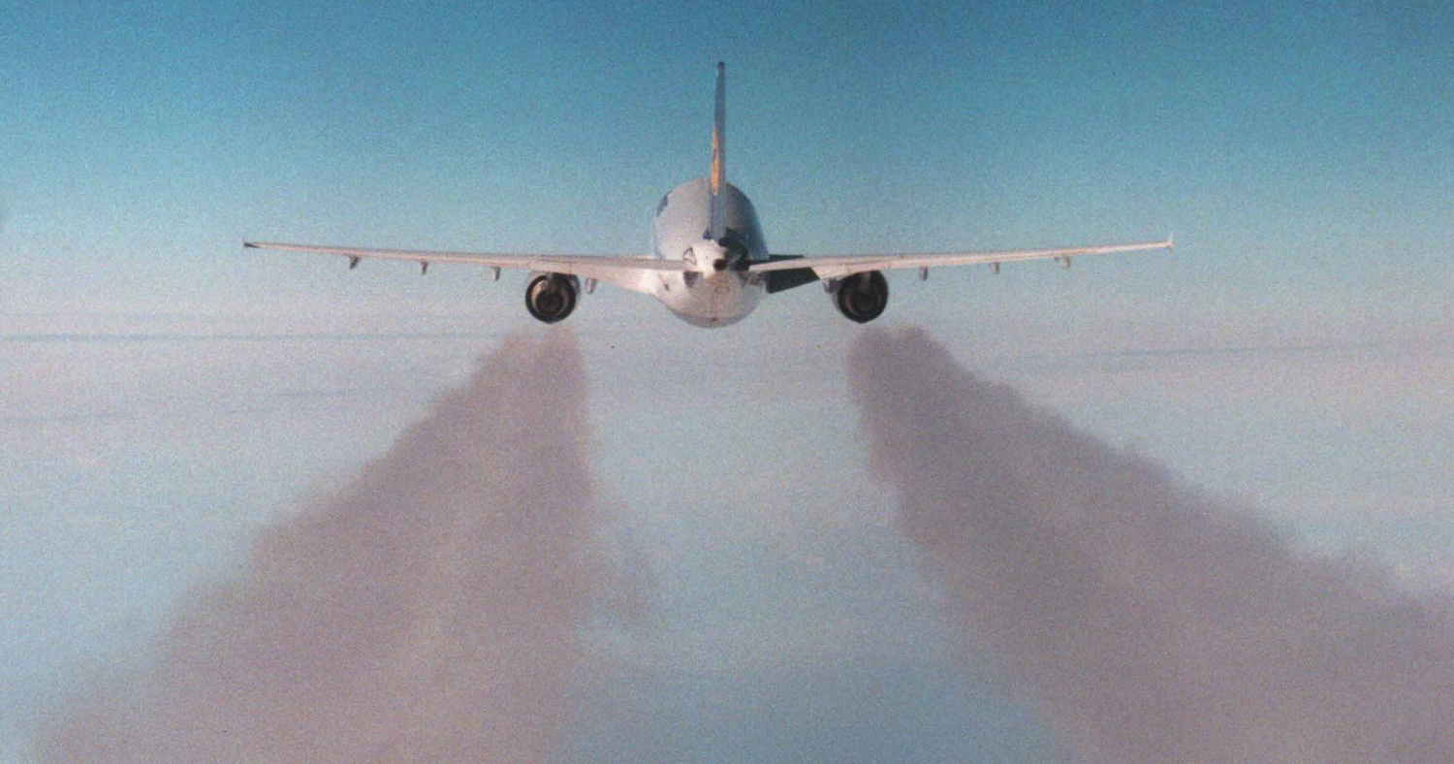
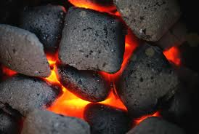
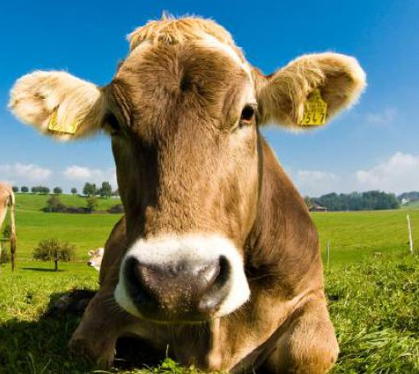
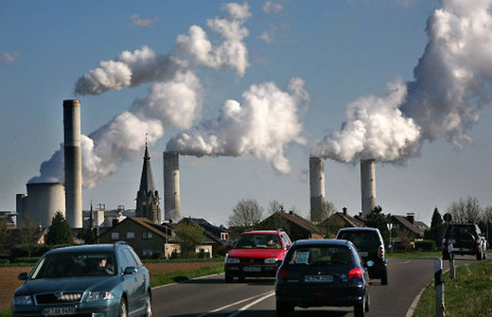
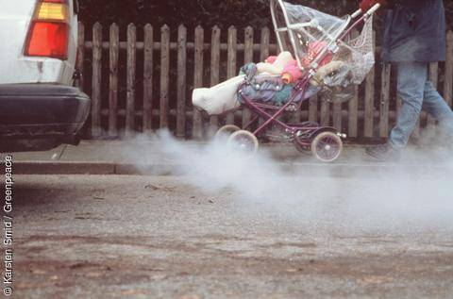
Causes
Source: ???????????

Slide 10
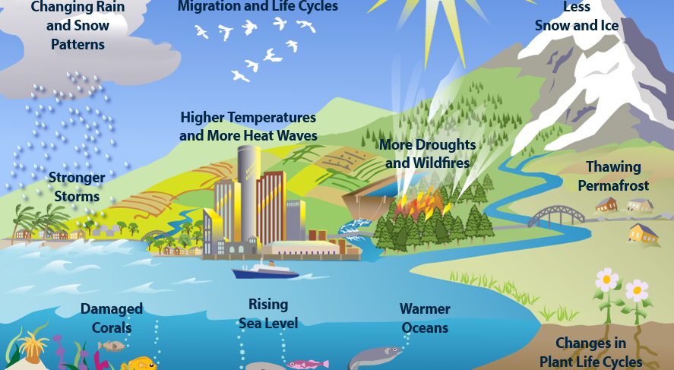
Evidence of Climate Change
Source: United States Environmental Protection Agency

Slide 11
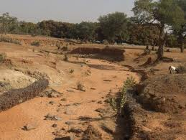
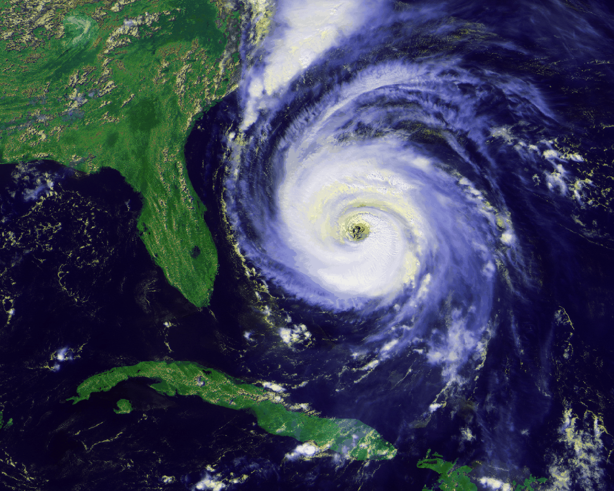
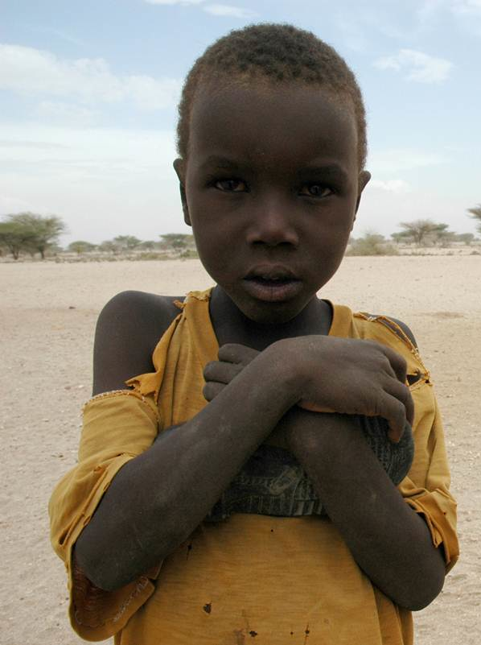
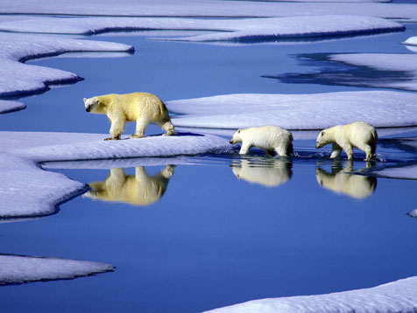
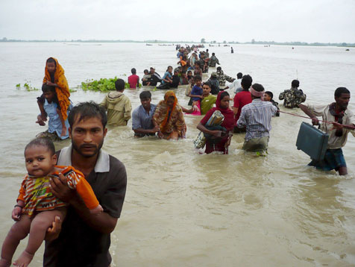
Effects

Slide 12
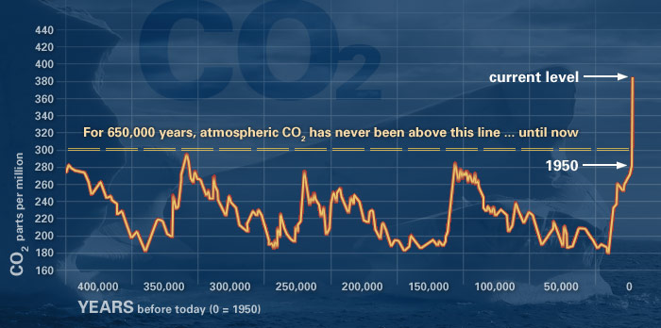
Temperature
Source: UC Riverside

Slide 13
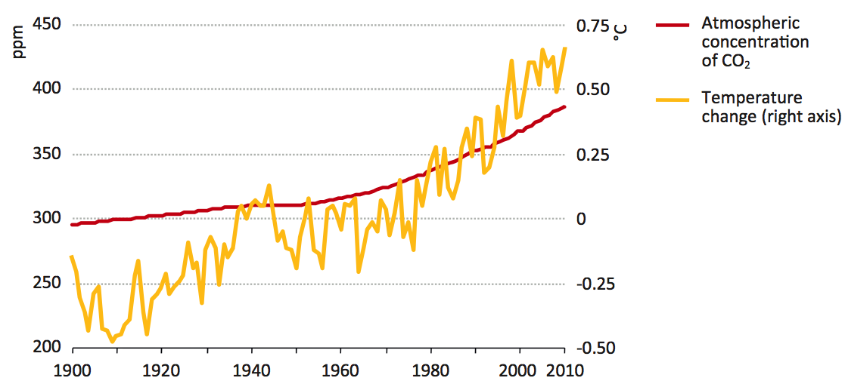
World Atmospheric Concentration of CO₂ and Average Global Temperature Change
Source: World Energy Outlook Special Report by IEA, June 2013

Slide 14
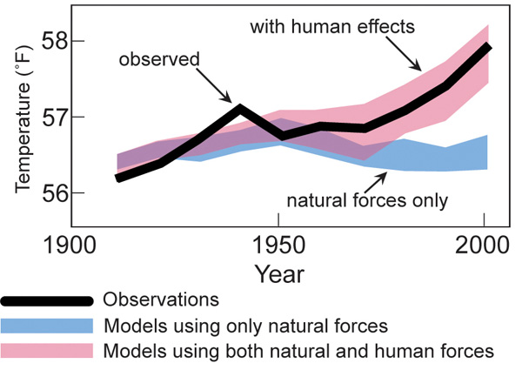
Global Temperature Models
Source: USGRCP 2009

Slide 15
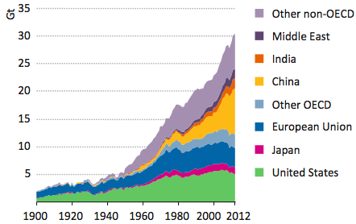
Energy Related CO₂ Emissions by Country
Source: IEA Database and Analysis, Boden et al., (2013)

Slide 16
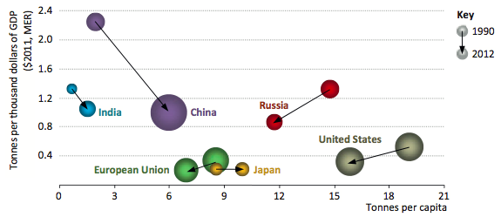
Energy Related CO₂ Emissions Per Capita
Source: World Energy Outlook Special Report by IEA, June 2013

Slide 17
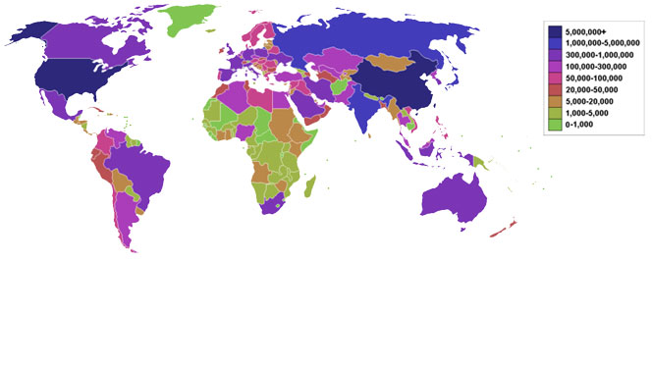
Global CO₂ Footprint
(In thousands of tons per year – burning of fossil fuels)
Source: Sciencemuseum.org.uk

Slide 18
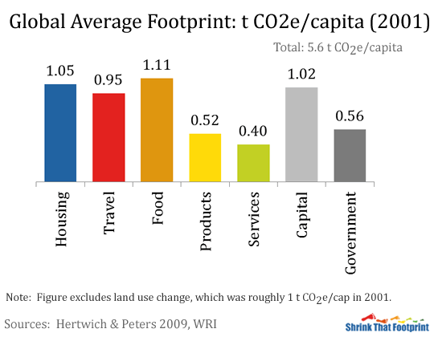
Global Average Personal Footprint for 2001
5.6 t CO₂e/Capita
Source: E. Hertwich & G. Peters 2009, WRI

Slide 19
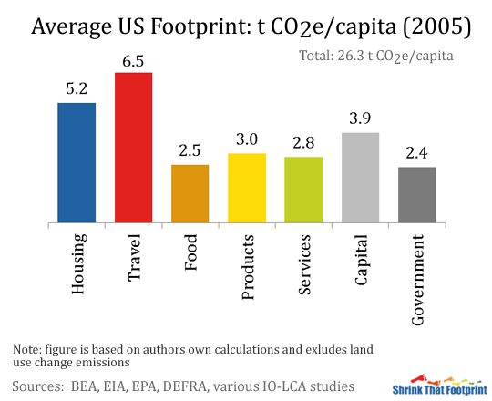
US Average Personal Footprint for 2001
26.3 t CO₂e/Capita
Source: E. Hertwich & G. Peters 2009, WRI

Slide 20
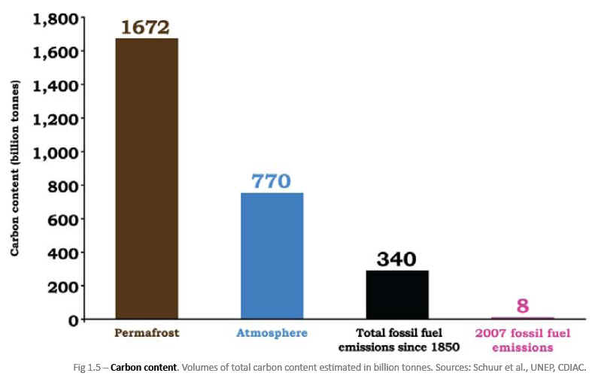
Carbon Content

Slide 21
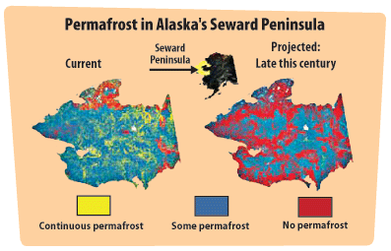
Melting Permafrost
Source: EPA – US Global Change Research Program (2009)

Slide 22
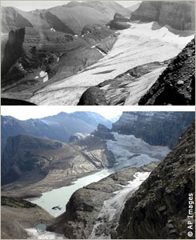
Melting Ice
Glacier National Park
1910 – 150 Glaciers
Now – Less than 30
Of those remaining, most have shrunk in size by 2/3.
1940
2004
Source: National Geographic

Slide 23
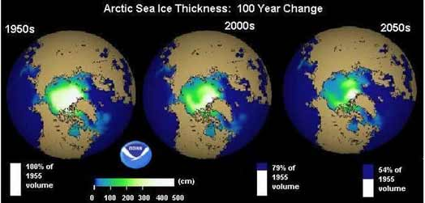
Losing Arctic Sea Ice
Source: NOAA

Slide 24
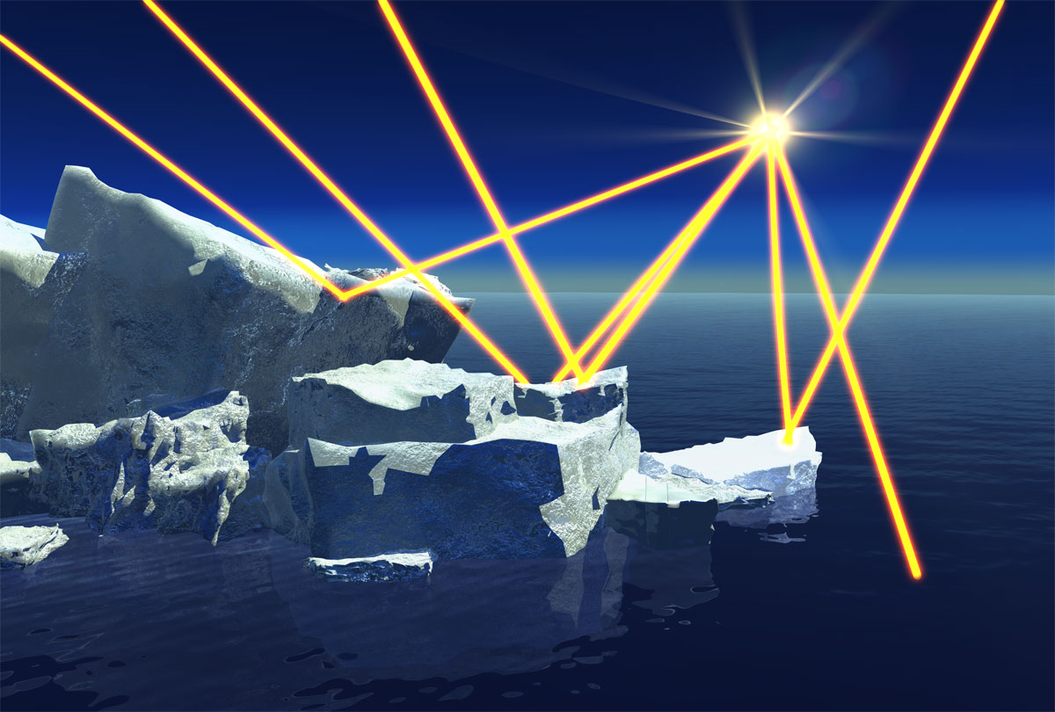
Albedo Effect
Ice: More Sun Radiation is Reflected, Less is Absorbed
(Dark) Water: More Sun Radiation is Absorbed, Less is Reflected
http://www.nasa.gov/mpeg/110649main_blacksoot.mpeg
Source: NASA

Slide 25
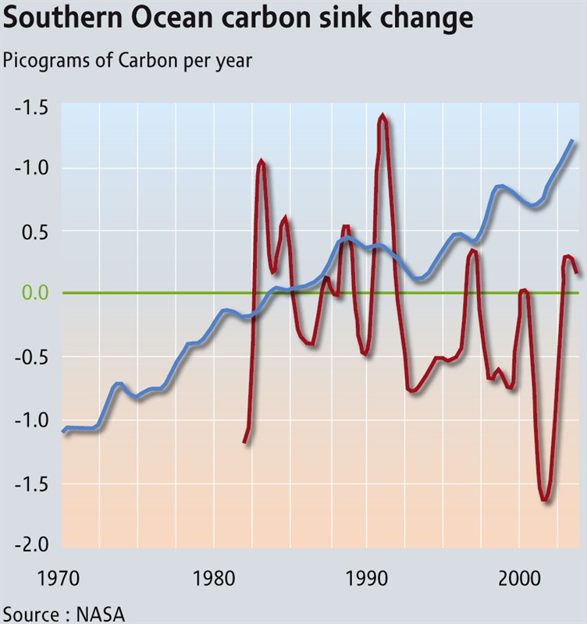
Warming Ocean Temperature
Blue = atmospheric CO₂
Red = Ocean absorptive capacity
Warmer ocean waters will hold less dissolved carbon, leaving more in the atmosphere.
Source: NASA

Slide 26
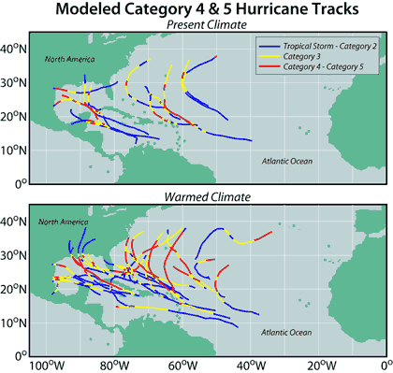
Weather Patterns
Scientists are predicting that hurricane intensity could increase due to the warmer ocean waters.
Source: Hurricane Science/Environmental Defense Fund

Slide 27
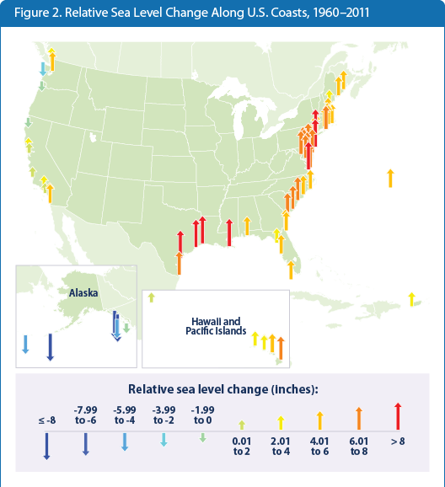
Sea Levels
flood.firetree.net
(Data Provided by NASA)
2°C (3.5°F) Rise in
Global Temperature
=
1m Rise in Sea Level
Source: United States Environmental Protection Agency

Slide 28
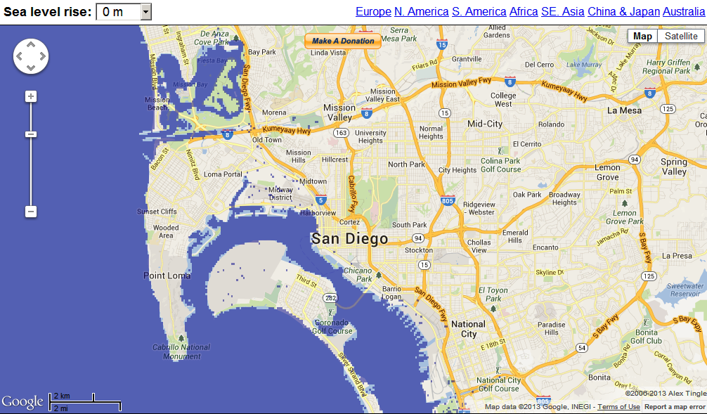
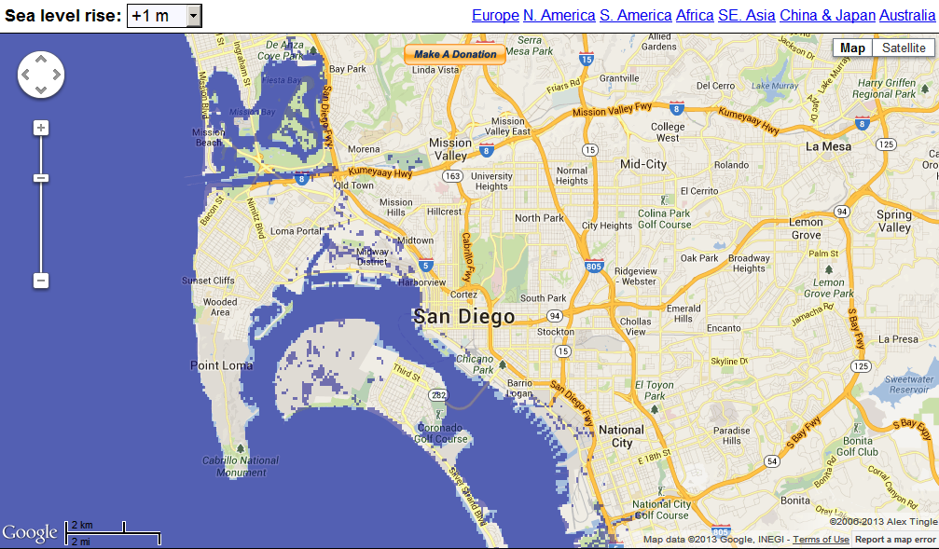

San Diego
Notes:
San Diego

Slide 29
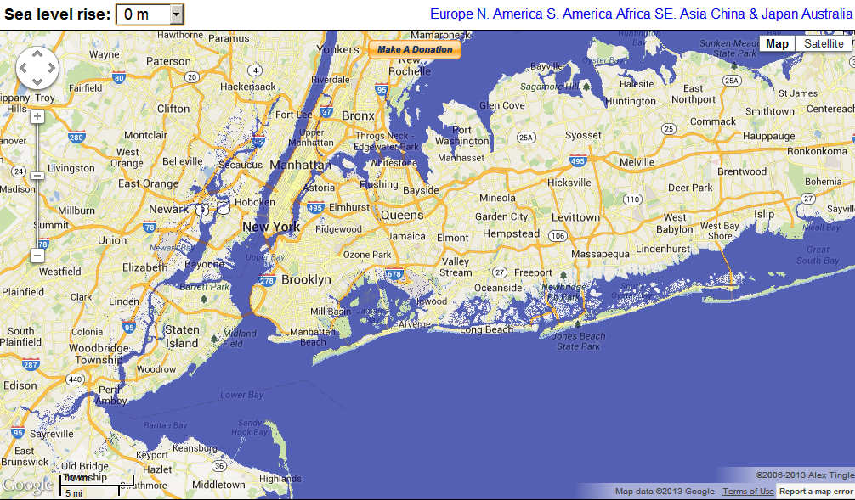
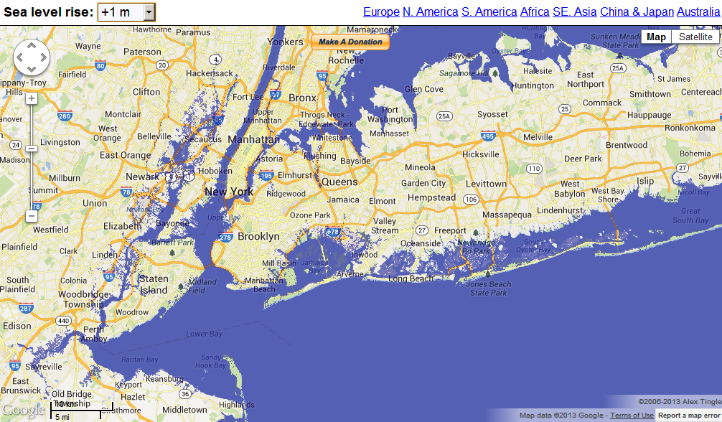

New York
Notes:
New York

Slide 30
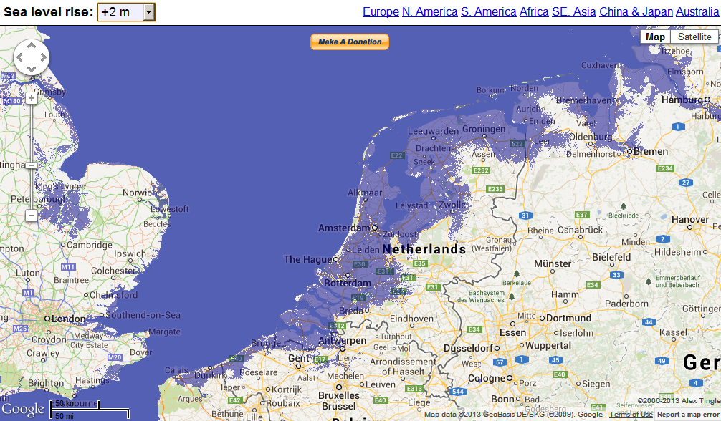
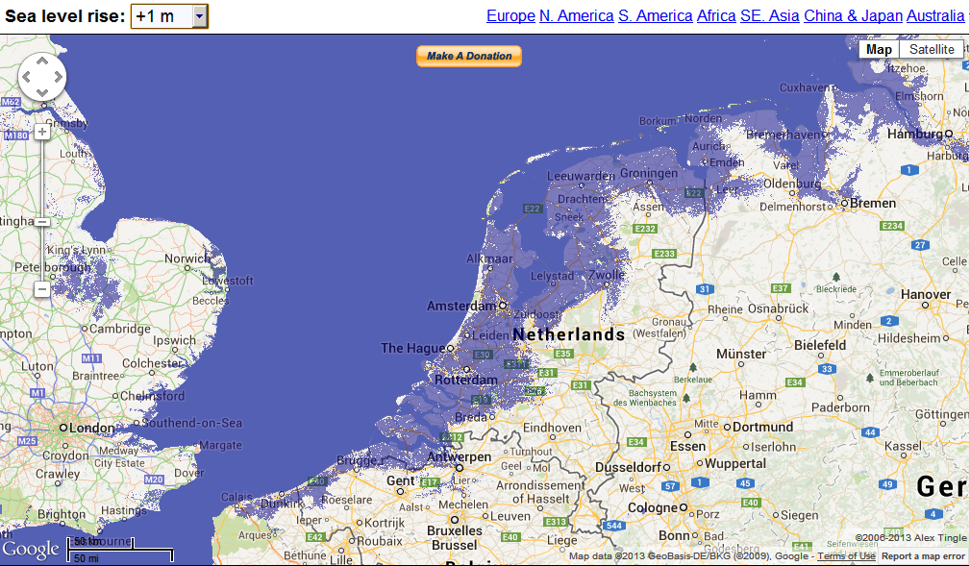
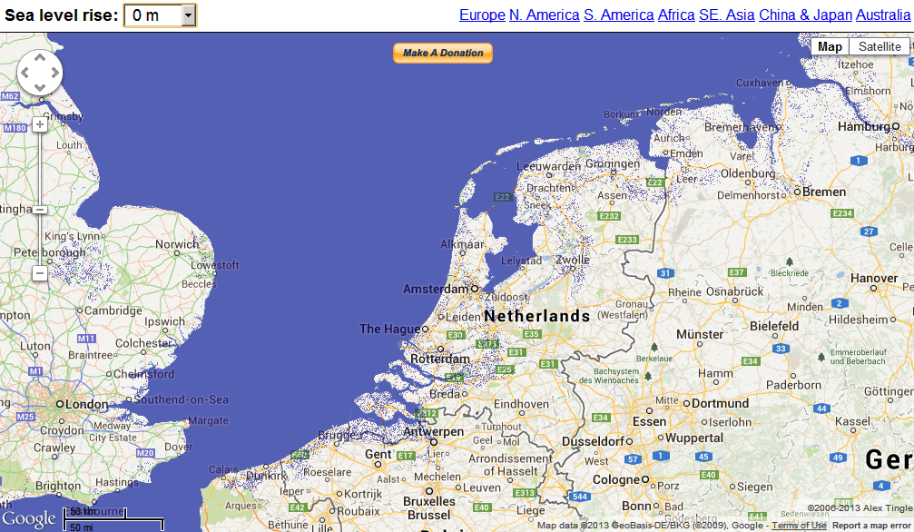
Netherlands

Slide 31
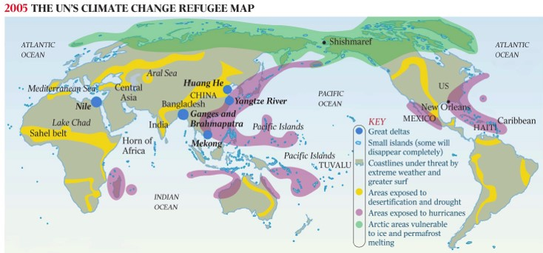
Climate Refugees
The London-based Environmental Justice Foundation reports that around 26 million people worldwide have already had to move due to the effects of climate change, a figure that could grow to 150 million by 2050.
Source: UN/World Watch Institute

Slide 32
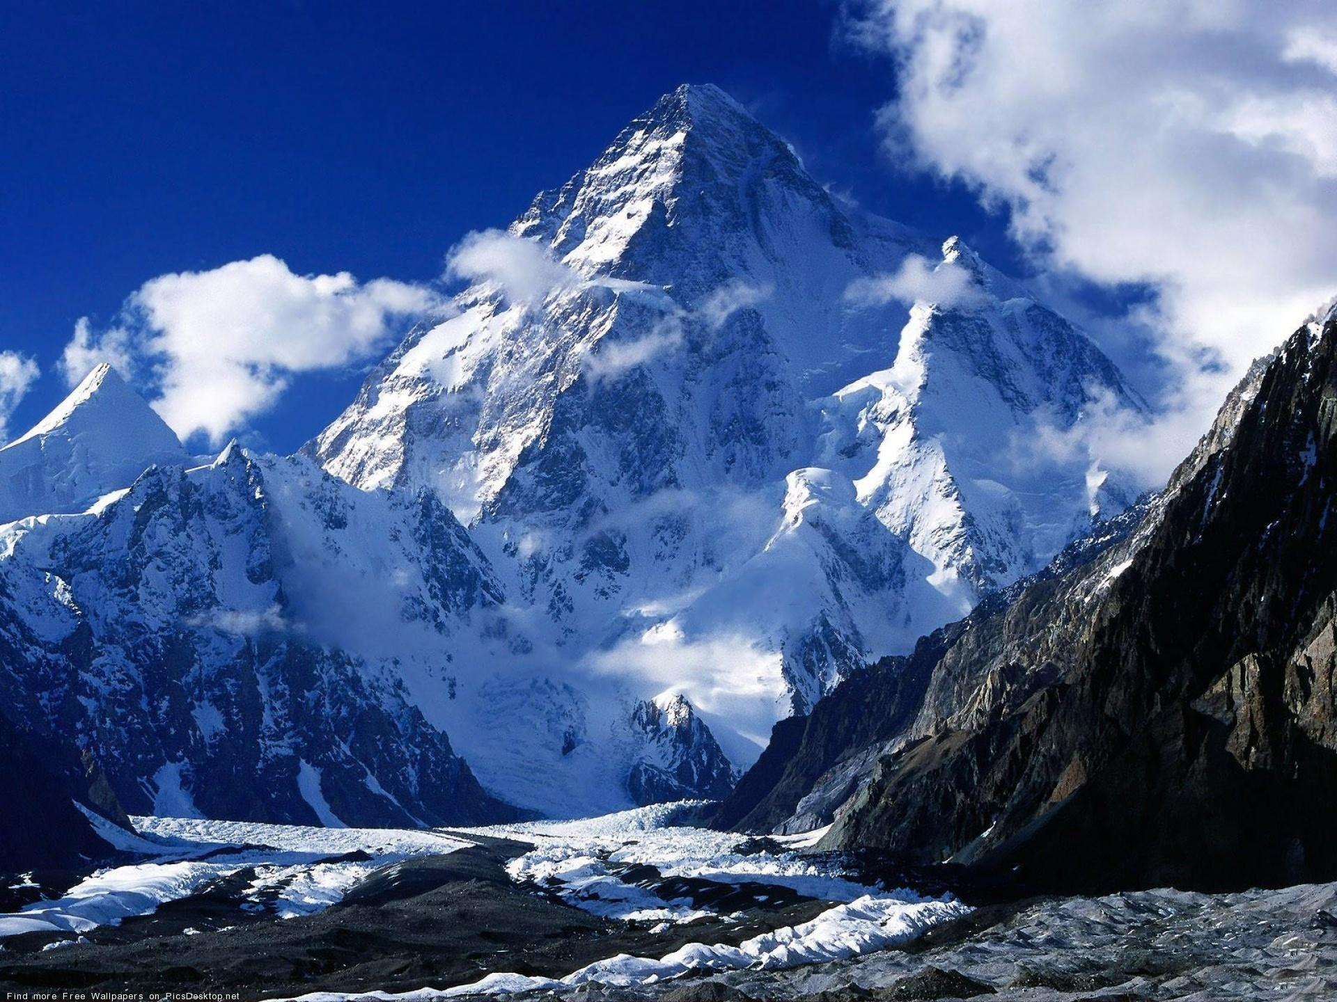
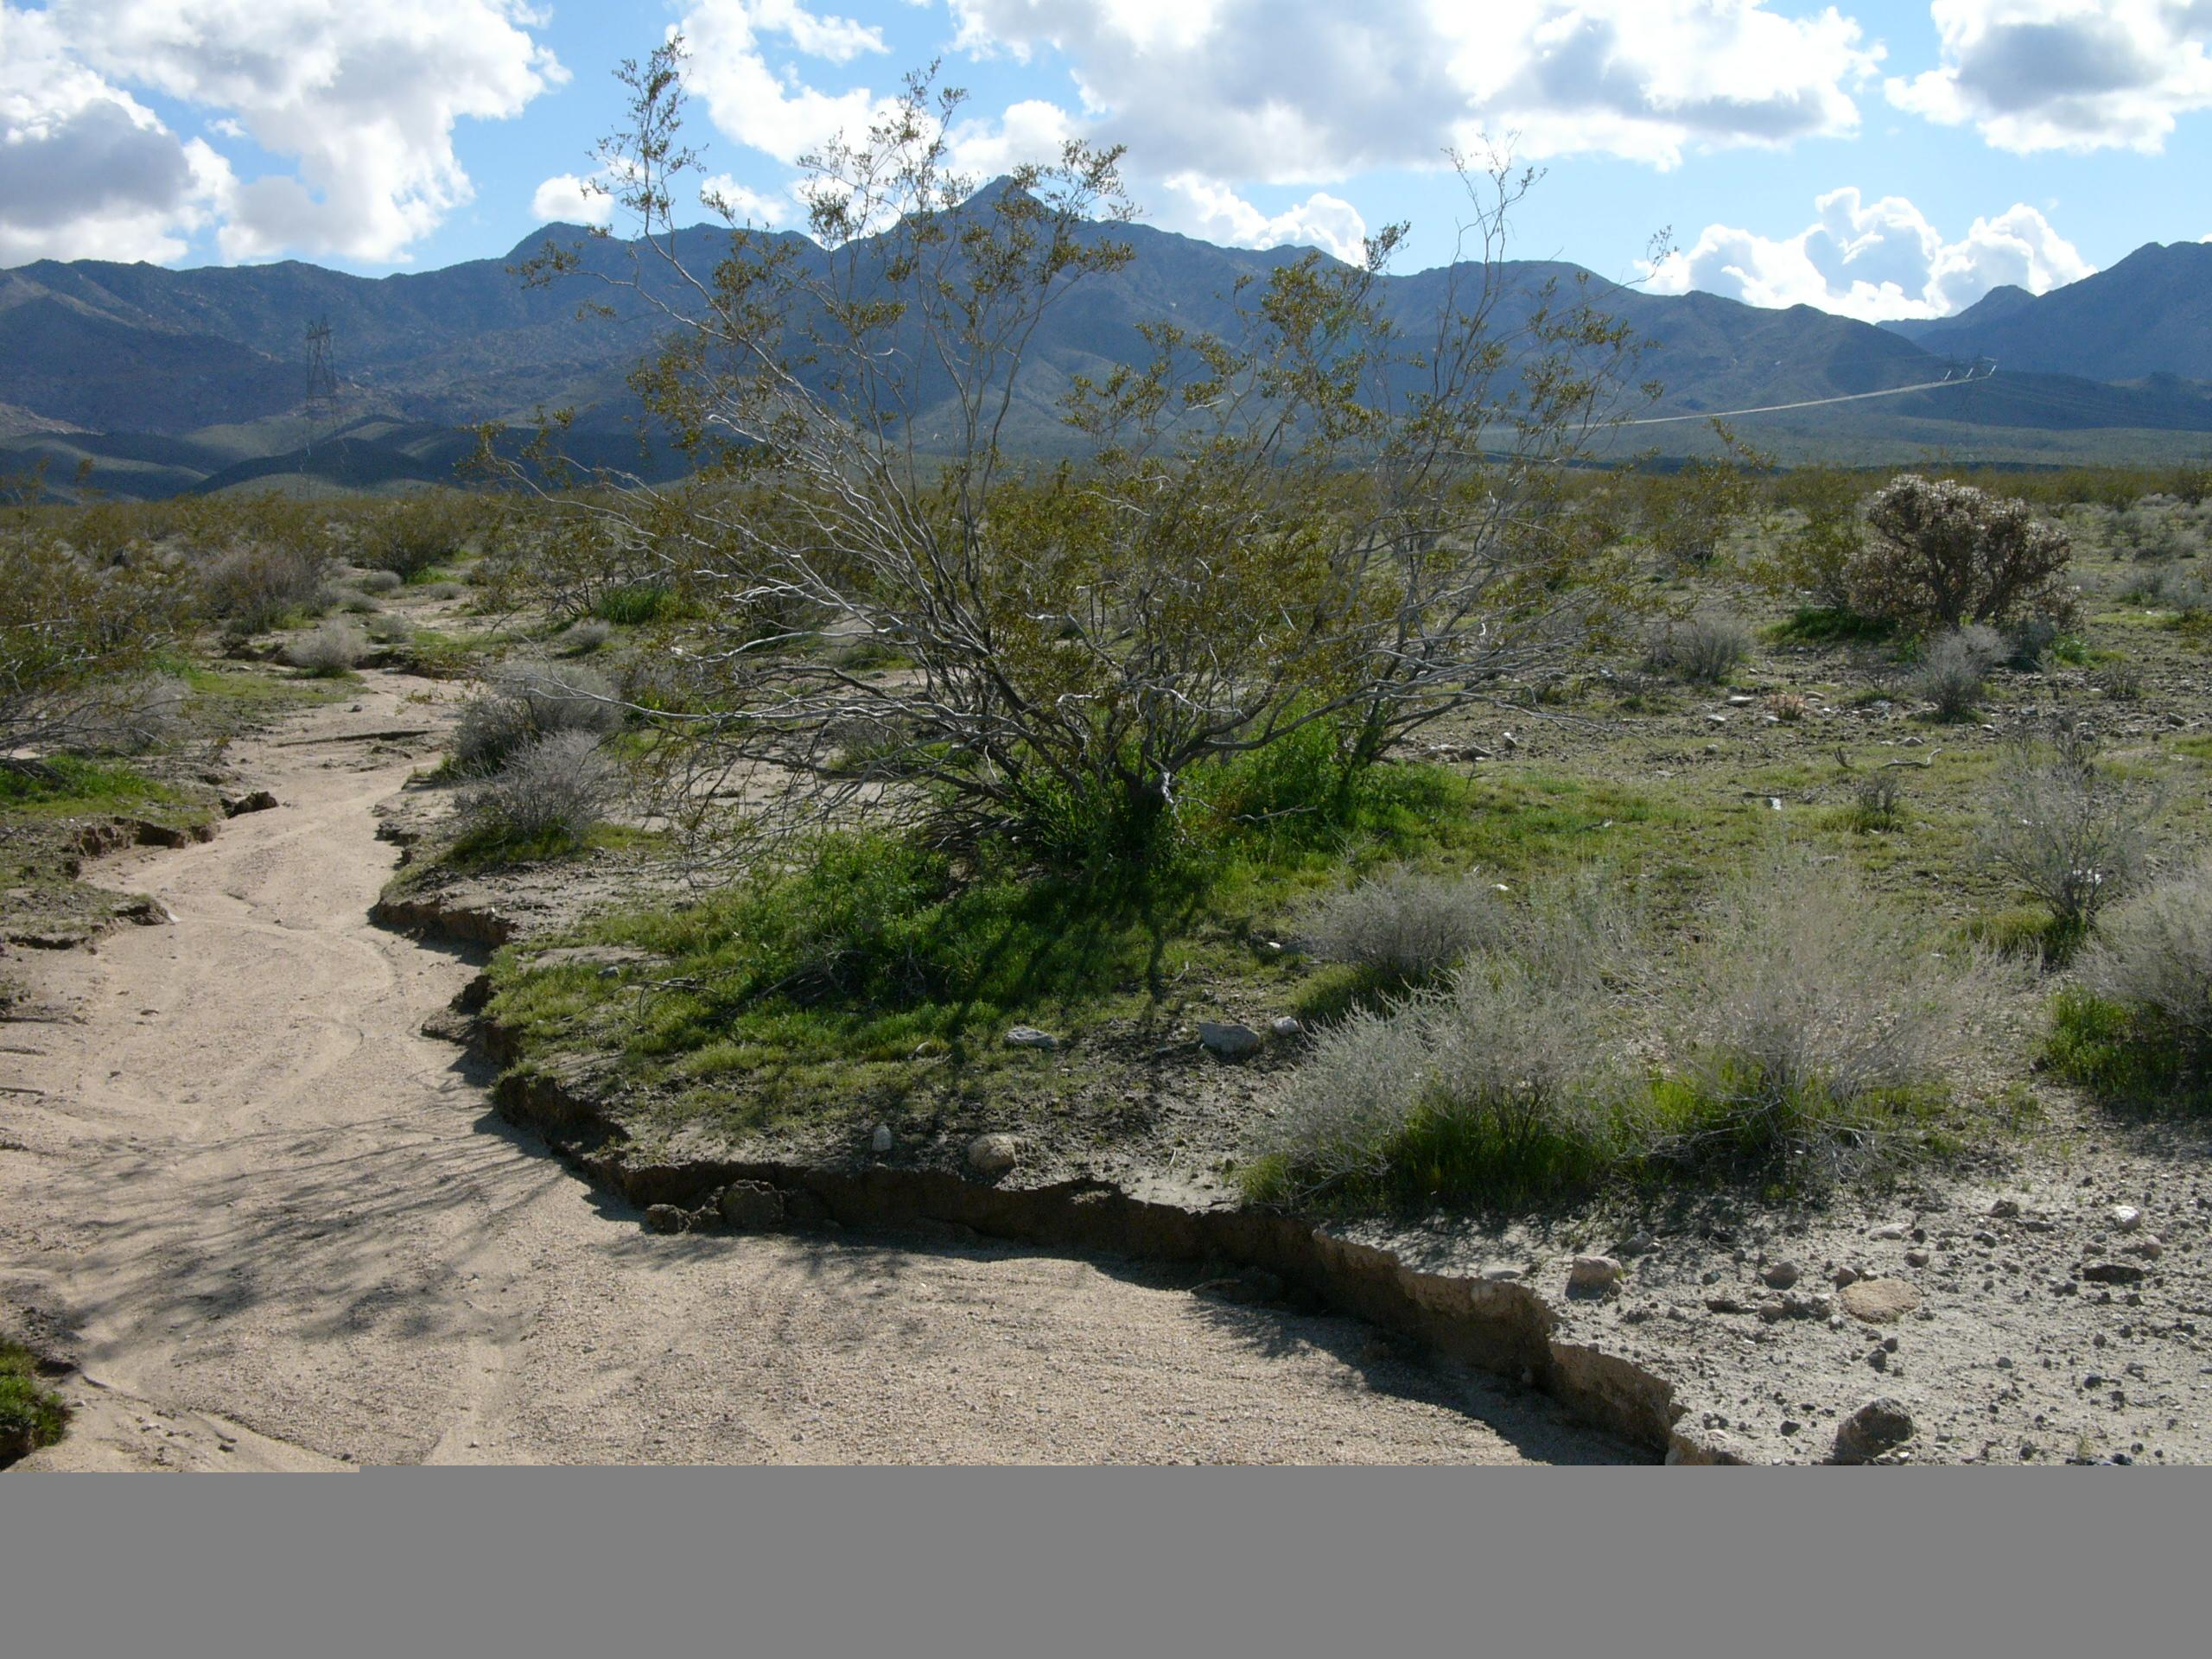
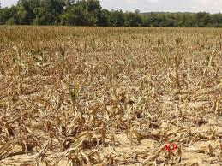

Dry Rivers and Food Security
Less Ice In Glaciers
Less Water In Rivers
Less Water For Crops
Less Food For People

Slide 33
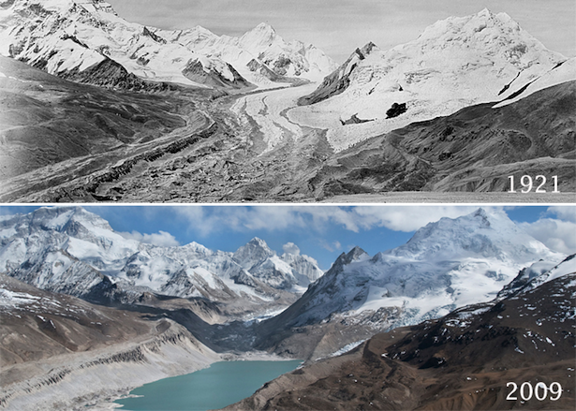
Dry Rivers - India
The Himalayan Glaciers will be completely melted by 2035
>70% of the Ganges River Flow Comes From These Glaciers
Source: Yao Tandong, IPCC 2007

Slide 34
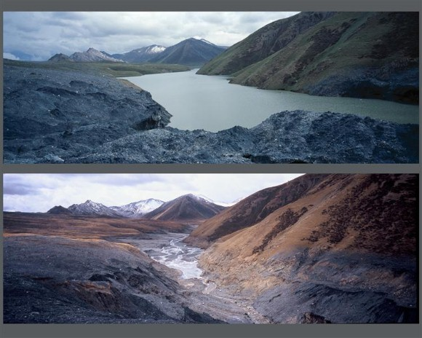
Dry Rivers - China
2/3 of the Tibet-Qing-hai Plateau Glaciers Will Be Melted by 2050
>68% of the Yangtze and Yellow Rivers Flow Comes From These Glaciers
Source: IPCC 2007/Green Peace

Slide 35
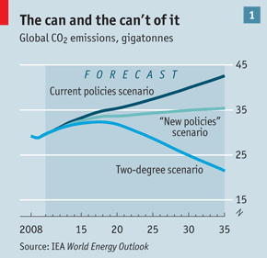
“Roadmaps” ….
A few cities and even countries are committed to reaching special targets regarding their CO₂ emissions and environmental performance.
These “roadmaps” are basically political driven!
the most important climate target:
the 2°C target until 2050

Slide 36
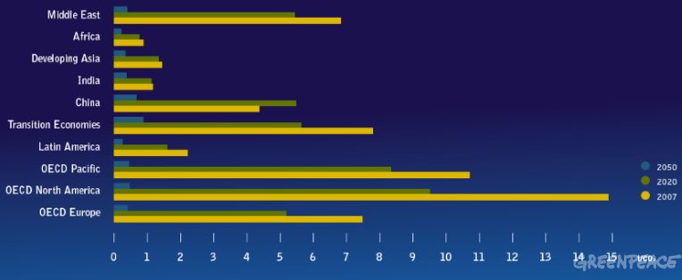
The future global footprint per Capita
< 1t CO₂e / year and Capita by 2050
Source: Greenpeace

Slide 37
Energy Potential
Source: R.Perez

Slide 38
“Don’t be put off by people who know what is not possible. Do what needs to be done, and check to see if it was impossible only after you are done.”
- Paul Hawken

Slide 39
