Slide 1
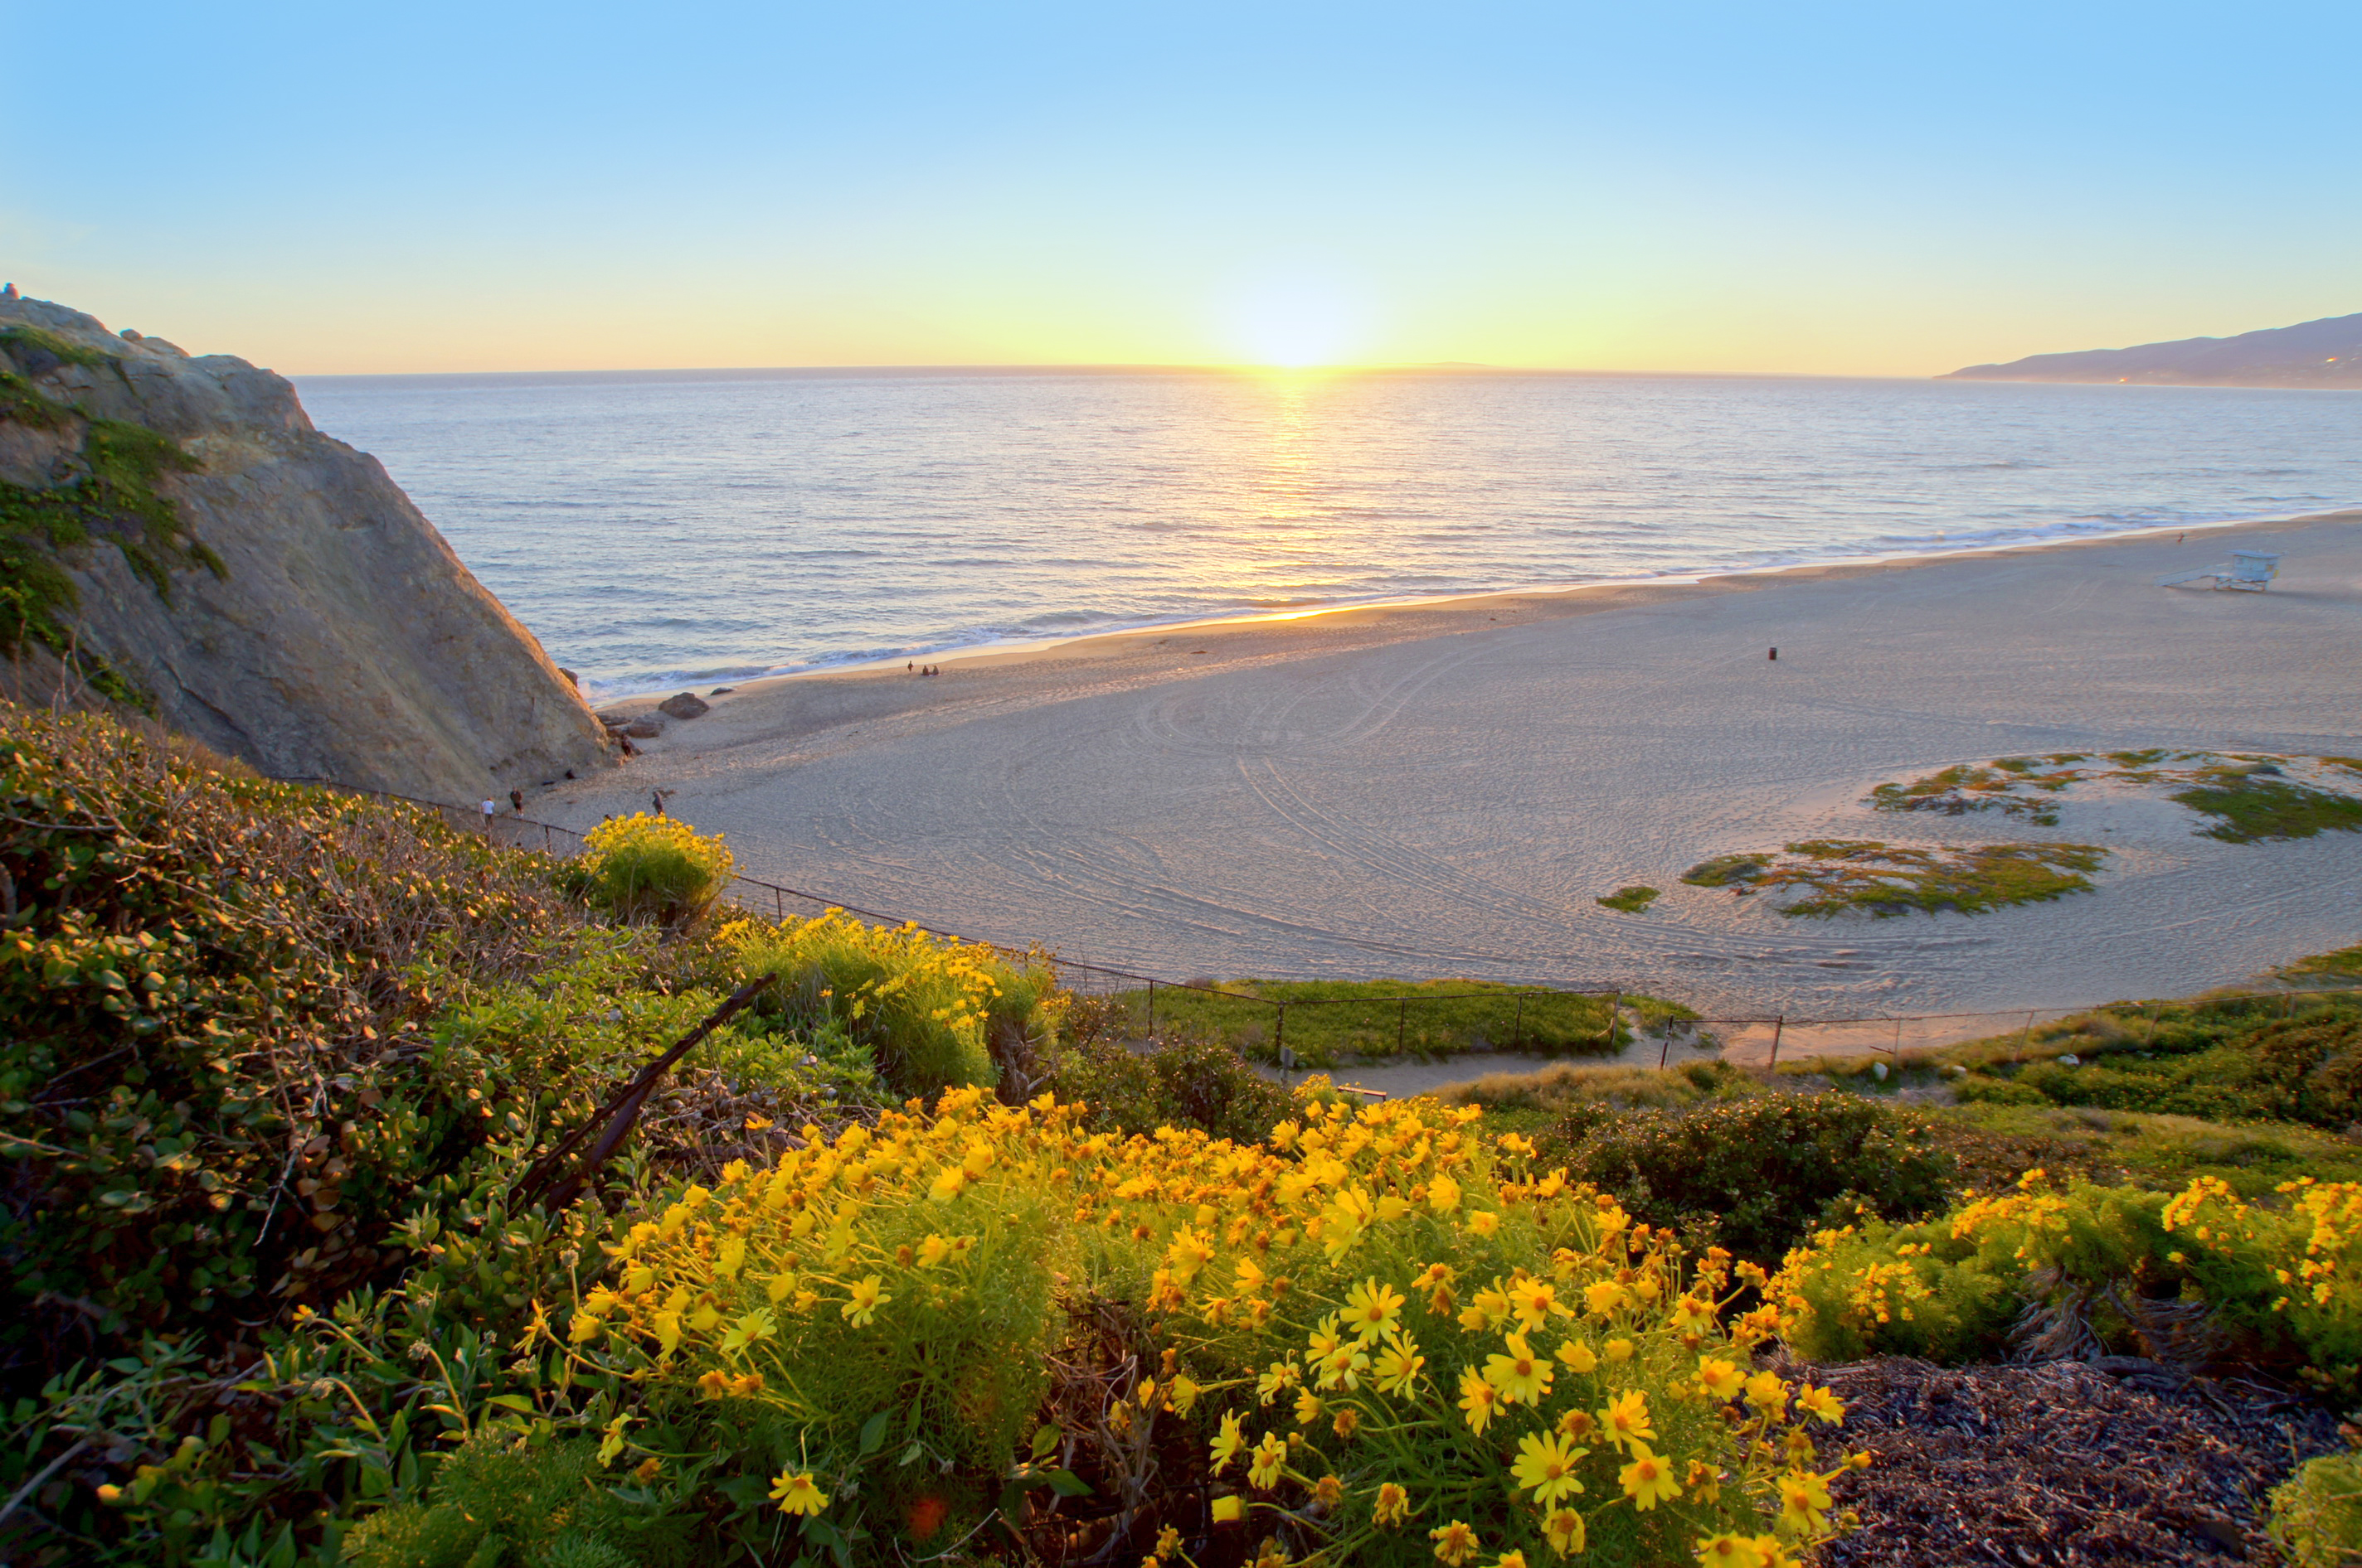

Overview:
San Diego Climate Action Plan
&
Community Choice Energy
Notes:
1

Slide 2
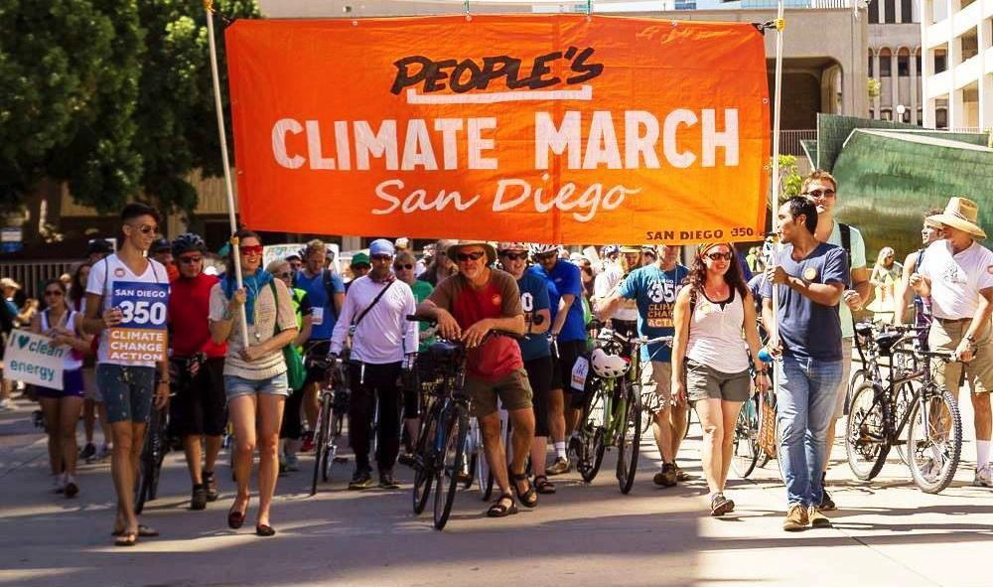
Our Mission: Stop Climate Change
The Leading Climate Watchdog Organization

Slide 3
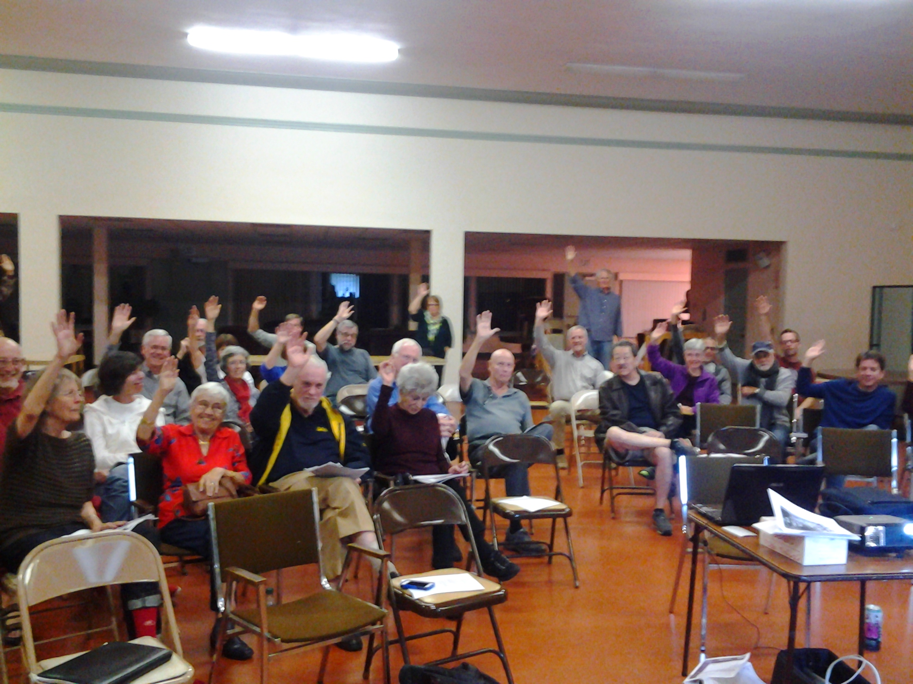
Our Goals:
Pass Climate Action Plans
Build the Base
Replicate and Scale

Slide 4
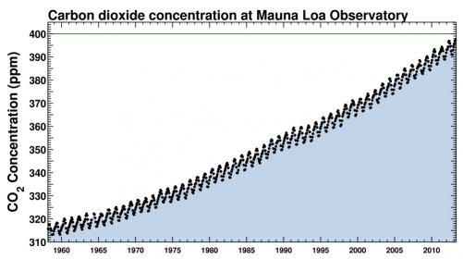
Highest CO2 Levels in Human History
Notes:
4

Slide 5
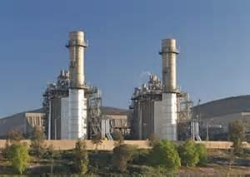
Dirty Energy Still Rules Today
In 2013, coal, oil, and natural gas provided 87% of the world's energy.
That fraction has not changed since 1999.
Notes:
5

Slide 6
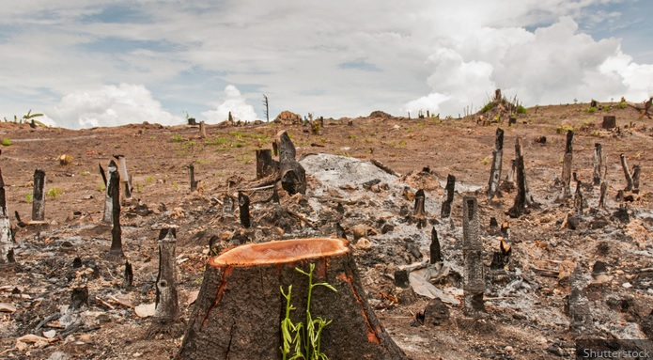
Life on Earth now officially at risk,
scientists say

Slide 7
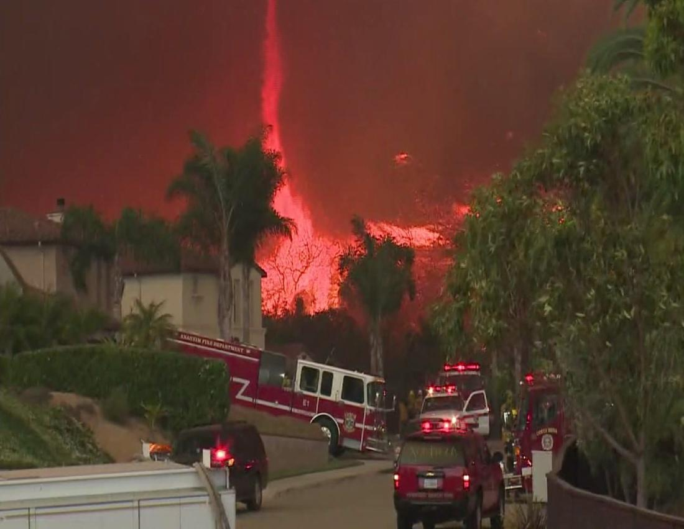
Climate Impacts in San Diego
Heat waves, more intense storms & drought
Increased fire frequency, intensity & area
Sea-level rise & coastal effects
Small window of opportunity to
slow climate change
Notes:
7

Slide 8
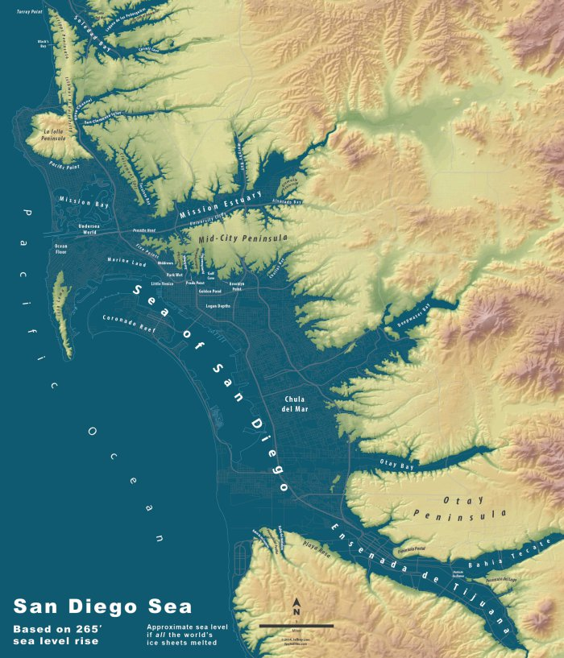
In 2050, if current trends continue...
Sea level will be 12-18 inches higher and fragile cliffs will collapse.
Beaches will shrink and some will disappear.
Coastal properties will be flooded with increasing regularity.

Slide 9

Purposes of the Climate Action Plan (CAP)
Roadmap to cut City’s carbon footprint 49% by 2035
Comply with CA laws; Implement & mitigate the 2008 General Plan
Legally-binding goals
Notes:
9

Slide 10
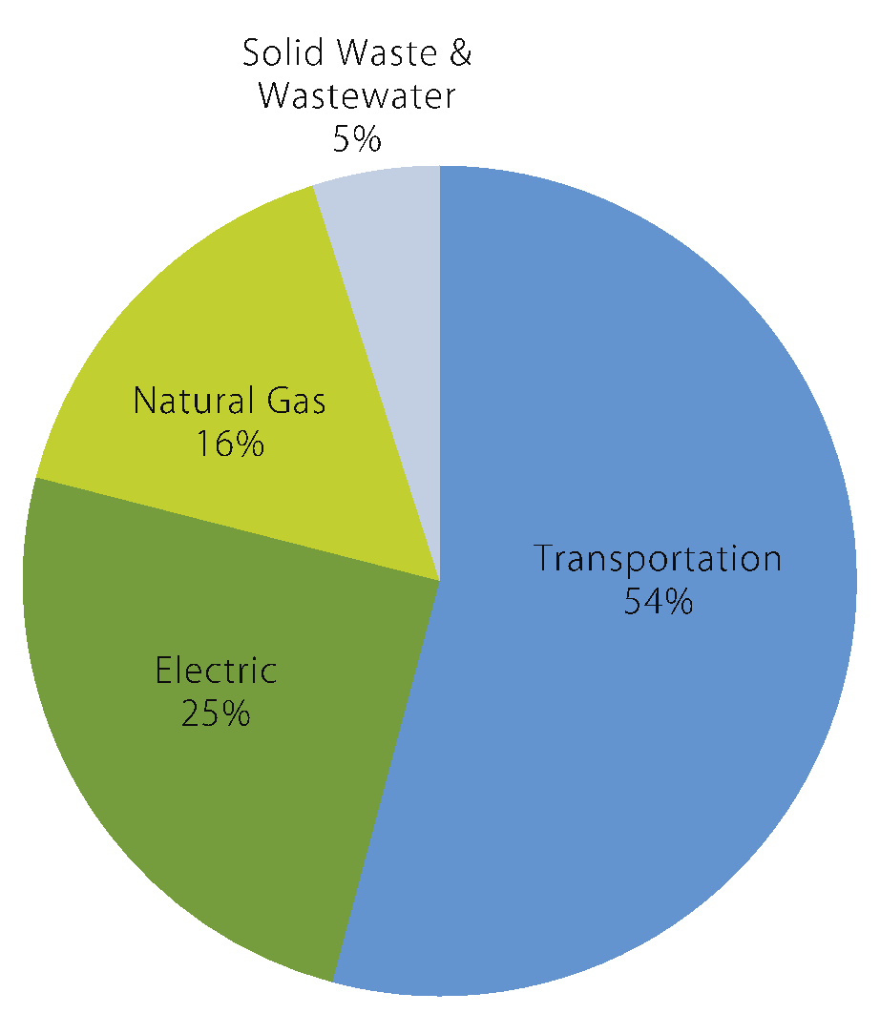
By the Numbers
Updated Community Baseline 2010 Inventory

Slide 11
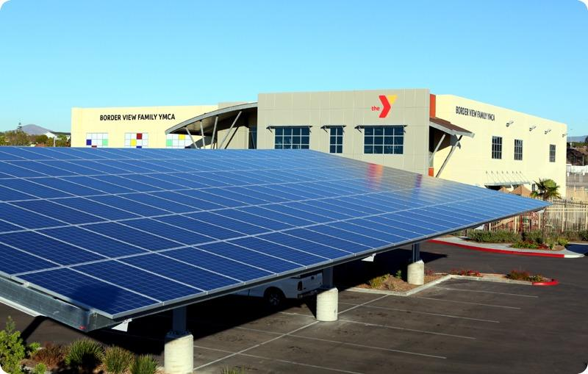
By the Numbers
Climate Action Plan: 5 Strategies
ENERGY & WATER EFFICIENT BUILDINGS
CLEAN & RENEWABLE ENERGY
BIKING, WALKING & TRANSIT
ZERO WASTE
CLIMATE RESILIENCY
Co-Benefits:
Cost Savings
Job Creation
Improved Public Health
Economic Opportunity
Increased Quality of Life
Notes:
11

Slide 12
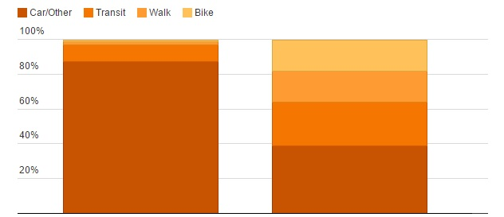
How the CAP Changes SD’s Commute
Residents Living Within a Half Mile of a Transit Stop
Car/Other
Transit
Walk
Bike
1%
2%
10%
87%
18% Bike
18% Walk
25% Transit
39% Car/Other
2008 (SANDAG estimate)
2035 (City Goal)
(Courtesy of Voice of San Diego)
*

Slide 13
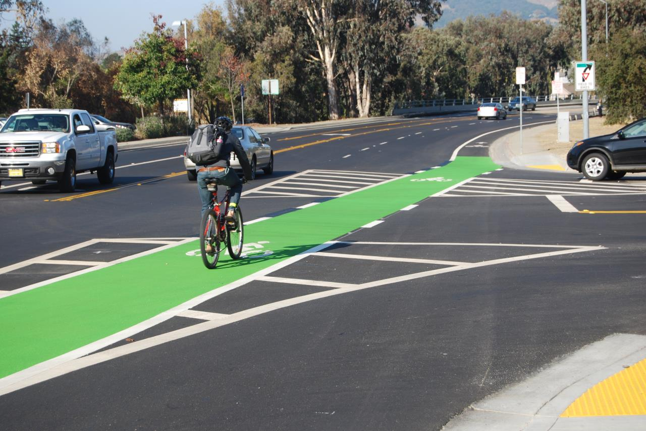
How San Luis Obispo Established the
Nation's Most Powerful Bike Funding Policy
1) Dramatically revised transit goals
2) Re-prioritized Level of Service hierarchy
3) Shifted spending to match goals

Slide 14
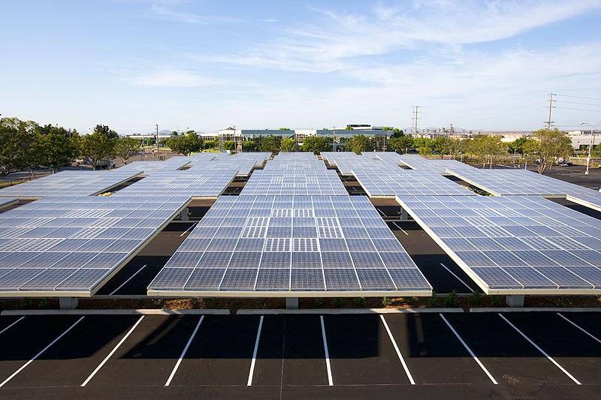
Clean and Renewable Energy Actions/Goals:
Achieve 100% renewable electricity by 2035
San Diego will be one of 10 cities in the world
aiming for 100% renewable energy
Notes:
14

Slide 15
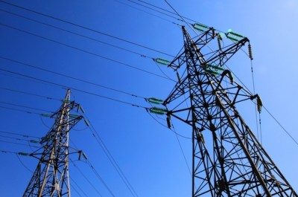
How do we get to 100% renewable
in an energy monopoly?

Slide 16
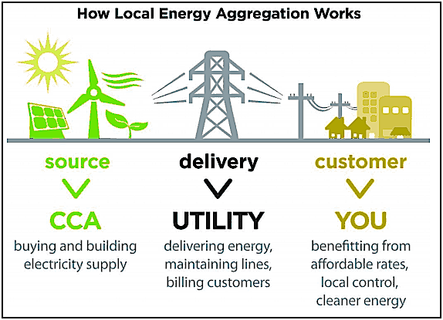
Community Choice Energy
Notes:
16

Slide 17

Why is Community Choice So Powerful?
Choice and competition
Allows rapid switch to cleaner power
Competitive, often cheaper, rates
Local jobs & local economic development
Accountable to the community
Proven success in Marin and Sonoma

Slide 18
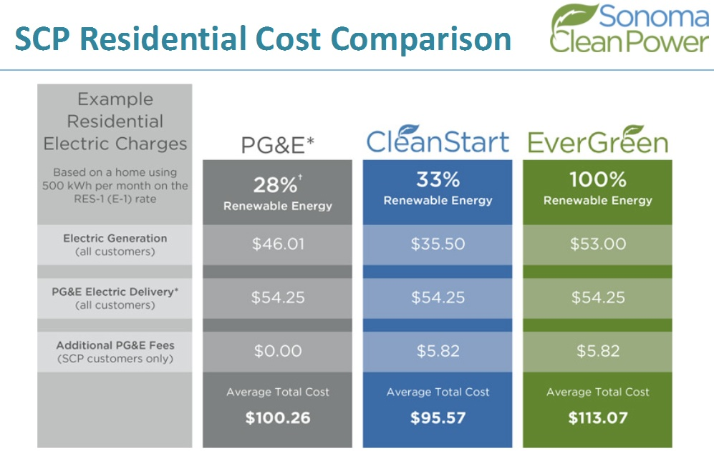
Notes:
18

Slide 19
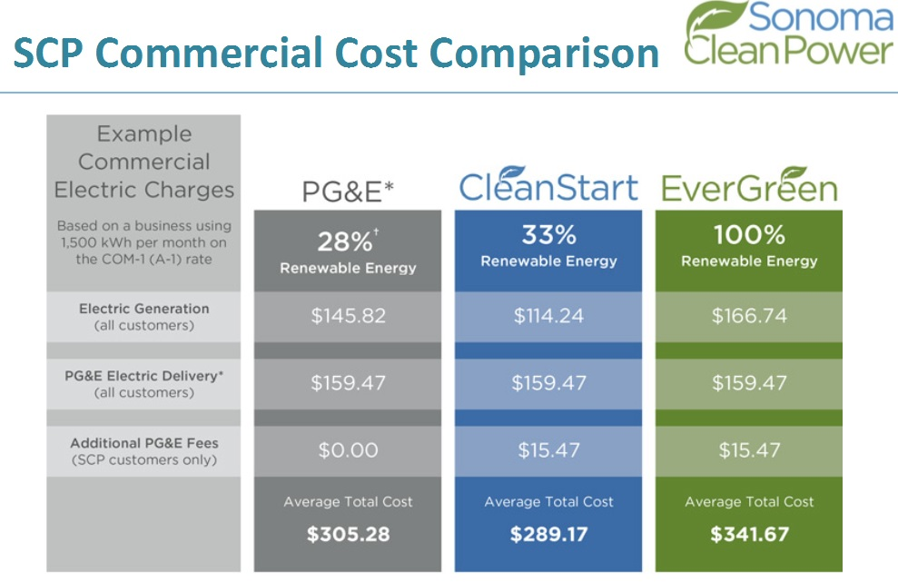

Slide 20


CCA Provides Lower Energy Rates with Higher Renewable Energy Content
Voice of San Diego Fact Check confirmed that
“CCAs in Marin and Sonoma are offering lower rates with a higher renewable energy content.”
(Voice of San Diego, February 17, 2015)

Slide 21
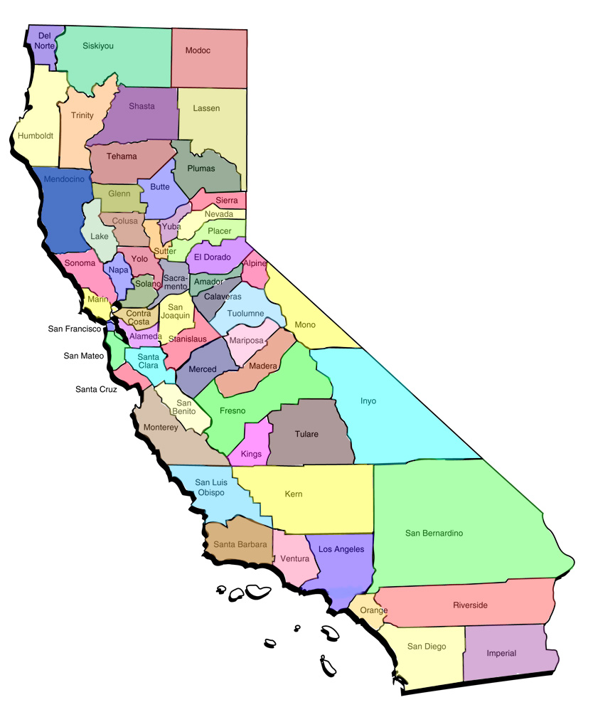
Growing Interest Around the State
Alameda County
Contra Costa County (Richmond joined MCE
Humboldt County
Los Angeles (Lancaster, South Bay Cities)
Monterey County (tri-county)
Napa County (unincorporated joined MCE)
San Benito (tri-county)
San Luis Obispo City and County
San Mateo County
Santa Barbara County
Santa Clara (Sunnyvale, Cupertino, Mtn. View)
Santa Cruz County (tri-County)
San Diego City and County
Solano County (Benicia joined Marin)
Yolo County (City of Davis leading)
Notes:
21

Slide 22
San Diego Green Economy Statistics
San Diego ranks as the nation’s #3 metro city for cleantech leadership.
(Clean Edge)
Clean energy named a top five field primed for job growth in San Diego. (San Diego Workforce Partnership)
San Diego is #1 in the nation in solar installations per capita. In 2013, the solar industry employed 47,223 Californians. Up 8% from 2012.
Electric vehicle sales are up. 12,000 electric vehicle drivers in SDG&E territory. 677 public charging stations at 199 locations. 28 DC fast chargers.
75,000 San Diego regional smart streetlight retrofits will be completed by 2015. $4 million in annual energy savings. Eliminates 12,700 metric tons of carbon emissions annually.

Slide 23


By the Numbers
INDUSTRY | JOBS | WAGES | ECNONOMIC IMPACT
Biorenewables | 1,020 | $80 M | $175 M
Smart Grid | 460 | $37.2 M | $91.5 M
Solar | 1,133 | $134.2 M | $517.6 M
Energy Storage | 561 | $56.3 M | $133.9 M
Energy Efficiency | 1,013 | $89.6 M | $299.8 M
Clean Transportation | 1,050 | $92.6 M | $311.3 M

Slide 24
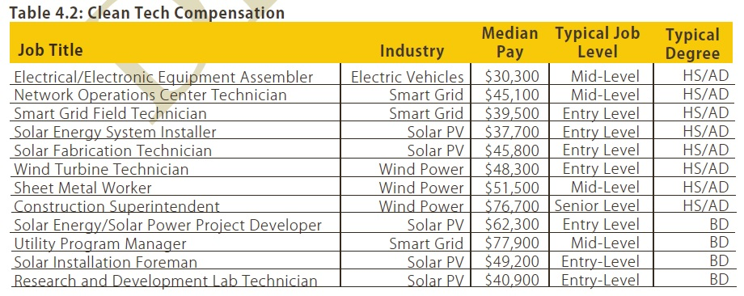
The Value of Green Jobs

Slide 25
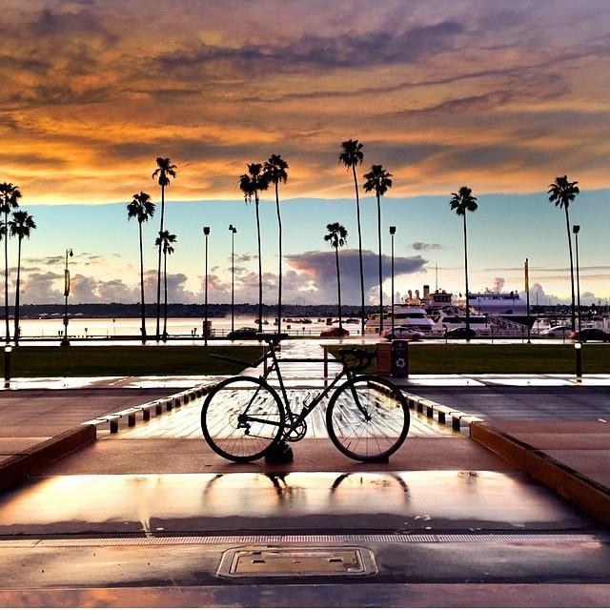
Next Steps
Ne
CAP Environmental Review 2015
CAP City Council Vote late 2015
Community Choice Feasibility Studies 2015
Public Input
*

Slide 26
Contact Information
Nicole Capretz
Executive Director
nicole@climateactioncampaign.org
Kath Rogers
Operations Director
kath@climateactioncampaign.org
Twitter: @sdclimateaction
Facebook: www.facebook.com/climateactioncampaign
Website: ClimateActionCampaign.org

