Slide 1

Procurement of Grid-Scale Energy Storage
Don Liddell, Douglass & Liddell
Co-Founder and General Counsel, California Energy Storage Alliance ​

Slide 2







STEERING COMMITTEE MEMBERS
1 Energy Systems | Dynapower Company | ImMODO Energy Services Corporation | Rosendin Electric
Advanced Microgrid Solutions | Eagle Crest Energy Company | Johnson Controls | S&C Electric Company
Alton Energy | EDF Renewable Energy | K&L Gates | Saft America
American Vanadium | Energy Storage Systems | KYOCERA Solar | Samsung
Amperex Technology Limited | Enersys | LG Chem | SEEO
Aquion Energy | EnerVault Corporation | LightSail Energy | Sharp Electronics Corporation
ARES North America | Enphase Energy | Lockheed Martin Advanced Energy Storage | Skylar Capital Management
Bosch | EV Grid | LS Power Development | Sovereign Energy
Bright Energy Storage Technologies | FAFCO Thermal Storage Systems | Mobile Solar | Stoel Rives
Brookfield | FIAMM Energy Storage Solutions | NEC Energy Solutions, Inc. | SunEdison
Chargepoint | Flextronics | OCI | SunPower
Clean Energy Systems | Foresight Renewable Solutions | OutBack Power Technologies | TAS Energy
Coda Energy | Greensmith Energy | Panasonic | Toshiba International Corporation
Consolidated Edison Development | Gridscape Solutions | Parker Hannifin Corporation | Trimark Associates
Cumulus Energy Storage | Gridtential Energy | PDE Total Energy Solutions | Tri-Technic
Customized Energy Solutions | Halotechnics | Primus Power Corporation | Unienergy Technologies
Demand Energy | Hitachi Chemical | Recurrent Energy | Wellhead Electric
DN Tanks | Hydrogenics | Renewable Energy Systems Americas | Younicos
Duke Energy | Imergy Power Systems

Slide 3









Energy Storage Alliances Around the World
California Energy Storage Alliance (CESA) Founded
Texas Energy Storage Alliance (TESA) Founded
Energy Storage Association (ESA) Advocacy Council Created
India Energy Storage Alliance (IESA) Founded
Ontario Energy Storage Alliance (OESA) Founded
2009
2010
2011
2012
2013
China Energy Storage Alliance (CNESA) Founded
New York Battery and Energy Storage (NY-BEST) Founded
European Association for the Storage of Energy (EASE) Founded
German Energy Storage Association Founded

Slide 4
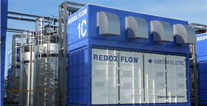
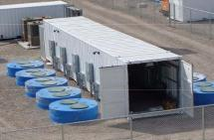
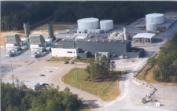
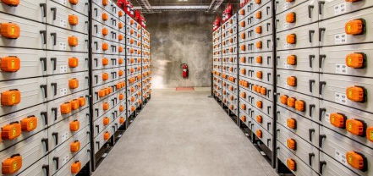
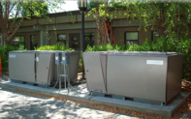

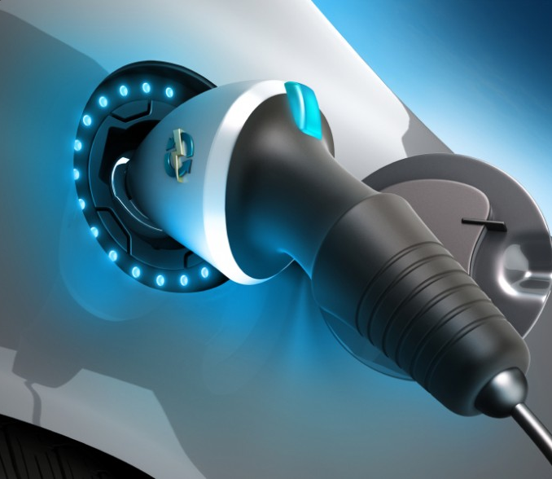
Energy Storage is a Very Broad Asset Class
Electro-Chemical Storage
Mechanical Storage
Bulk Mechanical Storage
(Flow battery / Lithium Ion )
(Flywheel)
(Compressed Air)
Thermal Storage
Bulk Gravitational Storage
Transportation
(Ice / Molten Salt)
(Pumped Hydro)
(Electric Vehicles)
Notes:
Broad asset class
Lots already installed! Approx 200+ GW globally
Includes
135 GW pumped hydro
64 GW UPS – emergency backup
2-3 GW of grid storage (various types) shown above

Slide 5
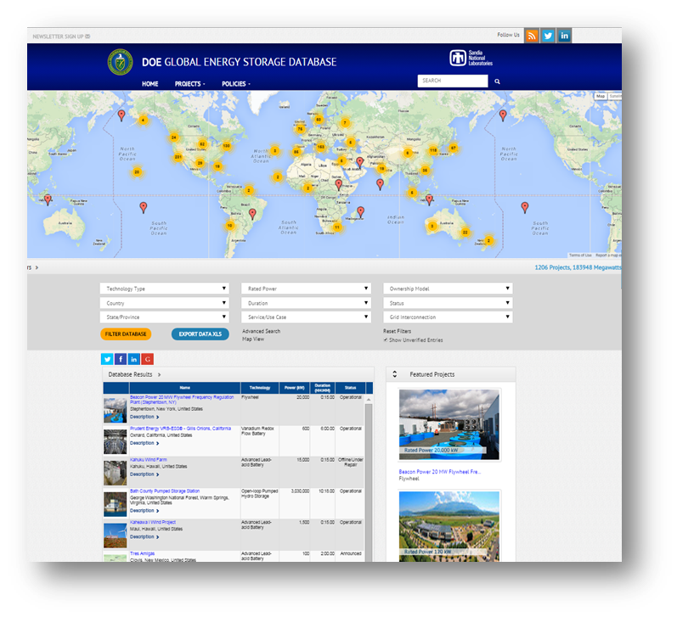
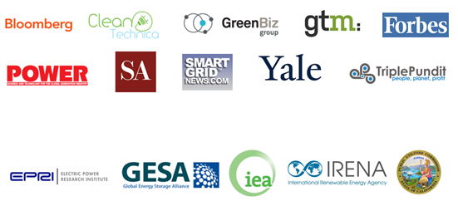
DOE Global Energy Storage Database
Live Since June 2012
1,206 Projects
21 Policies
Users in 189 countries
60+ data fields
50+ energy storage technologies
Data Visualization
860,000 page views
Foundational to the grid storage industry – free data access to entire ecosystem

Slide 6
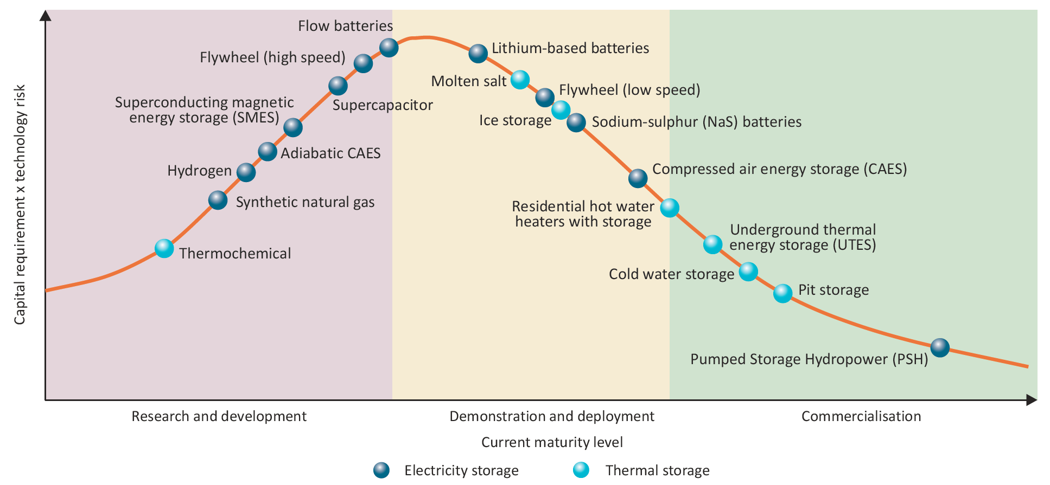
IEA’s View of Maturity of Energy Storage Technologies
Source: International Energy Agency, Technology Roadmap, Energy Storage, OECD/IEA, March 2014.

Slide 7
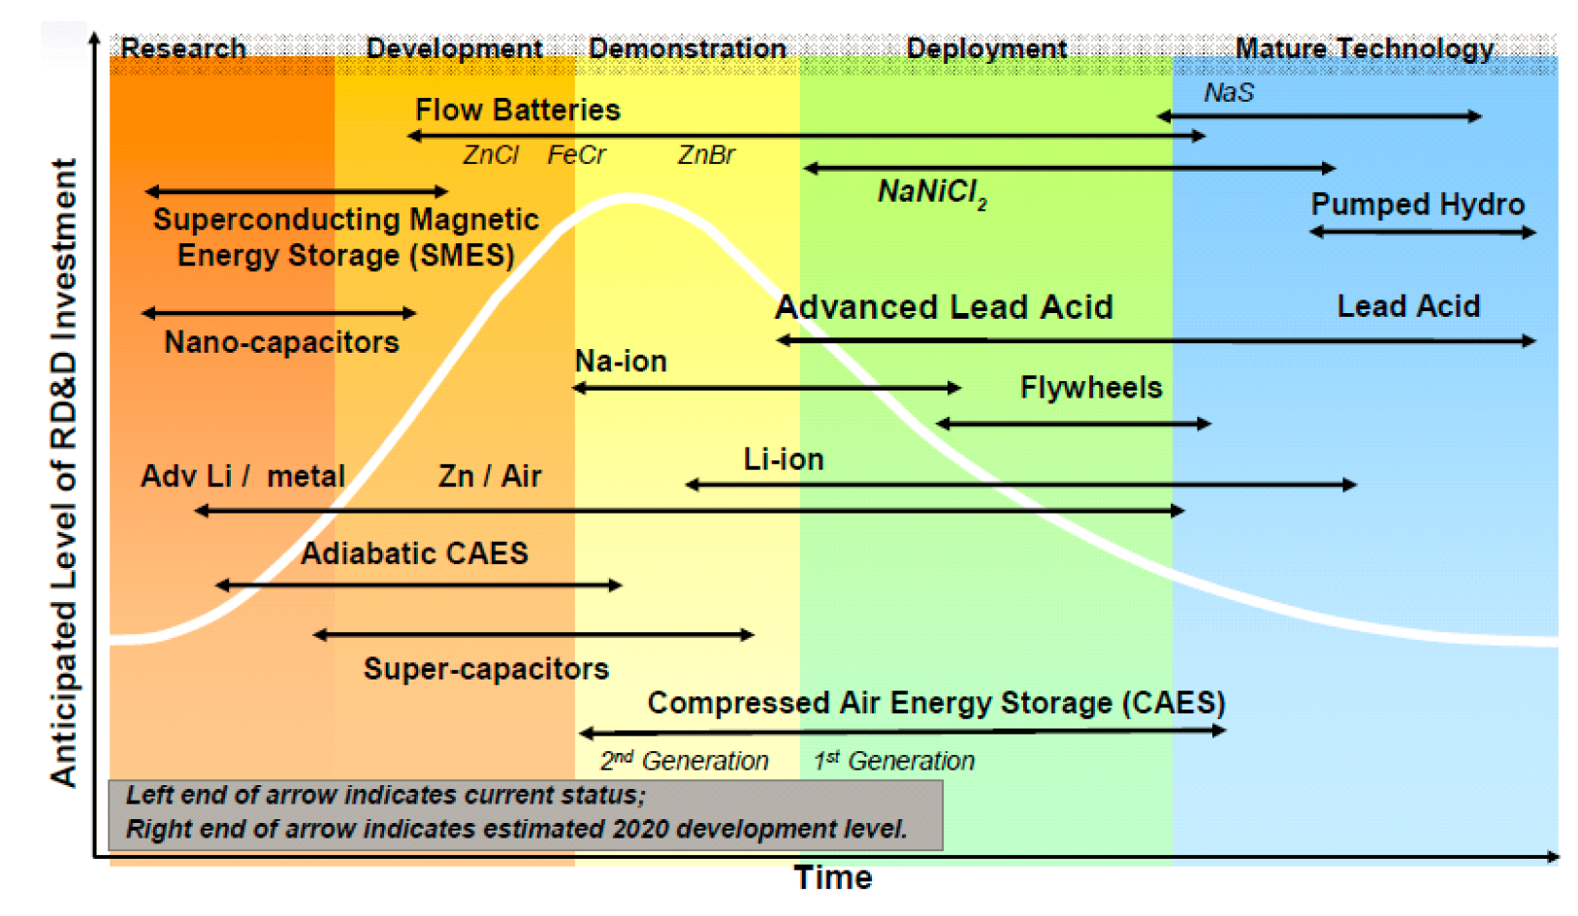
Another View of Maturity of Energy Storage Technologies
Research
Development
Demonstration
Deployment
Mature Technology
Source: Carnegie, et al., Utility Scale Energy Storage Systems, State Utility Forecasting Group, Purdue
University. June 2013.
Notes:
California Energy Markets quoted the CAISO on July 18, 2014, as reporting that in Cluster 7 there are 39 storage projects, of which 27 are stand-alone and 12 are combined with generation. All are battery except one advanced rail energy-storage project.

Slide 8
Overview of AB 2514
Required CPUC to open a proceeding to determine appropriate targets, if any, for each load serving entity to procure viable and cost-effective energy storage systems.
Required CPUC, by October 1, 2013, to adopt an energy storage procurement target, if determined to be appropriate, to be achieved by each load serving entity by December 31, 2015, and a second target to be achieved by December 31, 2020.
Required CPUC to consider a variety of possible policies to encourage the cost-effective deployment of energy storage systems, including refinement of existing procurement methods to properly value energy storage systems.
Required CPUC to reevaluate determinations made in its proceeding not less than once every three years.
Required CEC to establish a comparable scheme by regulation for each publicly owned utility that lags each of the dates applicable to the CPUC by one year.
Enacted in September 2010, required CPUC to open a proceeding to determine appropriate targets, if any, for each load serving entity to procure viable and cost-effective energy storage systems.
Required CPUC, by October 1, 2013, to adopt an energy storage procurement target, if determined to be appropriate, to be achieved by each load serving entity by December 31, 2015, and a second target to be achieved by December 31, 2020.
Required CEC to establish a comparable scheme by regulation for each publicly owned utility that lags each of the dates applicable to the CPUC by one year.
Notes:
AB 2514 required the CPUC to open a proceeding to determine appropriate targets, if any, for each load serving entity to procure viable and cost-effective energy storage systems.

Slide 9
AB 2514 Definition of Energy Storage
(1) “Energy storage system” means commercially available technology that is capable of absorbing energy, storing it for a period of time, and thereafter dispatching the energy. …
.... AND
(4) An “energy storage system” shall do one or more of the following:
(A) Use mechanical, chemical, or thermal processes to store energy that was generated at one time for use at a later time.
(B) Store thermal energy for direct use for heating or cooling at a later time in a manner that avoids the need to use electricity at that later time.
Source: Public Utilities Code Section 2835(a)(1).

Slide 10
Overview of Energy Storage Framework Decision
D.14-10-040, issued October 17, 2014, established CPUC’s policies and mechanisms for procurement of energy storage under AB 2514.
Procurement targets for each investor owned utility and procurement requirements for other load serving entities.
Mechanisms to procure energy storage and means to adjust targets, as necessary.
Program evaluation criteria.
A target of 1,325 megawatts of energy storage must be procured by investor owned utilities by 2020, and a schedule is set for solicitation of energy storage every two years beginning in 2014.
Utilities required to file separate applications containing proposals for their first energy storage solicitations by March 1, 2014.

Slide 11
Overview of Energy Storage Procurement Process
Procurement methodology
Utilities must procure energy storage through competitive solicitations.
First competitive solicitation must be held by December 1, 2014.
Additional biennial solicitations must be held in 2016, 2018, and 2020.
ESPs and CCAs must procure storage equivalent to 1% of peak load by 2020 with an initial solicitation in 2016.
Energy storage grid domains
Procurement targets split into three interconnection grid domains.
Specific targets per domain for each utilities’ biennial target.
Some flexibility between domains (certain restrictions apply).
Pumped hydro over 50 MW not eligible to count toward targets.
Notes:
Flexibility Within Procurement Targets
Utilities are allowed discretion in shifting MWs between transmission and distribution storage grid domains as needed subject to the following limitations:
Up to 80% of MWs assigned to the transmission and distribution grid domains could be shifted to the other domain without a showing. Although no showing is required, shifting is still subject to other restrictions.
No shifting of procurement target MWs is allowed into or out of the customer-side domain.
No portion of procurement targets can be traded among the utilities.
Deferment of Procurement Targets
Each utility may request a deferment of up to 80 % of its procurement targets with an affirmative showing of unreasonableness of cost based on approved evaluation methodology or the lack of operationally viable number of bids in energy storage solicitation.
If a request is granted, the procurement target for the next solicitation must be increased to include the deferred amount.
Utilities are expected to fulfill target totals by 2020.
If target totals are not met by 2020, CPUC will consider whether the target date to achieve the MW goals should be extended past 2020.
Cost-Effectiveness
- CPUC evaluated the cost-effectiveness of energy storage based on methodologies developed by the Electric Power Research Institute (EPRI) and by DNV GL Energy & Sustainability (DNV GL).
- Actual finding of cost-effectiveness must be made in utility applications for approval of energy storage contracts or rate based asset additions using specific projects and actual project inputs.
- Utilities must assess the full range of benefits and costs identified in the use-case framework and the EPRI and DNV KEMA reports entered into the record in the proceeding.
Utilities are allowed to propose their own methodology to evaluate the cost and benefits of energy storage proposals.

Slide 12
Energy Storage Grid Domains
STORAGE GRID DOMAIN (Grid Interconnection Point) | REGULATORY FUNCTION | USE-CASE EXAMPLES
Transmission-Connected | Generation/Market | Co-Located Energy Storage Concentrated Solar Power, Wind + Energy Storage, Gas Fired Generation + Thermal Energy Storage
 |  | Stand-Alone Energy Storage Ancillary Services, Peaker, Load-Following
 | Transmission Reliability (FERC) | Voltage Support
Distribution-Connected | Distribution Reliability | Substation Energy Storage (Deferral)
 | Generation/Market | Distributed Generation + Energy Storage
 | Dual-Use (Reliability & Market) | Distributed Peaker
Behind-The-Meter | Customer Sited Storage | Bill Mgt/Permanent Load Shifting, Power Quality, Electric Vehicle Charging
Notes:
Annual utilization
Range
Speed of response – (show FR graph)

Slide 13
Energy Storage Procurement Targets
Storage Grid Domain Point of Interconnection | 2014 | 2016 | 2018 | 2020 | Total
Southern California Edison
Transmission | 50 | 65 | 85 | 110 | 310
Distribution | 30 | 40 | 50 | 65 | 185
Customer | 10 | 15 | 25 | 35 | 85
Subtotal SCE | 90 | 120 | 160 | 210 | 580
Pacific Gas & Electric
Transmission | 50 | 65 | 85 | 110 | 310
Distribution | 30 | 40 | 50 | 65 | 185
Customer | 10 | 15 | 25 | 35 | 85
Subtotal PG&E | 90 | 120 | 160 | 210 | 580
San Diego Gas & Electric
Transmission | 10 | 15 | 22 | 33 | 80
Distribution | 7 | 10 | 15 | 23 | 55
Customer | 3 | 5 | 8 | 14 | 30
Subtotal SDG&E | 20 | 30 | 45 | 70 | 165
Total – all 3 Utilities | 200 | 270 | 365 | 490 | 1,325
Notes:
Annual utilization
Range
Speed of response – (show FR graph)

Slide 14
2014 Energy Storage Procurement
CPUC’s Framework Decision applies only to applications filed by the utilities. It does not apply to other load serving entities (energy service providers and community choice aggregators) or publicly owned utilities.
D.14-145, issued October 16, 2014, approved utility energy storage applications in October 2014. Requests for Offers were issued on December 1, 2014.
Utilities issued RFOs for a total of 94.3 MW of energy storage. No behind-the meter projects were requested by any of the utilities.

Slide 15

PG&E’s 2014 AB 2514 RFO
PG&E requested offers for 74 MW of storage, 50 MW transmission and 24 MW distribution level interconnected storage. Transmission must be sized at least 10 MW, and distribution must be sized at least 1 MW. No behind-the meter projects are requested.
Projects offered must be fully permitted, and interconnected. Site Control is not required to submit offers, but bidders must have exact site(s) identified and must be on track to obtaining site control.
Stand-alone projects – must commence or have commenced operation between January 1, 2010 and December 31, 2022.
Storage component of hybrid projects (paired with existing RPS or fossil generation) may have existed prior to January 1, 2010, but the storage must be new and online as early as possible prior to December 31, 2022.
Distribution deferral projects must be online by 2017 or 2018. Utility-owned PV sites must be online by December 31, 2017.
Offers due on February 17, 2015. PG&E expects to select a short list by April 24, 2015.
RFO information is available here.

Slide 16

SCE’s 2014 AB 2514 RFO
SCE requested offers for 16.3 MW of storage that provide only RA and RA with an option to also be fully dispatchable and provide ancillary services. No behind-the meter projects are requested. Projects must be sized at least 1 MW, interconnected at the transmission or distribution level, and fully deliverable.
By the Final Offer deadline, offers must possess (1) a completed Phase I Interconnection Study, or (2) a signed interconnection agreement, or (3) an equivalent or better interconnection study, agreement, process, or exemption.
SCE will consider offers for energy storage projects with forecasted initial delivery dates to SCE on January 1, 2017 or later. All energy storage projects must have a proposed commercial operation date of December 1, 2024, or earlier.
Notices of intent to submit offers are due on February 2, 2015. SCE expects to select a short list by April 1, 2015.
RFO information is available here.

Slide 17

SDG&E’s 2014 AB 2514 RFO
SDG&E requested for one or more equipment supply and installation agreements that will provide a total of 4 MW of energy storage for distribution and power quality, entailing manufacture, and installation storage. SDG&E expects to provide capacity support and one or more 12kV circuits, in 1MW/3MWh incremental sub-units, from a single contractor. The storage system will not participate in wholesale markets.
As part of SDG&E’s separate 2014 All-Source RFO for LCR, SDG&E is seeking to procure between 25 MW and 800 MW of energy storage. The energy storage product types within this RFO solicits offers for both third party owned, contracted resources and utility owned resources. Offers under that procurement process are due on January 5, 2015. (See, information here).
Offers are due on March 31, 2015.
RFO information is available here.

Slide 18
Other CPUC Storage-Related Procurement Proceedings
Coordination among Long Term Procurement Planning and Renewables Portfolio Standard proceedings and energy storage target fulfillment is expected to increase over time.
Resources procured through LTPP, RPS, and other CPUC proceedings will count towards targets after they are operational for one year.
CPUC will consider adjusting targets based on need determinations in LTPP proceedings.
Any improvements to Least-Cost-Best-Fit criteria, as they apply to energy storage attributes, will be accomplished through the RPS proceeding.

Slide 19
Long-Term Procurement Planning Process
Every two years, the CPUC opens a LTPP proceeding to review and approve ten-year forward-looking procurement plans submitted for approval by California’s investor owned utilities.
R.12-03-014, the 2012 LTPP proceeding, evaluated the need for new energy resources and established rules for rate recovery of procurement contracts to meet electric system needs for California’s investor owned utilities in four separate procedural “tracks”.
R.13-12-010, the 2014 LTPP proceeding, was opened in December 2013. A decision on Phase 1a should be issued in Q1 2015. Phase 1b will specify resources to meet any need determined in Phase 1a before the end of 2015.

Slide 20
LTPP Track 1: SCE’s Local Capacity Capacity Requirement
D.13-02-015, issued February 13, 2013, authorized SCE to procure between 1400 MW and 1800 MW in the Western LA Basin Local Reliability Area, and procure between 215 MW and 290 MW in the Moorpark Local Reliability Area by 2021, including a minimum 50 MW of energy storage and up to 600 MW from preferred resources or energy storage.
SCE issued an All-Source RFO in October 2013. The results of the RFO were submitted to the CPUC in an application submitted on November 21, 2014.
The negotiating parties are subject to nondisclosure agreements, and will enter into contracts with confidentiality provisions in effect for the term of the contracts. No public disclosure of cost or pricing information is planned.

Slide 21
LTPP Track 4: SONGS Replacement
D.14-03-004, issued March 13, 2014, authorized SCE to procure between 500 and 700 MW of additional resources, in addition to the results from its LCR RFO.
SDG&E was authorized to procure between 500 and 800 MW of new non-transmission resources, including a minimum of 25 MW of energy storage, by 2022.
System needs are driven by local capacity needs in Southern California stemming from expected changes in the make up of the statewide generation fleet that will result from once through cooling rules and early retirement of SONGS.

Slide 22
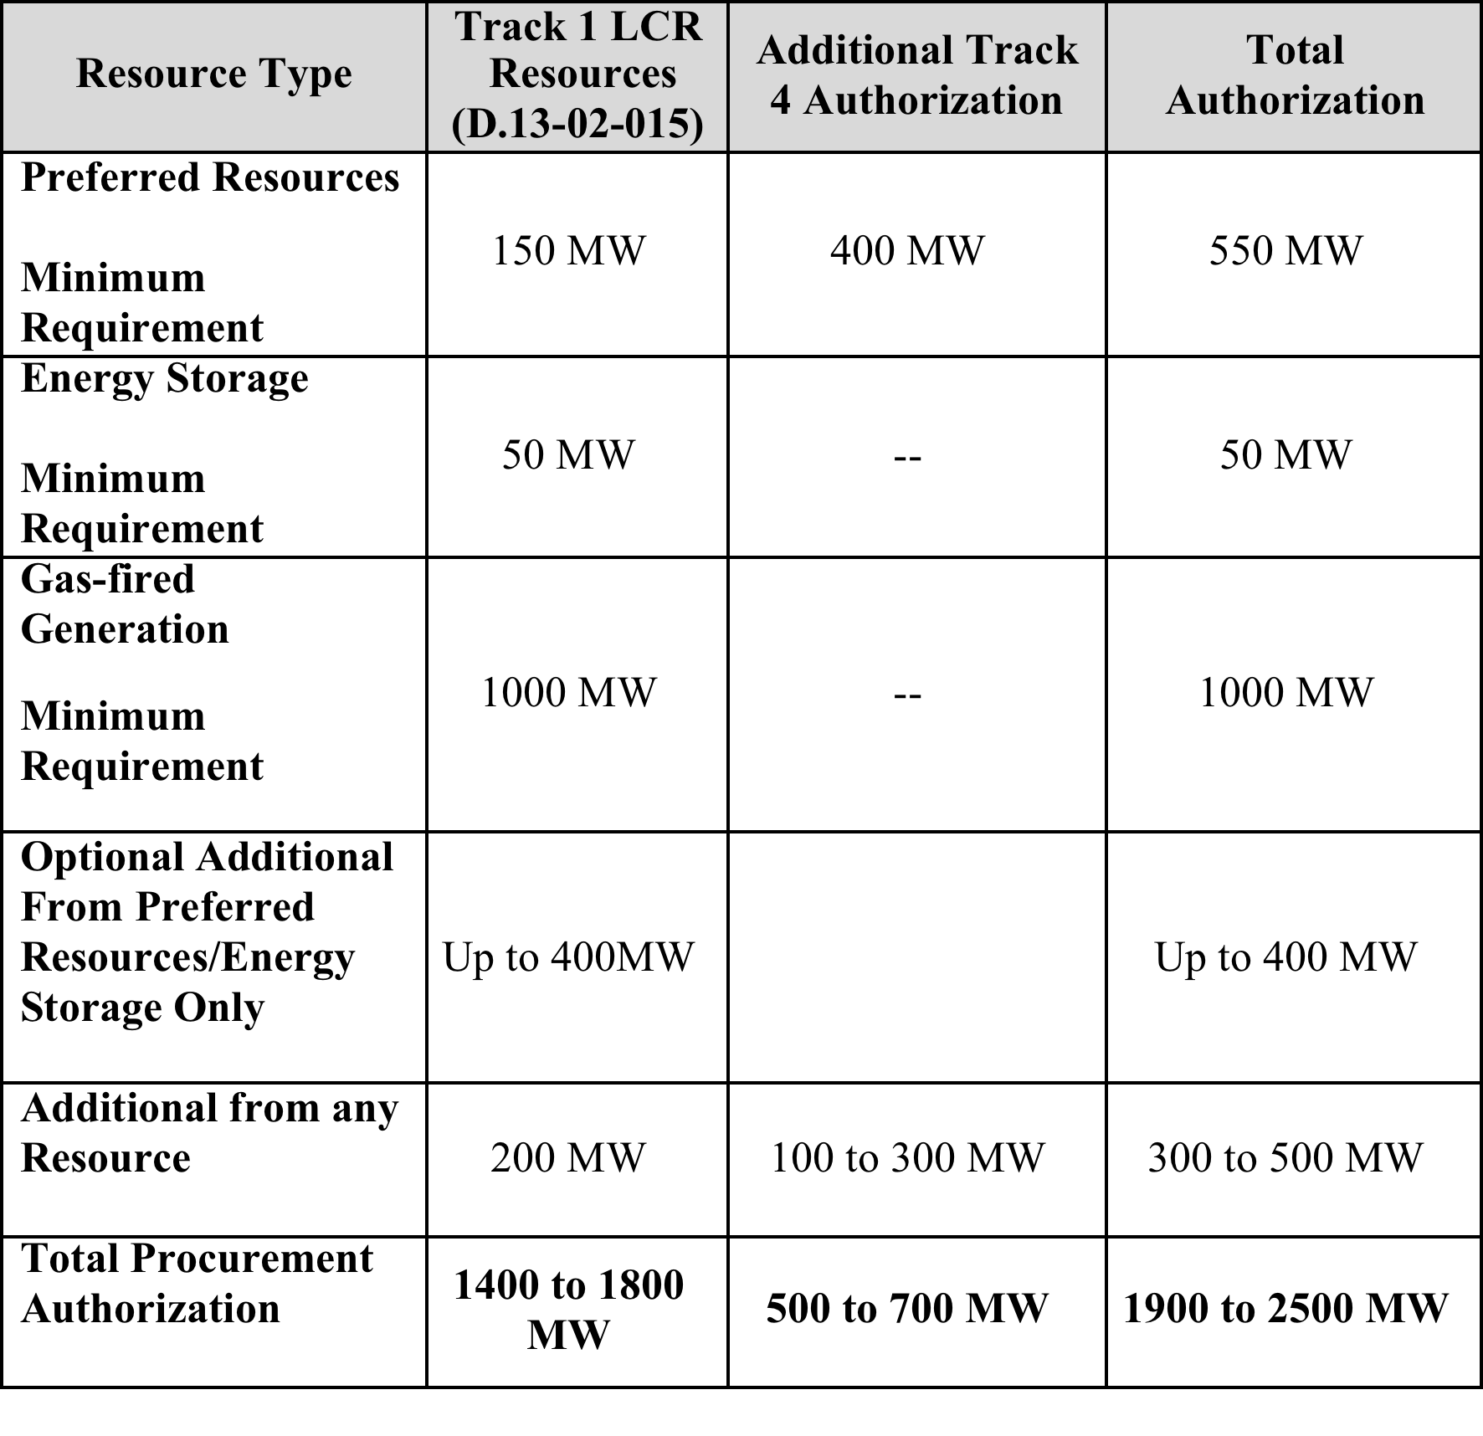
SCE’s LTPP Energy Storage Requirement
Source: SCE Procurement Authorization and Requirements (Track 1 + Track 4)

Slide 23
SCE’s 2012 LTPP RFO
SCE consolidated its Track 1 and Track 4 solicitations as a single RFO and filed two separate applications seeking CPUC approval of proposed contracts with selected bidders for the Western LA Basin and Moorpark areas of its service territory in November 2014.
SCE’s applications ask for CPUC approval to procure 261 MW of energy storage resources.

Slide 24
SCE’s LCR Winners
Product Category | Counterparty | Total Contracts | Max Quantity (LCR MW)
Preferred Resources and Energy Storage
Energy Efficiency | Onsite Energy Corporation Sterling Analytics NRG Energy Efficiency | 26 | 124.01
Demand Response | NRG Distributed Generation NRG Curtailment Solutions | 7 | 75.00
Renewable Distributed Generation | Solar Star California (Sunpower) | 4 | 37.92
Energy Storage | AES Alamitos Ice Energy Advanced Microgrid Solutions Stem Energy | 23 | 263.64
Total Preferred Resources and Energy Storage |  | 60 | 500.60
Gas-Fired Generation
Gas-Fired Generation | AES Alamitos AES Huntington Beach Stanton Energy Reliability Center (Wellhead) | 3 | 1,382.00
Total Resources |  | 63 | 1,882.60
Source: SCE Application for Approval of Results of LCR RFO (A.14-11-012)

Slide 25
SCE’s LCR Energy Storage Winners
Seller | Resource Type | Total Contracts | Max Quantity (LCR MW)
Selected Energy Storage Resources
AES | In-Front-of-Meter Battery Energy Storage | 1 | 100.0
Ice Energy | Behind-the-Meter Thermal Energy Storage | 16 | 25.6
Advanced Microgrid Solutions | Behind-the-Meter Battery Energy Storage | 4 | 50.0
Stem | Behind-the-Meter Battery Energy Storage | 5 | 85.0
Total |  | 26 | 260.6
Source: SCE RFO winners. https://www.sce.com/wps/portal/home/procurement/solicitation/lcr

Slide 26
SDG&E’s LTPP Energy Storage Requirement
Source: SDG&E Procurement Authorization and Requirements

Slide 27
SDG&E’s 2012 LTPP RFO
SDG&E announced the All-Source RFO schedule for its Track 4 procurement plan in September 2014. Offers in response to the RFO were due on January 5, 2015.
Shortlisted bidders are expected to be notified on June 5, 2015.
SDG&E plans to submit signed agreements to the CPUC for approval in Q1 2016.

Slide 28
Publicly Owned Utility Energy Storage Requirement
AB 2514 requires publicly owned electric utilities to, on or before March 1, 2012, initiate a process to determine appropriate targets, if any, to procure viable and cost‐effective energy storage systems to be achieved by December 31, 2016, and December 31, 2021.
The California Energy Commission must review the plans and reports submitted by publicly owned electric utilities in October 2014. However, the CEC has no enforcement authority.

Slide 29
SCPPA Energy Storage Procurement
In February 2014, SCPPA issued an RFP seeking proposals for renewable and energy storage development, and began its first in-depth analysis and review of energy storage-related proposals.
SCPPA strongly encouraged potential energy storage bidders to submit proposals on or before April 1, 2014. The RFP was amended to allow energy storage-related proposals to be submitted through the end of 2014.
On January 1, 2015, SCPPA issued a “rolling RFP” seeking proposals at any time during the calendar year 2015 for the best combination of projects or products to store energy, including for the purpose of integrating RPS-compliant intermittent renewable energy into its members’ systems for the period 2015-2020.

Slide 30
Imperial Irrigation District Energy Storage Procurement
In January 2014, the Imperial Irrigation District issued an RFQ for
20 to 40 MW of battery energy storage.
In May 2014, IID announced shortlisted bidders, selecting the following nine firms to continue to the next phase of the solicitation process: 1. AES Energy Storage 2. Black & Veatch 3. Coachella Energy Storage 4. Duke Energy Business Services 5. Invenergy Storage Development 6. PMCCA, dba Performance Mechanical Contractors 7. S&C Electric Company 8. UC Synergetic (Hitachi) 9. ZBB Energy Corporation.
In December 2014, IID held a mandatory shortlisted bidders conference and issued an RFO to the remaining eight bidders in January 2015 to deliver a 33 MW energy storage system to come on-line by December 2016 to meet NERC/FERC requirements.

Slide 31
LADWP Storage Procurement Targets Under Consideration
Connection Level | Proposed Targets
 | 2016 Targets |  |  | 2021 Targets
 | Project Name | Energy Storage Type | Capacity | Project Name | Energy Storage Type | Capacity
Generation | Castaic | Pump Storage Hydro | 21 MW | Valley Gen. Station | Thermal ES | 60 MW
 | Sub-Total |  | 21 MW | Sub-Total |  | 60 MW
Transmission | None |  |  | Beacon Solar | Battery ESS | 30 MW
 |  |  |  | Q09 Solar | Battery ESS | 20 MW
 |  |  |  | Sub-Total |  | 50 MW
Distribution | None |  |  | Dist. Circuit | Battery ESS | 4 MW
 |  |  |  | Sub-Total |  | 4 MW
Customer | LAX | Thermal ES | 3 MW | Distributed ESS | Thermal ES | 40 MW
 | Garage of Future | Battery ESS | 0.05 MW
 | La Kretz | Battery ESS | 0.025 MW
 | Sub-Total |  | 3.08 MW |  | Sub-Total | 40 MW
 |  | Total | 24.08 MW |  | Total | 154 MW
Source: LADWP Energy Storage Development Plan. 9/2/2014

Slide 32
Don Liddell
Co-Founder and General Counsel, CESA
Douglass & Liddell
2928 2nd Avenue
San Diego, CA 92103
Phone: (619) 993-9096
Email: liddell@energyattorney.com

